Slide 1
Secondary anamolous growth in Bignonia stem
Dr . Rohini Trivedi
Dept. of Botany MLSU

Slide 2
Bignonia stem
The outline is with ridges and furrows
Epidermis:Single-layered epidermis, with cuticle and multicellular hairs
Cortex divided into collenchyma and parenchyma. In the ridges sclerenchyma may develop.
Endodermis without casparian strips and pericycle consists of sclerenchymatous patches.

Slide 3
Primary vascular bundle conjoint collateral, endarch and open. Xylem towards pith.
A central parenchymatous pith is present.
Secondary growth takes place by forming the normal cambial ring which is normal in position and behaves normally for some time .

Slide 4
But after some time four segment of cambium which is placed diagonally opposite produces less secondary xylem inside but more secondary phloem out side resulting in the furrows of secondary xylem being filled with secondary phloem.
Bars of sclerenchyma may form in secondary phloem to help prevent the crushing of secondary phloem by the thick walled cells of secondary xylem on borders.

Slide 5
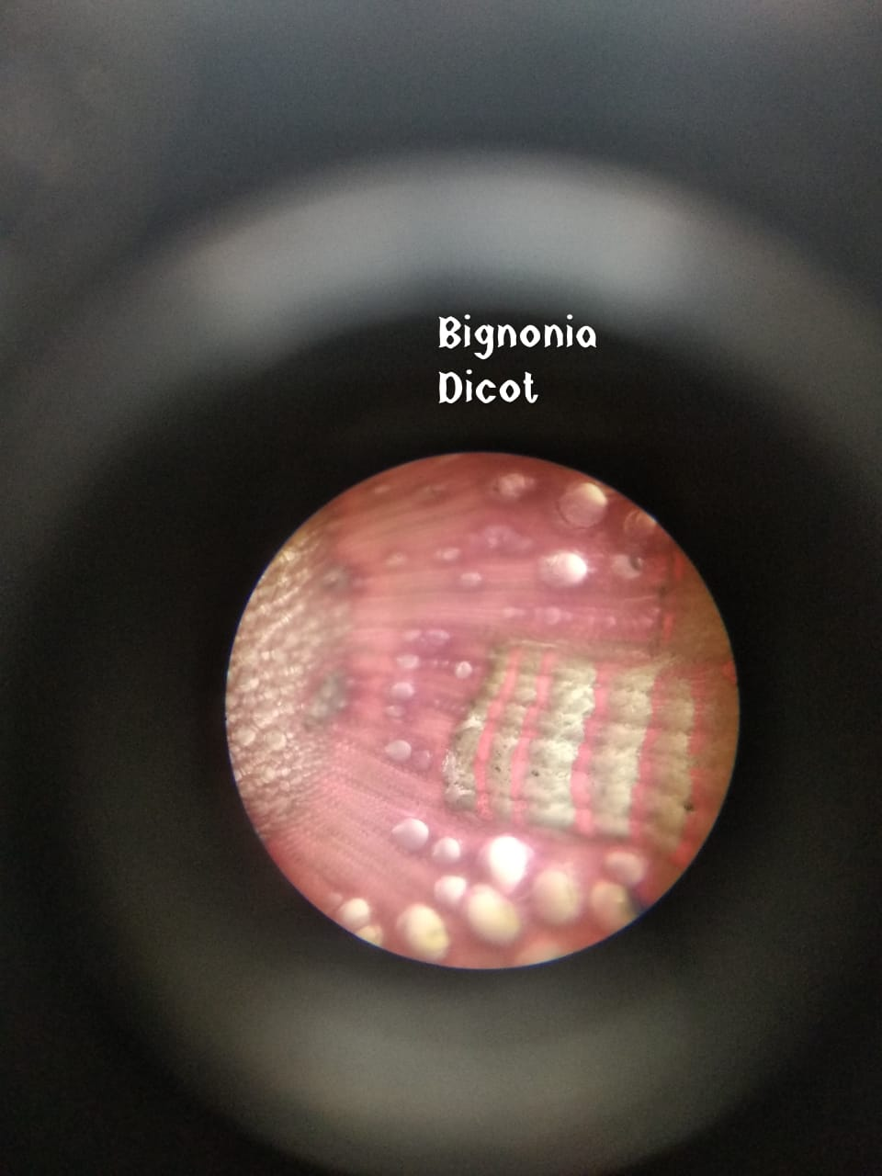
Bignonia

