Slide 2
VARIABILITY IN PATHOGEN
Dr. Rohini Trivedi
Dept. of Botany
MLSU

Slide 3
MECHANISMS OF VARIABILITY
It has been the experience of researchers with numerous host–pathogen combinations, however, that, after a new gene for resistance to a pathogen is introduced into a crop variety and that the variety is planted in the fields, a new population (race) of the pathogen appears that contains a new gene for virulence that enables the pathogen to attack the crop plants containing the new gene for resistance.

Slide 4
New genes can arise randomly and suddenly de novo through mutations, or by rearrangement of the genetic material of the pathogens through the ever ongoing events of genetic variability in organisms.

Slide 5
Genetic variability in true oomycetes and in fungi is produced from sexual spores such as oospores, ascospores, and basidiospores.
In parasitic higher plants it is produced from seeds and in nematodes is produced from fertilized eggs.

Slide 6
When individuals are produced asexually, the frequency and degree of variability among the progeny are reduced greatly, but even then certain individuals among the progeny will show different characteristics.

Slide 7
Because of the astronomical number of individuals produced by microorganisms asexually, the total amount of variability produced by at least some microorganisms is probably as great and possibly greater than the total variability found in microorganisms reproducing sexually.

Slide 8
This is the case in the overwhelmingly asexual reproduction of fungi by means of conidia, zoospores, sclerotia, and uredospores.
In bacteria, mollicutes, and viruses.

Slide 9
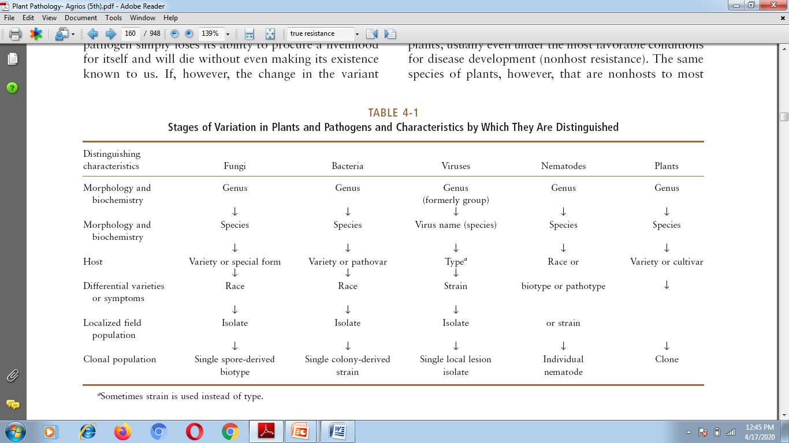

Slide 10
Gene and Genotype Flow among Plant Pathogens
Gene flow is the process by which certain alleles (genes) move from one population to another geographically separated population. In plant pathology, gene flow is very important because it deals with the movement of virulent mutant alleles among different field populations.

Slide 11
High gene flow in a pathogen increases the size of the population and of the geographical area in which its genetic material occurs. Therefore, pathogens that show a high level of gene flow generally have greater genetic diversity than pathogens that show a low level of gene flow.

Slide 12
In pathogens reproducing only asexually, in which no recombination occurs, entire genotypes can be transferred from one population to another. This is known as genotype flow.

Slide 13
Pathogens that produce hardy spores or other propagules, such as rust and powdery mildew fungi, that can spread over long distances, can distribute their genomes over large areas, sometimes encompassing entire continents.

Slide 14
However, soil-borne fungi and nematodes move slowly and are present in small areas and their level of genetic flow is limited.

Slide 15
It is obvious that it is more likely that the one mutant of the smaller population will be lost than the 1,000 mutants of the larger population, i.e., in small populations, genetic drift results in a loss of alleles over time.
In plant pathology, pathogens that exist in large populations have a greater potential for evolution than pathogens that exist in small populations.

Slide 16
Selection is a directional process by which the fittest variants in a particular environment increase their frequency in the population (positive selection), whereas less fit variants decrease.
Selection results in a decrease in the diversity within a population, but it may cause an increase in the diversity between populations. Selection is affected by almost every factor- their frequency (negative selection), the life cycle of a pathogen, to its host, its vector if any and to the environment.

Slide 17
The kind of life cycle and the mating system followed affect the opportunities and limitations for genetic diversity (gene or genome diversity) and evolution of each particular pathogen. As a brief example we will mention the wheat stem rust fungus Puccinia graminis f. sp. tritici, which in the haploid state infects barberry while in the diploid state it infects wheat. Reproduction can be sexual, asexual, or both. In asexual pathogen populations, genotype diversity is more significant than gene diversity, whereas sexual pathogen populations show more gene diversity.

Slide 18
Therefore, pathogens undergoing any type of recombination pose a greater threat than pathogens that undergo little or no recombination. The result of this is that the recombining pathogen population can put together new combinations of virulence genes or alleles as fast as breeders can put together genes for resistance.

Slide 19
Therefore, pyramiding resistance genes in plants may not be as effective a strategy for as long as plant breeders hoped it would.

Slide 20
Specialized Mechanisms of Variability in Pathogens
Sexual-like Processes in Fungi
Heterokaryosis is the condition in which, as a result of fertilization or anastomosis, cells of fungal hyphae or parts of hyphae contain two or more nuclei that are genetically different.

Slide 21
Parasexualism is the process by which genetic recombinations can occur within fungal heterokaryons.
This comes about by the occasional fusion of the two nuclei and formation of a diploid nucleus.

Slide 22
During multiplication, crossing-over occurs in a few mitotic divisions and results in the appearance of genetic recombinants as the diploid nucleus progressively and rapidly loses individual chromosomes to revert to its haploid state.

Slide 23
Heteroploidy is the existence of cells, tissues, or whole organisms with numbers of chromosomes per nucleus. Heteroploids may be haploids, diploids, triploids, or tetraploids or they may be aneuploids

Slide 24
Aneuploids, i.e., have one, two, three, or more extra chromosomes or are missing one or more chromosomes from the normal euploid number

Slide 25
New biotypes of bacteria seem to arise with varying frequency by means of at least three sexual-like processes TRANSFORMATION , CONJUGATION and TRANSDUCTION.

Slide 26
Genetic Recombination in Viruses
When two strains of the same virus are inoculated into the same host plant, one or more new virus strains are recovered with properties (virulence, symptomatology)different from those of either of the original strains introduced into the host.

Slide 27
Loss of Pathogen Virulence in Culture
The virulence of pathogenic microorganisms toward one or all of their hosts often decreases when the pathogens are kept in culture for relatively long periods of time or when they are passed one or more times through different hosts.

Slide 28
The new strains probably are recombinants, although their appearance through mutation cannot be ruled out.

Slide 29
If the culturing of the pathogen is prolonged sufficiently, the pathogen may lose virulence completely. Such partial or complete loss of virulence in pathogens is sometimes called attenuation, and it has been shown to occur in bacteria, fungi, and viruses.

Slide 30
Refer to chapter 4 of Agrios. (the e-book has already been forwarded to you via your email IDs )
Happy learning
Stay Home stay safe healthy and study

