Slide 1
ETHOLOGICAL STUDIES IN WILD.
Methods of studying animal behaviour in wild
BY : DR.NILOFER SYED

Slide 2
Till now we had been studying about the method of studying animal behaviour in lab. Now, let’s learn about the methods of studying animal behaviour in wild.

Slide 3
BEHAVIOUR CAN BE STUDIED AT DIFFERENT LEVELS LIKE:
Species level (e.g. courtship behaviour)
Family group (searching for food)
Population level (migration behaviour)
Individual (how the animal is swimming)
Behavioural type (way of feeding)

Slide 4

Species level (e.g. courtship behaviour)
Family group (searching for food)
Population level (migration behaviour)
Individual (how the animal is swimming)
Behavioural type (way of feeding)

Slide 5
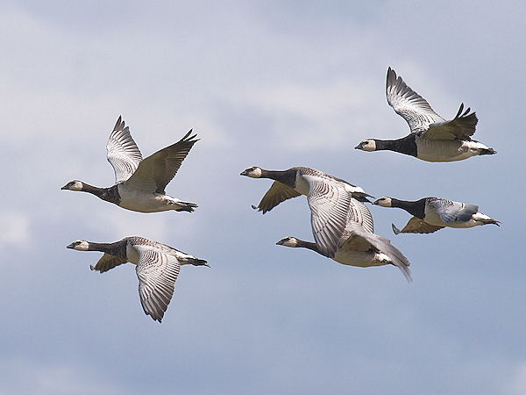
Species level (e.g. courtship behaviour)
Family group (searching for food)
Population level (migration behaviour)
Individual (how the animal is swimming)
Behavioural type (way of feeding)

Slide 6
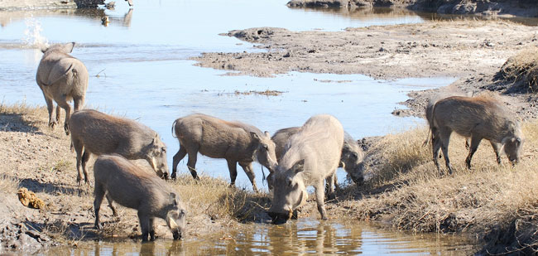
Species level (e.g. courtship behaviour)
Family group (searching for food)
Population level (migration behaviour)
Individual (how the animal is swimming)
Behavioural type (way of feeding)

Slide 7
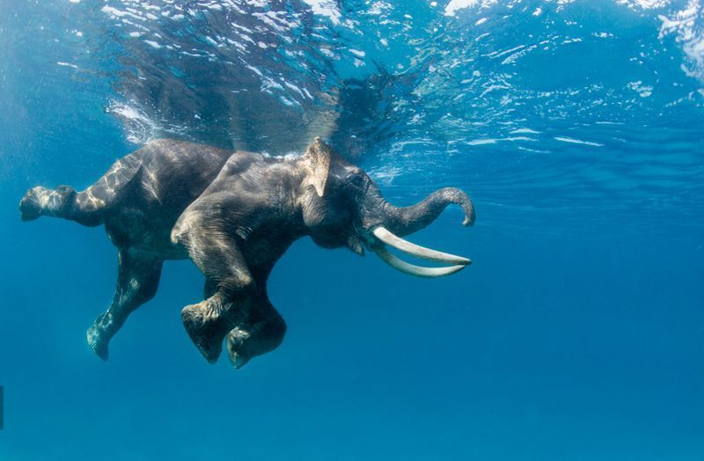
Species level (e.g. courtship behaviour)
Family group (searching for food)
Population level (migration behaviour)
Individual (how the animal is swimming)
Behavioural type (way of feeding)

Slide 8
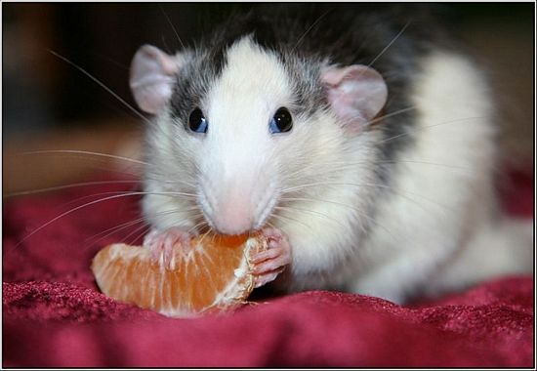
Species level (e.g. courtship behaviour)
Family group (searching for food)
Population level (migration behaviour)
Individual (how the animal is swimming)
Behavioural type (way of feeding)

Slide 9
BUT BEFORE ENTERING INTO THE DETAILS OF THE STUDY YOU MUST ORGANIZE YOU STUDY. FOR THIS YOU CAN USE FOLLOWING STEPS
Level of organization
At the species level or
At the individual level.
Unit of behaviour
Moving
Pattern of behaviour (in moving)
Walking
Reproducing
eating
Swimming
Flying
Diving
Act of behaviour (in flying)
Take off
Flight
landing

Slide 10
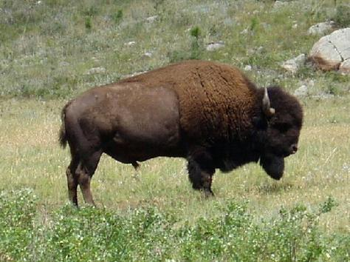
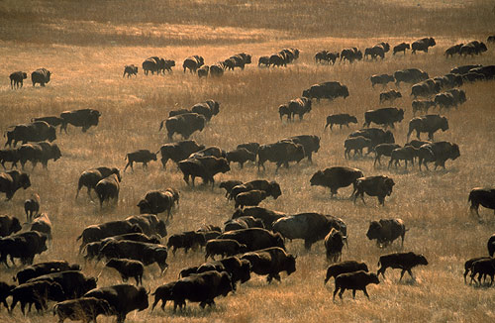
Level of organization
  At the species level or
  At the individual level.

Slide 11
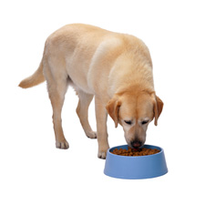
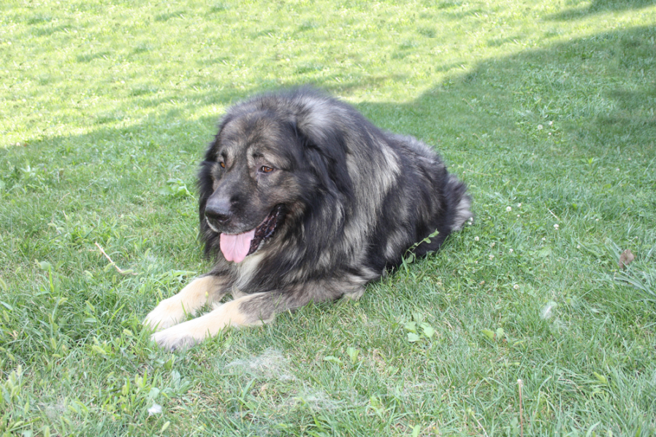
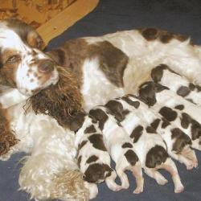
Unit of behaviour
  Moving
  Reproducing
  eating

Slide 12
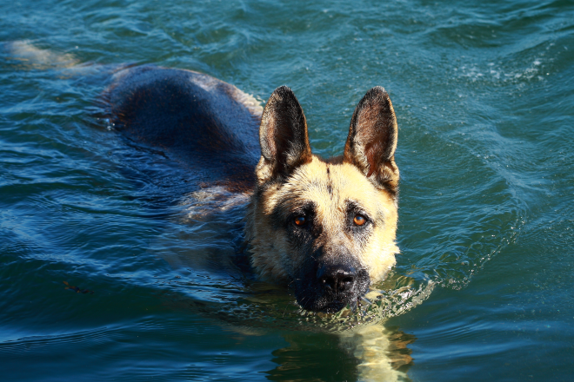
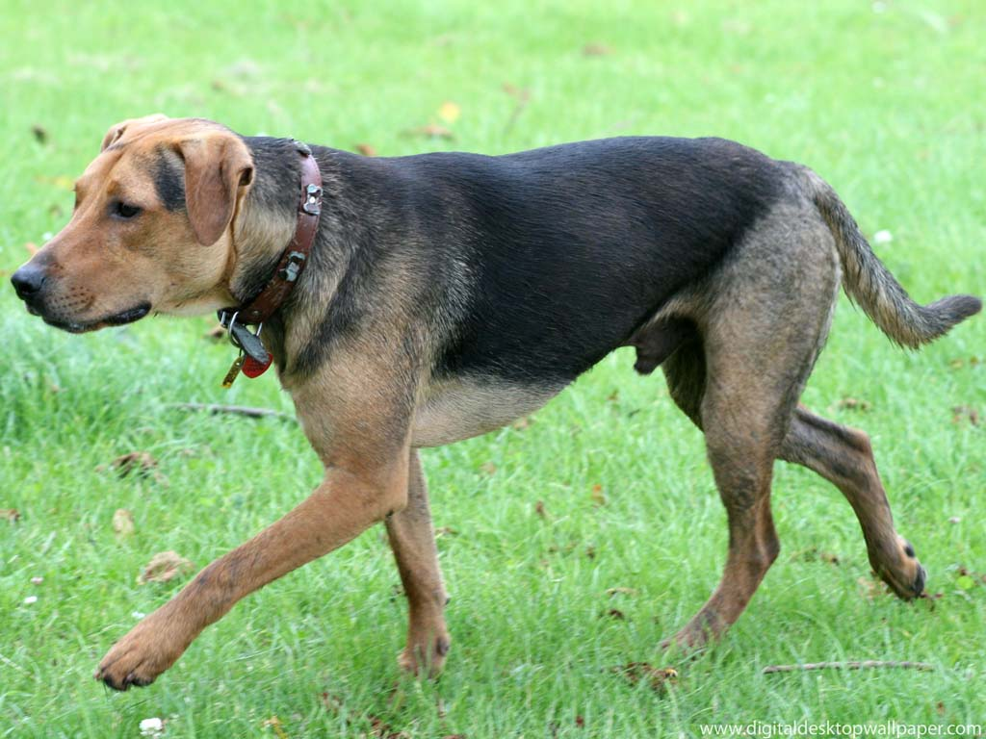
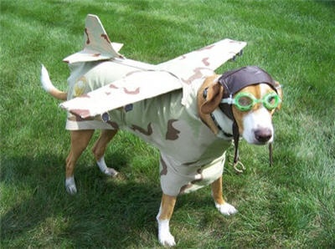
Pattern of behaviour (in moving)
  Walking
  Swimming
  Flying
  Diving

Slide 13
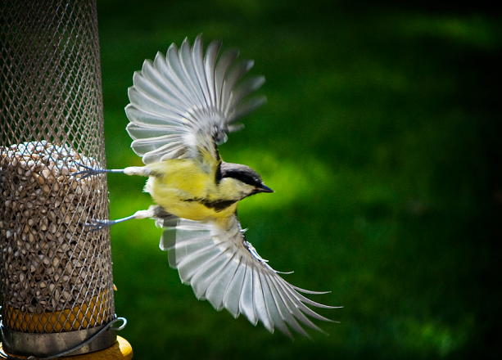
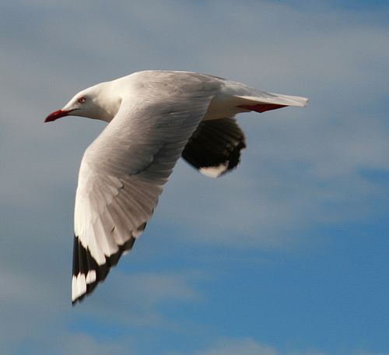
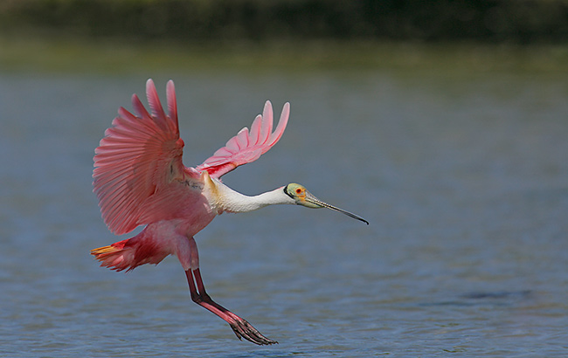
Act of behaviour (in flying)
  Take off
  Flight
  landing

Slide 14
There are various methods which are employed for studying animal behaviour. However, most accepted methodology was developed by Altmann in 1974.

Slide 15
Altmann’s methodology.
Ad libitum
Focal animal
Scan or instaneous sampling
All occurrences,
Sequence
One zero

Slide 16
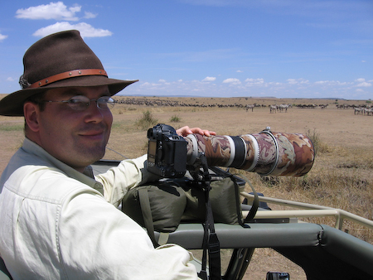
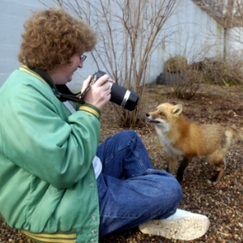
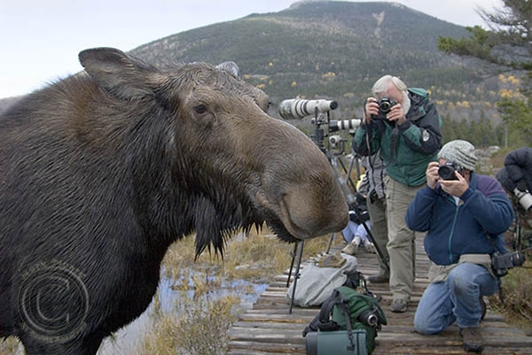
Ad libitum
In this type one stays with the group of the animal and records the behaviour for certain period of time without a restricted focus on certain act.
f.e. most of the wild life photographers do this type of study.

Slide 17
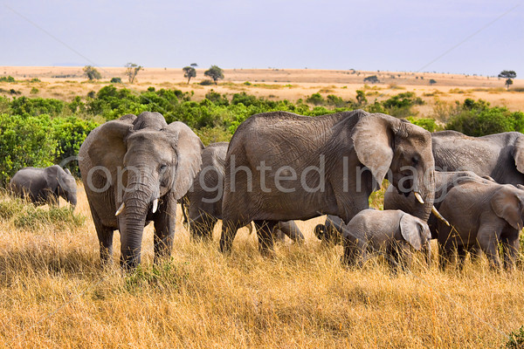
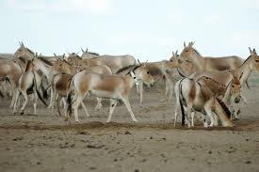
Focal animal
In this type one stays focused on the specific animal of the group and tries to study its behaviour…

Slide 18
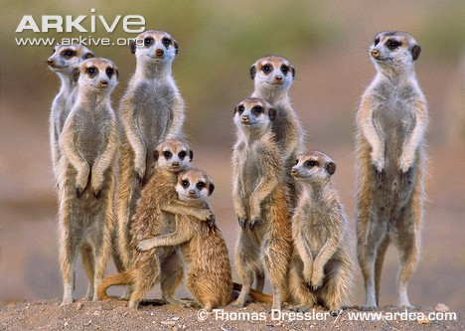
Scan or instaneous sampling
In this method one tries to study the behaviour of all the animals of group one by one and tries to establish a behaviour pattern of that animal species

Slide 19
All occurrences,
This method is contrast to the focal sampling. Here we try to study the behaviour of all the animals of the group and all their behaviour patterns. For this one may need to stay with the group for days and may be years.

Slide 20
Sequence
In this one tries to study a chain of sequence that are observed in animal behaviour. F.e. we try to see the sequnce of events in the courtship behaviour of stickle back.

Slide 21
One zero sampling.
In this type of study one tries to record the occurance of a specific behaviour in a given unit of time.
If the behaviour occurs, it is taken as one; if it does not, it is taken as zero.

Slide 22
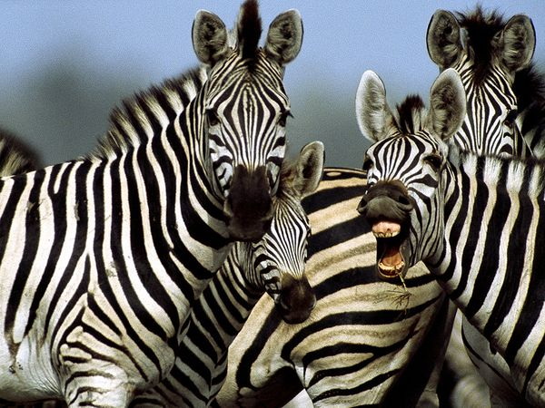
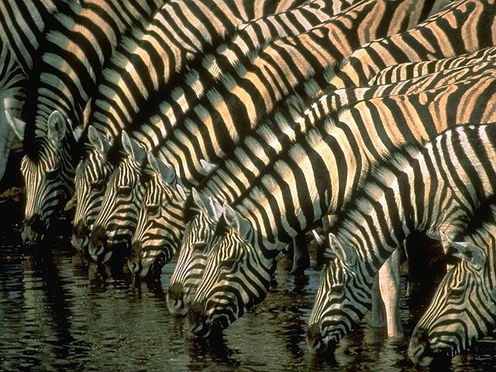
All these methods require that you identify and observe the same animals correctly.

Slide 23
To avoid this problems there are several means of identifying and naming the individuals.

Slide 24
Natural marks
Artificial marking
Trapping
Darting
Netting
Ear notches and ear tags
tatoos

Slide 25
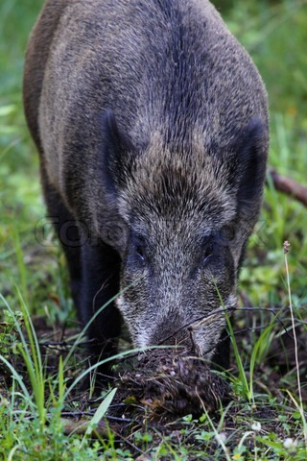
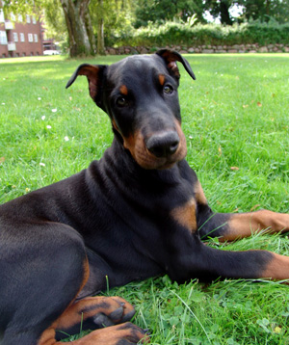
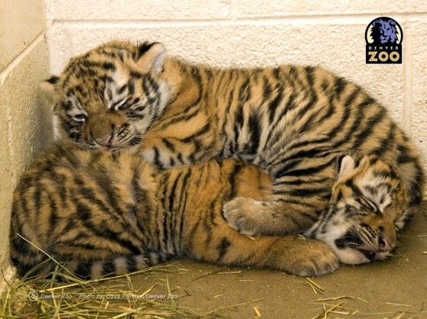
Natural marks

Slide 26
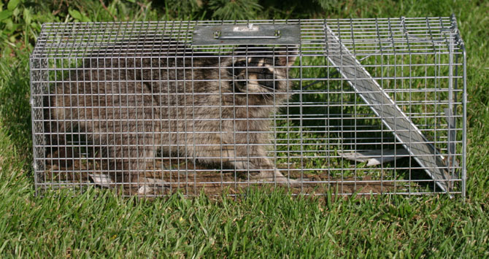
TRAPPING

Slide 27
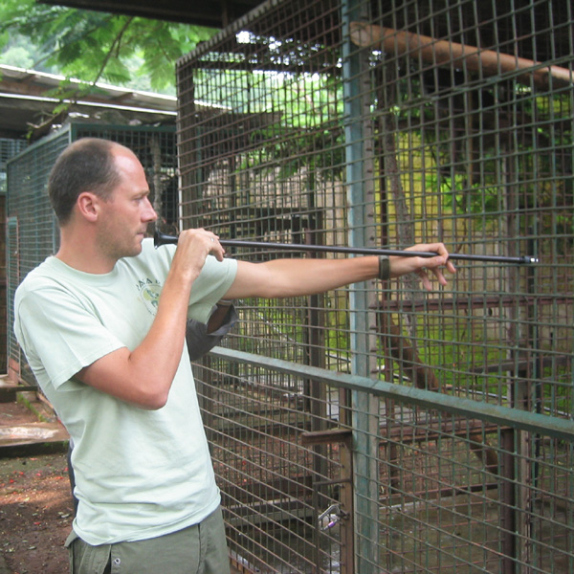
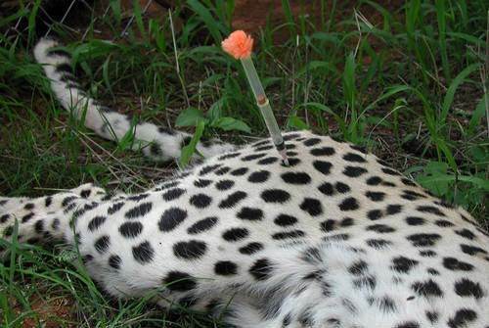
Darting

Slide 28
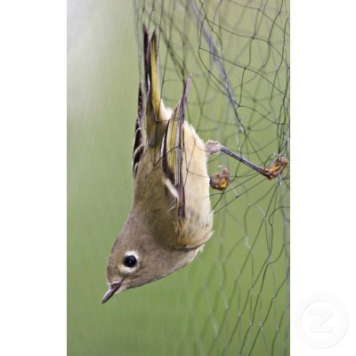
Netting

Slide 29
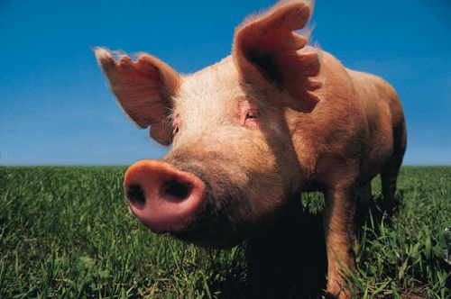
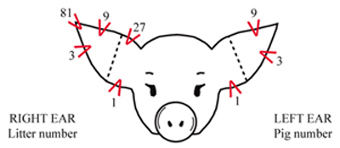
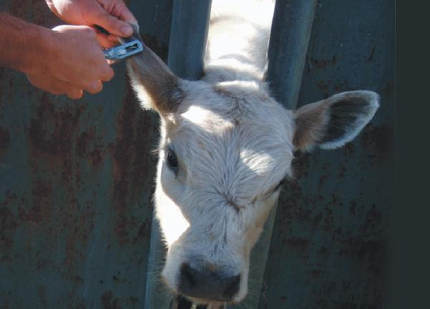
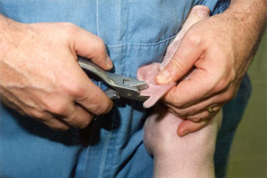
Ear notches and ear tags

Slide 30
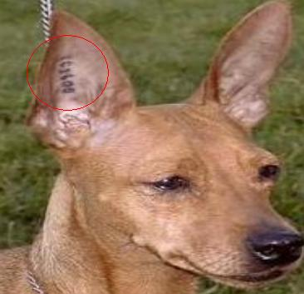
tatoos

Slide 31
Following on foot
Biotelemetry or radiotelemetry
Satellite telemetry system

Slide 32
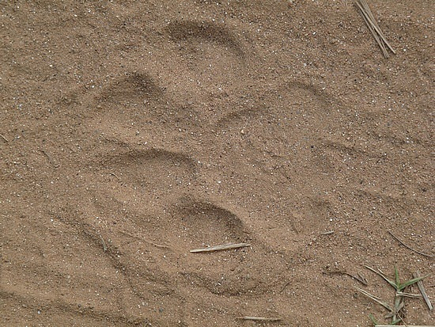

Slide 33
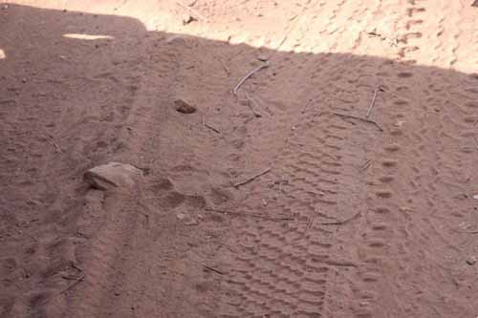

Slide 34
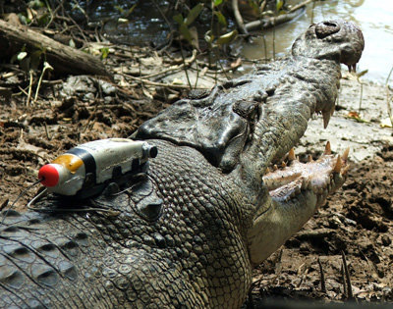
Biotelemetry

Slide 35
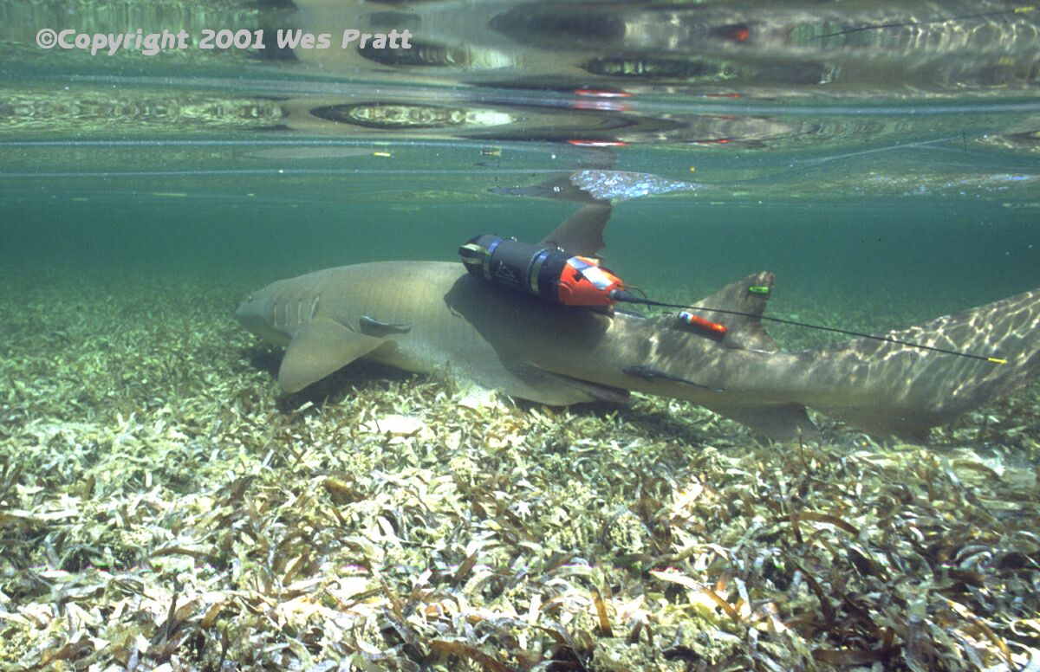

Slide 36
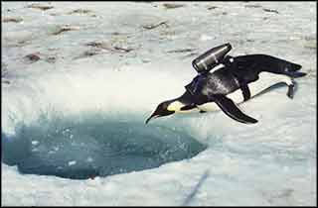

Slide 37
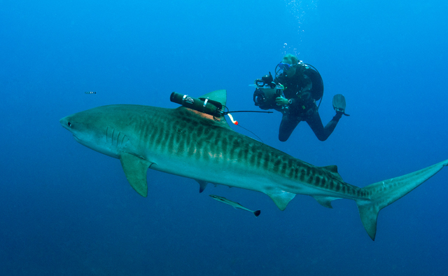

Slide 38
One beautiful example that can be sited here of this technology is that sea turtles were believed to be herbivores… But because of this technology we could learn that they were omnivores and also feeds upon some molluscans if available.

Slide 39
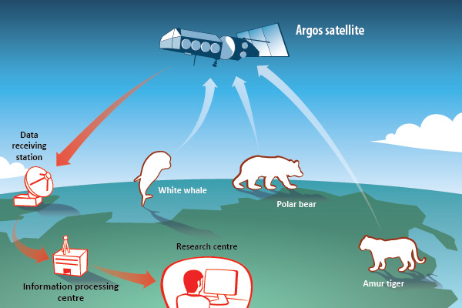
Satellite telemetry

Slide 40
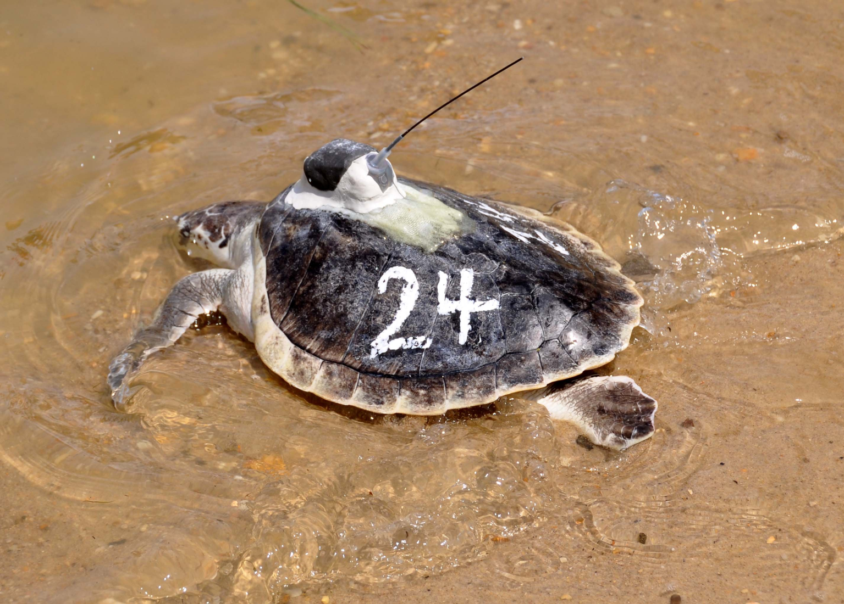

Slide 41
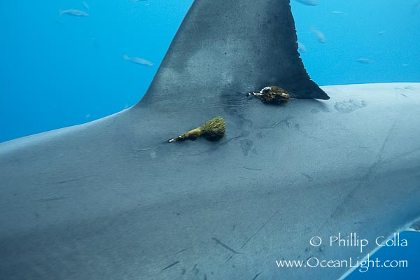

Slide 42
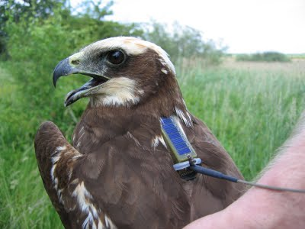

Slide 43
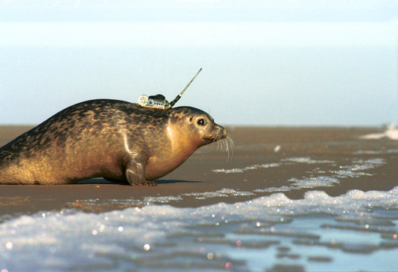

Slide 44
