Slide 1
Mitochondria

Slide 2
Membrane bound cell organelles, associated with cell respiration, the source of energy, being termed as power house of the cell
Discovered by Benda (1898)
Present in eukaryotic cell
Bean shaped organelles, 1-10 um long and about 0.5um wide, occur free in cytoplasm

Slide 3
STRUCTURE:
Bounded by two membrane- outer and inner membrane, Both membrane are about 60-70 A thick
Outer membrane contain more phospholipid and cholestrol than inner membrane the inner mitochondrial membrane contains an unusually high percentage (greater than 70%) of proteins, which are
involved in oxidative phosphorylation as well as in the transport of metabolites (e.g., pyruvate and fatty acids) between the cytosol and mitochondria.
Space between membrane- perimitochondrial space or inter membrane space
Space bounded by inner membrane – inner membrane space, its filled with matrix

Slide 4
Matrix: dense granules, DNA, ribosomes, and enzymes (krebs cycle)
Outer membrane is smooth while inner membrane is thrown up into series of folds, called Cristae
Several thousand particles are present on inner side of the inner membrane – elementary particles or oxysomes or F0-F1 particel

Slide 5
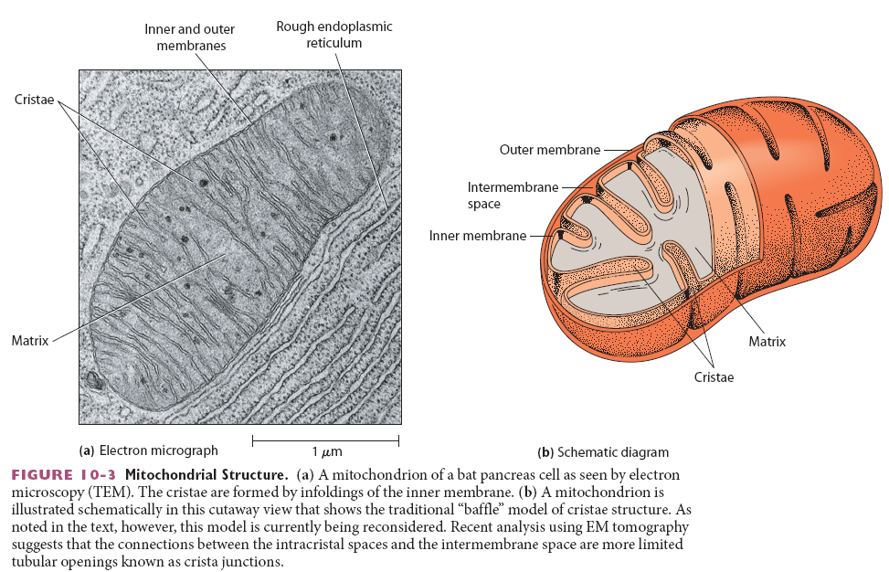
Structure

Slide 6
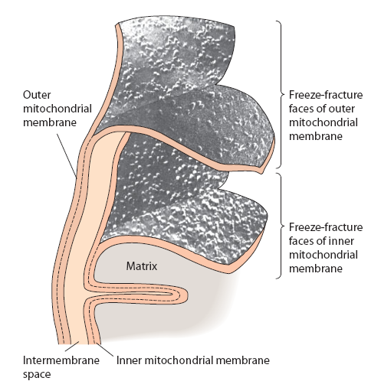
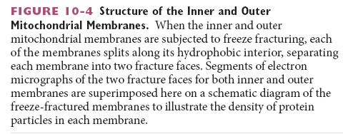

Slide 7
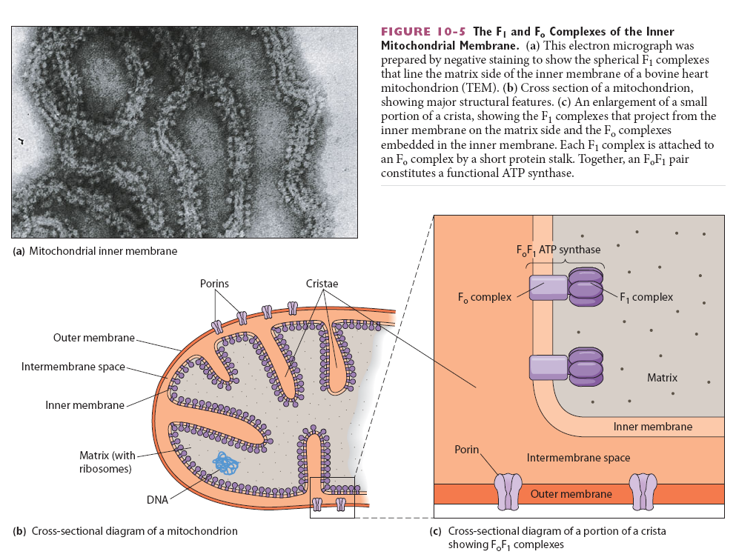
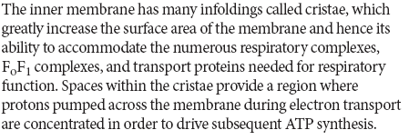

Slide 8
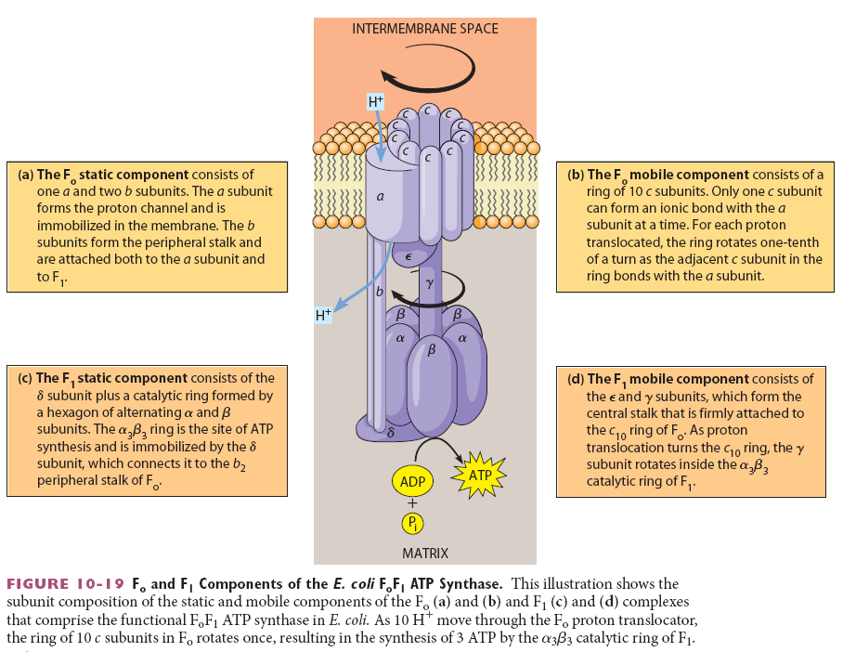

Slide 9
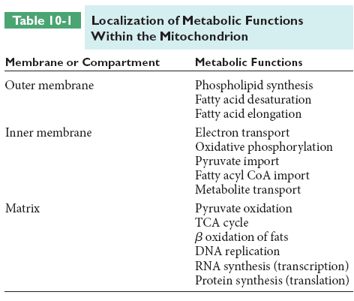

Slide 10
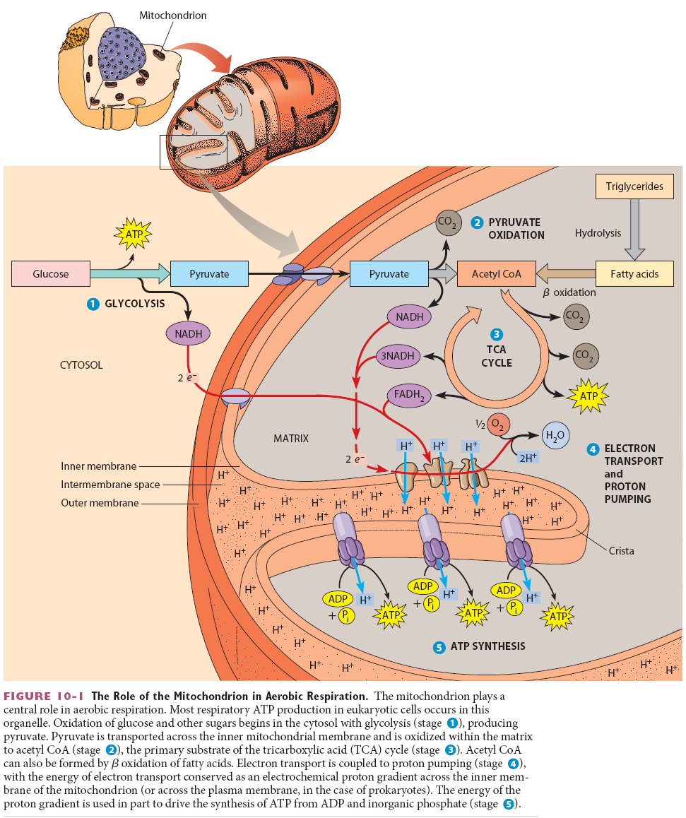

Slide 12
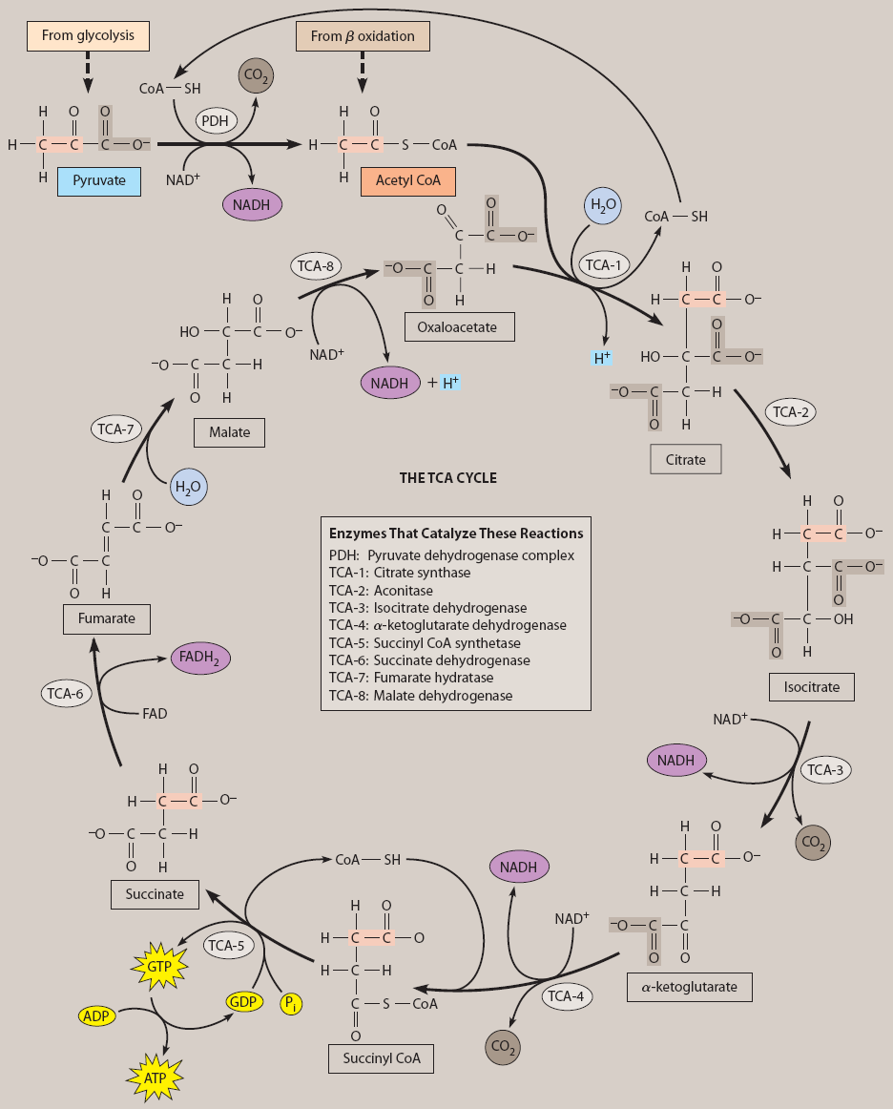

Slide 13
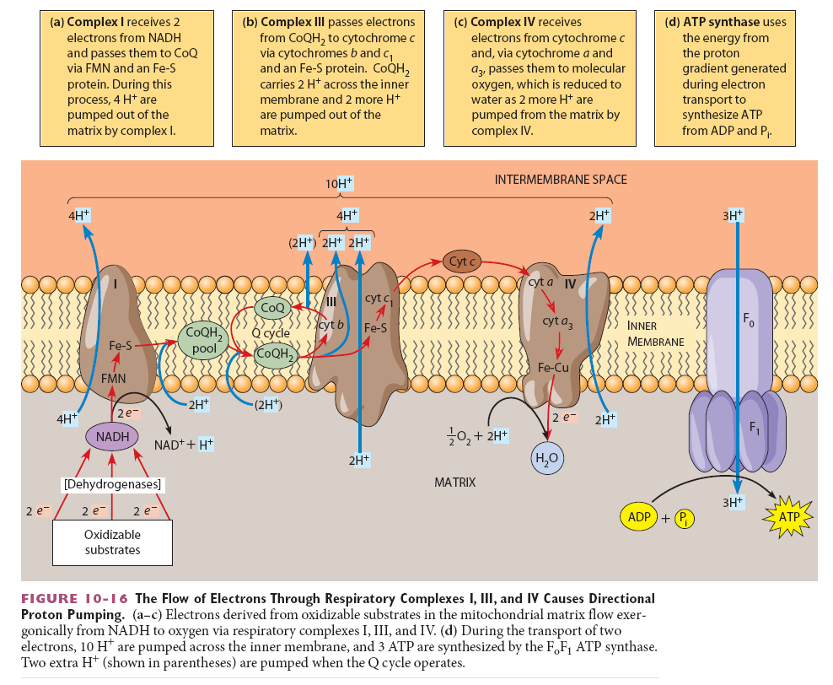

Slide 14
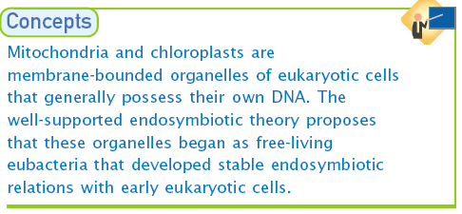
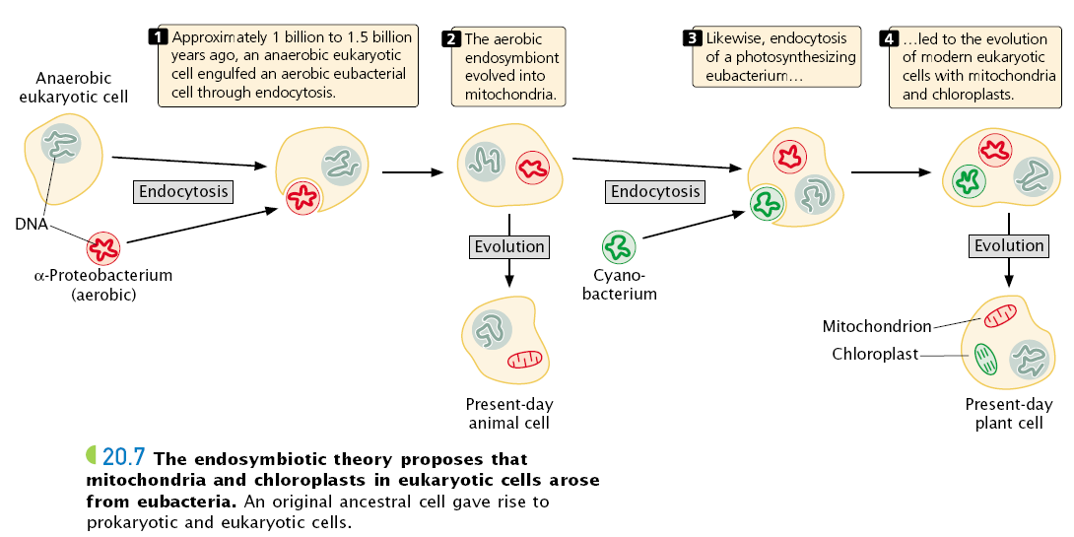
Mitochondrial Origin

Slide 15
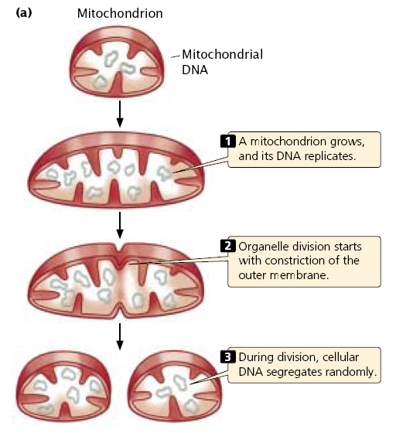
Mitochondrial Division

Slide 16
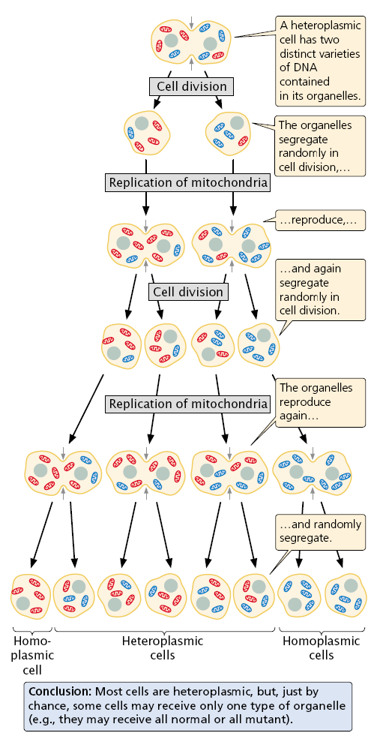
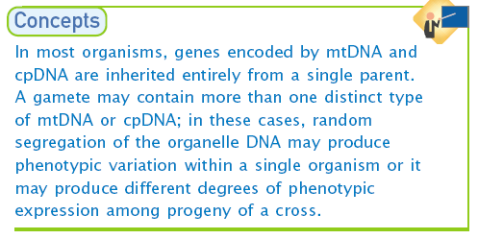

Slide 17
Semi autonomy:
Presence of mtDNA (circular)
DNA dependent RNA synthesis
Presence of ribosome (70s)
Protein synthesis
Can multiply by division
Contain gene for male sterility

Slide 18
Mitochondria contain their own genetic system, which is separate and distinct from the nuclear genome of the cell. Mitochondria are thought to have evolved from bacteria that developed a symbiotic relationship in which they lived within larger cells (endosymbiosis). This hypothesis has recently been substantiated by the results of DNA sequence analysis, which revealed striking similarities between the genomes of mitochondria and of the bacterium Rickettsia prowazekii. Rickettsia are intracellular parasites which, like mitochondria, are only able to reproduce within eukaryotic cells. Consistent with their similar symbiotic lifestyles, the genomic DNA sequences of Rickettsia and mitochondria suggest that they share a common ancestor, from which the genetic system of present‐day mitochondria evolved.

Slide 19
Mitochondrial genomes are usually circular DNA molecules, like those of bacteria, which are present in multiple copies per organelle. They vary considerably in size between
different species. The genomes of human and most other animal mitochondria are only about 16 kb, but substantially larger mitochondrial genomes are found in yeasts
(approximately 80 kb) and plants (more than 200 kb). However, these larger mitochondrial genomes are composed predominantly of noncoding sequences and do not appear to
contain significantly more genetic information. For example, the largest sequenced mitochondrial genome is that of the plant Arabidopsis thaliana. Although Arabidopsis
mitochondrial DNA is approximately 367 kb, it encodes only 32 proteins: just more than twice the number encoded by human mitochondrial DNA. Mitochondrial genomes encode
all of the ribosomal RNAs and most of the transfer RNAs needed for translation of these protein‐coding sequences within mitochondria. Other mitochondrial proteins are
encoded by nuclear genes, which are thought to have been transferred to the nucleus from the ancestral mitochondrial genome.

Slide 20
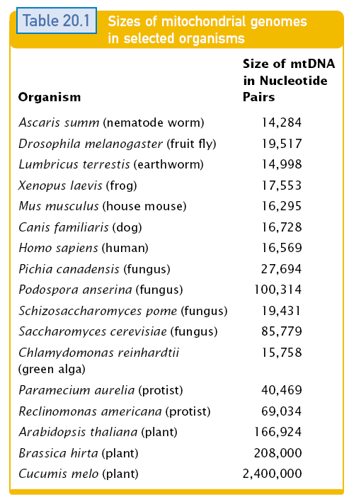

Slide 21
Mitochondrial Genome
Generally, mitochondrial DNA encodes:
tRNAs
rRNAs
Protein subunits, including:
Polypeptides of cytochrome oxidase
NADH dehydrogenase
ATPase

Slide 22
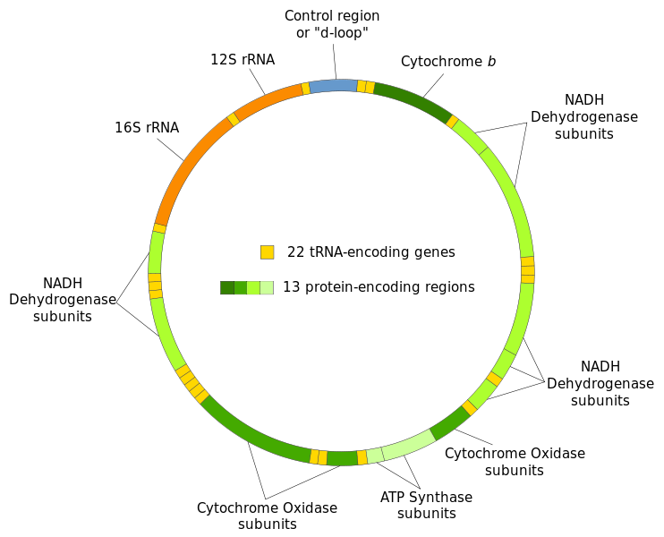
Map of the genes of human mitochondrial DNA

Slide 24
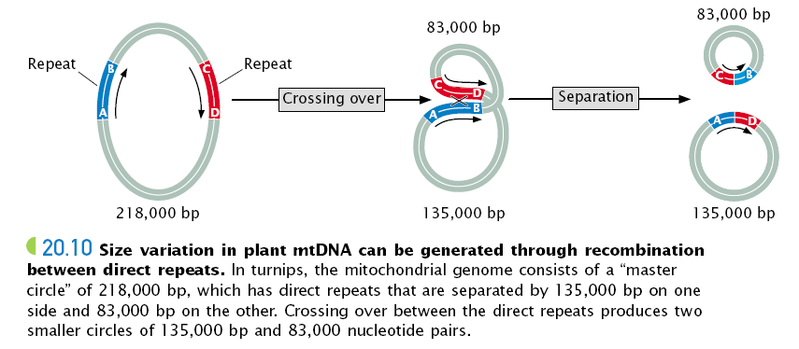

Slide 25
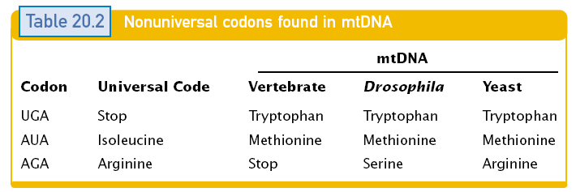
Exception in Genetic code

Slide 27
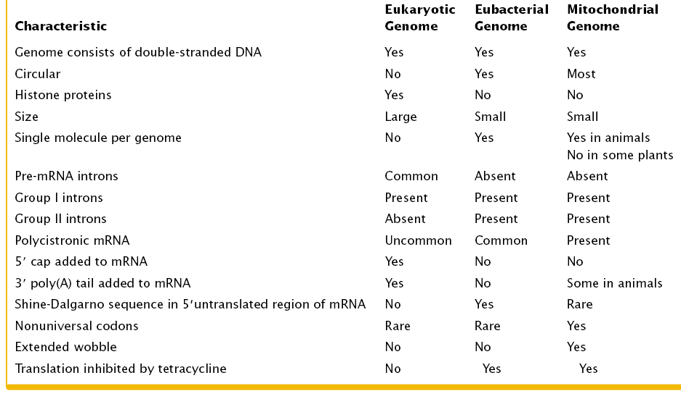

Slide 28
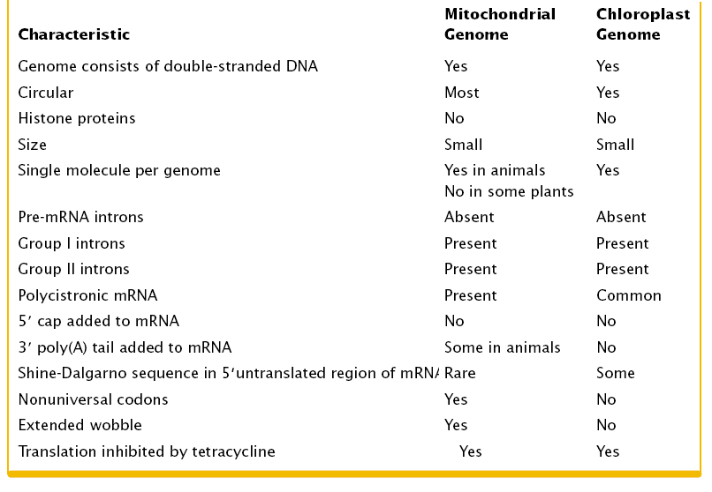

Slide 29
Like the DNA of nuclear genomes, mitochondrial DNA can be altered by mutations, which are frequently deleterious to the organelle. Since almost all the mitochondria of fertilized eggs are contributed by the oocyte rather than by the sperm, germ‐line mutations in mitochondrial DNA are transmitted to the next generation by the mother. Such mutations have
been associated with a number of diseases. For example, Leber's hereditary optic neuropathy, a disease that leads to blindness, can be caused by mutations in mitochondrial genes that encode components of the electron transport chain.
Mutation in one of the mitochondrial transfer RNA genes, characterized by a decrease in synthesis of mitochondrial protein required for electron transport chain and ATP synthesis causes a disorder of muscles termed as a. Myoclonic epilepsy and ragged red fiber disease (MERRF).

Slide 30
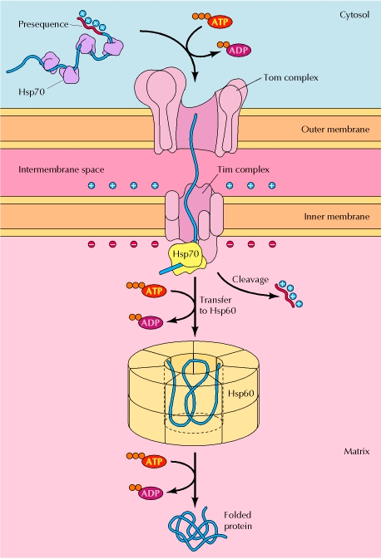
Import of proteins into mitochondria
Proteins are targeted for mitochondria by an amino-terminal presequence containing positively charged amino acids. Proteins are maintained in a partially unfolded state by association with a cytosolic Hsp70 and are recognized by a receptor on the surface of mitochondria. The unfolded polypeptide chains are then translocated through the Tom complex in the outer membrane and transferred to the Tim complex in the inner membrane. The voltage component of the electrochemical gradient is required for translocation across the inner membrane. The presequence is cleaved by a matrix protease, and a mitochondrial Hsp70 binds the polypeptide chain as it crosses the inner membrane, driving further protein translocation. A mitochondrial Hsp60 then facilitates folding of the imported polypeptide within the matrix.

Slide 31
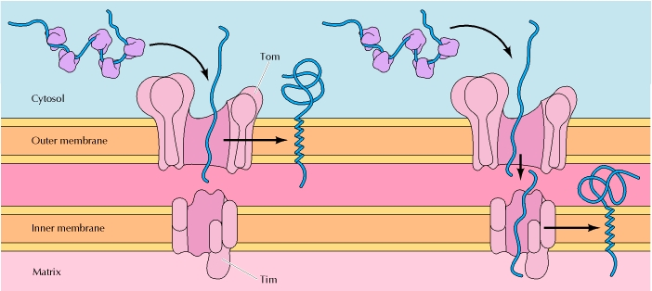
Insertion of mitochondrial membrane proteins
Proteins targeted for the mitochondrial membranes contain hydrophobic stop-transfer sequences that halt their translocation through the Tom or Tim complexes and lead to their incorporation into the outer or inner membranes, respectively.

Slide 32
Proteins can be targeted to the intermembrane space by several mechanisms. Some proteins (I) are translocated through the Tom complex and released into the intermembrane space. Other proteins (II) are transferred from the Tom complex to the Tim complex, but they contain hydrophobic stop-transfer sequences that halt translocation through the Tim complex. These stop-transfer sequences are then cleaved to release the proteins into the intermembrane space. Still other proteins (III) are imported to the matrix, as depicted in Figure 10.4. Removal of the presequence within the matrix then exposes a hydrophobic signal sequence, which targets the protein back across the inner membrane to the intermembrane space.

