Slide 1


Respiration
ATP as currency of energy.
Ultra structure of mitochondrion and its functions.
Mechanism of aerobic and non aerobic respiration.
Significance of respiration.

Slide 2


Respiration
Energy is stored as organic food in plants.
Energy is released when organic food is oxidised during respiration.
Potential energy in food is converted into kinetic energy. Energy releasing and energy supplying process.
The energy released is of two types:
Heat energy
Chemical energy

Slide 3

Definition
It is an intracellular oxidation process in which complex organic substances are broken down into simpler substances with stepwise release of energy.

Slide 4
Raw materials
  Glucose
  Oxygen
Product
  38 ATPs or 686 Kcal or 2870 KJ
Byproduct
  Carbon dioxide

Slide 5


Reaction
C₆ H₁₂O₆ + 6CO₂
Enzymes
6H₂ O + 6CO₂ + 686 Kcal or 38 ATP

Slide 6

Overview of Respiration
Respiration involves:
Gaseous exchange
  External respiration
  Internal respiration
Catabolic process
  Exergonic process
  Formation of water

Slide 7



Types of Respiration
1. Aerobic Respiration
The oxidation of the glucose with the help of atmospheric oxygen is called aerobic respiration.
+ 6O₂ 6CO₂ + 6H₂ O + 38 ATP
^{C}6 ^{H}12 ^{O}6
2. Anaerobic Respiration
The partial oxidation of organic food in the absence of atmospheric oxygen is called anaerobic respiration.
2C₂ H₅ OH + 6CO₂ + 2 ATP
^{C}6 ^{H}12 ^{O}6

Slide 8
Aerobic respiration
Anaerobic respiration
Requires molecular oxygen.
Does not molecular oxygen.
Respiratory substrate is fully oxidized.
Respiratory substrate is incompletely or
partially oxidized.
End products: CO2 and H2O
End products: Ethyl alcohol and CO2
Exchange of gases between environment and organism
Exchange of gases is not involved.
Metabolic water is formed
Metabolic water is not formed.
Occurs partly in cytoplasm and partly in mitochondria.
Occurs entirely in cytoplasm.
38 ATP molecules formed from a glucose
molecule.
2 ATP molecules from a glucose
molecule
Involve electron transport chain.
ETC not required.
Process runs continuously throughout life in plants and animals.
Occurs continuously only in some microorganisms. In others it takes place temporary for short period during oxygen deficiency.

Slide 9

Respiratory substrate
The organic substances which are oxidized in cellular respiration for releasing energy are called respiratory substrate.
a. Carbohydrates:
glucose, fructose, starch, glycogen, sucrose.
b. Fats: when carbohydrates are exhausted, fats are used as respiratory source.
c. Proteins: used as respiratory substrate under starvation.

Slide 10



ATP
ATP is energy rich organic compound which stores biologically usable form of energy.
Universal carrier of chemical energy in living world. Energy currency of cells.
Energy released when ATP is hydrolyzed to ADP andAMP.
ATP + H₂ O ADP + ip + 7.3 Kcal
Energy is stored when ADP & AMP are phosphorylazed to ATP.
ADP + ip ATP

Slide 11




ATP - Structure
It is a ribonucleotide consisting of 3 components:
a. Adenine
b. Ribose
c. Three Phosphate groups
Adenine + Ribose = Adenosine.
1st Phosphate group is attached to Ribose and then to each other in a linear fashion.

Slide 12

ADENINE
RIBOSE SUGAR
α
β
γ
PO4
PO4
PO4
ADENOSINE
PHOSPHATE GROUPS

Slide 13



ATP - Functions
Storage of energy. Supply of energy.
Minimization of energy wastage. Phosphate group donor

Slide 14

Mitochondria
Double membrane bounded. Center for aerobic respiration. Present in all living eukaryotic cells.
Differ in shape. (filamentous, rod shaped). 0.5- 1µm in diameter & 2-6µm in length.
Colorless

Slide 15


Mitochondria – Structure
Mitochondrial membranes
  Outer membrane
  Inner membrane
  Cristae
  Elementary particles
Mitochondrial chambers
  Outer membrane
  Inner membrane

Slide 16

Mitochondrial membrane
oOuter membrane- permeable to certain solutes.
Consists of 40% lipids & 60% proteins.
oInner membrane- consists of 80% proteins & 20% lipids. Selectively permeable.
oCristae- inner membrane infolded into the matrix. Encloses a narrow space called intracristal space.
Contains enzymes for respiration
oElementary particles- present on inner surface of inner membrane. Named as FI particles or Oxysomes. Range between 10⁴-10⁵ in a single mitochondrion.

Slide 17


Mitochondrial chamber
Outer chamber- present between outer & inner membrane. Filled with watery fluid and few enzymes. It temporarily stores ATP molecules after synthesis.
Inner chamber- central cavity of mitochondrion filled with more dense, semi fluid, granular matrix. Matrix contains enzymes, DNA, RNA, ribosomes. 2- 6 circular double stranded of molecule DNA.

Slide 18
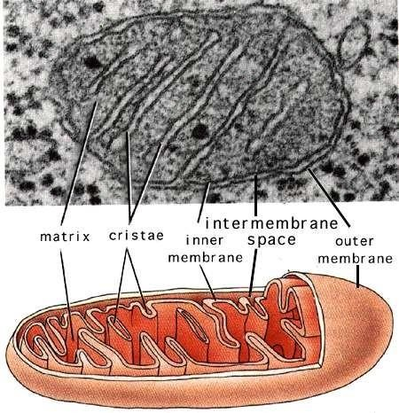

Slide 19
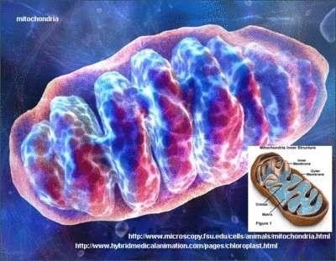
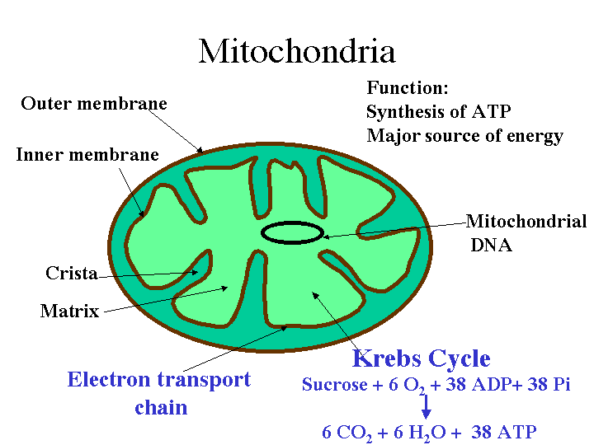

Slide 20
Mitochondria -Functions
Power house of cell Intermediate compounds Calcium storage and Maternal inheritance

Slide 21

Aerobic respiration
Aerobic respiration is completed in
Glycolysis
Oxidative carboxylation (Acetylation)
Krebs cycle
Electron transport system

Slide 22


Glycolysis
The sequence of reactions in which glucose (6C) is broken down into two molecules of pyruvic acid(3C).
Also called as EMP pathway named after their discoverers Embden, Meyerhoff, and Paranas. 1st step in breakdown of glucose.
Does not require presence of oxygen & there is no output of carbon dioxide.
Occurs in cytoplasm of cell.
Involves series of 10 reaction, each controlled by a specific enzyme.

Slide 23

The reactions are studied in three groups:
Activation or phosphorylation of glucose molecule.
Cleavage or fragmentation
Oxidation.

Slide 24
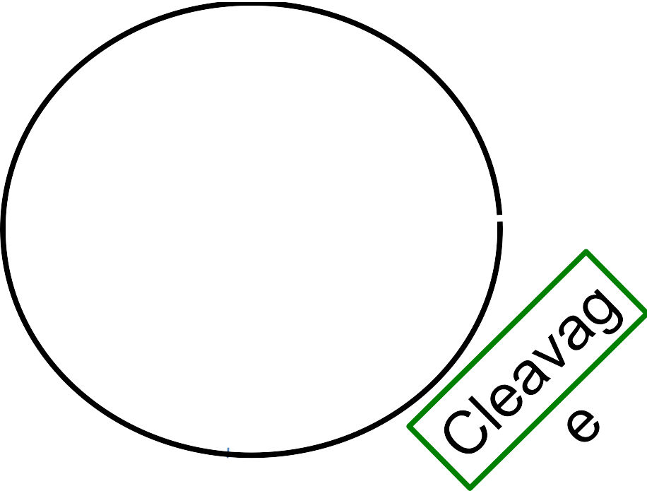
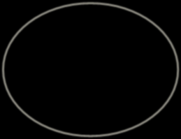
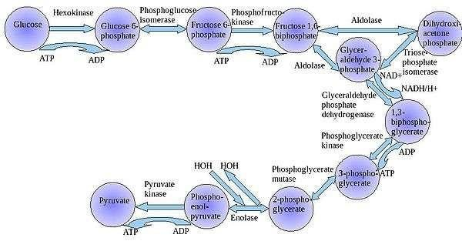




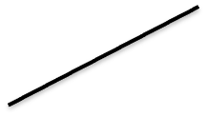
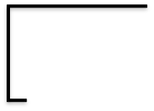
Activation

Slide 25


Activation or Phosphorylation of Glucose
Phosphorylation of glucose
  Glucose is converted to Glucose 6- phosphate
Isomerisation
  Glucose 6- phosphate isomerised to Fructose 6-phosphate.
Second phosphorylation
  Fructose 6-phosphate is phosphorylased to Fructose 1, 6- diphosphate by enzyme Phosphofructokinase(PFK).

Slide 26

Cleavage or Fragmentation
Cleavage
  Fructose 1, 6 bi phosphate is an unstable compound and splits to produce 3C compounds 3PGAL and DHAP.
Isomerisation
  Glycolysis utilizes only PGAL, therefore DHAP is isomerised to 3PGAL

Slide 27

Oxidation
Oxidative phosphorylation(Dehydrogenation):
  3PGAL is oxidized by removal of Hydrogen(H2) and simultaneous phosphorylation of the product resulting in 1,3 Di PGA
ATP synthesis:
  1,3 Di PGA is converted to 3 PGA by release of one phosphate group.
Isomerization:
  Phosphate group at 3rd carbon is shifted to 2nd i.e. 3 PGA to 2PGA.

Slide 28
9. Dehydration :
o 2 PGA loses a molecule of water and gets converted to PEPA
10. ATP synthesis (formation of Pyruvic acid)
o PEPA is converted to Pyruvic acid by removal of phosphate group.

Slide 29


Net reaction of Glycolysis
^{C}6^{H}12^{O}6 _{H}+
+ 2 ADP +2 NAD⁺
2 C₃H₄O₃ + 2 ATP +2NADH+
Pyruvic
acid
Net gain of ATP
+
6 ATP FROM 2 NADH2 4 ATP BY DIRECT •
2 ATP UTILISED
=
8 NET GAIN

Slide 30
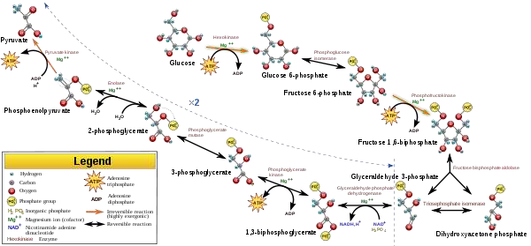

Slide 31


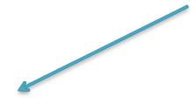
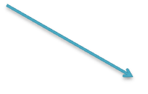
Fate of Pyruvic Acid
Glucose
Glycolysis
Pyruvic acid
O₂ isused
O₂ is not used
Aerobic respiration
Anaerobic respiration

Slide 32
Thank you

