Slide 1
Flowers Submitted by Bhanu Raj Meena

Slide 2
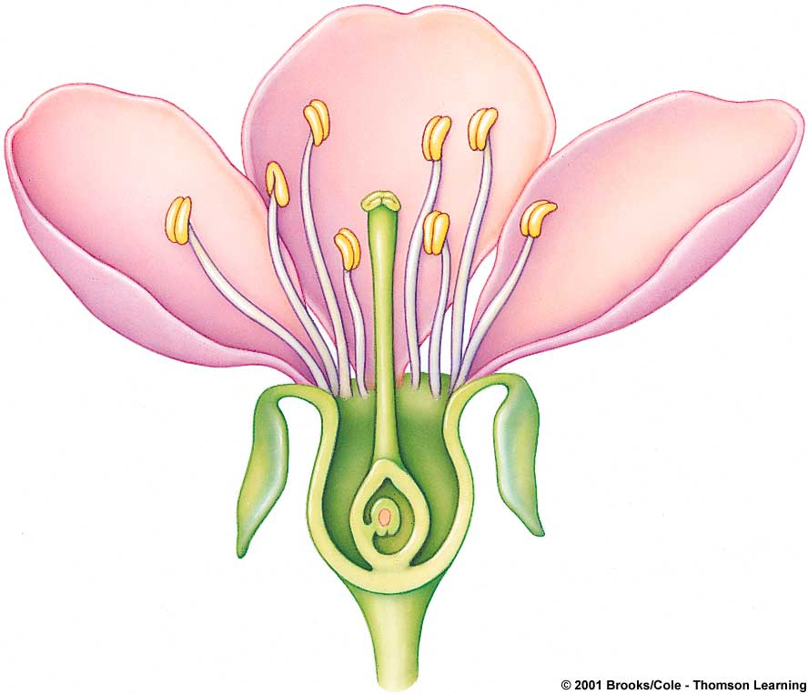
Basic structure of the angiosperm flower
STAMEN
(male reproductive part)
CARPEL
(female reproductive part)
filament
anther
stigma
style
ovary
This is a hermaphrodite flower with a single carpel
OVULE (forms within ovary)
petal (all petals combined are the flower’s corolla)
sepal (all sepals combined are the flower’s calyx)
receptacle

Slide 3
Collective nouns that can cause confusion!
Calyx
The outer whorl of a flower made up of sepals that are usually green, and protect the flower in bud.
Carpel
Bears the stigma, and frequently an elongated style, and encloses the ovules (sometimes gynaecium). The megasporophyll of the flower
Corolla
The collective term for the petals of a flower

Slide 4
Collective nouns that can cause confusion!
Ovary
The total of the carpels in a flower is the ovary
Pistil
Each separate carpel when there are lots of them in the ovary
Perianth
The floral envelope, it includes the calyx and corolla.
Stamen
The anther and its supporting filament. The microsporophyll of the flower

Slide 5
Thanks

