Slide 1
Reproduction
of
Flower
Submitted
By
Bhanu Raj Meena

Slide 2
Flower – its evolution; foliar stamens; open carples; primitive living angiosperms; floral anatomy; inferior ovary; placentation and its evolution.

Slide 3
The problem of homology and morphology evolution of the flower has occupied research workers for a long time.
Floral Organs
Investigators such as Wolff and Goethe in the eighteenth century, de Candolle at the beginning of the nineteenth century, and many others since then were interested in this problem (Arber 1937,1950). Opinions were expressed that floral organs are derived directly from foliage leaves.
However, in the light of the view generally accepted today that the laves and stem constitute a single unit which is termed the shoot, we can visualize the development of the flower as being parallel to that of a vegetative branched not as being derived from it.

Slide 4
The flower consists of an axis on which the rest of the floral organs are borne. That part of the axis that represents the internodes terminated by the flower is termed the pedicel. The distal end of the pedicel is swollen to various extents and this portion is termed the floral receptacle or thalamus.
The floral organs are attached to the receptacle. A typical flower has four type of organs:
(1). The outermost organs of the flower are the sepals; which together constitute the calyx which is usually green and is found lowest on the receptacle.
(2) On the inside of the sepals is the Corolla consisting of the petals which are generally colored.
These two types of organs together form the perianth; However, sometimes one of them may be lacking. When all the organs of the perianth are similar they are termed tepals.

Slide 5
Within the perianth two kinds of reproductive organs are found: externally the stamens which together from the androecium, and internally the carpels which form the gynoecium.
The arrangement of the floral organs on the receptacle may be spiral or whorled,& both types of arrangement may occur in the same flower. In most flowers in which the arrangement is whorled the organs of each whorl alternate with those of the neighboring whorl.
The floral organs may be free or fused. Fusion of organs of the same types is termed Cohesion & that of different types of organs adnation.
The term pistil is no longer used as it is not sufficiently well defined. This term was used both for each of the free carpels of a flower as well as for the unit which is formed by the fusion of a few carpels ;

Slide 6
There fore, we shall refer to all the carpels of a flower, whether they are free or fused as the gynoecium.
The stamen consists of a filament which distally bears the anther. Two lobes can be distinguished in the anther and they are attached to a continuation of the filament which is termed the connective. Each of these lobes contains two pollen sacs in which pollen grains are found.
The pollen grains in their early stage of development are the microspores of the angiosperms.
The free carpel or fused gynoecium usually consists of the three parts:- The Ovary, a hollow body which contains one or more ovules: The Style which result from the elongation of the ovary wall; and The Stigma which is that part at the top of the style which has a surface structure enabling pollination.

Slide 7
The ovules are attached to a special thickened region of the carpel wall which is termed the placenta.
When the carpels are found on the highest level of the floral axis the ovary is termed superior or the flower hypogynous.
In certain plants the perianth & stamens are located on the edge of a laterally expanded disc which raises them above the ovary; such a flower is termed perigynous, and its ovary is said to be intermediate or pseudo-inferior.
The concave disc may completely enclose the ovary so that it then found below the other floral organs; in such a flower the ovary is to be inferior and the flower epigynous.

Slide 8
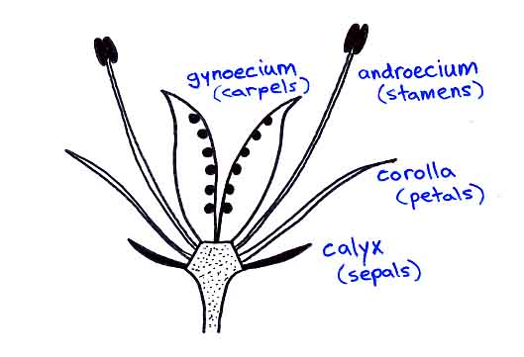
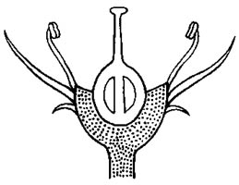
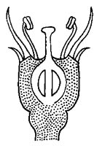
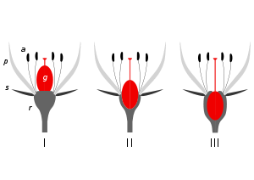
Superior or
Hypogynous
Intermediate or
Pseudo-inferior
or Perigynous
Inferior or
Epigynous

Slide 9
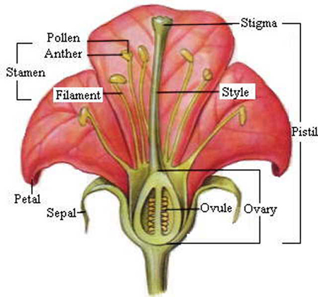

Slide 10
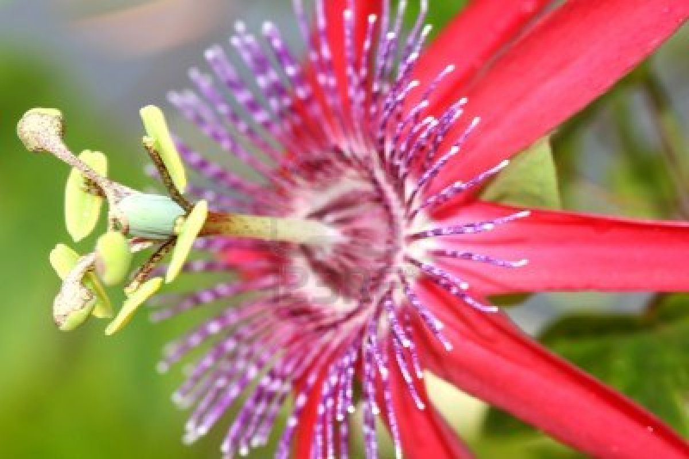
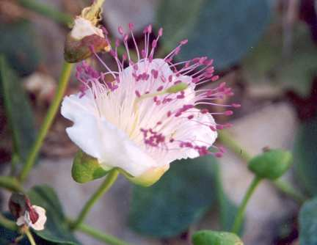
In some plants, e.g. Capparis only that parts of the receptacle that bears carpels is elongated; such a structure is termed a gynophores. An elongation of that part of the receptacle that bears the carpels and stamens e.g. Passiflora is termed androgynophore.
Capparis
Passiflora

Slide 11
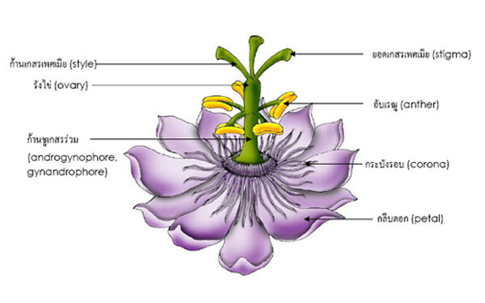
Stigma
Style
Ovary
Anther
Androgynophore,Gynondrophore
Corona
Petal

Slide 12
THANKS

