Slide 1
Practical 1
Instrumentation: Spots

Slide 2
pH Meter

Slide 3
pH Meter
What is pH Measurement?
pH Measurement specifies the degree of relative acidity or alkalinity of an aqueous solution at a given temperature.
It is generally measured using a pH Meter.
All living beings depend on a proper pH level to sustain life and hence pH Measurement becomes an important aspect of our lives.
Theoretically, pH is derived from the word “Pondus Hydrogenii” which means “Potential Hydrogen” or Power of Hydrogen.

Slide 4
In an aqueous solution, a pH of 7 describes a neutral solution because the activities of Hydrogen (H+) and Hydroxide ions (OH-) are equal.
The solution is described as acidic when the pH is below 7,as the activity of Hydrogen ion is dominant when compared to Hydroxide ion.
Hence a solution is termed more acidic when the Hydrogen ion activity increases and the pH value decreases.
On the contrary, the solution is described as basic (or alkaline) when the pH is above 7, as the activity of Hydroxide ion is dominant when compared to Hydrogen ion.

Slide 5
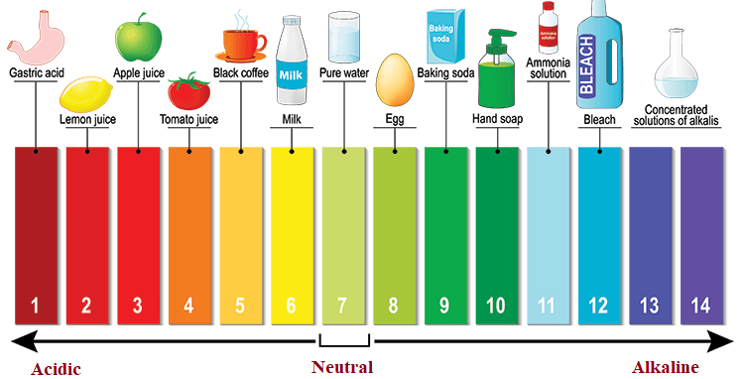

Slide 6
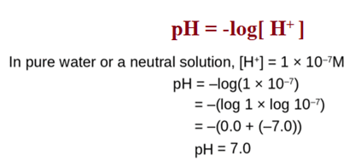
pH is represented in the form of an equation as the negative logarithm of the Hydrogen ion concentration.

Slide 7
Components of pH meter
Measuring Electrode
Reference Electrode
Temperature Sensor
Sample Solution being measured

Slide 8
The pH Meter measures the voltage of an electro chemical cell and based on the Temperature Sensor determines the pH of a solution.
Most of the pH Meters the electrodes and the Temperature Sensor are fabricated into a single body and are called as Combination Electrodes.

Slide 9
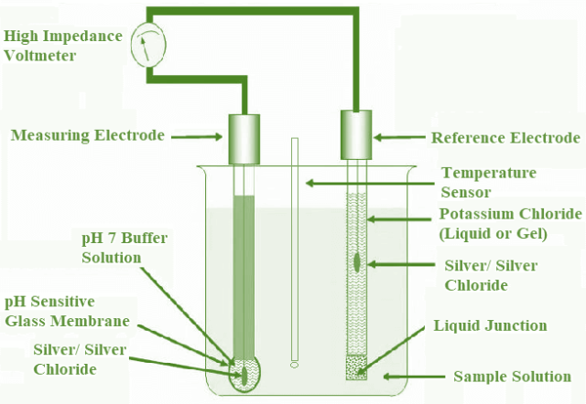
pH Meter:
Measuring Electrode made of glass
Reference/Colomel Electrode
Temperature Sensor
Liquid junction.

Slide 10
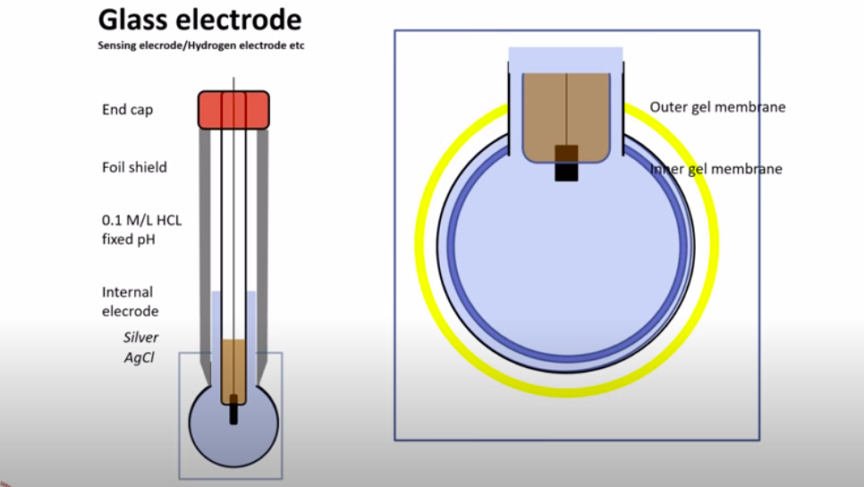

Slide 11
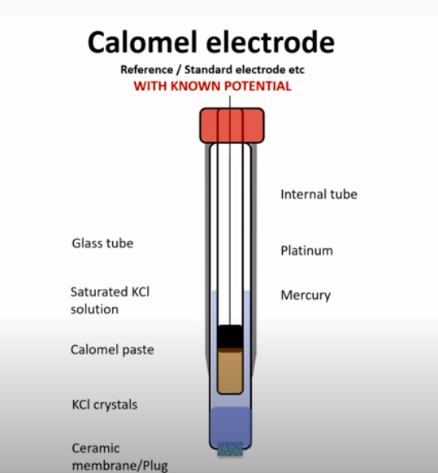

Slide 12
Ion-exchange process also takes place on the inner surface of the Glass Electrode from the sample solution.
This creates a potential difference (Hydrogen- ion activity) between them.
The Liquid Junction potential is usually small and relatively constant which mainly depends on the concentration of the ions in the sample solution.
All three potentials are summed up and measured by High Impedance Voltmeter.
The output of the Impedance Voltmeter is Voltage readings and it has to be calibrated to get precise pH Measurement.
Calibration is done by dipping the Measuring Electrode into Buffer Solution of known pH which helps in interpreting millivolt reading as pH measurement of the Sample Solution at the given temperature.
https://www.youtube.com/watch?v=vuhSlDcmJEA

Slide 13
The applications include:
pH Measurement is very crucial in Agriculture industry for soil evaluation. Major crops require alkaline environment and hence pH Measurement becomes necessary.
It is also used in Food industry especially for dairy products like cheese, curds, yogurts, etc.
It becomes mandatory for chemical and pharmaceutical industries.
It becomes a significant factor in the production of detergents.
pH level monitoring is essential in water treatment plants and RO water purifiers.

Slide 14
Advantages of pH Measurement
The advantages are:
pH Measurement is inexpensive and robust.
Pocket size pH Meters are user friendly.
Readings are accurate and precise.
Disadvantages of pH Measurement
The disadvantages are:
Temperature impacts the output readings.
pH Measurement using glass electrodes must be clean as deposition on the electrodes affects the readings.

Slide 15
Centrifuge

Slide 16
What is Centrifuge
A centrifuge is a machine that separates particles according to their size, shape, density and viscosity of the medium, by subjecting them to artificially induced gravitational fields.
This can be used as a preparative approach to separate complex mixtures present in samples or analytically, to determine the mass, shape or density of particles.
Materials with higher particle density will sediment towards the axis of centrifugation (down the tube), while materials with a lower particle density will sediment away from the axis of centrifugation.
Cells, subcellular components, virus particles and precipitated forms of proteins and nucleic acids are commonly separated by this method.

Slide 17
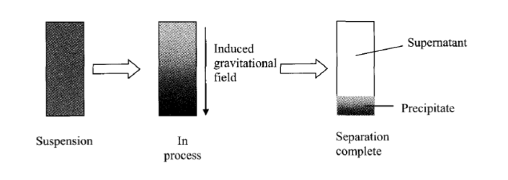
Principle

Slide 18
The centrifuge mainly works on the principle of sedimentation, where the acceleration at centripetal force causes denser substances to separate out along the radial direction at the bottom of the tube.
The apparent centripetal force that draws a rotating body away from the center of rotation which is caused by the inertia of the body as the body’s path is continually redirected.
The acceleration achieved by centrifugation is expressed as a multiple of the earth’s gravitational force (g). This is called the radial force produced by the spinning rotor or Relative centrifugal force (RCF) or g-force.
Based on the acceleration values they can reach, centrifuges are categorized into bench top (upto 15000 g), high speed refrigerated centrifuges (50000 g) and ultracentrifuges (500000 g).
Depending on the sample type, there are several centrifugation methods available. Examples include isopycnic, ultrafiltration, density gradient, phase separation, and pelleting.
As ultracentrifuges can operate under cold conditions and in the vacuum, they are ideal for separating macromolecules like proteins, nucleic acids and carbohydrates.

Slide 19
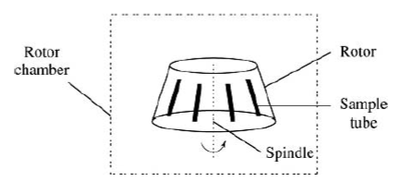
Design

Slide 20
Components
A centrifuge has three basic parts, namely rotor, drive shaft and motor.
Rotors can be mounted on the drive shaft, which connects it to the motor. Rotors are usually made from robust material, like aluminium alloy or stainless steel.
The motor provides the power to turn the rotor.
Usually, a secure cabinet surrounds and supports these parts.
The sample is placed in a reinforced plastic tube which is then held in a rotor which rotates around a spindle.
For the minimizing of vibration and strain on the shaft and bearings, a loaded rotor should be well balanced, i.e., its total mass should be distributed about the axis of rotation such that the resultant of all elemental forces is zero.

Slide 21
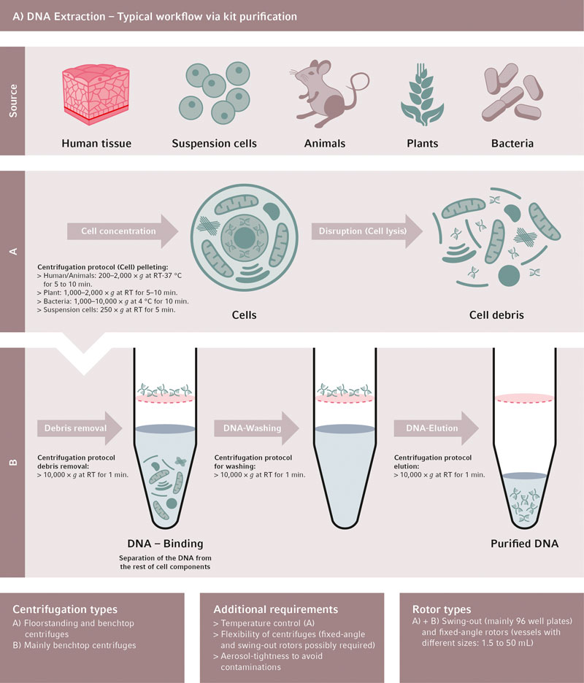

Slide 22
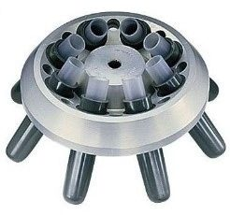
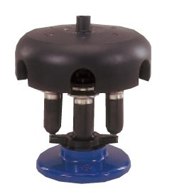
Types
Fixed-angle rotors: The sample tubes are placed in a machined hole in the metal rotor which is at a fixed angle (generally 45⁰), relative to the vertical axis of rotation. This angle remains constant during the centrifugation process and the pellet is obtained against the side-wall of the tube.
Swinging-bucket rotor: The sample tubes are placed in a holder which is suspended from the rotor. When the centripetal force is applied, the holder swings out to become horizontal with the horizontal axis of the rotor and the pellet is obtained at the bottom of the tube.
https://www.youtube.com/watch?v=NqVaMiTI8Uw

Slide 23
Spectrophotometer

Slide 24
What is spectrophotometer?
A spectrophotometer is an instrument that measures the amount of light absorbed by a sample.
Spectrophotometer techniques are mostly used to measure the concentration of solutes in solution by measuring the amount of the light that is absorbed by the solution in a cuvette placed in the spectrophotometer.
Scientist Arnold J. Beckman and his colleagues at the National Technologies Laboratory (NTL) invented the Beckman DU spectrophotometer in 1940.

Slide 25
Principle
The spectrophotometer technique is to measure light intensity as a function of wavelength. It does this by diffracting the light beam into a spectrum of wavelengths, detecting the intensities with a charge-coupled device, and displaying the results as a graph on the detector and then on the display device.
In the spectrophotometer, a prism (or) grating is used to split the incident beam into different wavelengths.
By suitable mechanisms, waves of specific wavelengths can be manipulated to fall on the test solution. The range of the wavelengths of the incident light can be as low as 1 to 2nm.
The spectrophotometer is useful for measuring the absorption spectrum of a compound, that is, the absorption of light by a solution at each wavelength.

Slide 26
Principle

Slide 27
Components
A table and cheap radiant energy source
Materials that can be excited to high energy states by a high voltage electric discharge (or) by electrical heating serve as excellent radiant energy sources.
A monochromator, to break the polychromatic radiation into component wavelength (or) bands of wavelengths.
A monochromator resolves polychromatic radiation into its individual wavelengths and isolates these wavelengths into very narrow bands.

Slide 28
Prisms:
A prism disperses polychromatic light from the source into its constituent wavelengths by virtue of its ability to reflect different wavelengths to a different extent
Two types of Prisms are usually employed in commercial instruments. Namely, 600 cornu quartz prism and 300 Littrow Prism.
Grating:
Gratings are often used in the monochromators of spectrophotometers operating ultraviolet, visible and infrared regions.
Transport vessels (cuvettes), to hold the sample
Samples to be studied in the ultraviolet (or) visible region are usually glasses (or) solutions and are put in cells known as “CUVETTES”.
Cuvettes meant for the visible region are made up of either ordinary glass (or) sometimes Quartz.
A Photosensitive detector and an associated readout system
Most detectors depend on the photoelectric effect. The current is then proportional to the light intensity and therefore a measure of it.
Radiation detectors generate electronic signals which are proportional to the transmitter light.
These signals need to be translated and amplified and recorded by, Ammeters, Potentiometers and Potentiometric recorders.

Slide 29
Applications
Detection of concentration of substances
Detection of impurities
Structure elucidation of organic compounds
Monitoring dissolved oxygen content in freshwater and marine ecosystems
Characterization of proteins
Detection of functional groups
Respiratory gas analysis in hospitals
Molecular weight determination of compounds
The visible and UV spectrophotometer may be used to identify classes of compounds in both the pure state and in biological preparations.
https://www.youtube.com/watch?v=EvDwmgSbnnk

Slide 30
Phase contrast microscope

Slide 31
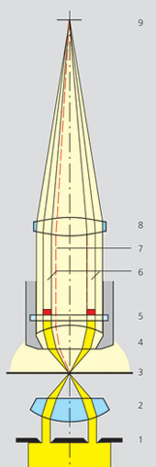
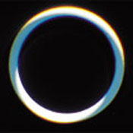
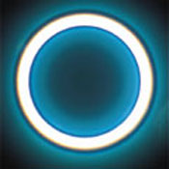
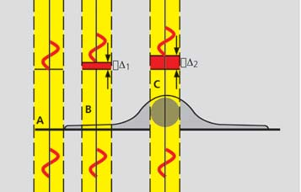
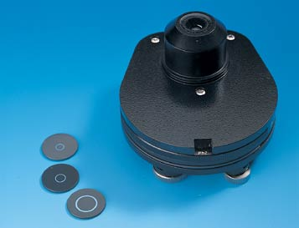
Phase contrast
Principle: Incident light [Io] is out of phase with transmitted light [I] as it was slowed down while passing through different parts of the sample and when the phases of the light are synchronized by an interference lens, a new image with greater contrast is seen.
Phase ring
I0
not aligned
aligned
Phase stops
I
https://www.youtube.com/watch?v=fCZw4X7V5Pw

Slide 32
Phase contrast
Application: Phase contrast is the most commonly used contrasting technique All tissue culture microscopes and the time-lapse microscopes are set up for phase.
brightfield
wrong phase stop
right phase stop

Slide 33
Applications
Determine morphologies of living cells such as plant and animal cells
Studying microbial motility and structures of locomotion
To detect certain microbial elements such as the bacterial endospores

Slide 34
Gel Electrophoresis
Gel electrophoresis is used to characterize one of the most basic properties - molecular mass - of both polynucleotides and polypeptides.
Gel electrophoresis can also be used to determine:
(1) the purity of these samples,
(2) heterogeneity/extent of degradation,
(3) subunit composition.

Slide 35
DNA
The most common gel electrophoresis materials for DNA molecules is agarose and acrylamide.
DNA agarose gels
The electrophoretic migration rate of DNA through agarose gels is dependent upon four main parameters:
1. The molecular size of the DNA. Molecules of linear duplex DNA travel through agarose gels at a rate which is inversely proportional to the log of their molecular weight.

Slide 36
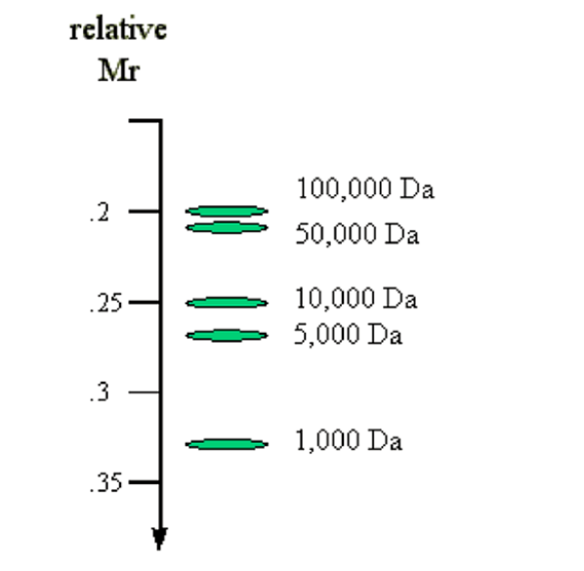

Slide 37
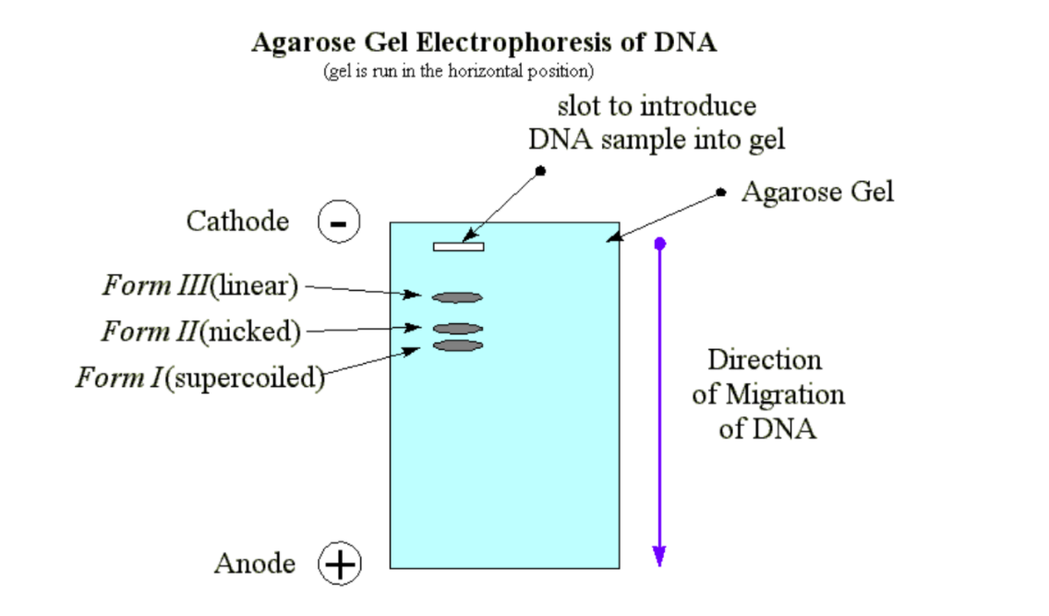
Agarose gels are usually poured and run horizontally
Finally, the DNA being an acidic molecule, migrates towards the positively charged electrode (cathode).

Slide 38
DNA acrylamide Gels
Acrylamide gels are useful for separation of small DNA fragments typically oligonucleotides <100 base pairs. These gels are usually of a low acrylamide concentration (<=6%) and contain the non-ionic denaturing agent Urea (6M). The denaturing agent prevents secondary structure formation in oligonucleotides and allows a relatively accurate determination of molecular mass.

Slide 39
Stains
Ethidium
The most convenient method to visualize DNA in gel electrophoresis is staining with the fluorescent dye ethidium bromide. This compound contains a planar group that intercalates between the stacked bases of DNA. The orientation and proximity of ethidium with the stacked bases causes the dye to display an increased florescence compared to free dye (in solution). U.V. radiation at 254 nm is absorbed by the DNA and transmitted to the bound dye and the energy is re-emitted at 590 nm in the red-orange region of the spectrum.

Slide 40
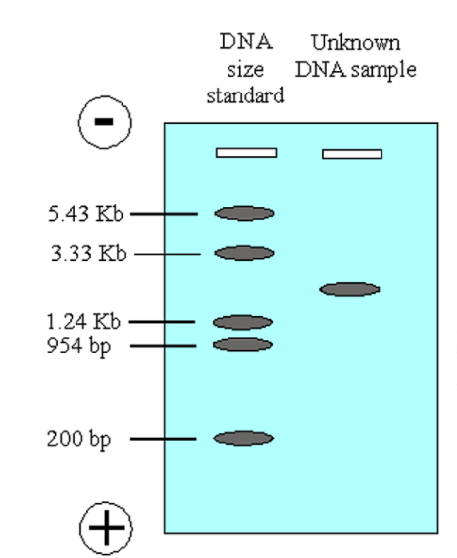
In both DNA and protein gels, molecular weight markers are run in a lane at one end of the gel
https://www.youtube.com/watch?v=vq759wKCCUQ

Slide 41
PCR

Slide 42
What is PCR?
Polymerase chain reaction (PCR) is a common laboratory technique used to make many copies (millions or billions!) of a particular region of DNA. This DNA region can be anything the experimenter is interested in.
DNA amplified by PCR may be sent for sequencing, visualized by gel electrophoresis, or cloned into a plasmid for further experiments.
PCR is used in many areas of biology and medicine, including molecular biology research, medical diagnostics, and even some branches of ecology.

Slide 43
DNA Polymerase
The DNA polymerase typically used in PCR is called Taq polymerase, after the heat-tolerant bacterium from which it was isolated (Thermus aquaticus).
T. aquaticus lives in hot springs and hydrothermal vents. Its DNA polymerase is very heat-stable and is most active around 70 °\text C70°C70, °, start text, C, end text (a temperature at which a human or E. coli DNA polymerase would be nonfunctional). This heat-stability makes Taq polymerase ideal for PCR. As we'll see, high temperature is used repeatedly in PCR to denature the template DNA, or separate its strands.
Like other DNA polymerases, Taq polymerase can only make DNA if it's given a primer, a short sequence of nucleotides that provides a starting point for DNA synthesis.

Slide 44
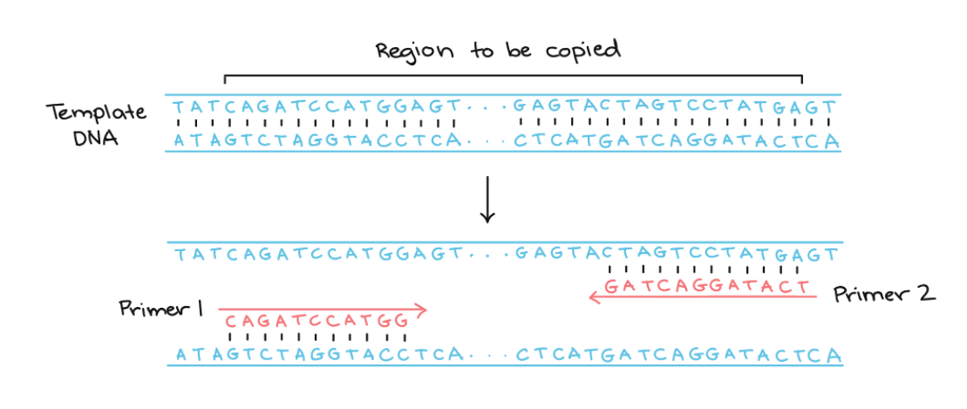
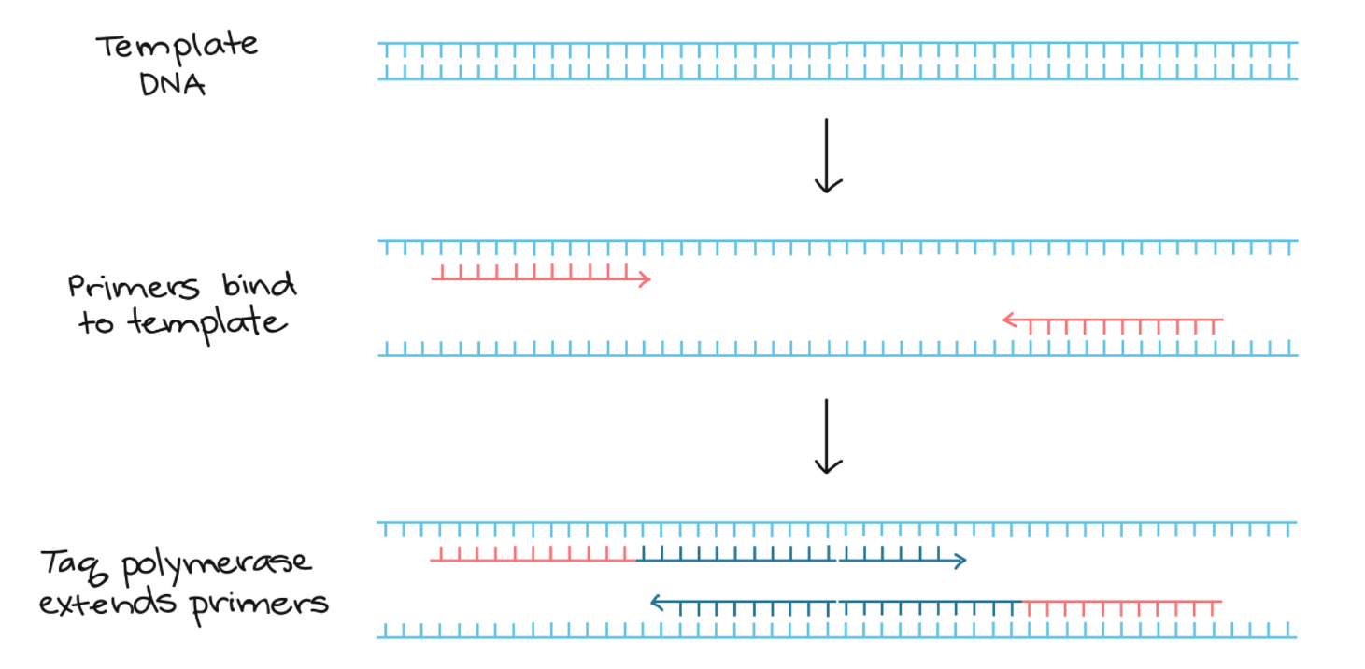

Slide 45
The basic steps are:
Denaturation (96 ° C): Heat the reaction strongly to separate, or denature, the DNA strands. This provides single-stranded template for the next step.
Annealing : Cool the reaction so the primers can bind to their complementary sequences on the single-stranded template DNA.
Extension (72 °C): Raise the reaction temperatures so Taq polymerase extends the primers, synthesizing new strands of DNA.
This cycle repeats 25- 35 times in a typical PCR reaction, which generally takes 2 - 4 hours, depending on the length of the DNA region being copied.
If the reaction is efficient (works well), the target region can go from just one or a few copies to billions.

Slide 46
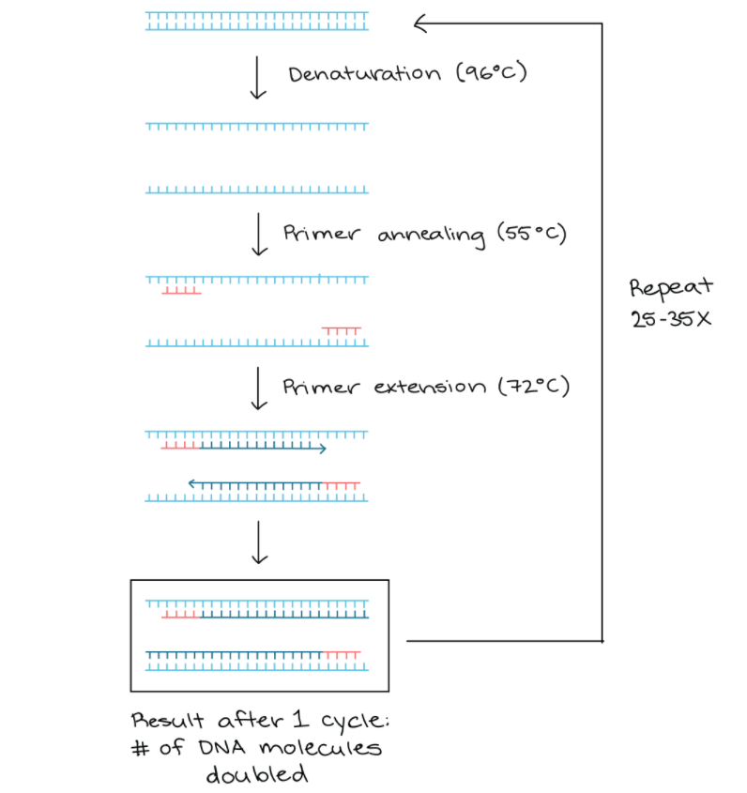

Slide 47
Experiment 1:
https://www.youtube.com/watch?v=tsG2e9gPOqw

Slide 48
Experiment 2. Extraction of chloroplast from given plant leaf sample by differential centrifugation
http://vlab.amrita.edu/?sub=3&brch=187&sim=878&cnt=1

Slide 49
Chromatography

Slide 50
What is Chromatography?
Chromatography is an important biophysical technique that enables the separation, identification, and purification of the components of a mixture for qualitative and quantitative analysis.
The Russian botanist Mikhail Tswett coined the term chromatography in 1906.
The first analytical use of chromatography was described by James and Martin in 1952, for the use of gas chromatography for the analysis of fatty acid mixtures.
A wide range of chromatographic procedures makes use of differences in size, binding affinities, charge, and other properties to separate materials.
It is a powerful separation tool that is used in all branches of science and is often the only means of separating components from complex mixtures.

Slide 51
Chromatography is based on the principle where molecules in mixture applied onto the surface or into the solid, and fluid stationary phase (stable phase) is separating from each other while moving with the aid of a mobile phase.
The factors effective on this separation process include molecular characteristics related to adsorption (liquid-solid), partition (liquid-solid), and affinity or differences among their molecular weights.
Because of these differences, some components of the mixture stay longer in the stationary phase, and they move slowly in the chromatography system, while others pass rapidly into the mobile phase, and leave the system faster.

Slide 52
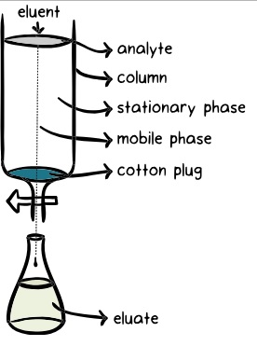

Slide 53
Components of Chromatography
Three components thus form the basis of the chromatography technique.
Stationary phase: This phase is always composed of a “solid” phase or “a layer of a liquid adsorbed on the surface solid support”.
Mobile phase: This phase is always composed of “liquid” or a “gaseous component.”
Separated molecules

Slide 54
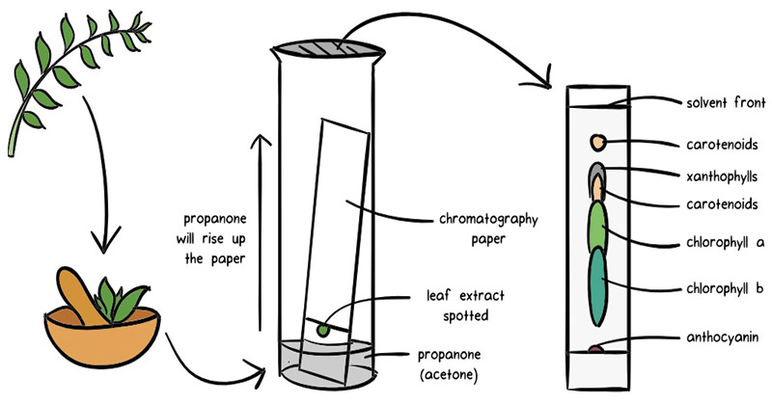
The type of interaction between the stationary phase, mobile phase, and substances contained in the mixture is the basic component effective on the separation of molecules from each other.

Slide 55
Types of Chromatography
Substances can be separated on the basis of a variety of methods and the presence of characteristics such as size and shape, total charge, hydrophobic groups present on the surface, and binding capacity with the stationary phase.
This leads to different types of chromatography techniques, each with their own instrumentation and working principle.
For instance, four separation techniques based on molecular characteristics and interaction type use mechanisms of ion exchange, surface adsorption, partition, and size exclusion.
Other chromatography techniques are based on the stationary bed, including column, thin layer, and paper chromatography.

Slide 56
Application
Pharmaceutical sector
To identify and analyze samples for the presence of trace elements or chemicals.
Separation of compounds based on their molecular weight and element composition.
Detects the unknown compounds and purity of mixture.
In drug development.
Chemical industry
In testing water samples and also checks air quality.
HPLC and GC are very much used for detecting various contaminants such as polychlorinated biphenyl (PCBs) in pesticides and oils.
In various life sciences applications
Food Industry
In food spoilage and additive detection
Determining the nutritional quality of food
Forensic Science
In forensic pathology and crime scene testing like analyzing blood and hair samples of crime place.
Molecular Biology Studies
Various hyphenated techniques in chromatography such as EC-LC-MS are applied in the study of metabolomics and proteomics along with nucleic acid research.
HPLC is used in Protein Separation like Insulin Purification, Plasma Fractionation, and Enzyme Purification and also in various departments like Fuel Industry, biotechnology, and biochemical processes.
https://www.youtube.com/watch?v=mz_xcNrTK_U

