Slide 1
Dehydrogenase Activity

Slide 2
T. Turnberg discovered this group of enzymes.
Dehydrogenases are group of intracellular respiratory enzymes that catalyze oxidation–reduction reactions.
Dehydrogenases transfer two hydrogen atoms from organic compounds to electron acceptors, thereby oxidizing the organic compounds and generating energy.
Dehydrogenases catalyze the oxidation-reduction reaction with the help coenzyme such as NAD⁺/NADP⁺ or flavin such as FAD, FMN as an electron acceptor.
Alcohol dehydrogenase catalyzes the conversion of alcohol to aldehyde/ketone with the reduction of NAD(P)⁺ to NAD(P)H.
These enzymes do not occur in a free form and so represent only the activity of live intact cells.

Slide 3
To demonstrate the enzyme activity of dehydrogenase in given plant
Requirement: Potato tuber
Triphenyl tetrazolium chloride(0.2%)
Methylene Blue (0.12%)

Slide 4
Procedure
Test 1
Potato tuber → peele → Sliced
Put the slices in COLD water and BOILING water
Few drops of TTC
Incubate at 37 degree overnight

Slide 5
Test 2
Slices of Potato placed n COOL and BOILED water
Add few drops of methylene blue
Incubate at 37 degrees overnight

Slide 6
Observations
Test 1
Slices in cold water → Red color (TTC is reduced to Triphenyformazen TF)
This is done by dehydrogenase in sample
Slices of boiled potato don’t show up
Test 2
Methylene blue colour discharges in cold water.
Colour remains same in boiling water

Slide 7
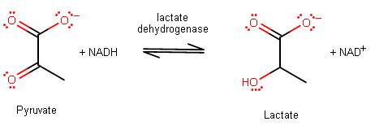
Example
Lactate dehydrogenase (LDH) is actually going to de-hydrogenate (transfer a hydride, H:− from) NADH and transfer the hydride onto pyruvate to transform it into lactate.
It is the last enzyme of the glycolytic sequence or pathway essential for ATP generation.
Lactate is thus the reduced (hydrogenated) form of pyruvate.
https://www.youtube.com/watch?v=hSca4reTrRQ

Slide 8
Lactate dehydrogenase, an oxidoreductase [EC 1.1.1.27] exists in different forms in different tissues possessing different subunits as a multi-enzyme complex called isoenzyme.
Lactate dehydrogenase is a tetrameric enzyme, but only two distinct subunits have been found; those designated H for heart (myocardium) and M for muscle. These two subunits are combined in five different ways. The lactate dehydrogenase isoenzymes, subunit compositions and major locations are shown below.

Slide 9
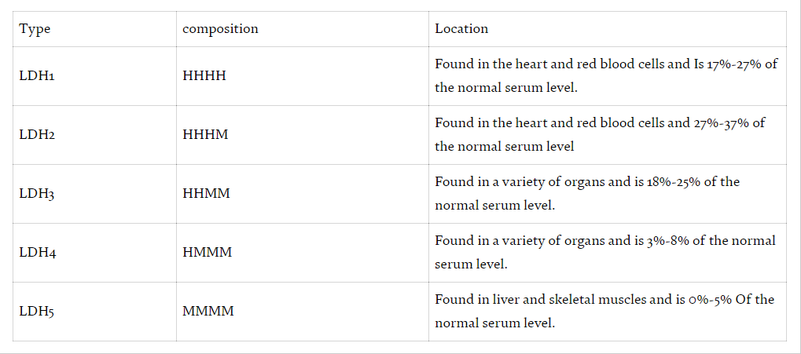
Isoforms of LDH

