Slide 1
Experiment 1
To Demonstrate the enzyme activity of peroxidase in given sample

Slide 2
Peroxidase is an enzyme found in a wide variety of organisms, from plants to humans to bacteria.
Its function is to break down hydrogen peroxide (H2O2), which is one of the toxins produced as a byproduct of using oxygen for respiration.

Slide 3
Difference between Peroxide & Catalase
Peroxidase detoxifies hydrogen peroxide, catalase detoxifies hydroxyl radicals.
Catalase produces oxygen, peroxidase does not.
Co-factors of peroxidase: heme and Histidine

Slide 4
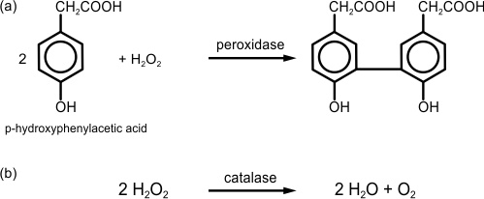
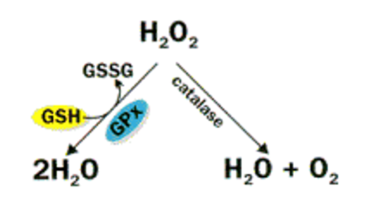

Slide 5
https://study.com/academy/lesson/lab-13-enzyme-activity.html

Slide 6
Peroxidase Assay
https://www.youtube.com/watch?v=ezayzkqZtgk
https://www.youtube.com/watch?v=JBClWls3SUk

Slide 7
Calculation
The enzyme activity can be calculated according to the following equation:
Enzyme activity (Units/L) = (ΔAbs × Total assay volume) / ( Δt x ε x l x Enzyme sample volume).
Abs= Absorbance
ΔAbs = Absorbance of sample – Absorbance of Blank
Δt = Time
ε = extinction coefficient of substrates (concentration of substance dissolved in a given solute and measured at a given wavelength)
l = the cuvette diameter (1cm)

Slide 8
Extinction coefficient refers to several different measures of the absorption of light in a medium: Attenuation coefficient, sometimes called "extinction coefficient" how strongly a substance absorbs light at a given wavelength, per mass density.
The extinction coefficient allows you to determine the remaining amount of substrate after reaching equilibrium.

