Slide 1
Sample preparation in microscopy
Optical Microscopy

Slide 2
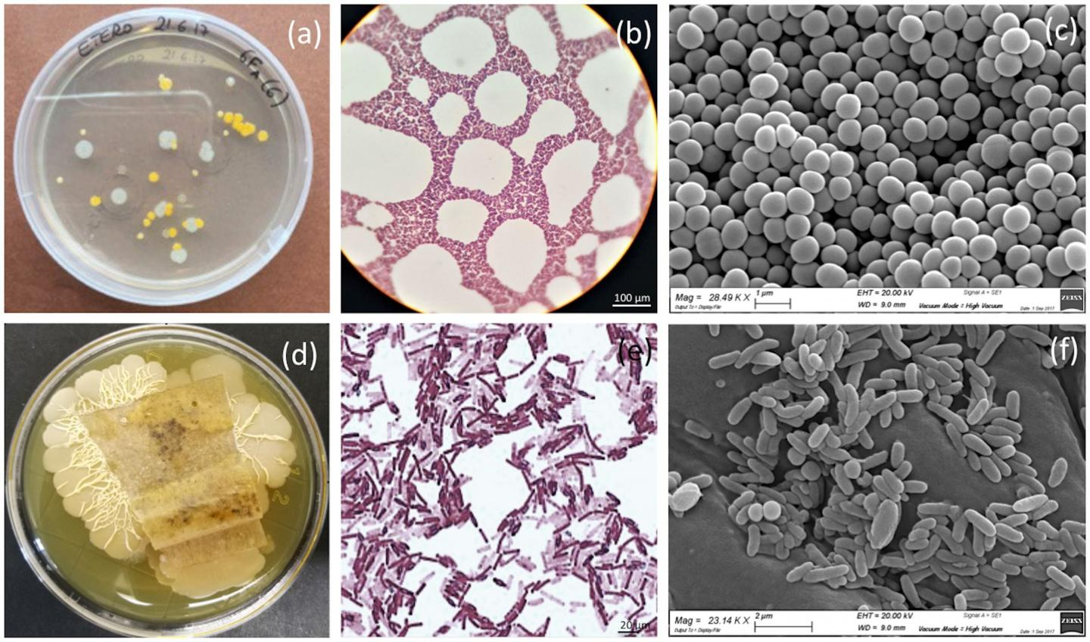
Why sample preparation is needed?
Microorganisms/biological samples are generally transparent, fragile, and highly sensitive to their environments, and for that reason, careful preparation is required to visualize them without significantly perturbing their structure.
First: Immobilize and selectively staining cells or parts of cells.
Second: Visualize the cells by staining.

Slide 3
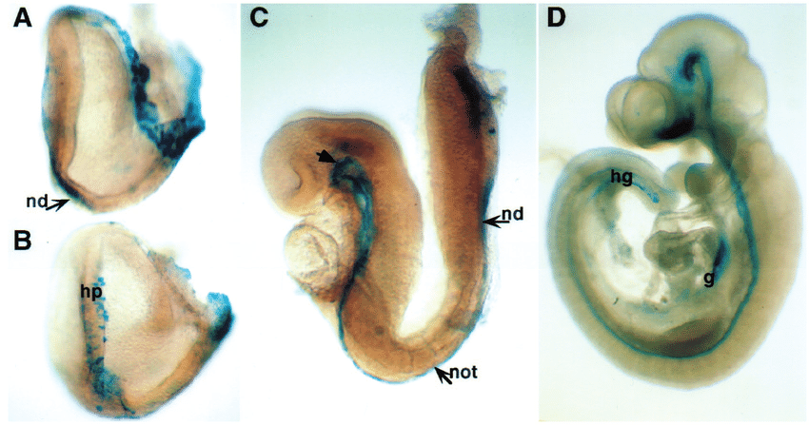
Types of Specimen
Whole-mounts: An entire organism or structure is small enough or thin enough to be placed directly onto a microscope slide (e.g. a small unicellular or multicellular organism or a membrane that can be stretched thinly on to a slide)

Slide 4
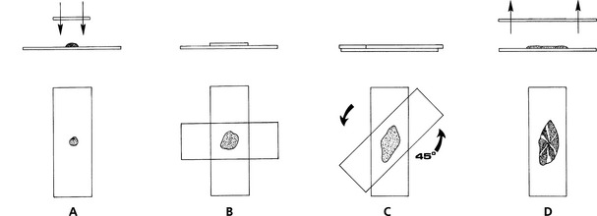
“Squash” preparations: Cells are intentionally squashed or crushed onto a slide to reveal their contents (e.g. botanical specimens where cells are disrupted to reveal chromosomes)

Slide 5
Preparation of Smear
Smearing involves the placement of a small sample of the microorganism on a slide, dispersing it, and then drying and heating it to fix or immobilize the cells onto the slide surface.
The procedure also kills the cells.
Dispersing and drying the cells enhances the uptake of the dye used in staining, while heat fixing is required to prevent cells from being washed off the slide during staining and subsequent rinsing.
A specimen should be of optimal thickness.

Slide 6
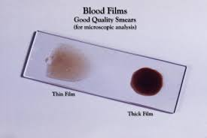
Smears: The specimen consists of cells suspended in a fluid (e.g. blood, semen, cerebro-spinal fluid, or a culture of microorganisms), or where individual cells have been scraped brushed or aspirated (sucked) from a surface or from within an organ (exfoliative cytology).
Smears are the basis of the well-known “Pap test” that is used to screen for cervical cancer in women.

Slide 7
Sections: The specimens are supported in some way so that very thin slices can be cut from them, mounted on slides, and stained. Sections are prepared using an instrument called a “microtome”.

Slide 8
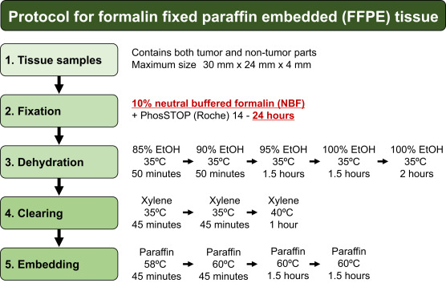
Processing
The specimens are in an aqueous environment to start with (water-based) and must be passed through multiple changes of dehydrating and clearing solvents (typically ethanol and xylene) before they can be placed in molten wax (which is hydrophobic and immiscible with water).
The duration and step details of the “processing schedule” chosen for a particular batch of specimens will depend on the nature and size of the specimens.

Slide 9
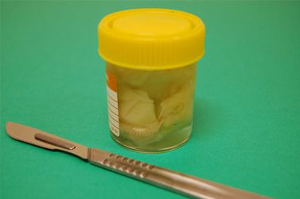
Fixation
Fixation prevent decay and preserve cells and tissues in a “life-like” state.
It does this by stopping enzyme activity, killing microorganisms and hardening the specimen while maintaining sufficient of the molecular structure to enable appropriate staining methods to be applied.
The most popular fixing agent is formaldehyde, usually in the form of a phosphate-buffered solution (often referred to as “formalin”).
Ideally specimens should be fixed by immersion in formalin for six to twelve hours before they are processed.

Slide 10
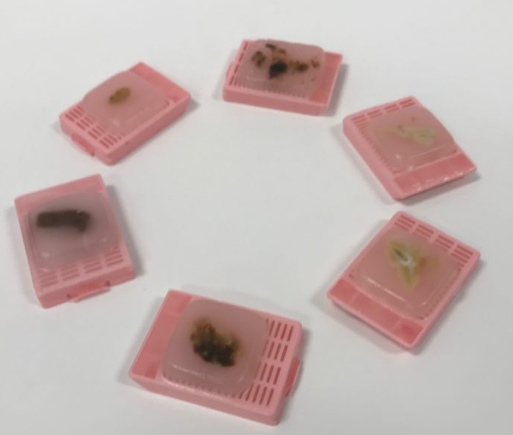
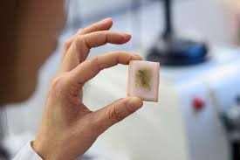
Embedding
The tissue is placed in wax-filled molds.
The cassette, now filled with wax and forming part of the block, provides a stable base for clamping in the microtome.
The block containing the specimen is now ready for section cutting.

Slide 11
Section preparation
Most fresh tissue is very delicate, easily distorted and damaged and it is thus impossible to prepare thin sections (slices) from it unless it is supported in some way whilst it is being cut.
The specimen also needs to be preserved or “fixed” before sections are prepared.
Broadly there are two strategies that can be employed to provide this support:
Microtome
Cryostat

Slide 12
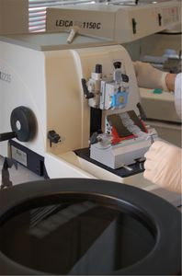
The specimens can be infiltrated with a liquid agent that can subsequently be converted into a solid that has appropriate physical properties that will allow thin sections to be cut from it.
Various agents can be used for infiltrating and supporting specimens including
Epoxy and methacrylate resins
Paraffin waxes for routine light microscopy. This produces so-called “paraffin sections”.
These sections are usually prepared with a “rotary” microtome.

Slide 13
1. The tissue can be rapidly frozen and kept frozen while sections are cut using a cryostat microtome (a microtome in a freezing chamber). These are called “frozen sections”. Frozen sections can be prepared very quickly and are therefore used when an intra-operative diagnosis is required to guide a surgical procedure or where any type of interference with the chemical makeup of the cells is to be avoided (as in some histochemical investigations).

Slide 14
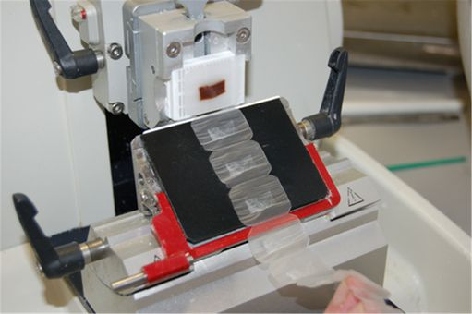
Sectioning
Sections are cut on a precision instrument called a “microtome” using extremely fine steel blades.
Paraffin sections are usually cut at a thickness of 3 - 5µm ensuring that only a single layer of cells makes up the section (a red blood cell has a diameter of about 7µm).
One of the advantages of paraffin wax as an embedding agent is that as sections are cut they will stick together edge-to-edge, forming a “ribbon” of sections. This makes handling easier.
Sections are now “floated out” on the surface of warm water in a flotation bath to flatten them and then picked up onto microscope slides. After thorough drying they are ready for staining.

Slide 15
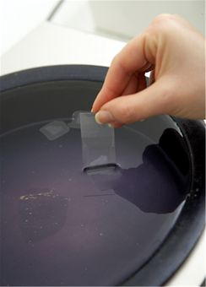
https://www.youtube.com/watch?v=7-LIbAWPc-g

Slide 16
Staining
Staining can be very helpful in visualizing transparent organisms like microorganisms and their internal structures.
Staining involves adding a single dye, or sequence of dyes, which selectively attach to parts of the cell either chemically (like an acid-base reaction), or through physical processes (by being trapped inside the cell, for example).
The routine stain used universally as a starting point in providing essential structural information, is the hematoxylin and eosin (H&E) stain. With this method cell nuclei are stained blue and cytoplasm and many extra-cellular components in shades of pink.
Staining can also be used as a tool to identify unknown organisms based on their reactions to staining procedures. The Gram stain, probably the most important type of staining known in microbiology, is an example of this and will be described in detail below.

Slide 17
Simple Staining
This is useful for simply visualizing cells, to determine characteristics like size, shape, and count.
Most cells acquire a negative charge so take up a basic stains which are positive at neutral pH. Positive stain that selectively attaches to the cell surface.
Examples of stains that can be used for this technique include crystal violet, safranin, and methylene blue.

Slide 18
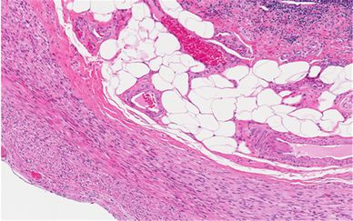

Slide 19
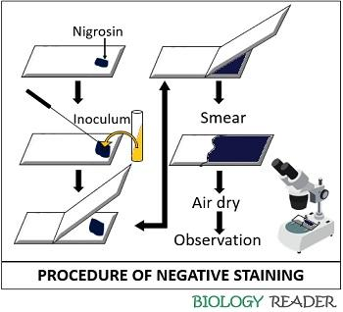
Negative Staining
These stains are acidic, and therefore become negatively charged at a neutral pH.
Instead of staining the cells, they are repelled from the cells and attach and stain the rest of the specimen. When using a negative stain, cells appear bright on a dark background.
Nigrosin is a stain that can be used in this way.

Slide 20
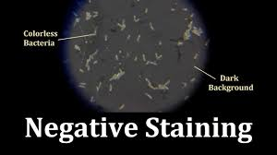

Slide 21
Acid-fast staining
Acid-fast staining is adapted for organisms with nonpolar and impenetrable cell walls.
Examples of such organisms are members of the genus Mycobacterium.
The thickness and waxy nature of the cell walls of these organisms make it difficult to stain using the standard Gram technique.
In this procedure, the specimen is first exposed to carbol fuchsin and heated (or alternatively, exposed to a lipid solubilizer). This stains the cell.
In the second step, the specimen is exposed to an acid-alcohol solution.
Only cells with a sufficiently impenetrable cell wall will retain the dye in this step, and these cells are said to be acid fast.
A second counter-stain can then be used to re-stain the decolorized organisms, similar to the Gram staining procedure.

Slide 22
Gram Staining
Gram staining is multi-step technique, but is a powerful method for classifying bacteria.
The technique involves exposing the cells to a primary stain, crystal violet, then exposing them to an iodine solution, which forms a complex with the stain. All cells will take up crystal violet and form this complex.
Next, the specimen is exposed to a decolorizer, which is either ethanol, or a mixture of acetone and ethanol.
In some cells, called ‘gram negative’ cells, the decolorizer will dissolve the stain-iodine complex and carry it out of the cell.
In ‘gram positive’ cells, the complex cannot pass back through the cell wall, and is trapped inside the cell.
Finally, a second stain is added to re-stain the gram negative cells, typically safranin or carbol fuchsin.
The second stain will also enter gram-positive cells, but it is lighter in color so the staining in those cells is dominated by the darker purple crystal violet-iodine complex.
Gram staining classifies cells based on the reaction of the cell walls to the decolorizing solvent. Gram positive cells, which show up purple, have a high concentration of sugar-protein complexes in their cell walls, while gram negative cells, which show up pink or red, have a low concentration of these complexes.
Prepare light, thin films

Slide 23
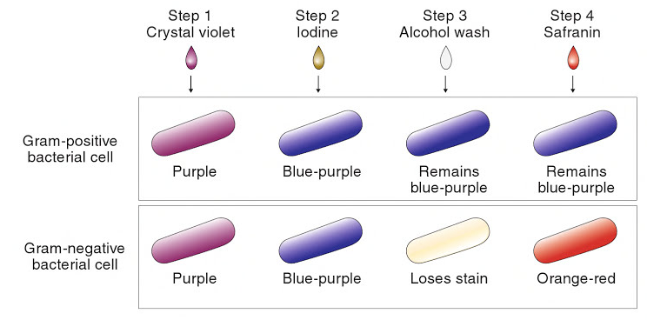

Slide 24
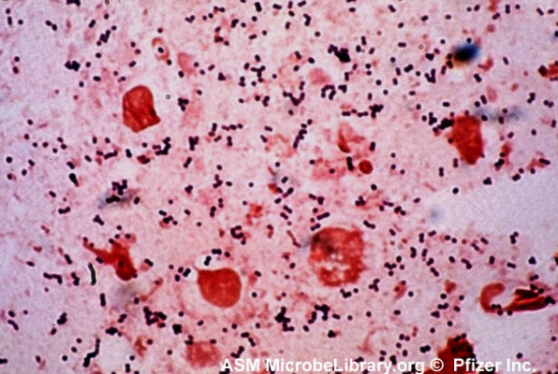
https://www.youtube.com/watch?v=_s0KgMcB8xg

Slide 25
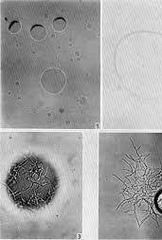
The hanging drop technique
The smear / stain technique kills and immobilizes the microorganisms, which prevents analysis of motility and other related properties.
By using so called “wet mount” techniques, the microorganisms can be kept in a liquid environment in which they are alive during analysis.
The simplest type of wet mount method is to place a drop of liquid containing the microorganism onto a slide, then gently placing a coverslip over the drop.
In this method, a liquid droplet with the microorganism is hanging down below the coverslip, with the sample sealed from atmosphere using a ring of wax or petroleum jelly.

Slide 26
