Slide 1


THE BALANCED SCORECARD
APPROACH
Powerpoint Templates
Powerpoint Templates _{Page 1}

Slide 2

WHAT IS BALANCED SCORECARD?
The Balanced Scorecard is a strategic planning and management system used to align business activites to the vision and strategy of the organization by monitoring perfomance against strategic goals
Powerpoint Templates

Slide 3
BALANCED SCORECARD Concept
❑ It was publishes in 1992 by kaplan and Norton, a book followed in 1996
❑
Traditional performance measurement
that only focus on external accounting data are obsolete
❑ The approach is to provide ‘balance’ to the finacial persperctive.
Powerpoint Templates

Slide 4
Why use a Balance Scorecard?
Improve organisational performance by measuring what matters
Increase focus on strategy and results
Align organization strategy with workers on a day-to-day basis
Focus on drivers key to future performance
Improve communication of the organization’s Vision and Strategy
Powerpoint Templates

Slide 5
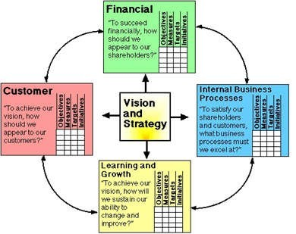
4 Original Business Perspectives
The Balanced Scorecard model suggest that we view the organization from 4 perspective
Then Develop metrics, collect data and analyze it relative to each of these perspectives
Powerpoint Templates

Slide 6
4 Business Perspective Question
Financial
❑ What must we do to create sustainable economic value?
Internal Business Process
❑ To satisfy our stakeholders what must be our levels of productivity, efficiency, and quality?
Learning and Growth
❑ How does our employee performance management system, including feedback to employees, support height performance?
Customer
❑ What do our Customer require from s and how are we doing according to those requirements
Powerpoint Templates

Slide 7
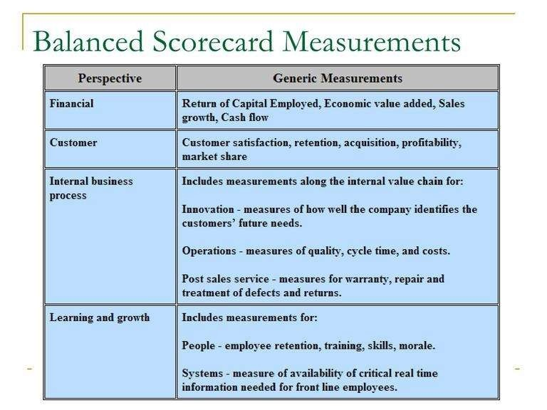
Powerpoint Templates

Slide 8
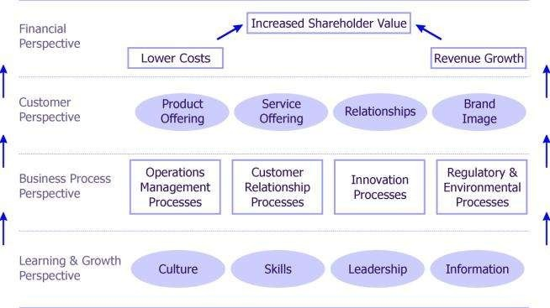
Balanced Scorecard Strategy Map
Powerpoint Templates

