Slide 1
SIX SIGMA

Slide 2
Six Sigma methodology is the implementation of a measurement based strategy that focuses on process improvement and variation reduction through the application of Six Sigma improvement projects.
Both Six Sigma processes are executed by Six Sigma Green Belts and Six Sigma Black Belts, and are overseen by Six Sigma Master Black Belts.

Slide 3
Master Black Belts, identified by champions, act as in-house coaches on Six Sigma. They devote 100% of their time to Six Sigma. They assist champions and guide Black Belts and Green Belts. Apart from statistical tasks, they spend their time on ensuring consistent application of Six Sigma across various functions and departments.

Slide 4
• Black Belts operate under Master Black Belts to apply Six Sigma methodology to specific projects.
They devote 100% of their time to Six Sigma. They primarily focus on Six Sigma project execution, whereas Champions and Master Black Belts focus on identifying projects/functions for Six Sigma.

Slide 5
Green Belts are the employees who take up Six Sigma implementation along with their other job responsibilities, operating under the guidance of Black Belts.

Slide 6
This is accomplished through the use of two Six Sigma sub methodologies:
DMAIC and
DMADV.

Slide 7
The Six Sigma DMAIC process is an improvement system for existing processes falling below specification and looking for incremental improvement.
define,
measure,
analyze,
improve,
control)

Slide 8
The Six Sigma DMADV process is an improvement system used to develop new processes or products at Six Sigma quality levels. It can also be employed if a current process requires more than just incremental improvement.
define,
measure,
analyze,
design,
verify

Slide 9
How to apply sigma
First we should start with what a Sigma is. A “1-Sigma” is one standard deviation from the norm (norm is also called mean or average). When plotted against a normal distribution, a “bell-shaped curve” it shows how much variance a particular data item is from the average.

Slide 10
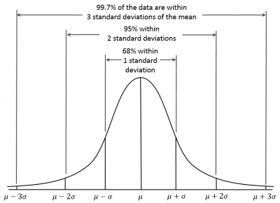
.

Slide 11
The 68-95-99.7 rule is another way of looking at variation. In a normal distribution, it is postulated that things that are true 68% of the time are considered 1-Sigma events. Things that are true 95% of the time are considered 2-Sigma events and the three-Sigma rule implies that heuristically nearly all values lie within three standard deviations of the mean (3-Sigma).

Slide 12
Companies like Motorola (1986) and General Electric (1995) used the term as a quality initiative. The initiative is widely known through it’s banner slogan “Defects Per Million Opportunities (DPMO)”.
The Six Sigma quality initiative has a goal of not producing more than 3.4 defects per million opportunities.

