Slide 1

Plan Do Check Action and OLAP

Slide 2
Meaning
Plan Do Check Action is the action of defining, gathering, analyzing, and distributing intelligence about products, customers, competitors and any aspect of the environment needed to support executives and managers in making strategic decisions for an organization.

Slide 3
Key points
1. Plan Do Check Action is an ethical and legal business practice, as opposed to industrial espionage which is illegal.
2. The focus is on the external business environment.
3. There is a process involved in gathering information, converting it into intelligence and then utilizing this in business decision making. Some CI professionals erroneously emphasize that if the intelligence gathered is not usable (or actionable) then it is not intelligence.

Slide 4
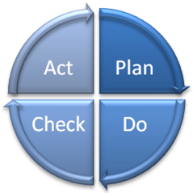
The cycle of PDCA

Slide 5
The cycle of PDCA
It has the following four stages (Often called the Deming cycle as Ed Deming promoted this cycle everywhere):
Plan: identify what can be improved and what change is needed
Do: implement the design change
Check/ Study: measure and analyze the process or outcome
Act: if the results are not as hoped for

Slide 6
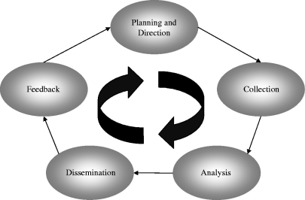
5 elements of PDCA

Slide 7
5 elements of PDCA
There are slightly different versions out there, but they all seem to embody the same five elements:
planning and direction,
collection,
analysis,
dissemination and
feedback

Slide 8
Benefits of Plan Do Check Action
Source for best practices – the only real way to isolate and find “best practices” is to engage in some form of competitive intelligence; otherwise you end up relying on crude and generic type benchmarking data.
Helps formulate strategy through an understanding of industry, company, and competitors.
Plan Do Check Action is the essence of strategic business analysis.
Helps identify areas for improvement as well as risks and opportunities.
Isolates performance gaps in relation to the competition.

Slide 9
Objectives of Plan Do Check Action
i. To provide an early warning of opportunities and threats, such as new acquisitions or alliances and future competitive products and services;
ii. To ensure greater management awareness of changes among competitors, making the organization better able to adapt and respond appropriately;
iii. To ensure that the strategic planning decisions are based on relevant and timely competitive intelligence; and
iv. To provide a systematic audit of the organization’s competitiveness that gives the CEO an unfiltered and unbiased assessment of the firm’s relative position.

Slide 10
On-Line Analytical Processing (OLAP)

Slide 11
On-Line Analytical Processing
On-Line Analytical Processing (OLAP) is a category of software technology that enables analysts, managers and executives to gain insight into data through fast, consistent, interactive access to a wide variety of possible views of information that has been transformed from raw data to reflect the real dimensionality of the enterprise as understood by the user.

Slide 12
TYPES
Multidimensional
Relational
Hybrid

Slide 13
Multidimensional
MOLAP is a “multi-dimensional online analytical processing”.’MOLAP’ is the ‘classic’ form of OLAP and is sometimes referred to as just OLAP. MOLAP stores this data in an optimized multi-dimensional array storage, rather than in a relational database. Therefore it requires the pre-computation and storage of information in the cube - the operation known as processing.

Slide 14
Relational
ROLAP works directly with relational databases. The base data and the dimension tables are stored as relational tables and new tables are created to hold the aggregated information.

Slide 15
Hybrid
There is no clear agreement across the industry as to what constitutes “Hybrid OLAP”, except that a database will divide data between relational and specialized storage. For example, for some vendors, a HOLAP database will use relational tables to hold the larger quantities of detailed data, and use specialized storage for at least some aspects of the smaller quantities of more-aggregate or less detailed data.

