Slide 1
Plant Anatomy
Presented By
Garima Yadav
Research Scholar
Mohanlal Sukhadia University, Udaipur Department Of Botany

Slide 2
Necessary Instruments
Forceps,
Dissecting needles,
Glass droppers,
Good and sharp razor,
Safety blade,
A fine hair brush
Dissecting microscope,
Compound microscope
Slides
Cover glasses
Watch glasses, Petri dishes
Fast green( soft tissues)
Safranin( hard tissues)

Slide 3
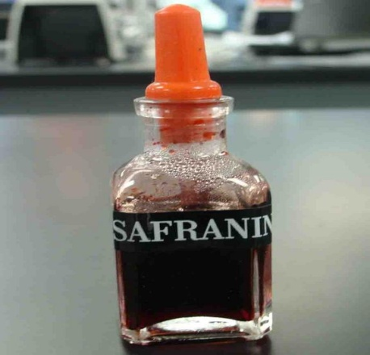
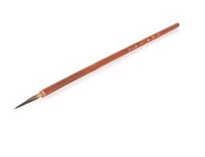
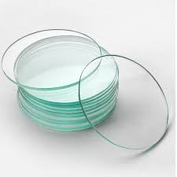
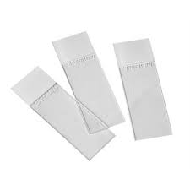
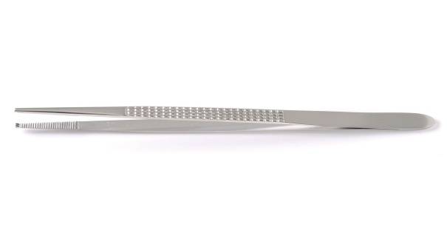
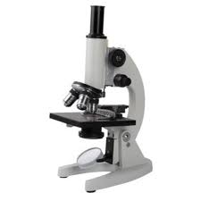
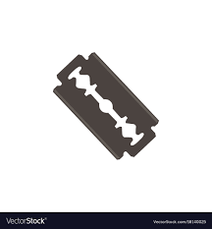
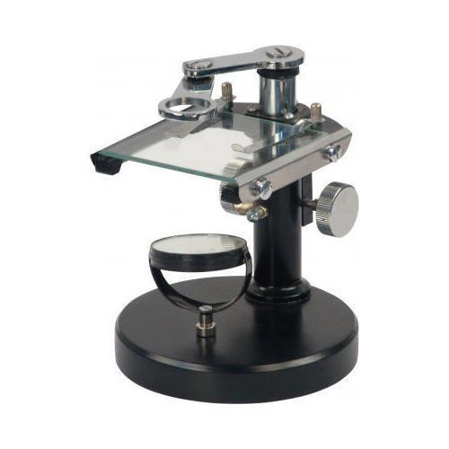
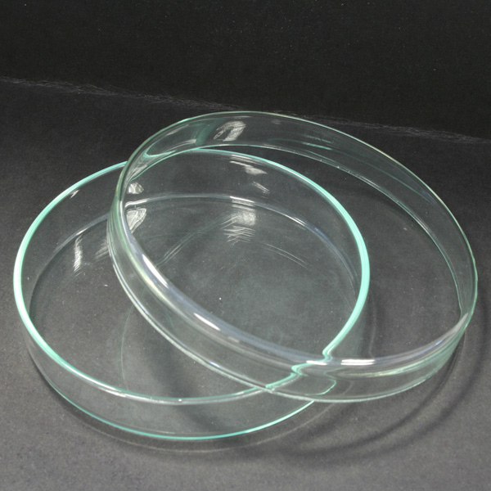

Slide 4
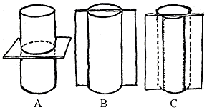
Section cutting
Transverse
Longitudinal
(I) Radial Longitudinal section (R.L.s)
(ii) Tangential Longitudinal section (T.L.s.)

Slide 5
Slide Preparation
Section cutting
Transfer the section into watch
glass containing safranin
Wash with water and stain with fast green
Transfer the section into
watch glass containing water
Mount with glycerin drop on slide and cover with cover slip and observe under microscope

Slide 6
Plant Anatomy
Three fundamental organs of plant are - stem, root and leaves. All these organs are made of tissue systems.
The tissues constituting the tissue system are derived from meristematic tissues. These are situated only at a few places called meristems.
The tissues are classified into two major groups simple tissues and the complex tissues.
The simple tissues are made of only one type cells. These include parenchyma, sclerenchyma, collenchyma, etc.
The complex tissues are made of more than one type of cells. Complex tissues include xylem and phloem. The xylem consists of cell types such as tracheids, vessels, xylem fibers and xylem parenchyma. The phloem is composed of sieve cells
, companion cells, phloem_ fibers and phloem parenchyma.

Slide 7
Plant Anatomy
Groups of some of these different types of tissues together perform a common function and are called tissue system.
There are three tissue systems epidermal tissue system, ground or fundamental tissue system and vascular tissue system.
Tissue is a group of cells which may be similar or (simple tissue) or dissimilar in character (complex tissue) and is specialized for a particular function.
Characteristics functions and distribution of some of these plant tissues are given in the following table.

Slide 8
Tissue | Living or dead | WaIl material | Cell Shape | Main functions | Distribution
Parenchyma | Living | Cellulose, pectins and hemicelluloses | Usually isodiamet-ric, sometime-s elongated | Packing tissue. Supporting herbaceous plants ,Metabolically active. Intercellular air spaces allow gaseous exchange. Food storage. Transport of materials through cells or cell walls. | Cortex, pith, medullary rays and packing tissue in xylem and phloem.

Slide 9
2. Modified parenchyma
(a) Epidermis | Living | Cellulose, pectins and hemicelluloses, and covering of cutin | Elongated and flattened | Protection from desiccation and infection. Hairs and glands may have additional functions. | Single layer of cells covering entire primary plant body.
(b) Mesophyll | Living | Cellulose, pectins and hemicelluloses | Isodiametric chlorenchyma, irregular or column shaped depending on location | Photosynthesis (contains chloroplasts). Storage of starch. | Between upper and lower epidermis of leaves.

Slide 10
(e) Endodermis | Living | Cellulose, pectins and hemicelluloses, and deposits of suberin (Casparian strips) | As epidermis | Selective barrier to movement of water and mineral salts (between cortex and xylem) in roots. Starch sheath with possible role in geotropic response in stems. | Around vascular tissue. (innermost layer of cortex)
(d) Pericycle | Living | Cellulose, pectins and hemicellulose-s | As parenchyma | In roots, it retains meristematic activity producing lateral roots and contributing to secondary growth if this occurs. | In roots between central vascular tissue and endodermis.

Slide 11
3.Collenchyma | Living | Cellulose, pectins and hemicelluloses | Elongated and polygonal with tapering ends | Support (a mechanical function). | Outer regions of cortex, e.g. angles of stems, midrib of leaves.
4. Sclerenchyma Fibers Selereids | Dead | Mainly lignin. Cellulose pectins and hemi-celluloses also present. | Elongated and polygonal with tapering interlocking ends. | Support (purely mechanical). | Outer regions of cortex, pericyc1e of stems, xylem and phloem
 | Dead | As fibers | Roughly isodiametric, though variations occur | Support or mechanical protection | Cortex, pith, phloem, shells and stones of fruits, seed coats.

Slide 12
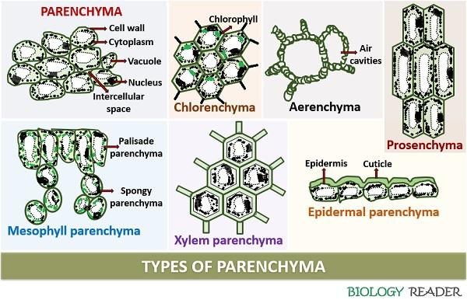

Slide 13
5. Xylem. Mixture of living and dead cells. Xylem also contains fibers and parenchyma
Tracheids Vessels. | Dead | Mainly lignin. Cellulose, pectins and hemicellul-oses also present. | Elongated and tubular | Translocat-ion of water and mineral salts. Support. | Vascular system
 | Dead | Mainly lignin. Cellulose, pectins and hemicelluloses also present. | Elongated but broad and cylindrical | Translocation of water and mineral salts. Support. | Vascular system

Slide 14
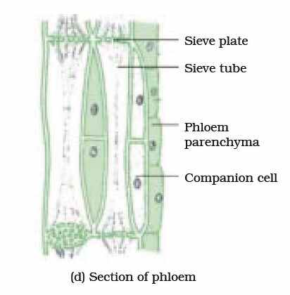
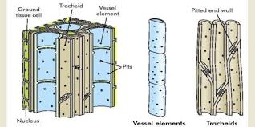

Slide 15
5. Phloem. Mixture of living and dead cells.
(a) Sieve tubes. (b) Companion cells | Living | Cellulose, pectins and hemicell-uloses. | Elongate-d and tubular | Translocation of organic solutes (food) | Vascular system
 | Living | Cellulose, pectins and hemicell-uloses. | Elongate-d and narrow | Work in association with sieve tubes | Vascular system

Slide 16
Comparison between Stem and Root
Characters | Stems | Roots
1. Endodermis | Mayor may not be present. | Always very clearly marked
2. Vascular bundles | Conjoint, collateral and endarch. | Radial and exarch.

Slide 17
Comparison between Stems of Dicotyledonous and Moncotyledonous Plants
Characters | Dicotyledons | Monocotyledons
1. Hypodermis | May or may not be present, if present mostly collenchymatous | Generally present, sclerenchymatous.
2. Cortex | A few layers of parenchyma extend up to the endodermis
3. Endodermis | Generally absent; mostly represented by endodermoid cells; If present, in the form of a ring | The cells following hypodermis are not differentiated. They are generally parenchymatous and extend from hypodermis up to the centre of the axis. It is known as ground tissue.

Slide 18
4. Pericycle | Present between the vascular tissue and cortex; either parenchymatous or sclerenchymatous, one to few layered.
s. Medullary ray | A strip of parenchyma between the vascular bundles.
6. Pith | A central and well marked out cylinder present; parenchymatous or sclerenchymatous | Well marked pith can not be distinguished
7. Vascular bundles | (a) Conjoint, collaterall bicollateral endarch, open. (b) Arranged in a ring. (c) Almost all of them are uniform In size. (d) Phloem parenchyma present. (e) Bundle sheath absent. | (a) Conjoint, collateral, endarch and closed. (b) Scattered throughout ground tissue. (c) Larger toward the centre and Smaller outside. (d) Phloem parenchyma absent. (e) Well developed bundle sheath present.

Slide 19
Comparison between Roots of Dicotyledons and Monocotyledons
Characters | Dicotyledons | Monocotyledons
1. Vascular bundles | There are about 2-6 protoxylem groups (i.e. condition is diarch to hexarch); rarely more groups. | The number of protoxylem groups generally exceeds 2-6, therefore, the condition is polyarch; rarely only a few.
2. Pericycle | It generally gives rise to lateral roots, vascular cambium and cork cambium. | Only lateral roots are produced.
3. Cambium | It appears later to form a complete ring between the xylem and phloem groups. | It is altogether absent.
4. Pith | Small or absent. | Large and well developed.

Slide 20
Primary Growth In Plants
Primary growth is growth that occurs as a result of cell division at shoot apical meristem and root apical meristem, causing them to elongate, and gives rise to primary tissue.

Slide 21
Secondary growth in plants
In dicotyledons, the stem and the root both grow once again after the plant acquires primary structure. This growth is known as secondary growth. ,It occurs due to the activity of a secondary meristem or two lateral meristems-
The vascular cambium and the phellogen or cork cambium.
Vascular cambium forms secondary xylem and secondary phloem.
Phellogen originates in the extrastelar region and forms periderm.
The plants become woody and the girth increases. The tissues added by the vascular cambium are secondary xylem (wood) and secondary phloem
Many dicotyledons and monocotyledons, however show the different type of growth from the normal type described above, termed as anomalous or abnormal growth.

Slide 22
Primary anomalous growth
Scattered vascular bundles in dicotyledons
Vascular bundles arranged in rings in monocotyledons.
Cortical bundles.
Medullary bundles
Intraxylary or internal phloem.
Separate xylem and phloem bundle.
Absence of vessels in xylem.
Ploystelic condition.

Slide 23
Secondary anomalous growth
Abnormal behavior of normal cambium.
Abnormal behavior of abnormal cambium.
Formation of accessory cambial rings.
Formation of interxylary phloem.

Slide 24
Boerhaavia
Outline appears almost circular in transverse section.
Epidermis. 1. It is an outermost single layer of cells.
2. The outer face has thick cuticle.
Cortex. 1. It is many layers deep. The region is differentiated into outer collenchymas and inner parenchyma.
2. Collenchymas follows epidermis. It is three to five cells deep. The walls the neighboring cells are thickened.
3. Parenchyma follows the zone of collenchymas. It forms rest of the cortex. It contains numerous chloroplasts. Intercellular spaces are present.
Endodermis and pericycle. These layers are indistinct.
Vascular tissue system. 1. There' are many vascular bundles which are arranged in rings. A zone of secondary tissues is also very distinct.

Slide 25
2. The outermost ring has many bundles. Due to secondary growth, phloem occurs in the form of crushed and obliterated patches. Abundant prosenchyma (conjunctive tissue) is present. Secondary phloem forms a complete ring. Cambium that follows separates phloem and xylem. The primary xylem groups are situated close to the pith. Protoxylem is endarch and the vascular bundles are conjoint, collateral, endarch and open.
3. The innermost ring consists of two vascular bundles. Each bundle is conjoint, collateral, endarch and open. The bundles lie close to the pith, and are, therefore, known as medullary bundles. These bundles produce a small amount of secondary phloem and secondary xylem in radial rows.
4. The middle ring consists of six or seven (upto fourteen) bundles. These bundles are smaller than those of the inner ring. Each bundle is conjoint, collateral, endarch and open. Pith. In the centre a small parenchymatous pith is present.

Slide 26
Identification
1. Stem. Vascular bundles conjoint, collateral and open.
2. Dicotyledonous stem-
1. Cortex well differentiated.
2. Presence of secondary growth.
3. Vascular bundles in a ring.

Slide 27
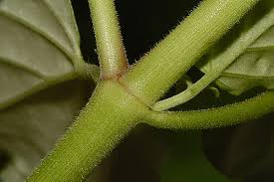
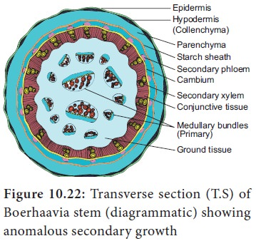

Slide 29
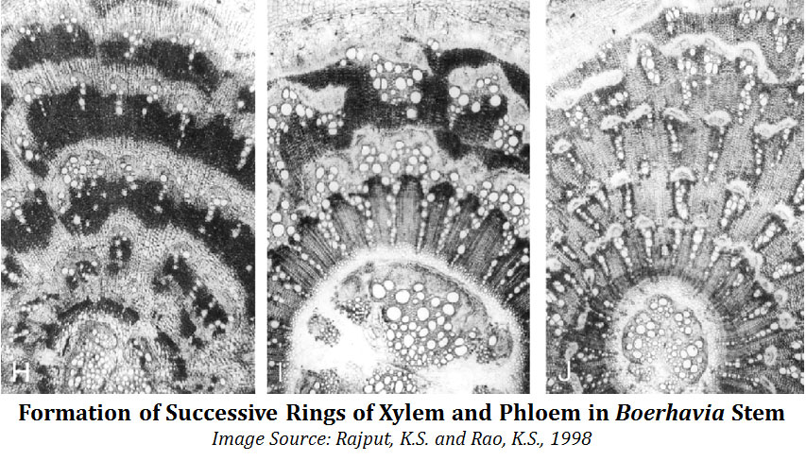
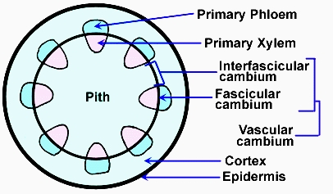

Slide 30
1. Medullary bundles. The vascular bundles are arranged in three rings. Out of these, two inner rings occur in the pith and are, therefore, known as medullary bundles. The medullary bundles possess fascicular (intrafascicular) cambium and produce a little amount of secondary tissues.
2. Abnormal secondary growth. In Boerhaavia, vascular bundles of the outermost ring have fascicular cambium. Later, interfascicular cambium also develops, thus forming a complete ring. The cambial ring produces secondary xylem and secondary phloem. However, this cambial ring soon stops functioning. A new ring (accessory cambium) appears later in the region of the pericycle. This ring of cambium, also, as in earlier cases functions only for some time. Such many (upto twenty two) accessory cambia are produced successively, much farther away into the cortex every time. This results in the formation of successive alternate zones of secondary xylem and secondary phloem. These rings or zones (of secondary tissues) are sometimes eccentrically developed. Cambia produce a very large amount of prosenchyma into which xylem remains scattered and at times becomes indistinguishable from it.

Slide 31
Thank You

