Slide 1
Plant Anatomy
Presented By
Garima Yadav
Research Scholar
Mohanlal Sukhadia University, Udaipur Department Of Botany

Slide 2
Triticum (Wheat)
The outline of the transverse section is almost circular. There is a large cavity in the centre.
Epidermis.
1. It is an outermost single layer of rectangular cells.
2. The cells of the epidermis are thickly cuticularised.
3. A few stomata are present which lead into a sub-stomatal cavity below.
Ground tissue.
1. All the tissues inside the epidermis form ground tissue. It covers most of the section.
2. A few celled deep sclerenchymatous zone occurs just below the epidermis. It is interrupted at regular intervals by patches of chlorenchyma.
3. The patches of chlorenchyma are bounded by sclerenchyma on their sides and lower faces.
4. The stomata open only in this region of chlorenchyma.
5. The rest of the tissue is thin walled parenchyma with many intercellular spaces.

Slide 3
Vascular tissue system.
1. Vascular tissue system is represented by numerous vascular bundles. These are arranged in two series.
2. The bundles of the peripheral series are smaller than the bundles of the inner series.
3. The bundles of the peripheral series are mostly embedded in the sclerenchymatous patch situated below the epidermis.
4. Vascular bundles are conjoint, collateral, endarch and closed.
5. Each vascular bundle is almost completely enclosed by a band of sclerenchyma. Bundle sheath is prominent at the upper and the lower extremities of the vascular bundle.
6 The xylem elements are arranged in almost Y-shaped organisation which occupies the lower region of the vascular bundle.
7. Metaxylem elements are large and the smaller protoxylem elements are situated near the inner face of the vascular bundle.
8. The phloem occurs in the peripheral region of the bundle. It consists of sieve tubes and companion cells.
9. There is a hollow cylinder in the centre of the axis.

Slide 4
Identification
Stem.
1. Vascular bundles are conjoint, collateral and endarch.
2. Stomata are present in the epidermis.
Monocotyledonous stem.
1. Endodermis and pericycle are absent.
2. Vascular bundles are numerous and closed (cambium absent).
3. Bundle sheath is prominent.
4. Ground tissue is present.

Slide 5
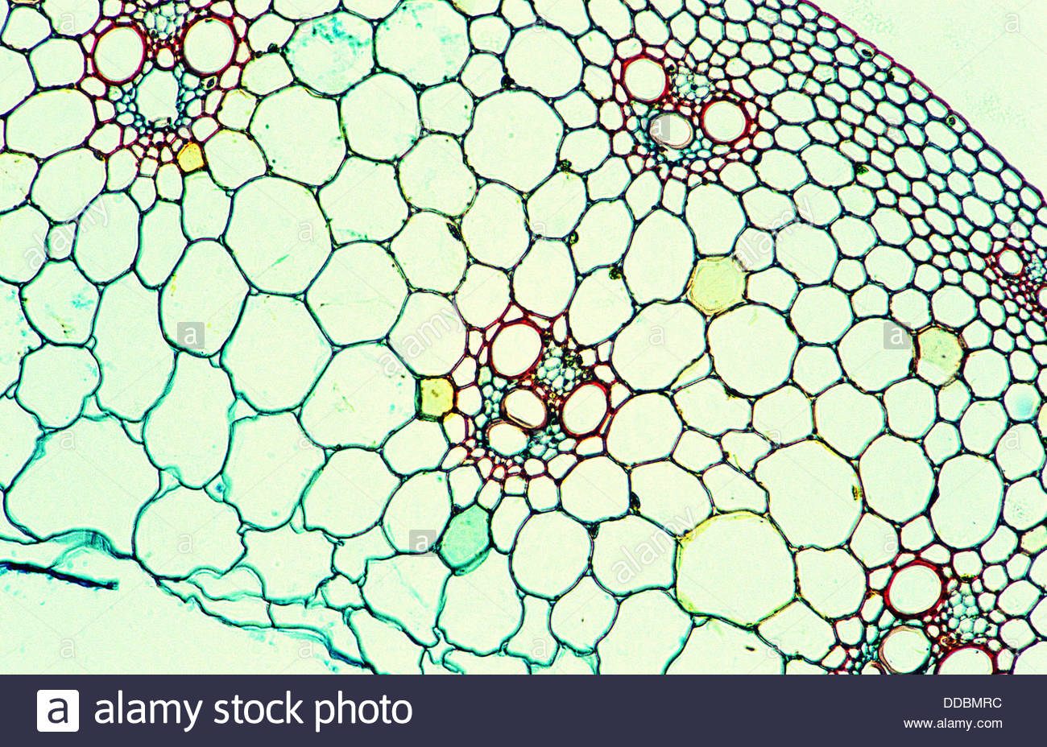
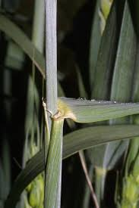
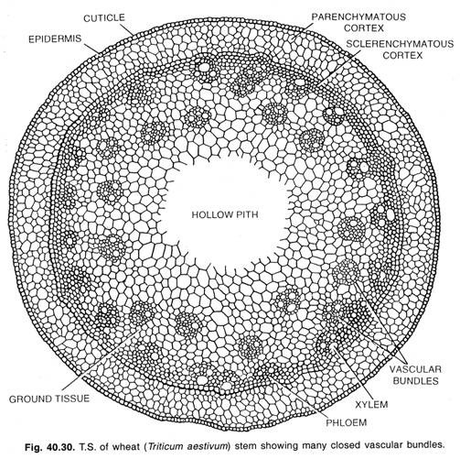

Slide 6
Nyctanthes
The outline is almost circular with four angles protruded as bulges.
1. Epidermis.
1. This is the single outermost layer of cells.
2. It is thickly cuticularised and multicellular hairs are present.
2. Cortex.
1. It is few layered thick and is differentiated into outer region of collenchyma and inner
parenchyma.
2. Collenchyma is several layers deep in the ridges and a few cells deep in other regions.
3. Parenchyma forms rest of the cortex. The cells are thin and many intercellular spaces are present.
4. Cortex has four vascular bundles, one in each of the four bulges at four angles. Each one is conjoint, collateral, exarch and open. The protoxylem of the bundles is directed towards the epidermis, hence the bundles are called inverted. The xylem of the bundles is situated closer to the epidermis and the phloem away from it. Both these elements are separated by a cambium. The cambium is active and produces a little amount of secondary tissues. These are known as cortical vascular 'bundles.
3. Endodermis.
A distinct endodermis with caspaian strips is absent.

Slide 7
4. Pericycle.
It is present just below the cortical region and separates cortical region from the vascular tissues. It forms almost a complete ring of parenchymatous cells.
5. Vascular tissue system.
1. The structure shows secondary growth.
2. The tissues occur in the following sequence-primary phloem, secondary phloem, cambium, secondary xylem and primary xylem.
3. The primary phloem occurs in small patches just below the pericycle.
4. Secondary phloem is in the form of a complete ring. It consists of phloem parenchyma, sieve tubes and companion cells.
5. The cambium is single layered and is present between the secondary phloem and secondary xylem.
6. Secondary xylem occupies most of the region towards the centre of the axis. It consists of tracheids, vessels and xylem parenchyma. A few vessels are very distinct. Annual rings are not very distinct.
7. Primary xylem lies close to the pith. The protoxylem is endarch. Primary vascular bundles are conjoint, collateral, endarch and open.
6. Pith. A large parenchymatous pith is present in the centre.

Slide 8
Identification
Stem. Vascular bundles: conjoint, collateral and endarch.
Dicotyledonous stem:
1.Cortex well differentiated.
2. Pericycle distinguishable.
3. Vascular bundles in a ring.
4. Secondary growth present.
5. Pith well developed.
[III] Point of interest
Cortical vascular bundles. The stem shows four vascular bundles in the cortex, one each in four corners of the angular stem. These bundles called as cortical bundles due to their location in the cortex, are in fact leaf trace bundles. Bundles arise at much lower a node. These pass through the cortex of the upper internode before supplying the leaf at the next upper node. During the course of their upward passage, the bundles become inversely oriented. Thus, the phloem of the bundles is directed away from the epidermis while the endarch protoxylem is closer to the epidermis.

Slide 9
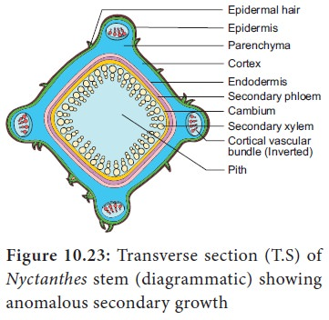
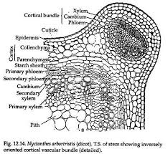
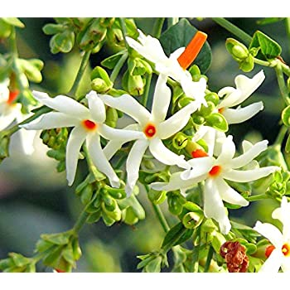

Slide 10
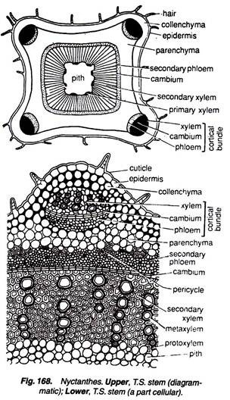

Slide 11
Chenopodium
The outline of the transverse section is almost circular.
Epidermis.
1. This outermost layer consists of a single row of barrel- shaped cells.
2. The cells are thickly cuticularised.
Cortex.
1. It forms a small part of the section. It is differentiated into outer collenchymatous and inner parenchymatous regions.
2. Collenchyma with angular thickenings follows epidermis and is about 3 to 4 layers deep.
3. Parenchyma: forms the inner region of the cortex and is five to ten layers deep.
Endodermis. This layer separates the cortex from underlying vascular tissues. Casparian strips are not present and, therefore, the layer is called starch sheath or endodermoid layer. After secondary growth it becomes indistinguishable.
Pericycle. A distinct pericycle is absent.

Slide 12
Vascular tissue system.
1. It consists of primary and secondary vascular tissues in the following order.
2. Primary phloem occurs in the form of patches of crushed and obliterated tissues.
3. It is followed by a complete ring of secondary phloem.
4. Unistratose cambium separates phloem from the secondary xylem tissues located inner to it.
5. There is a wide zone of conjunctive tissue. It is difficult to distinguish secondary xylem and the conjunctive tissue from one another.
6. Vascular bundles embedded in the conjunctive tissue are secondary in origin. Each vascular bundle is conjoint, collateral and endarch. These occur almost in a ring being distributed regularly (sometimes irregularly). The phloem of these secondary bundles appears in patches similar to included or interxylary phloem. The phloem of the adjacent bundles coalesce and a continuous zone of included phloem is seen embedded in the thick walled prosenchymatous tissue.
Pith.
1. It is well developed and prosenchymatous.
2. Medullary bundles occur in this region. These are conjoint, collateral, endarch and open and show little amount of secondarY growth.

Slide 13
Indentification
Stem. Cortex is well differentiated.
2. Primary vascular bundles are conjoint, collateral, endarch and open.
Dicotyledonous stem. 1. Vascular bundles in a ring.
2. Presence of secondary growth.
3. Well developed pith.
[III] Points of interest
1. Secondary growth. The structure. of the axis shows abnormal secondary growth. In Chenopodium, during secondary growth, extrastelar cambium is formed in the region of pericycle. This cambium produces a small amount of thin walled parenchyma in the beginning, thus pushing the primary vascular bundles towards the pith. These bundles as such appear to be medullary bundles. However, these are not clear trace bundles normally found but are primary vascular bundles. These bundles undergo a little amount of secondary growth due to the presence of fascicular cambium. . At a later stage of development, an arc of cambium is developed from the tissues of the pericycle. It produces lignified prosenchymatous conjunctive tissue. At the same time the cambium forms vascular bundles. These get embedded in the prosenchymatous conjunctive tissue. The phloem is developed centripetally and gets buried in this conjunctive tissue, formling included or interxylary phloem or phloem islands. The secondary cambium (extra stelar) continues to function indefinitely and forms complex secondary tissues. .

Slide 15
Bignonia
The outline of transverse section appears almost quadrangular.
Epidermis.
1. It is an outermost single layer of cells.
2. The cells are thickly cuticularised.
2. Cortex
1. A few layered cortex follows epidermis.
2. It is parenchymatous and many intercellular spaces are present.
3. Endodermis.
1. A distinct endodermis with casparian strips is absent, instead a parenchymatous layer is present.
2. This layer is called a starch sheath.
4. Pericycle.
1. It occurs just below the starch sheath in the form of a few patches of sclerenchyma.
2. These patches are of different sizes and form almost discontinuous ring.

Slide 16
5. Vascular tissue system.
1. Vascular tissue lies below the pericycle.
2. Secondary xylem is grooved at four places (sometimes more) due to phloem wedges.
3. Primary phloem occurs as small and crushed patches. These are situated close to the pericycle.
4. Secondary phloem forms a complete ring. At four diagonal regions, it intrudes into the secondary xylem to form an almost V-shaped structure. A few phloem cells are thick walled. These are called bast or phloem fibres.
5. Unistratose cambium separates phloem and xylem. It is depressed in the region of wedges.
6. Secondary xylem is notched at four places due to phloem wedges. Secondary xylem is made of tracheids, fibres, vessels, fibre-tracheids and parenchyma.
7. Primary xylem groups occur near the pith. Each group is endarch, protoxylem being closer to the axis.
8. The vascular bundles are thus conjoint, collateral, endarch and open.
6. Pith. A well-defined, parenchymatous pith occupies the centre

Slide 17
Identification
Stem. Vascular bundles conjoint, collateral endarch and open.
Dicotyledonous stem.
1. Well differentiated cortex.
2. Vescular bundles arranged in a ring.
3. Secondary growth present.
Points of interest.
Secondary growth. In Bignonia, ridged and furrowed (4- wedged or more) xylem cylinder is formed. This is due to abnormal cambial activity. In the beginning, cambium is normal in position and activity. At a later stage, at four places (or more) cambium produces greater amount of phloem on its outer side than the amount of secondary xylem on its inner side. This results in the formation of four (or more) deep wedges of secondary phloem which project into the secondary xylem .
The abnormal activity is restricted to four diagonally placed patches of cambium in the beginning. Later, this occurs at other places also and results into much ridged and furrowed xylem in mature and old stem.

Slide 18
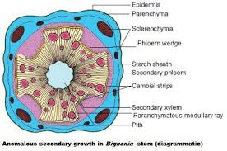

Slide 19
Salvadora
The outline of the transverse section appears almost circular.
1. Periderm.
1. It consists of cork, cork cambium and secondary cortex.
2. The cork forms a few layers of suberised cells. The cells are arranged in brick-like fashion. The cell walls are wavy.
3. Cork cambium is a single layer of tangentially elongated cells.
4. Secondary cortex is only a few layers deep. The cells are thin walled with abundant chloroplasts.
5. The periderm is surrounded by a thickly cuticularised epidermis, broken at places.
2. Cortex.
1. The primary cortex is represented by a small region that lies below the secondary cortex. Both
primary and secondary cortex are indistinguishable from one another.
2. The cells of this region are parenchymatous.
3. Endodermis. A distinct endodermis is absent or it is indistinguishable from the rest of the tissues.
4. Pericycle
1. It is a prominent but discontinuous layer.
2. It consists of thick walled group of sclerenchymatous cells.

Slide 20
5. Vascular tissue system.
1. It consists of both primary and secondary vascular tissues.
2. The outermost is the primary phloem. It appears as crushed and crumpled patches.
3. Secondary phloem situated outside the cambium is in the form of a complete ring.
4. Cambium separates phloem from xylem. It is unistratose. The cells are tangentially elongated.
5. Secondary xylem forms a complete cylinder. This region lies below the cambium. It is traversed by medullary rays and groups of included phloem.
6. Secondary xylem consists of tracheids and regularly dispersed large vessels.
7. Uniseriate and multiseriate medullary rays of vascular origin run radially from the primary phloem to the innermost primary xylem elements.
8. Groups of secondary phloem are many and are scattered almost like continuous but wavy zones. These are phloem islands or included phloem or interxylary phloem.
9. Primary xylem groups occur near the pith. Protoxylem elements are endarch and vascular bundles are conjoint, collateral and open.
6. Pith. A well dermed parenchymatous pith occupies the centre of the axis.

Slide 21
Identification
Stem. Vascular bundles conjoint, collateral, endarch and open.
Dicotyledonous stem.
1. Well differentiated cortex.
2. Vascular bundles arranged in a ring.
3. Occurrence of secondary growth.
Points of interest
1. Secondary growth. This genus is an example of Combretum or Entada type of interxylary phloem. In this case, small segments of cambium produce phloem towards its innerside instead of secondary xylem. This abnormal cambial activity continues for sometime and then stops. Later, the normal activity is restored by the production of secondary xylem towards the innerside. As a result, the phloem formed toward the innerside for a short period gets embedded in the xylem elements. These groups of embedded phloem are called as phloem islands' or included phloem or interxylary phloem. The development is said to be centripetal.

Slide 23
Dracaena
The outline of the transverse section is almost circular.
Periderm.
1. It is composed of cork (phellem), cork cambium (phellogen) and secondary cortex (phelloderm).
2. The cells of the phellem are rectangular, thickly suberised and dead.
3. A few lenticles also occur in the phellem.
4. The cork cambium is one or two layers thick. The cells are thin walled and tangentially elongated.
Cortex.
1. It is undifferentiated and wholly parenchymatous.
2. The cells are filled with starch. Many intercellular spaces are present.
Meristematic tissue.
1. It follows parenchyma and forms several layered deep zone.
2. The cells are almost rectangular and generally radially arranged. The cells are similar to cambium.

Slide 24
Vascular tissue system.
1. Numerous vascular bundles lie scattered in the ground tissue.
2. The primary vascular bundles are present near the centre of the axis. These are large in size and typically collateral and closed.
3. Secondary vascular bundles are present near the periphery. These are smaller in size and remain embedded in the thin walled tissue (sometimes thick walled due to lignification). Each vascular bundle is concentric (amphivasal) where phloem is surrounded by xylem.
4. Secondary phloem consists of short sieve tube elements.
5. Secondary xylem is composed of tracheids and xylem parenchyma.
Ground tissue.
1. This tissue extends from the inner side of the meristematic zone and fill up the major part of the axis.
2. The cells are parenchymatous. Numerous intercellular spaces are present.

Slide 25
Identification
Stem.
1. Vascular bundles are conjoint and collateral.
2. Ground tissue is present.
Monocotyledonous stem.
1. Vascular bundles are scattered.
2. Cambium is absent (vascular bundles closed).
3. Endodermis and pericycle are absent.
4. Pith is not well defined.
Point of interest
Secondary growth. At a very late stage during the development, a wide zone of secondary meristem (cambium) develops outside the vascular bundles in the parenchymatous region. This meristematic tissue cuts off vascular bundles on its inner side. These are concentric (amphivasal) in contrast to the primary bundles which are collateral. The amount of parenchymatous ground tissue also increases and, therefore, the diameter of the stem. The cambium (meristermatic zone) originates near the leaf primordia. The life of this zone or layer is limited. It stops functioning after sometime and the adjaceent cells take over. Another important feature in contrast to cambium of dicotyledons is that cambium in Dracaena cuts off both xylem and phloem on its inner side while on its outer face very little amount of parenchyma is produced.

Slide 26
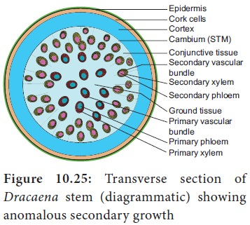

Slide 28
Thank You

