Slide 1
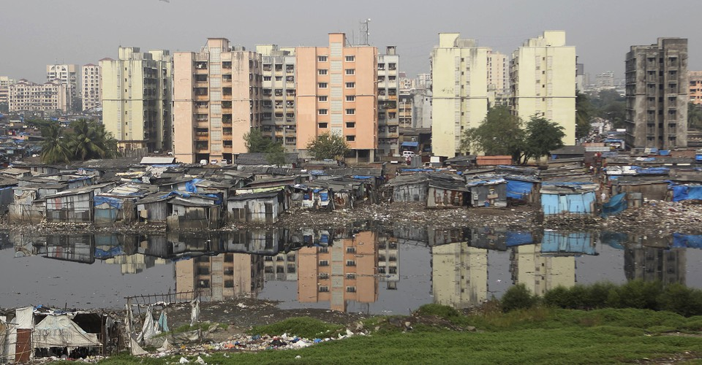
Ferdinand Tonnies(1855-1936)
Dr.Sumitra Sharma
Department of Sociology
M.L.Sukhadia University

Slide 2
Books & Concepts
A German Sociologist.
Books:-
Gemeinshaft and Gesellschaft
Community and Society (1887)
Custom : An Essay on Social codes (1909)
Concepts:-
Gemeinschaft (Community) & Gesellschaft (Society)

Slide 3
Gemeinschaft & Gesellschaft
Toennies was German Sociologist
In 1887, Toennies wrote on Community and society.
he used two terms Gemeinschaft (Community) & Gesellschaft (Society)
He said that a sense of community, or Gemeinschaft, characterizes traditional societies. In these societies, family, kin, and community ties are quite strong, with people caring for each other and looking out for one another.
As societies grew and industrialized and as people moved to cities, he wrote, social ties weakened and became more impersonal. Tönnies called this type of society a Gesellschaft, and he was quite critical of this development

Slide 4
Continue…
Gesellschaft relationships arose in an urban & capital setting, characterized by individualism & interpersonal monetary connections between people. Social ties became instrumental &superficial with self interest.
Ferdinand Tonnies worried about the loss of community. Tonnies observed a direct tension between community (Gemeinschaft) and the city (Gesselschaft).
He sees city as the center of science and culture, which always go hand in hand with commerce and industry.
The urban society is characterized by fragility or artificiality which formed based on legal arrangement or contract but rural society has strong status based attachment by giving extended family honor.

Slide 5
Difference between Community & Society
Gesellschaft (Society)
urban Society
Gemeinschaft (Community)
Rural Society
essential will (wesenwill)
self fulfilling
Community goals
Group value & norms , beliefs, rituals, mores & customs are important
Natural unity
Arbitrary will (Kurwill)
instrumental
Individual goals
Individual principles, fashion & fed are important
Contractual Unity

Slide 6
Thanks!

