Slide 1
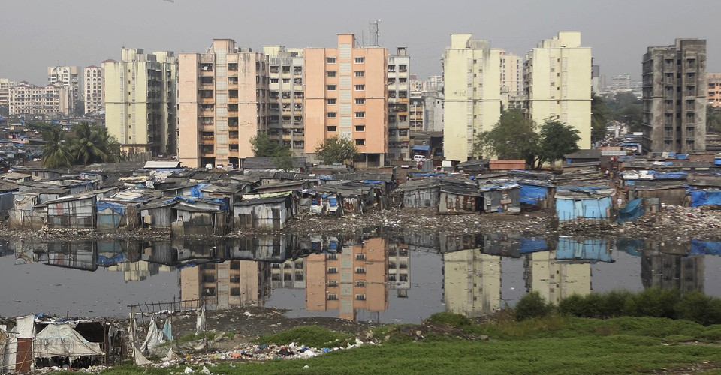
Urban Sociology (V-B)
Dr. Sumitra Sharma
Assistant Professor
Department of Sociology
M.L.Sukhadia University

Slide 2
Emile Durkheim (1858-1917)
Important Books
The Division of Labour in Society (1893)
The Rules of Sociological Method (1895)
Suicide : A Study in Sociology (1897)
The Elementary Forms of the Religious life (1912)

Slide 3
Important concepts
Social Fact ¼lkekftd rF;½
Division of labour ¼Je foHkktu½
Solidarity – Mechanical Solidarity and organic Solidarity ¼,drk% ;kaf=d ,drk vkSj lko;oh ,drk½
Collective consciousness ¼lkewfgd psruk½

Slide 4
Durkheim’s views on urban dimensions
According to Durkheim urban people simply organise themselves into in to different social life from their rural counterpart.
He described traditional rural life as a mechanical solidarity i.e. Social bonds are based on the common sentiments and shared moral values.
Durkheim argues in traditional societies collective consciousness entirely subsumes individual consciousness, norms are strong and behaviour is well regulated.

Slide 5
Conti….
According to Durkheim urbanization on other hand erodes this mechanical solidarity .
It generate new type of bonding which he termed as ‘organic solidarity’ . Here the social bonds are based on specialization and interdependence. He viewed that urban centres create new Kind of solidarity that is ‘organic solidarity’ .
In modern societies he argued that highly complex division of labour resulted in organic solidarity.

Slide 6
solidarity
Traditional Society (Rural)
Modern Society(Urban)
Mechanical Solidarity- a form of social interdependence based on common shared beliefs & strong group identity based on very simple division of labour
Uniformity
Society is in individual
Organic Solidarity- form of social interdependence based on differentiated specialized division of labour.
Differentiation
The individual is in society

Slide 7
Thank you☺

