Slide 1


Slide 2

LOCOMOTION IN BACTERIA
TYPES OF MOVEMENT
A. FLAGELLAR
STRUCTURE OF FLAGELLA
FLAGELLAR SYNTHESIS AND ASSEMBLY
MECHANISM OF FLAGELLAR MOVEMENT
B. GLIDING MOVEMENT
FLAGELLA AND INTELLIGENT DESIGN DEBATE .

Slide 3

A. FLAGELLAR MOVEMENT: Most motile bacteria move by use of flagella, threadlike locomotor appendages extending from the plasma membrane and cell wall. They are slender, rigid structure , about 20nm across and up to 15 or 20 μm long.

Slide 4
Transmission electron microscope studies have show that the bacteria flagellum is composed of three parts:
Filament : The longest and most obvious portion is the filament, which extend from the cell surface to the tip.
Basal body: A basal body is embedded in the cell. The basal body attaches the flagellum to the cell wall and plasma membrane. It is composed of a small rod instead into a series of ring.

Slide 5

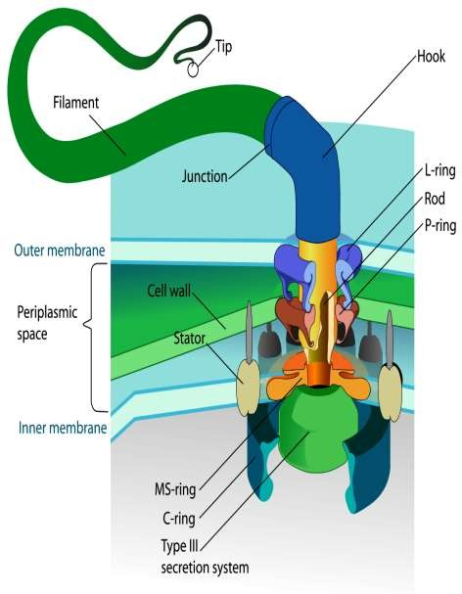
C. Hook : A short, curved segmented, the hook is present outside the cell wall and connects filament to the basal body. The hook and basal body are quite different from the filament . Slightly wider than the filament, the hook is made of different protein subunit.

Slide 6
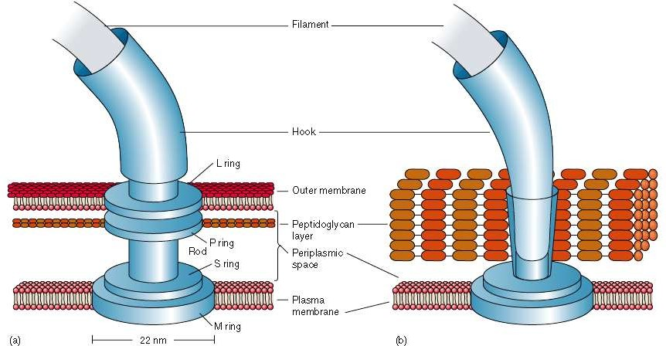
A. gram-negative
B. gram-positive bacteria

Slide 7

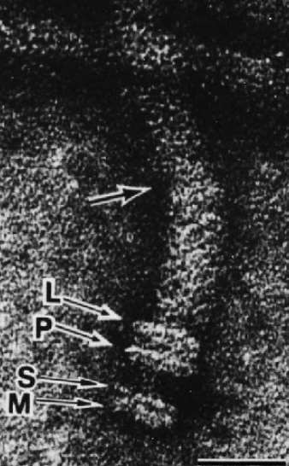
An enlarged view of the basal body of an E.coli
flagellum. All four rings (L,P,S and M)can be clearly seen. The uppermost arrow is at the junction of the hook and filament.

Slide 8

The synthesis of flagella is a complex process involving at least 20 to 30 genes.
Beside the gene for flagellin, 10 or more genes code for hook & basal body proteins.
Other genes are concerned with the control of flagellar construction or function.
It is not known how the cell regulates or determines the exact location of flagella.

Slide 9

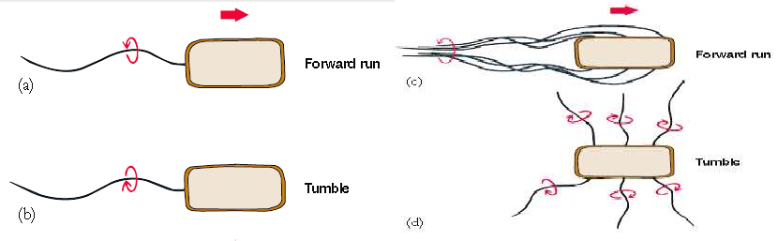
The filament is in the shape of a rigid helix, and the bacterium moves when this helix rotates.
The basal body act as motor and cause rotation.
Flagellar rotation determines the nature of bacterial movement

Slide 10
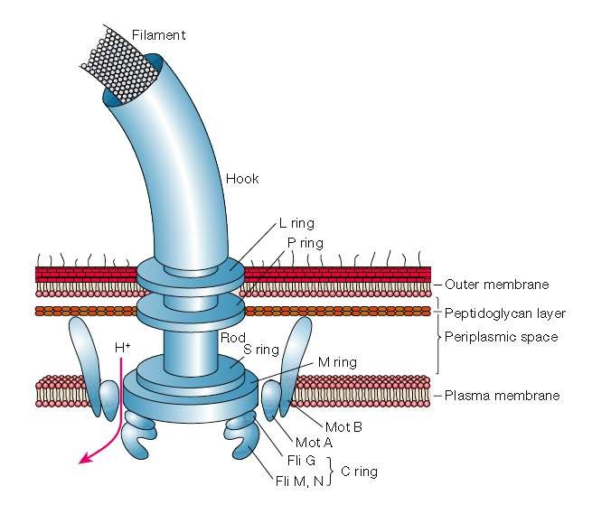
This diagram of a Gram-negative flagellum shows some important component and the flow of
proton that drives rotation. Five of the many flagellar proteins are labeled (Mot A, Mot B, Fli G, Fli M, Fli N) .

Slide 11

Spirochetes shows several types of movement such as
flexing, spinning, free swimming and creeping as they are flexible and helical bacteria and lake flagella.
Just within the cell envelop they have flagella like structure which are know as periplasmic flagella or axial fibrils.
The axial fibrils are present in the space between inner and outer membrane of cell envelope.

Slide 12
Some bacteria such as the species of cyanobacteri (eg. Cytophaga) and mycoplasma show gliding movement. When come in contact to a solid surface.
However no organelles are associated with the movement .
In the members of cytophagales and cyanobacteria , movement helps to find out the substratum eg. Wood, bark, etc for anchorage and reproduction.
They secrete slime with the help of which they get attached to substratum.

