Slide 1
Bacterial nutrition: types and modes of nutrition in bacteria

Slide 2
Nutrition is substances used in biosynthesis and energy production and therefore are required for all living things.
Bacteria, like all living cells, require energy and nutrients to build proteins and structural membranes and drive biochemical processes.
Bacteria require sources of carbon, nitrogen, phosphorous, iron and a large number of other molecules.
Carbon, nitrogen, and water are used in the highest quantities.
The nutritional requirements for bacteria can be grouped according to the carbon source and the energy source.
Some types of bacteria must consume pre-formed organic molecules to obtain energy, while other bacteria can generate their own energy from inorganic sources.

Slide 3
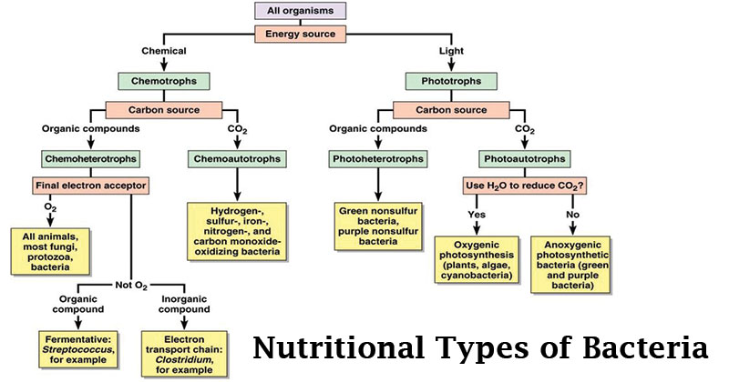

Slide 4
On the basis of energy source organisms are designated as:
Phototrophs:
The organisms which can utilize light as an energy source are known as phototrophs. These bacteria gain energy from light.
Chemotrophs:
These bacteria gain energy from chemical compounds. They cannot carry out photosynthesis.
On the basis of electron source organisms are designated as:
Lithotrophs:
Some organisms can use reduced organic compounds as electron donors and are termed as Lithotrophs.
They can be Chemolithotrophs and Photolithotrophs
Organotrophs:
Some organisms can use organic compounds as electron donors and are termed as organotrophs.
Some can be Chemoorganotrophs and Photoorganotrophs.

Slide 5
Thus, bacteria may be either:
Photo-lithotrops: These bacteria gain energy from light and use reduced inorganic compounds such as H₂S as a source of electrons. eg: Chromatium okeinii.
Photo-organotrophs: These bacteria gain energy from light an d use organic compounds such as Succinate as a source of electrons.eg; Rhodospirillum.
Chemo-lithotrophs: These bacteria gain energy from reduced inorganic compounds such as NH3 as a source of electron eg; Nitrosomonas.
Chemo-organotrophs: These bacteria gain energy from organic compounds such as glucose and amino acids as a source of electrons.eg; Pseudomonas pseudoflora.
Some bacteria can live ether chemo-lithotrophs or chemo-organotrophs like Pseudomonas pseudoflora as they can use either glucose or H2S as electron source.

Slide 6
On the basis of carbon source bacteria may be:
All organisms require carbon in some form for use in synthesizing cell components.
All organisms require at least a small amount of CO2.
However, some can use CO2 as their major or even sole source of carbon; such organisms are termed as Autotrophs (Autotrophic bacteria).
Others require organic compounds as their carbon source and are known as Heterotrophs (Heterotrophic bacteria).

Slide 7
Autotrophic Bacteria
These bacteria synthesize all their food from inorganic substances (H2O, C02, H2S salts).
The autotrophic bacteria are of two types:
(i) Photoautotrophs
These bacteria capture the energy of sunlight and transform it into the chemical energy.
In this process, CO2 is reduced to carbohydrates.
The hydrogen donor is water and the process produce free oxygen.
Photoautotroph has Chlorophyll pigment in the cell and its main function is to capture sunlight e.g., Cyanobacteria.
Some photoautotrophic bacteria are anaerobes and have bacteriochlorophyll and bacteriovirdin pigments respectively.
Purple Sulphur Bacteria:
These bacteria have the pigment bacteriochlorophyll located on the intra cytoplasmic membrane i.e., thylakoids.
These bacteria obtain energy from sulfur compounds e.g., Chromatiiun. Theopedia rosea, Thiospirilium.
Green Sulphur Bacteria:
These bacteria use hydrogen sulfide (H2S) as hydrogen donor. The reaction takes place in the presence of light and pigment termed as bacteriovirdin or bacteriopheophytin or chlorobium chlorophyll e.g., Chlorobium limicola, Chlorobacterium etc.
These bacteria take hydrogen from inorganic sources like sulphides and thiosulphates. Therefore, these bacteria are also known as photolithographs.

Slide 8
(ii) Chemoautotrophs
These bacteria do not require light (lack the light phase but have the dark phase of photosynthesis) and pigment for their nutrition.
These bacteria oxidize certain inorganic substances with the help of atmospheric oxygen.
This reaction releases the energy (exothermic) which is used to drive the synthetic processes of the cell.
1) Sulphomonas (Sulphur bacteria):
These bacteria obtain energy by oxidation of elemental sulphur or H2S, e.g., Thiobacillus, Beggiatoa.
Elemental Sulphur Oxidising Bacteria:
Denitrifying sulphur bacteria oxidize elemental sulphur to sulphuric acid e.g., Thiobacillus denitrificans
2S + 2H2O + 3O2 → 2H2SO4 + 126 kcal.
Sulphide Oxidizing Bacteria:
These bacteria oxidizes H2S and release the sulphur e.g., Beggiatoa.
2H2S +4O2 → 2H2O + 2S + 141.8 cal

Slide 9
Hydromonas (Hydrogen bacteria)
These convert hydrogen into water, e.g., Bacillus pantotrophus, Hydrogenomonas.
2H2 + O2 → 2H2O + 55 kcal.
4H2 + CO2 → 2H2O + CH4 + Energy
Ferromonas (Iron bacteria):
These bacteria inhabit in water and obtain energy by oxidation of ferrous compounds into ferric forms. e.g., Thiobacillus ferroxidans, Ferro bacillus, Leptothrix.
4FeCo3 + 6H2O + O2 → 4Fe (OH)3 + 4CO2 + 81 kcal.
Methanomonas (Methane bacteria):
These bacteria get their energy by oxidation of methane into water and carbon dioxide.
Nitrosomonas (Nitrifying bacteria):
These bacteria get their energy by oxidation of ammonia and nitrogen compounds into nitrates.
Nitrosomonas oxidises NH3 to nitrites. NH3 + ½O2 ® H2O + HNO2 + Energy
Nitrobacter converts nitrites to nitrates. NO2 + ½O2 ® NO2 + Energy
Carbon Bacteria:
These bacteria oxidizes CO into CO2 e.g., Bacillus oligocarbophillous, Oligotropha carboxydovorans
2CO + O2 → 2CO2 + Energy

Slide 10
Heterotrophic Bacteria
The heterotrophic bacteria obtain their food from organic substances, living or dead.
Most pathogenic bacteria of human beings, other plants and animals are heterotrophs.
Some heterotrops have simple nutritional requirement while some of them require large amount of vitamin and other growth promoting substance. Such organisms are called fastidious heterotrophs.
Heterotrophic bacteria are of three types:
a. Photoheterotrophs
These bacteria can utilize light energy but cannot use CO₂ as their sole source of carbon.
They obtain energy from organic compounds to satisfy their carbon and electron requirements. Bacteriochlorophyll pigment is found in these bacteria.
eg., Purple non-sulphur bacteria (Rhodospirillum, Rhodomicrobium, Rhodopseudomonas palustris).
b. Chemoheterotrophs
Chemoheterotrophs obtain both carbon and energy from organic compounds such as carbohydrates, lipids and proteins.
Glucose or Monosaccharide [(CH2O)n] + O2 → CO2 + H2O + Energy

Slide 11
There are three main categories that differ in how chemohetrotrophs obtain their organic nutrients:
(i) Saprophytic bacteria.
(ii) Parasitic bacteria.
(iii) Symbiotic bacteria.
i) Saprophytic bacteria
Saprophytic bacteria obtain their food from the dead and organic decaying matter such as leaves, fruits, vegetables, meat, animal feces, leather, humus etc.
These bacteria secrete enzymes to digest the food and absorb it.
The enzymes secreted to break down the complex compounds such as carbohydrate and protein, into simpler soluble compounds, which are easily absorbed.
Examples are Bacillus mycoides, B. ramosus, Acetobacter etc.

Slide 12
Parasitic bacteria
These bacteria obtain their nutrition from the tissues of the hosts on which they grow.
They may be harmless or may cause serious diseases.
Parasitic bacteria which cause various diseases in plants and animals are known as pathogens.
E.g., Bacillus typhosus, B. anthracis, B.tetani. B.diplheriae, B.tuberculosis, B. pneumoniae, Vibrio cholerae, Pseudomonas citri etc.
Symbiotic bacteria
Symbiotic bacteria live in close association with other organisms as symbionts.
They are beneficial to the organisms.
The common examples are the nitrogen-fixing bacteria, e.g., Bacillus radicicola, B. azotobacter, Rhizobium, Clostridium, Rhizobium spp.
These bacteria live inside the roots of leguminous plants.
These bacteria fix free atmospheric nitrogen into nitrogenous compounds which are utilized by the plants. In return, the plant provides nutrients and protection to the bacteria.

Slide 13
Oligotrophs vs. copiotrophs
Oligo means few; oligotrophs are adapted to life in environments where nutrients are scarce
  For example, rivers, other clean water systems.
Copio means abundant, as in “copious”
  The more nutrients, the better.
  Medically important bacteria are copiotrophs.
  Grow rapidly and easily in the lab.

Slide 14
Culture Medium
Defined vs. Complex
  Defined has known amounts of known chemicals.
  Complex: hydrolysates, extracts, etc.
    Exact chemical composition is not known.
Selective and differential
  Selective media limits the growth of unwanted microbes or allows growth of desired ones.
  Differential media enables “differentiation” between different microbes.
  A medium can be both.

Slide 15
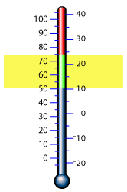
Physical requirements for growth
Prefixes and suffixes:
Bacteria are highly diverse in the types of conditions they can grow in.
  Optimal or required conditions implied by “-phile” meaning “love”
Some bacteria prefer other conditions, but can tolerate extremes
  Suffix “-tolerant”
Note the difference!

Slide 16
Oxygen: friend or foe?
Early atmosphere of Earth had none
  First created by cyanobacteria using photosynthesis
  Oxygen gas rusted iron in Earth’s crust, then excess collected in atmosphere
Strong oxidizing agent
Reacts with certain organic molecules, produces free radicals and strong oxidizers :
  Singlet oxygen, H₂O₂(peroxide), O₃⁻ (superoxide), and hydroxyl (OH-) radical.

Slide 17
Protections of bacteria against oxygen
  Bacteria possess protective enzymes, catalase and superoxide dismutase.
  Catalase breaks down hydrogen peroxide into water and oxygen gas.
  Superoxide dismutase breaks superoxide down into peroxide and oxygen gas.
  Anaerobes missing one or both; slow or no growth in the presence of oxygen.

Slide 18
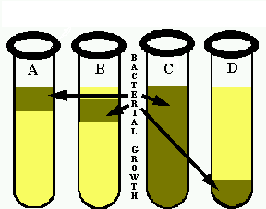
Relation to Oxygen
Aerobes: use oxygen in metabolism; obligate.
Microaerophiles: require oxygen (also obligate), but in small amounts.
Anaerobes: grow without oxygen; SEE NEXT
A: aerobe
B: microaerophile
Capnophiles: require larger amounts of carbon dioxide than are found normally in air.

Slide 19
Anaerobes grow without O₂
Classifications vary, but our definitions:
  Obligate (strict) anaerobes: killed or inhibited by oxygen.
  Aerotolerant anaerobes: do not use oxygen, but not killed by it.
  Facultative anaerobes: can grow with or without oxygen
C: could be facultative or aerotolerant.
D: strict anaerobe

Slide 20
Effect of temperature
Low temperature
  Enzymatic reactions too slow; enzymes too stiff
  Lipid membranes no longer fluid
High temperature
  Enzymes denature, lose shape and stop functioning
  Lipid membranes get too fluid, leak
  DNA denatures
As temperature increases, reactions and growth rate speed up; at max, critical enzymes denature.

Slide 21
Bacteria and temperature
Bacteria have temperature ranges (grow between 2 temperature extremes), and an optimal growth temperature. Both are used to classify bacteria.
As temperature increases, so do metabolic rates.
At high end of range, critical enzymes begin to denature, work slower. Growth rate drops off rapidly with small increase in temperature.

Slide 22
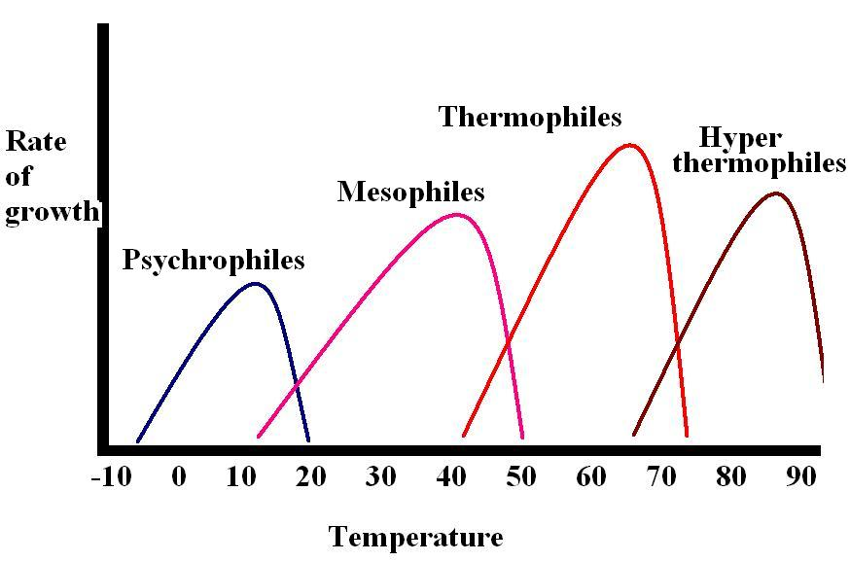
Classification of bacteria based on temperature

Slide 23
Terms related to temperature
Special cases:
  Psychrotrophs: are cold-tolerant bacteria or archaea that have the ability to grow at low temperatures, but have optimal and maximal growth temperatures above 15 and 20°C, respectively . They can also grow in the refrigerator; responsible for food spoilage.
  Thermoduric: bacteria that can withstand brief heat treatments to varying extents ie, the pasteurisation process. Species of bacteria which are thermoduric include Bacillus, Clostridium and Enterococci.

Slide 24
pH Effects
pH = -log[H+]
Lowest = 0 (very acid); highest = 14 (very basic) Neutral is pH 7.
Acidophiles/acidotolerant grow at low pH
Alkalophiles/alkalotolerant grow at high pH
Most bacteria prefer a neutral pH
  What is pH of human blood?
Some bacteria create their preferred conditions
  Lactobacillus creates low pH environment in vagina

Slide 25
Low water activity: halophiles, osmophiles, and xerotolerant
Water is critical for life; remove some, and things can’t grow. (food preservation: jerky, etc.)
Halophiles/halotolerant: relationship to high salt.
  Marine bacteria; archaea and really high salt.
Osmophiles: can stand hypertonic environments whether salt, sugar, or other dissolved solutes
  Fungi very good at this; grandma’s wax over jelly.
Xerotolerant: dry. Subject to desiccation. Fungi best
  Bread, dry rot of wood
  Survival of bacterial endospores.

Slide 26
Miscellaneous conditions
Radiation (solar, UV, gamma)
  Can all damage cells; bacteria have pigments to absorb energy and protect themselves.
  Endospores are radiation resistant.
  Deinococcus radiodurans: extremely radiation resistant
    Extremely efficient DNA repair, protection against dessication damage to DNA.
Barophiles/barotolerant: microbes from deep sea
  Baro- means pressure. Actually require high pressure as found in their environment.

