Slide 1
Chemosynthesis
It is the biological conversion of one or more carbon molecules (usually carbon dioxide or methane) and nutrients into organic matter using the oxidation of inorganic molecules (e.g. hydrogen gas, hydrogen sulfide) or methane as a source of energy, rather than sunlight, as in photosynthesis.
Chemosynthetic bacteria include a group of autotrophic bacteria that use chemical energy to produce their own food.
Like photosynthetic bacteria, chemosynthetic bacteria need a carbon source (e.g. carbon dioxide) as well as an energy source in order to manufacture their own food.
These bacteria are aerobic and therefore rely on oxygen to complete this process successfully.
However, some species (e.g. Sulfuricurvum kujiense) have been associated with anaerobic chemosynthesis.

Slide 2
Because of their ability to manufacture their own food using chemical energy, these organisms are able to survive in a variety of habitats/environments (including harsh environments with extreme conditions) as free-living organisms or in association with other organisms (through symbiosis with other organisms).
Unlike photosynthesis which is common in eukaryotic organisms and cyanobacteria, chemosynthetic reactions are mostly carried out by prokaryotic microorganisms (particularly bacteria and archaea)
Examples of chemosynthetic bacteria include:
Venenivibrio stagnispumantis
Beggiatoa
Thiobacillus neapolitanus
Thiobacillus novellus
Thiobacillus ferrooxidans

Slide 3
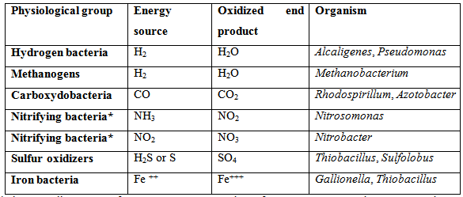
Chemoautotrophs are usually organized into "physiological groups" based on their inorganic substrate for energy production and growth (see Table below).

Slide 4
Hydrogen bacteria
The hydrogen bacteria oxidize H₂ (hydrogen gas) as an energy source.
The hydrogen bacteria are facultative lithotrophs as evidenced by the pseudomonads that fortuitously (by chance) possess a hydrogenase enzyme that will oxidize H₂ and put the electrons into their respiratory ETS.
They will use H₂ if they find it in their environment even though they are typically heterotrophic.
Indeed, most hydrogen bacteria are nutritionally versatile in their ability to use a wide range of carbon and energy sources.
Bacteria like Hydrogenovibrio marinus and Helicobacter pylori oxidize hydrogen as a source of energy under microaerophilic conditions. For the most part, these bacteria have been shown to be anaerobic and therefore thrive in areas with very little to no oxygen. This is largely due to the fact that the enzyme used for oxidation purposes (Hydrogenase) functions effectively in anaerobic conditions.

Slide 5
Hydrogen oxidizing bacteria mostly grow best under microaerophilic conditions because the hydrogenase enzyme used in hydrogen oxidation is inhibited by the presence of oxygen, but oxygen is still needed as a terminal electron acceptor.
Many organisms are capable of using hydrogen (H₂) as a source of energy.
While there are several mechanisms of anaerobic hydrogen oxidation (e.g. sulfate reducing- and acetogenic bacteria), hydrogen can also be used as an energy source aerobically.
In these organisms, hydrogen is oxidized by a membrane-bound hydrogenase causing proton pumping via electron transfer to various quinones and cytochromes.
In many organisms, a second cytoplasmic hydrogenase is used to generate reducing power in the form of NADH, which is subsequently used to fix carbon dioxide via the Calvin cycle.
Hydrogen-oxidizing organisms, such as Cupriavidus necator (formerly Ralstonia eutropha), often inhabit oxic-anoxic interfaces in nature to take advantage of the hydrogen produced by anaerobic fermentative organisms while still maintaining a supply of oxygen.

Slide 6
Methanogens
The methanogens used to be considered a major group of hydrogen bacteria - until it was discovered that they are Archaea.
The methanogens are able to oxidize H₂ as a sole source of energy while transferring the electrons from H₂ to CO₂ in its reduction to methane.
Metabolism of the methanogens is absolutely unique, yet methanogens represent the most prevalent and diverse group of Archaea.
Methanogens use H₂ and CO₂ to produce cell material and methane.
They have unique enzymes and electron transport processes.
Their type of energy generating metabolism is never seen in the Bacteria, and their mechanism of autotrophic CO₂ fixation is very rare, except in methanogens.

Slide 7
Carboxydobacteria
The carboxydobacteria are able to oxidize CO (carbon monoxide) to CO₂, using an enzyme CODH (carbon monoxide dehydrogenase).
The carboxydobacteria are not obligate CO users, i.e., some are also hydrogen bacteria, and some are phototrophic bacteria.
Interestingly, the enzyme CODH used by the carboxydobacteria to oxidize CO to CO₂, is used by the methanogens for the reverse reaction - the reduction of CO₂ to CO - in their unique pathway of CO₂ fixation.

Slide 8
Nitrifying bacteria
The nitrifying bacteria are represented by two genera, Nitrosomonas and Nitrobacter. Together these bacteria can accomplish the oxidation of NH₃ to NO₃, known as the process of nitrification.
No single organism can carry out the whole oxidative process.
Nitrosomonas oxidizes ammonia to NO₂ (nitrite ) and Nitrobacter oxidizes NO₂ to NO₃ (nitrate).
Most of the nitrifying bacteria are obligate lithoautotrophs, the exception being a few strains of Nitrobacter that will utilize acetate.
CO₂ fixation utilizes RUBP carboxylase and the Calvin Cycle.
Nitrifying bacteria grow in environments rich in ammonia, where extensive protein decomposition is taking place.
Nitrification in soil and aquatic habitats is an essential part of the nitrogen cycle.
In the case of nitrifying bacteria, ammonia is first oxidized to hydroxylamine in the cytoplasm (by ammonium monooxygenase). The hydroxylamine is then oxidized to produce nitrite in the periplasm by hydroxylamine oxidoreductase. This process produces a proton (one proton for each molecule of ammonium). As compared to nitrifying bacteria, denitrifying bacteria oxidize nitrate compounds as a source of energy.

Slide 9
Sulfur bacteria
Chemoautotrophic sulfur oxidizers include both Bacteria (e.g. Thiobacillus) and Archaea (e.g. Sulfolobus).
Sulfur oxidizers oxidize H₂S (sulfide) or S (elemental sulfur) as a source of energy.
Similarly, the purple and green sulfur bacteria oxidize H₂S or S as an electron donor for photosynthesis, and use the electrons for CO₂ fixation (the dark reaction of photosynthesis).
Obligate autotrophy is variable among the sulfur oxidizers.
Lithoautotrophic sulfur oxidizers are found in environments rich in H₂S, such as volcanic hot springs and fumaroles, and deep-sea thermal vents.
Some are found as symbionts and endosymbionts of higher organisms.
Since they can generate energy from an inorganic compound and fix CO₂ as autotrophs, they may play a fundamental role in primary production in environments that lack sunlight. As a result of their lithotrophic oxidations, these organisms produce sulfuric acid (H₂SO₄), and therefore tend to acidify their own environments.
Some of the sulfur oxidizers are acidophiles that will grow at a pH of 1 or less.
Some are hyperthermophiles that grow at temperatures of 115°C.
In some of the organisms, for instance, inorganic sulfur will be stored until they are required for use.

Slide 10
Sulfur Oxidation
Sulfur oxidation involves the oxidation of reduced sulfur compounds such as sulfide (H₂S), inorganic sulfur (S₀), and thiosulfate (S₂O₂⁻³) to form sulfuric acid (H₂SO₄). An example of a sulfur-oxidizing bacterium is Paracoccus.
Generally, the oxidation of sulfide occurs in stages, with inorganic sulfur being stored either inside or outside of the cell until needed.
The two step process occurs because sulfide is a better electron donor than inorganic sulfur or thiosulfate; this allows a greater number of protons to be translocated across the membrane.
Sulfur-oxidizing organisms generate reducing power for carbon dioxide fixation via the Calvin cycle using reverse electron flow—an energy-requiring process that pushes the electrons against their thermodynamic gradient to produce NADH.
Biochemically, reduced sulfur compounds are converted to sulfite (SO₂⁻³) and, subsequently, sulfate (SO₂⁻⁴) by the enzyme sulfite oxidase.
Some organisms, however, accomplish the same oxidation using a reversal of the APS reductase system used by sulfate-reducing bacteria.
In all cases the energy liberated is transferred to the electron transport chain for ATP and NADH production.
In addition to aerobic sulfur oxidation, some organisms (e.g. Thiobacillus denitrificans) use nitrate (NO⁻³) as a terminal electron acceptor and therefore grow anaerobically.

Slide 11
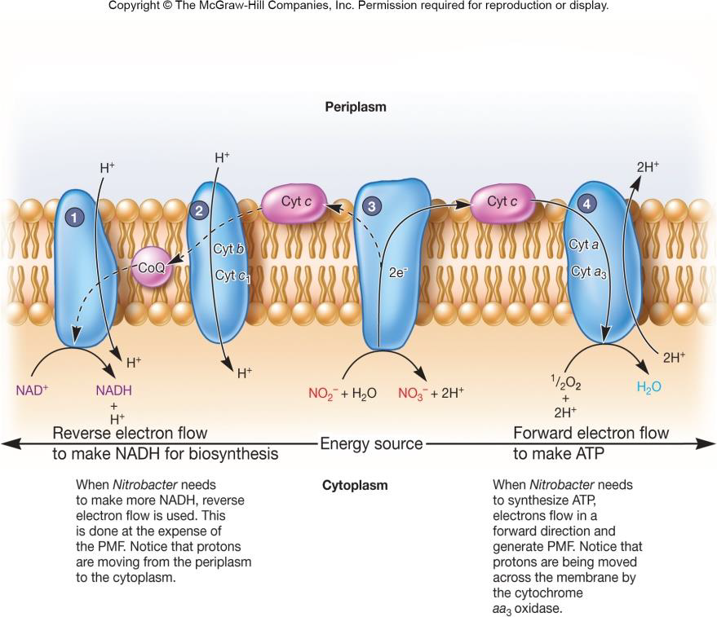

Slide 12
Iron bacteria
They oxidize Fe⁺⁺ (ferrous iron) to Fe⁺⁺⁺ (ferric iron).
At least two bacteria probably oxidize Fe⁺⁺ as a source of energy and/or electrons and are capable of chemoautotrophic growth:
The stalked bacterium Gallionella, which forms flocculant rust-colored colonies attached to objects in nature and Thiobacillus ferrooxidans, which is also a sulfur-oxidizing lithotroph.
Acidithiobacillus ferrooxidans and Leptospirillum ferrooxidans are some of the bacteria that oxidize iron.
This process has been shown to occur under different condition depending on the organism (e.g. low pH and oxic (contain free molecular oxygen) -anoxic(lack free O2, but may still have bound oxygen as NO3 for example).

Slide 13
Ferrous iron is a soluble form of iron that is stable at extremely low pHs or under anaerobic conditions.
Under aerobic, moderate pH conditions ferrous iron is oxidized spontaneously to the ferric (Fe³⁺) form and is hydrolyzed abiotically to insoluble ferric hydroxide (Fe(OH)₃).
There are three distinct types of ferrous iron-oxidizing microbes.
The first are acidophiles, such as the bacteria Acidithiobacillus ferrooxidans and Leptospirillum ferrooxidans, as well as the archaeon Ferroplasma. These microbes oxidize iron in environments that have a very low pH and are important in acid mine drainage.
The second type of microbes oxidizes ferrous iron at cirum-neutral pH. These micro-organisms (for example Gallionella ferruginea or Leptothrix ochracea) live at the oxic-anoxic interfaces and are microaerophiles.
The third type of iron-oxidizing microbes is anaerobic photosynthetic bacteria such as Rhodopseudomonas, which use ferrous iron to produce NADH for autotrophic carbon dioxide fixation.
Biochemically, aerobic iron oxidation is a very energetically poor process which therefore requires large amounts of iron to be oxidized by the enzyme rusticyanin to facilitate the formation of proton motive force.
Like sulfur oxidation, reverse electron flow must be used to form the NADH used for carbon dioxide fixation via the Calvin cycle.

Slide 14
During chemosynthesis, chemosynthetic bacteria, being non-photosynthetic, have to rely on energy produced by oxidation of inorganic compounds in order to manufacture food (sugars) while nitrogen-fixing bacteria convert nitrogen gas into nitrate.
All these processes serve to produce a proton used in carbon dioxide fixation.
Normally, these reactions occur in the cytoplasm in the presence of membrane-bound respiratory enzymes.
For instance, in the case of hydrogen oxidation, group 1 NiFe hydrogenases, found in the cytoplasm, catalyze the reaction to produce 2 electrons and protons (hydrogen with a positive charge) from a hydrogen molecule (H2 <>2H+ and 2e-). These electrons are then channeled to the quinone pool in the electron transport chain.

Slide 15
In the case of hydrogen sulfide, the compound undergoes oxidation to release electrons and hydrogen ions (referred to as protons given that they are separated from the compound and electrons and gain a positive charge). The products of this reaction are therefore sulfur, electrons as well as protons. Electrons and protons then enter the electron transport chain (at the membrane).
As electrons enter this chain, protons are pumped out of the cell. Electrons, on the other hand, are accepted by oxygen and attract the protons (hydrogen ions) thereby forming water molecules.
Through an enzyme known as ATP synthase, protons that had been previously pumped out of the cell are channeled back to the cell with their energy (kinetic energy) is stored as ATP and is used for sugar synthesis.

Slide 16
Carbon Assimilation in Chemosynthetic Bacteria (fixation)
Depending on the type of bacteria, their habitat, and carbon source, there are a number of metabolic pathways used for fixation. Some of the most common pathways include:
Calvin-Benson Cycle
In this cycle, the enzyme RuBisCo (ribulose 1, 5-bisphosphate carboxylase/oxygenase) facilitates the addition of molecular carbon dioxide to ribulose 1, 5-bisphosphate. This process generates a six-carbon compound that is, in turn, converted into two molecules of 3-PGA (3-phosphoglycerate). This process is referred to as carbon fixation given that it involves the conversion of carbon dioxide into organic molecules.
Through the energy stored in ATP and NADPH (generated through the oxidation process), the carbon compound (3-PGA) is again converted into another carbon compound to form G3P (Glyceraldehyde 3-phosphate) in the reduction phase.
As one of these molecules leaves the Calvin chain (to form the carbohydrate molecule/sugar), the other is involved in the regeneration of RuBP.

Slide 17
Krebs Reverse Cycle -
Carbon fixation in Krebs Reverse Cycle results in the production of pyruvate.
Also known as the Reductive Tricarboxylic Acid Cycle, this cycle starts with the fixation of two molecules of carbon dioxide.
It results in the production of acetyl coenzyme A (acetyl-CoA) that is in turn reductively carboxylated to produce pyruvate.
The pyruvate produced through the process is then used for the synthesis of the organic cell materials.

Slide 18
Some of the other processes used by these bacteria include: 3-Hydroxypropionate cycle
This pathway fixes carbon dioxide to form Malyl-CoA in the presence of acetyl-CoA and propionyl-CoA carboxylases.
This is then split to produce acetyl-CoA and glyoxylate.
Ultimately, the pathway results in the production of pyruvate which is used for synthesizing various organic materials required by the cell.
Reductive Acetyl-CoA Pathway
In this pathway, two molecules of carbon dioxide are fixed to form acetyl-CoA.
Typically, hydrogen acts as the electron donor in this reaction with Carbon Dioxide being the electron acceptor.
Dicarboxylate/4-Hydroxybutyrate Cycle
This cycle is common among bacteria found in anaerobic and microaerobic habitats (e.g. Desulfurococcales).
Like the 3-hydroxypropionate/4-hydroxybutyrate cycle, this cycle converts acetyl-CoA and two molecules of carbon into succinyl-coenzyme (CoA).
Some of the enzymes involved in this cycle include pyruvate synthase and phosphoenolpyruvate (PEP) carboxylase.

Slide 19
Importance of Chemosynthetic Bacteria
Chemosynthesis refers to the process through which chemosynthetic bacteria process food using chemical energy.
Therefore, compared to photosynthesis, these organisms are not dependent on light energy for production.
This makes them important primary producers in various habitats that contain oxidants as nitrates and sulfates.
In deep-sea vent ecosystems, for instance, the absence of sunlight means that photosynthesis cannot take place. However, because of the ability of some bacteria to manufacture food through chemosynthesis, they play an important role as producers in this ecosystem.
It also has benefit for other organisms through a symbiotic relationship. For instance, in various environments, nitrogen-fixing bacteria have been shown to form symbiotic relationships that benefit a variety of organisms (algae, diatoms, legumes, sponges, etc). Here, they are able to convert nitrogen (abundant in nature) into useable forms.
Here, these bacteria can catalyze atmospheric nitrogen to produce ammonia (using an enzyme known as nitrogenase) which is then used by plants for the synthesis of nitrogenous biomolecules.

Slide 20
One of the other symbiotic relationships that have received significant attention is between tubeworms (Riftia pachyptila) and chemosynthetic bacteria in hydrothermal vents.
In this environment, water temperatures are extremely high due to geothermal heat and these worms live at the seafloor (environment lacking light energy).
Despite the unfavorable conditions in this environment (extremely high temperatures and lack of light), the availability of hydrogen sulfide allows bacteria to carry out chemosynthesis.
Using a highly vascularized gill-like plume, the worm is able to take in dissolved carbon dioxide, oxygen, and hydrogen sulfide (the hemoglobin of these organisms are capable of binding oxygen and sulfides). They are then transported to specialized cells known as bacteriocytes where chemosynthetic bacteria reside.
Using the sulfide and oxygen, the bacteria produce energy (ATP) that is then used to convert carbon dioxide into sugars. These sugars are then used by the mollusk as a source of food.

