Slide 1
Photosynthesis is the use of light as a source of energy for growth, more specifically the conversion of light energy into chemical energy in the form of ATP.
Prokaryotes that can convert light energy into chemical energy include the photosynthetic cyanobacteria, the purple and green bacteria, and the "halobacteria" (actually archaea).
The cyanobacteria conduct plant photosynthesis, called oxygenic photosynthesis
The purple and green bacteria conduct bacterial photosynthesis or anoxygenic photosynthesis
The extreme halophilic archaea use a type of nonphotosynthetic photophosphorylation mediated by a pigment, bacteriorhodopsin, to transform light energy into ATP.
Net equation:
6CO ₂ +12H₂O+LightEnergy → C₆H₁₂O₆+6O₂+6H₂0
Photosynthetic reactions divided into two stages:
• Light reaction - light energy absorbed & converted to chemical energy (ATP, NADPH)
• Dark reaction- carbohydrates made from CO₂ using energy stored in ATP & NADPH

Slide 2
Types of bacterial photosynthesis
Five photosynthetic groups within domain Bacteria (based on 16S rRNA):
1. Oxygenic Photosynthesis
• Occurs in Cyanobacteria and prochlorophytes
• Synthesis of carbohydrates results in release of molecular O₂ and removal of CO₂ from atmoshphere.
• Occurs in lamellae which house thylakoids containing chlorophyll a/b and phycobilisomes pigments which gather light energy
• Uses two photosystems (PS):
- PS II- generates a proton-motive force for making ATP.
- PS I- generates low potential electrons for reducing power.

Slide 3
The oxygenic photosynthetic bacteria are unicellular or multicellular and possess bacterio­chlorophyll a and carry out oxygenic photosynthesis.
They contain phycobilins.
One group, prochlorophytes lack phycobilins, but contain both bacteriochlorophyll a and b. They are mostly represented by Gram-negative cyanobacteria having only membrane.
The light harvesting pigments are phycobilin proteins, phycoerythrin, phycocyanin, bacteriochlorophyll a and carotenoids but sheath capsule may contain yellow pigment called scytonemin or red-blue pigment gloeocapsin which may mask cellular pigmentation.
Phycobilins form phyobilisomes on both surfaces of membrane called thylakoids. Bacteriochlorophyll a and carotenoids are part of it.

Slide 4
2. Anoxygenic Photosynthesis
Uses light energy to create organic compounds, sulfur or fumarate compounds instead of O₂.
Occurs in purple bacteria, green sulfur bacteria, green gliding bacteria and heliobacteria.
Uses bacteriochlorophyll pigments instead of chlorophyll.
Uses one photosystem (PS I) to generate ATP in “cyclic” manner.
Ammonium salts are generally used as nitrogen source.
Nitrogen fixation has been reported in some bacterial species.
Some can grow chemo-auto-trophically under aerobic/micro-aerobic condition.
Fatty acids, ethanol and organic acids serve as carbon sources.
They are found in fresh water, brackish water, and marine and hyper-saline water

Slide 5
Photosynthetic Pigments
There are several types of pigments distributed among various phototrophic organisms.
Chlorophyll is the primary light-harvesting pigment in all photosynthetic organisms. Chlorophyll is a tetrapyrrole which contains magnesium at the center of the porphyrin ring. It contains a long hydrophobic side chain that associates with the photosynthetic membrane.
Cyanobacteria have chlorophyll a, the same as plants and algae.
The chlorophylls of the purple and green bacteria, called bacteriochlorophylls are chemically different than chlorophyll a in their substituent side chains. This is reflected in their light absorption spectra.
Chlorophyll a absorbs light in two regions of the spectrum, one around 450nm and the other between 650 -750nm
Bacterial chlorophylls absorb from 800-1000nm in the far red region of the spectrum.

Slide 6
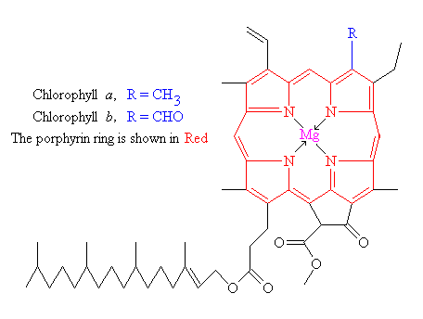

Slide 7
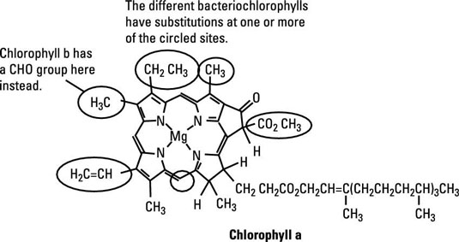

Slide 8
Carotenoids are always associated with the photosynthetic apparatus.
They function as secondary light-harvesting pigments , absorbing light in the blue-green spectral region between 400-550 nm.
Carotenoids transfer energy to chlorophyll, at near 100 percent efficiency, from wave lengths of light that are missed by chlorophyll.
In addition, carotenoids have an indispensable function to protect the photosynthetic apparatus from photo oxidative damage.
Carotenoids have long hydrocarbon side chains in a conjugated double bond system. Carotenoids "quench" the powerful oxygen radical, singlet oxygen, which is invariably produced in reactions between chlorophyll and O₂ (molecular oxygen).
Some non-photosynthetic bacterial pathogens, i.e., Staphylococcus aureus, produce carotenoids that protect the cells from lethal oxidations by singlet oxygen in phagocytes.

Slide 9
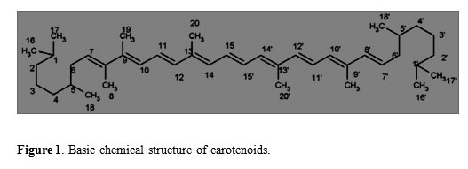

Slide 10
Phycobiliproteins are the major light harvesting pigments of the Cyanobacteria and may also occur in some groups of algae.
They may be red or blue, absorbing light in the middle of the spectrum between 550 and 650nm.
Phycobiliproteins consist of proteins that contain covalently-bound linear tetrapyrroles (phycobilins).
They are contained in granules called phycobilisomes that are closely associated with the photosynthetic apparatus.
Being closely linked to chlorophyll they can efficiently transfer light energy to chlorophyll at the reaction center.

Slide 11
Light Reaction
The Light Reactions depend upon the presence of chlorophyll, the primary light-harvesting pigment in the membrane of photosynthetic organisms.
The functional components of the photochemical system are light harvesting pigments, a membrane electron transport system, and an ATPase enzyme.
The photosynthetic electron transport system of is fundamentally similar to a respiratory ETS, except that there is a low redox electron acceptor (e.g. ferredoxin ) at the top (low redox end) of the electron transport chain, that is first reduced by the electron displaced from chlorophyll.
All phototrophic bacteria are capable of performing cyclic photophosphorylation.
The universal mechanism of cyclic photophosphorylation is referred to as Photosystem I.
Bacterial photosynthesis uses only Photosystem I (PSI), but the more evolved cyanobacteria, as well as algae and plants, have an additional light-harvesting system called Photosystem II (PSII).
Photosystem II is used to reduce Photosystem I when electrons are withdrawn from PSI for CO₂ fixation.
PSII transfers electrons from H₂O and produces O₂.

Slide 12
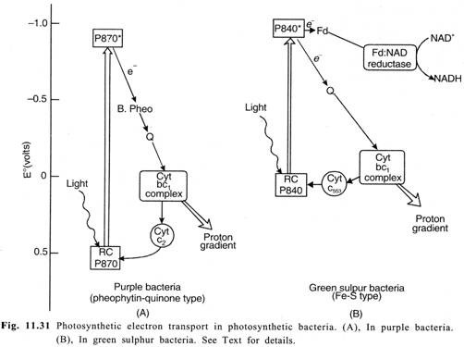

Slide 13
(i) Cyclic photosynthetic electron transport:
Excitation of P-840 in pigment system by a photon of light results in transfer of an elec­tron from the reaction centre to Cyt be₁ complex through a quinone (Q) and back to the reac­tion centre via Cyt C₅₅₃. The electron transport through the Cyt bc₁ complex causes proton pumping across the membrane, producing a proton motive force that powers synthesis of ATP from ADP + Pi by ATP synthase (photophosphorylation).
(ii) Non-cyclic photosynthetic electron transport:
During this process, some electrons flow from excited P-840 to an Fe-S protein Ferre­doxin (Fd), which in turn passes electrons to NAD⁺ through Fd: NAD-reductase and ultimately forming NADH. The electrons from the reaction centre which reduce NAD⁺ → NADH, are compensated by electrons coming from oxidation of H₂S to elemental S and then to SO₄²⁻. This process is chemically analogous to oxidation of H₂O by oxygenic plants.

Slide 14
Dark reaction
The use of RUBP carboxylase and the Calvin cycle is the most common mechanism for CO₂ fixation among autotrophs.
Indeed, RUBP carboxylase is said to be the most abundant enzyme on the planet (nitrogenase, which fixes N₂ is second most abundant).
This is the only mechanism of autotrophic CO₂ fixation among eukaryotes, and it is used, as well, by all cyanobacteria and purple bacteria.
Lithoautotrophic bacteria also use this pathway. But the green bacteria and the methanogens, as well as a few isolated groups of prokaryotes, have alternative mechanisms of autotrophic CO₂ fixation and do not possess RUBP carboxylase.
RUBP carboxylase ( ribulose bisphosphate carboxylase ) uses ribulose bisphosphate (RUBP) and CO₂ as co-substrates. In a complicated reaction the CO₂ is "fixed" by addition to the RUBP, which is immediately cleaved into two molecules of 3-phosphoglyceric acid (PGA).
The fixed CO₂ winds up in the -COO group of one of the PGA molecules. Actually, this is the reaction which initiates the Calvin cycle.

Slide 15
The Calvin cycle is concerned with the conversion of PGA to intermediates in glycolysis that can be used for biosynthesis, and with the regeneration of RUBP, the substrate that drives the cycle.
After the initial fixation of CO₂, 2 PGA are reduced and combined to form hexose-phosphate by reactions which are essentially the reverse of the oxidative Embden-Meyerhof pathway.
The hexose phosphate is converted to pentose-phosphate, which is phosphorylated to regenerate RUBP.
An important function of the Calvin cycle is to provide the organic precursors for the biosynthesis of cell material.
Intermediates must be constantly withdrawn from the Calvin cycle in order to make cell material.
In this regard, the Calvin cycle is an anabolic pathway.
The fixation of CO₂ to the level of glucose (C₆H₁₂O₆) requires 18 ATP and 12 NADPH₂.

Slide 16
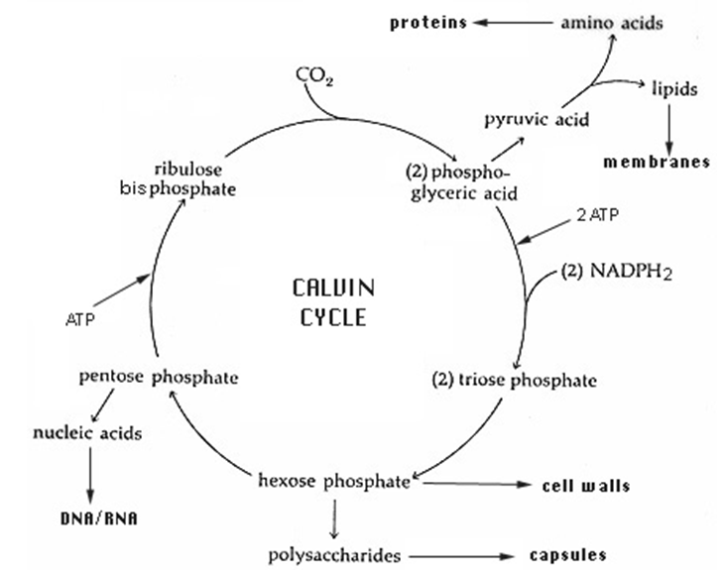

Slide 17
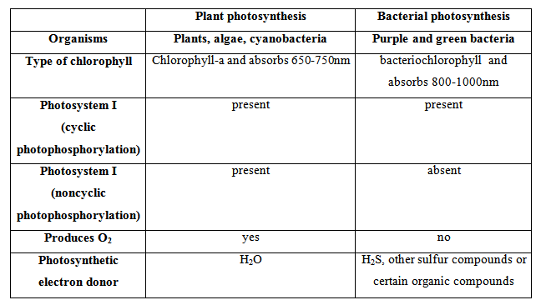

Slide 18
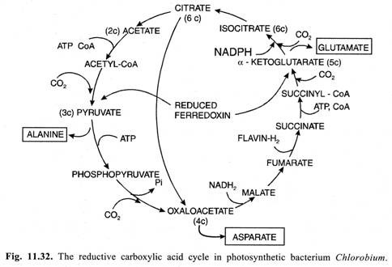
Reductive Carboxylic Acid Cycle:
In some photosynthetic bacteria such as Chlorobium, Chromatium etc. another carbon reduction cycle is known to operate which is called as Reductive Carboxylic Acid Cycle.

Slide 19
Reduced ferredoxin generated during photochemical process has strong reducing poten­tial which drives the reversal of two reactions of Krebs’ Cycle which are otherwise irre­versible in aerobic cell.
Acetyl-CoA + CO₂ + Fd (Red) → Pyruvate + CoA + Fd (oxi)
Succinyl-CoA + CO₂ + Fd (Red) → α-ketoglu tarate + CoA + Fd (oxi)
Each turn of this cycle incorporates 4CO₂ molecules which results in net synthesis of one oxaloacetate molecule.
Oxaloacetate by further metabolism through this cycle provides C₂—C₆ carbon compounds which are utilised for the synthesis of various amino acids, lip­ids and other organic compounds in bacterial cells.
However, the amino acids are main soluble products of photosynthesis in such bacteria.
α-keto acids such as pyruvate, oxaloacetate and α-ketoglutarate produced during this cycle after amination may result in the formation of amino acids-alanine, aspartate and glutamate respectively.
Reductive carboxylic acid cycle does not occur in algae and higher green plants.

Slide 20
Carbon Assimilation in Bacteria Using Organic Compounds:
Certain purple bacteria make use of simple organic compounds such as acetic acid, butyric acid, propi­onic acid etc. as the major carbon source for photosynthesizing organic matter in the cells.
In such cases, photo assimilation of organic compounds usually directly leads to the forma­tion of organic polymers.
For instance, in Rhodospirillum rubrum conversion of acetic acid into poly-β-hydroxybutyric acid is a reductive process:-
2nC₂H₄O₂ + 2nH → (C₄H₆O₂)n + 2nH₂O
Similarly, photo assimilation of succinic acid, propionic acid etc. leads to the accumu­lation of glycogen like polysaccharides.
Photosynthesis of these carbon reserves inside the bacterial cells appears to be analogous to the formation of starch in algae and higher green plants.

