Slide 1
PHENYLPROPANOIDS AND FLAVONOIDS TEA AND RUTA
DR. SUNITA PANCHAWAT
Assistant Professor
Department of Pharmaceutical Sciences
MLSU, Udaipur

Slide 2
Phenylpropanoids
The phenylpropanoids are a family of organic compounds with an aromatic ring and a three-carbon propene tail of coumaric acid, and are synthesized by plants from the amino acids phenylalanine and tyrosine via shikimic acid pathway.

Slide 3
The phenylpropanoid pathway starts from the aromatic amino acid phenylalanine (Phe, with the phenylpropanoid moiety C₆–C₃) and leads to derivatives with one, two, or more aromatic rings (C₆), each ring with a characteristic substitution pattern, and with different modifications of the propane residue of Phe (C₃).

Slide 4
Phenylpropanoid compounds constitute a broad range of structural cyclic substances. They are formed as a result of deamination of the amino acid phenylamine by the enzyme phenylalanine-ammonia lyase (PAL).
Phenyl propanoids can be structurally different due to hydroxylation, glycosidation,alkylation, phenylation, sulfatation and methylation.

Slide 5
Functions:
Phenylpropanoid serve as essential components of a number of structural polymers.
They provide protection from ultraviolet light.
They protect plants, defend against herbivores and pathogens.
Phenylpropanoids mediate plant pollinator interactions as floral pigments and scent compounds.

Slide 6
Classification:
There is still no generally accepted classification of this group of compounds. Classification is based on current impressions of the biosynthesis of phenolic compounds. Phenylpropanoids can conveniently be treated as a large class of natural compounds consisting of the following groups;

Slide 7
I. Simple phenylpropanoids;
a. Cinnamyl alcohols and their derivatives (ethers, glycosides).
b. Cinnamic acids and their derivatives (esters, glycosides, other derivatives).
c. Cinnamides
d. Phenylpropanes.
II. Complex Phenylpropanoids;
Phenylpropanoid glycosides based on phenylethanes.
b. Oxidative coupling products (lignoids): flavolignans; xanthonolignans; coumarinolignans; alkaloidolignans; neolignans; lignans (dimers and oligomers of phenylpropanoids).

Slide 8
III. Biogenetically related phenylpropanoids (flavonoids, coumarins).
FLAVONOIDS
Flavonoids (Latin word flavus meaning yellow) are secondary metabolites of plants and fungus. Chemically, flavonoids contain 15-carbon skeleton, which consists of two phenyl rings (A and B) and a heterocyclic ring (a three carbon bridge, C). This carbon structure can be abbreviated C6-C3-C6.

Slide 9
Functions:
To attract pollinator animals flavonoids play important role as plant pigments for flower coloration, producing yellow or red/blue pigmentation in petals.
Flavonoids in higher plants involved in UV filtration, nitrogen fixation and floral pigmentation.
They may also act as chemical messengers, physiological regulators and cell cycle inhibitors.
Flavonoids in combination with Rhizobia living in soil can lead to root hair deformation and several cellular responses such as ion fluxes and the formation of a root nodule.

Slide 10
Classification:
Flavones- Ring A is substituted by two phenolic hydroxyl group at C-5, C-7. They have a double bond between positions 2 and 3 and a ketone in position 4 of the C ring. These represents majority of flavonoids. Flavones are widely present in leaves, flowers and fruits as glucosides. Celery, parsley, red peppers, chamomile, mint and ginkgo biloba are among the major sources of flavones. Examples: Apigenin, Luteolin, Parsley-Apin, Buchu-Diosmin.

Slide 11
II. Flavonols
Compared with flavones, flavonols have a hydroxyl group in position 3 of the C ring, which may also be glycosylated. Flavonols are flavonoids with a ketone group. They are building blocks of proanthocyanins. Examples; Buck wheat-Rutin, Ring (Crategus oxycantha)- Quereitrin.
III. Flavanones
Flavanones, also called dihydroflavones, have the C ring saturated; therefore, unlike flavones, the double bond between positions 2 and 3 is saturated and this is the only structural difference between the two subgroups of flavonoids. Example; Lemon, sweet orange- Hespiridin, Bitter orange.

Slide 12
IV. Flavanonols
Flavanonols, also called dihydroflavones, are the 3-hydroxy derivatives of flavanones; they are an highly multisubstituted subgroup. Examples: Taxifolin (dihydroquercetin), dihydrokaemferol.
V. Isoflavones
As anticipated, isoflavones are a subgroup of flavonoids in which the B ring is attached to position 3 of the C ring. Examples: Sharapunkha-Tephrosin.
VI. Flavanols
Flavnols are also referred as catechins as well flavan-3-ols. In flavanols hydroxyl group is almost always bound to position 3 of C ring. Examples: Catechin, Epicatechin.

Slide 13
VII. Anthocyanidins
Anthocyanidins are the aglycones of antocyanins; they ase the flavylium (2- phenylchromenyylium) cations. Sugar units are bound mostly to position 3 of the C ring and they are often conjugated with phenolic acids, such as ferulic acid. They are the onlygroup of flavonoids that gives color to plants (all other flavonoids are colorless). Examples: Pelargonium flower-Plargonidin, Petunia flower- Petunidin.
VII. Chalcones
Chalcones do not have central heterocyclic nucleus and are characterized by three carbon chain with a ketone function and α,β unsaturation. Chalcones are flavonoids with open structure; they are classifieds because they have similar synthetic pathways. Examples: Safflor red-Carthamin.

Slide 14
Chemical Tests
Shinoda test- To dry powder or extract, add 5 ml of 95% ethanol, few drops of concentrated hydrochloric acid and four pieces of magnesium turnings. A pink or red colour indicates the presence of flavonoid. Colours varying from orange to red indicated flavones, red to crimson indicated flavonoids, crimson to magenta indicated flavonones.
Sodium hydroxide test- About 5 mg of the compound is dissolved in water, warmed and filtered. 10% aqueous sodium hydroxide is added to 2 ml of this solution. This produces a yellow coloration. A change in colour from yellow to colorless on addition of dilute HCl is an indication for the presence of flavonoids.

Slide 15
TEA AND RUTA

Slide 16
TEA
Synonym- Tea plant, Tea Shrub, Camellia thea
Biological source- It consists of dried leaves and leaf bud of Thea sinensis, Family: Theaceae
Distribution- India, China, Shrilanka, Indonesia and Japan.
Black Tea (India and Shrilanka)
Green Tea (China and Japan)

Slide 17
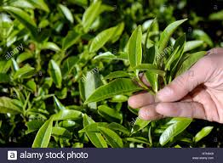

Slide 18
Chemical Constituents- Polyphenols, Catechins (flavanols).
Major catechins are (-)-epicatechin gallate, (-)-epicatechin.
Other compounds are purine alkaloids viz., caffeine, theophylline and theobromine. Trace compounds present in tea are amino acids, carbohydrates, proteins, chlorophyll, volatile organic compounds, fluoride, aluminium, minerals, black and green tea are extremely good source of Vitamin C.

Slide 20
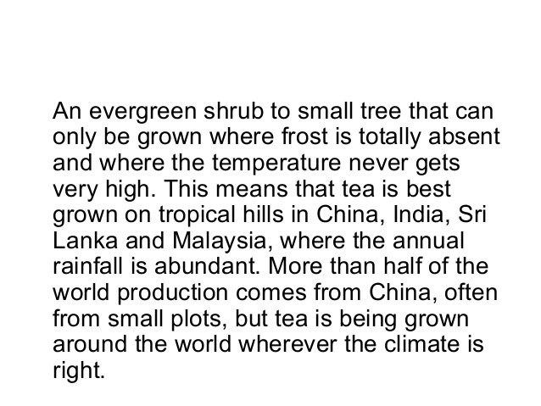

Slide 21
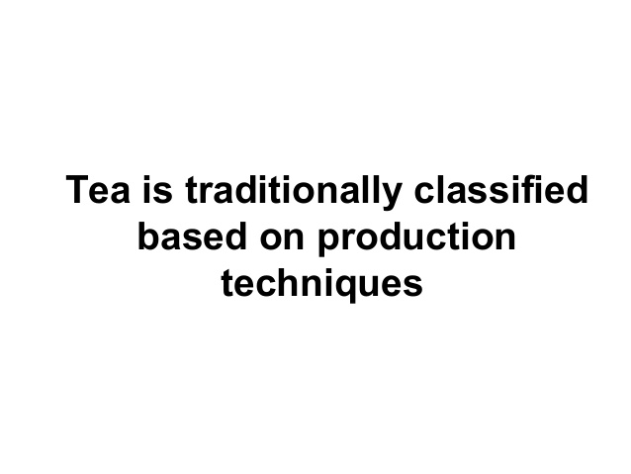

Slide 22
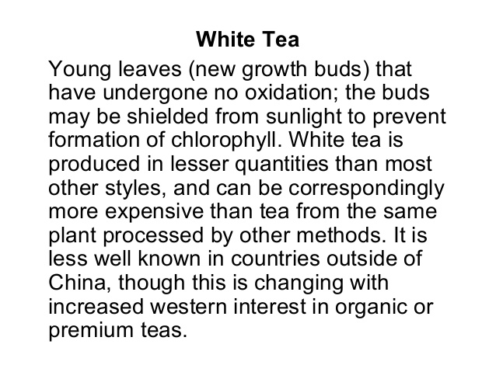

Slide 23
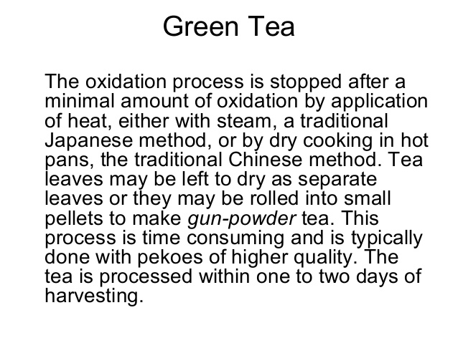

Slide 26
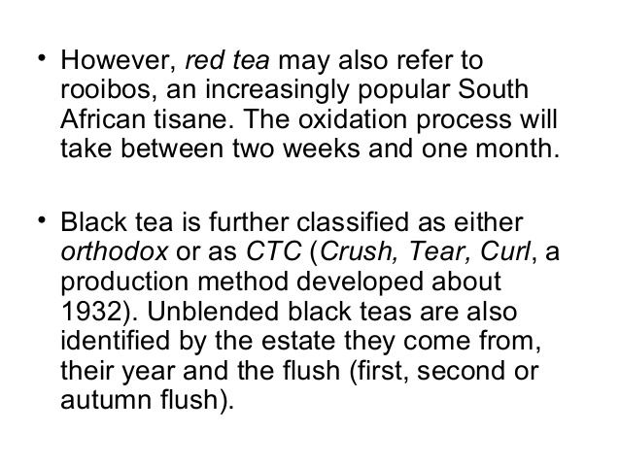

Slide 27
Uses
Purine alkaloids (caffeine, theophylline and theobromine)are CNS stimulant and diuretic.
Catechins have antioxidant, anticancer and anti-ageing effects.
Green tea used in obesity and weight loss treatment.

Slide 28
RUTA
Synonym- Rue, Garden rue, German rue, Sadab.
Biological source- It consists of fresh and dried leaves of Ruta graveolens L., Family: Rutaceae
Distribution- It is native to the Balkan Peninsula. It is now grown throughout the world in gardens.

Slide 29
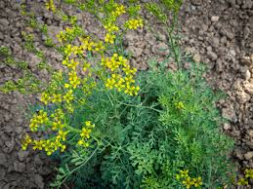
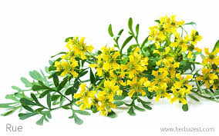
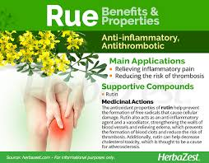

Slide 31
Chemical Constituents
Glycosides: Flavonoid rutin
Alkaloids: Coquisagenine, skimmianine and graveoline, furanocoumarins (psoralens), bergaptene and xanthotoxine.
Volatile oil: Methyl-nonyl-ketone, methyl-n-octyl-ketone and methyl-heptyl-ketone.
Alcohol: Methyl-ethyl-carbinol, pinene and limonenes.
Flavonoid: Rutin and Quercetin

Slide 32
Uses
Rue is used for painful conditions including headache, arthritis, cramps and muscle spasms.
In Chinese medicine rue is considered as an emmenagogue, hemostat, intestinal antispasmodic, sedative, uterine stimulant, vermifuge, rheumatism, cold and fever.
In Poland it is used as an aphrodisiac and choleretic.
Medicinally it is used as bitters, an aromatic stimulant, ecbolic and in suppression of the menses.

