Slide 1
Manufacturing systems
Semester –II
Polymer Processing Management
Unit-1
Brian Russell

Slide 2
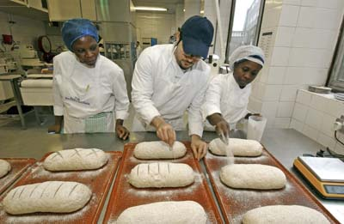
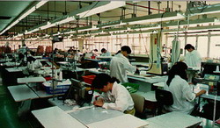
Manufacturing
Manufacturing involves efficiently turning raw materials into goods which we need or want and are able to sell to others.

Slide 3
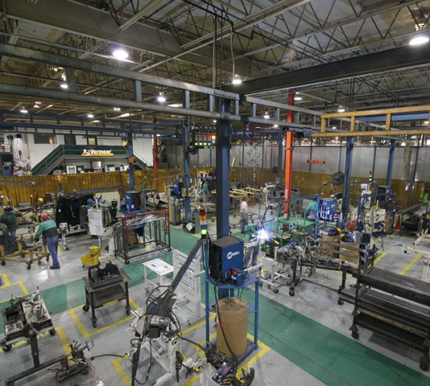
Manufacturing
Manufacturing requires:
Special buildings or places of work
Organisation of people
Organisation of tools & equipment
Health and safety considerations
Communication systems
Efficient working methods

Slide 4
SYSTEMS APPROACH TO MANUFACTURING

Slide 5
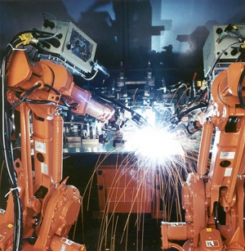
Planning for manufacturing
Planning the manufacturing methods at the design stage is an essential part of good product design

Slide 6
How many products?
The first decision when organising manufacturing is to determine how many products are required as that will have the biggest impact on how the manufacturing is organised. It will also be important to keep in mind how much the customer is likely to pay for the product and what levels of quality are required as these will greatly affect the organisational decisions.

Slide 7
Scales of production
The following terms are used to describe the different scales of production:
One-off or Jobbing Production
Batch Production
Mass or Flow Production
Continuous Production

Slide 8
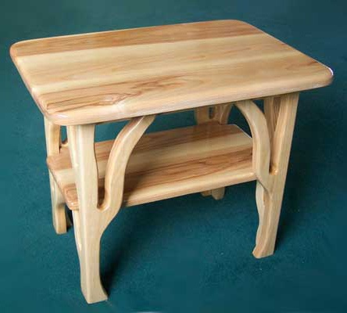
One off or Jobbing production
Sometimes called custom production it is dependant upon highly skilled workers who are able to take on a number of tasks and build a product to a customer’s exact needs.
No two products will be exactly the same which is often the reason the customers are prepared to pay more.

Slide 9
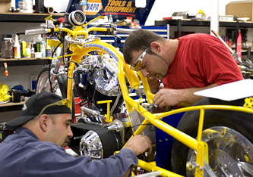
One off or Jobbing production
Simple products made by a single worker, such as a wedding cake, to very complex products, such as oil rigs manufactured by hundreds of workers are examples of one-off production

Slide 10
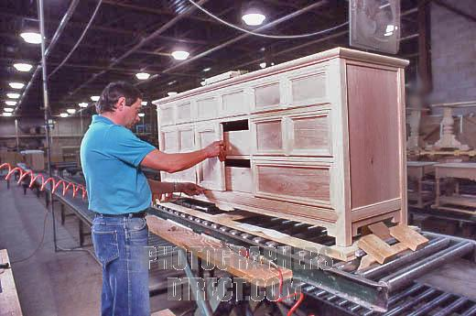
Batch production
This involves manufacturing a number of identical products, usually by workers who take on more specialised roles.
Manufacturing aids are usually needed although batch production typically makes use of generalised tools and equipment which can be used to make other products.

Slide 11
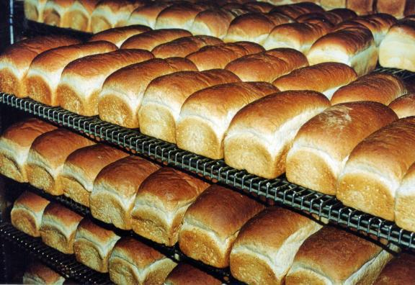
Batch production
Bread and cakes are often made in batches and the number of products is determined by the amount of dough mixed. Furniture is usually made in batches as they are often bulky and expensive to store.

Slide 12
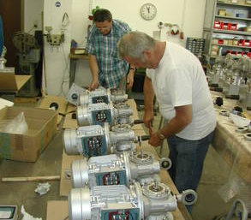
Batch production
Batches might be as small as a handful and as large as several thousand

Slide 13
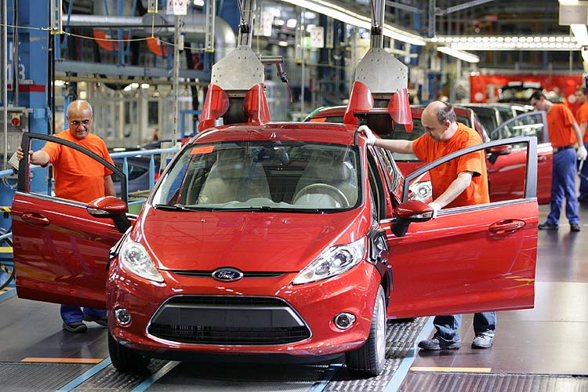
Mass or Flow production
With this scale of production it is usual for the products to move along a production line as it is a very efficient way of making products in a short period of time. Workers are often less skilled as there is usually more reliance upon machinery set up to do a single task at each stage.

Slide 14
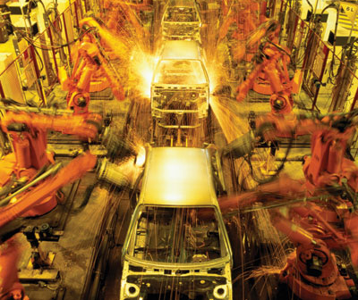
Mass or Flow production
Production lines could use lots of workers doing manual tasks, such as soldering and assembling components, but usually involves some degree of automation.

Slide 15
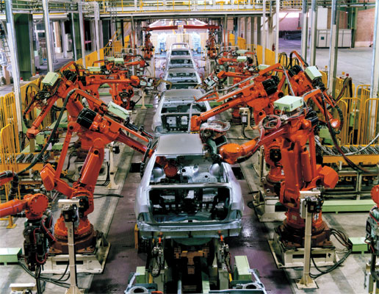
Mass or Flow production
Car production is typically organised in this way and the manufacturing space has been created or adapted to allow the production to be as efficient as possible. Many thousands of the same product are necessary to justify the investment in machinery.

Slide 16
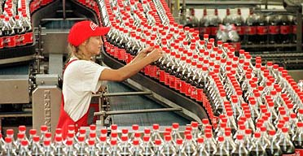
Continuous production
This is where the number of products required is so huge that the production line needs to run day and night.
To ensure that this can happen the whole manufacturing plant is often designed around a single product.
Automation is vital to this type of production

Slide 17
Continuous production
Soft drinks are an example of a product manufactured using continuous production where the design of the manufacturing plant is essential to enable the quantities to be achieved at low costs.

Slide 18
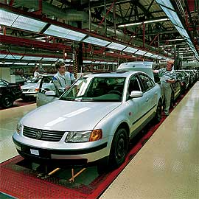
Just in Time manufacturing
Advances in computer technology means that many products can be manufactured using all the cost savings of mass production but still give the customer a wide range of choices.
Not exactly custom production but sometimes hundreds of options are possible as every product is made to an individual specification.

Slide 19
Just in Time manufacturing
This is only possible because of:
Shared information systems between manufacturer and individual component and material suppliers
Excellent supplier partnerships

Slide 20
Benefits of Just in Time
Reduced lead times between placing an order and receiving the product
Less finance is tied up in stock as every product is already ordered by a customer and the suppliers provide materials and components when needed

Slide 21
Lean Manufacturing
Lean Manufacturing is an initiative focused on eliminating all waste in manufacturing processes resulting in a more competitive and profitable position in the industry. Lean production is aimed at the elimination of waste in every area of production including customer relations, product design, supplier networks and factory management. Its goal is to incorporate less human effort, less stock, less time to develop products, and less space to become highly responsive to customer demand while producing top quality products in the most efficient and economical manner possible.

Slide 22
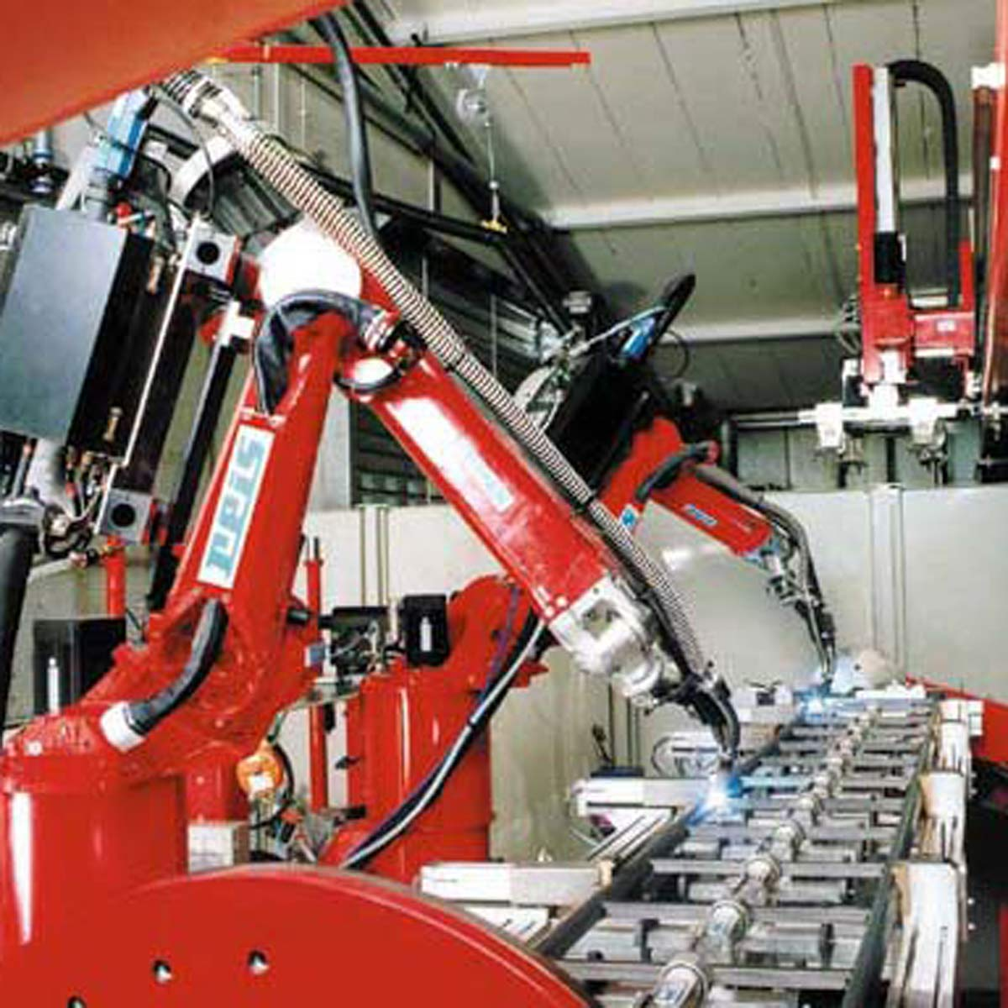
Flexible Manufacturing
Flexible manufacturing aims for parts of the manufacturing system to be as flexible as possible.
One example of this is the ability for machines to change what they make without having to be altered by people.

Slide 23
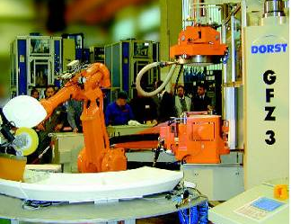
Flexible Manufacturing
Automated materials handling is an essential part of this method of manufacturing which is only possible because of advances in ICT.
This can have major time saving benefits allowing customised production at mass production prices.

Slide 24
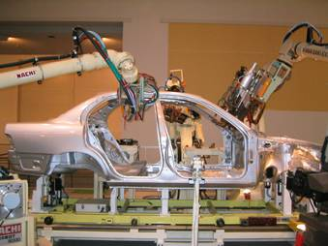
Computer Integrated Manufacture
All the computer functions are integrated together in a fully automated system.
This would include moving materials/assemblies between machining operations.

Slide 25
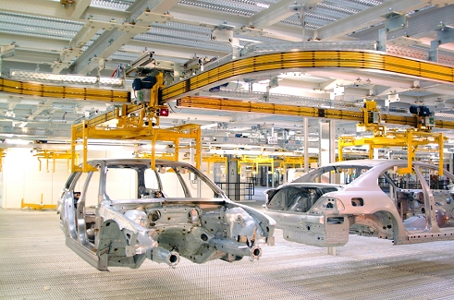
Capital costs
Lots of manufacturing decisions are based upon being able to produce unit costs per product or component which are acceptable to the customer.
With high volume production such as car manufacturing this investment can be in billions of pounds to set up the manufacturing plant

Slide 26
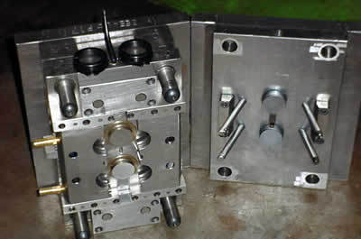
Tooling costs
Making moulds to be able to produce plastic parts very cheaply is dependent upon manufacturing many thousands to offset the cost of making the moulds. Typically, manufacturers would need to be able to sell over 250,000 products to be able to consider injection moulding as a viable production method.

Slide 27
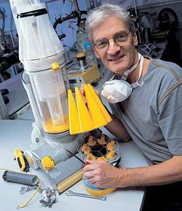
R&D costs
Often referred to as R&D the cost of research, designing and developing the product has got to be paid for at some stage.
One–off production of custom products needs to cover the R&D costs in a single product. This means that it forms a high percentage of the overall cost.

Slide 28
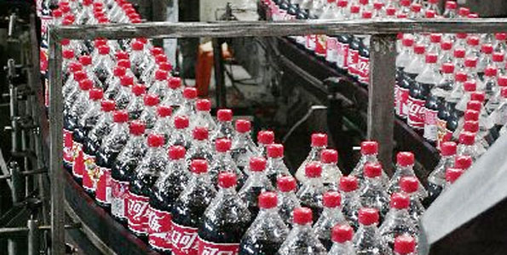
R&D costs
With continuous production the volumes are so large that R&D costs might represent an insignificant percentage of an individual product. This is particularly likely to be the case if the product is one that will keep the production line flowing for a number of years.
Using standard components can have a major impact on both time and costs as someone else has already invested in the R&D.

Slide 29
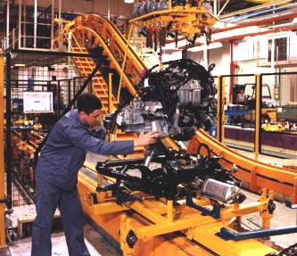
Labour costs
The costs of employing people is a major part of production costs.
One-off production tends to have high labour costs. Workers are generally highly skilled and the use of automated machinery is uncommon.

Slide 30
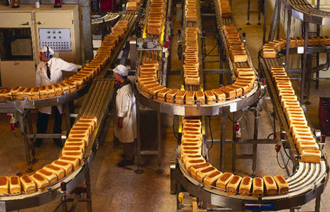
Labour costs
Continuous production is likely to use a very small number of workers in comparison with the products manufactured. Investment will have been very high with a major aim being to keep labour costs to the minimum.

Slide 31
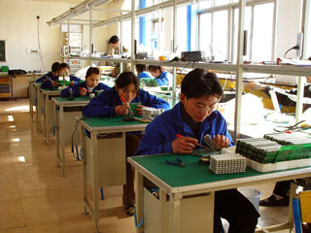
Labour costs
Manufacturing products in countries with low labour costs can have a major impact on the cost of the finished product.
Workers need to take rest breaks whereas automated machinery can run for vast periods of time before the need to have a service break.

Slide 32
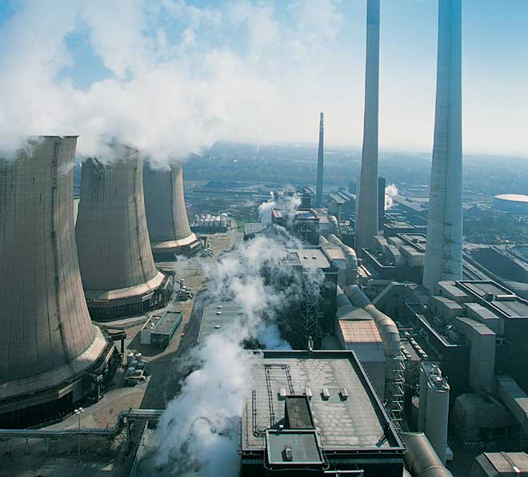
Energy costs
This is another area where there are likely to be big differences due to the scale of the production. Transport and energy costs have a major impact on the final cost of the product.

Slide 33
Energy costs
One-off production is likely to have smaller energy costs as a lot of hand production takes place.
By contrast, continuous production is likely to have massive energy costs although that is shared out across a lot of products.

Slide 34
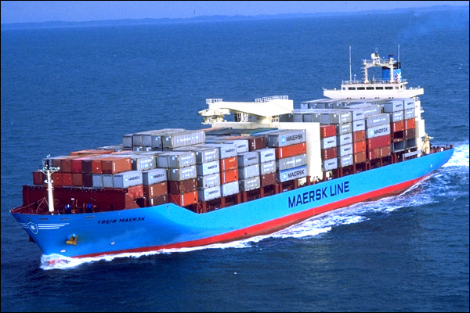
Transport costs
Local one-off production is likely to have low transport costs but that is likely to be in contrast to continuous production where products may be transported around the world.

Slide 35
The scale of production
In conclusion, there is a great deal to consider and many of these decisions are driven by the marketing department who will have to be certain that they can sell the products once manufactured and at a good enough price to regain the investment made.
Being able to reduce the need for capital investment, labour costs and transport and energy costs are important design decisions.

Slide 36
Moral issues
Being able to produce high quality cheap products will always have an impact elsewhere. Think about what those issues would be.

Slide 37
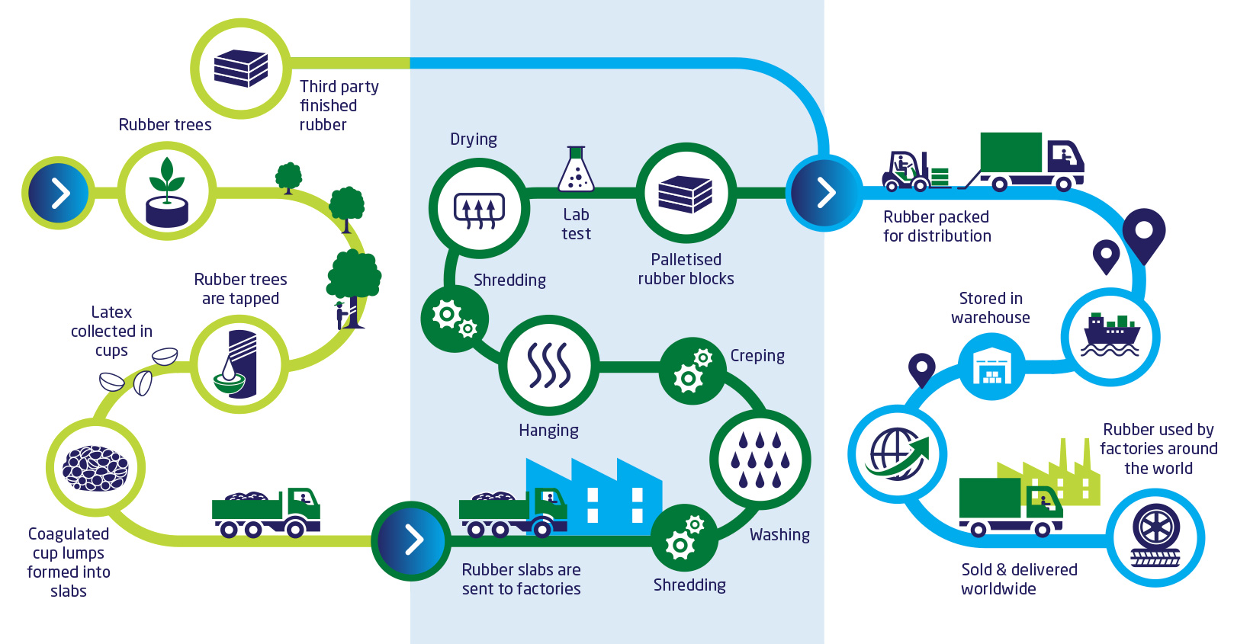
NATURAL RUBBER SUPPLY CHAIN

