Slide 1
POLYMER PROCESSING MANAGEMENT
UNIT-1
Manufacturing system, process control & quality control

Slide 9
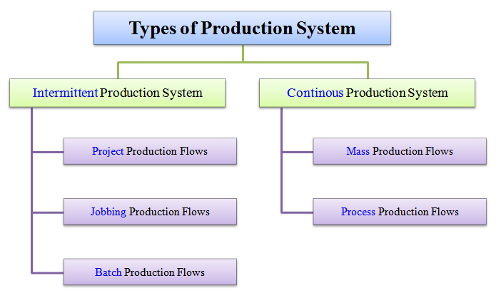

Slide 21
