Slide 1
Process Control:
Introduction to Quality Control

Slide 2
Learning Objectives
At the end of this module, participants should be able to:
Define quality control and describe its relationship to the overall quality management system.
Describe differences in quantitative, qualitative, and semi-quantitative examinations.

Slide 3
The Quality Management System
Organization
Personnel
Equipment
Process Control
Purchasing
&
Inventory
Information Management
Assessment
Documents
&
Records
Occurrence Management
Process Improvement
Customer Service
Facilities
&
Safety
Notes:
3

Slide 4
Definition
Quality Control (QC) is part of quality management focused on fulfilling quality requirements ISO 9000:2000 (3.4.10)
QC is examining “control” materials of known substances along with patient samples to monitor the accuracy and precision of the complete examination (analytic) process.

Slide 5
Purpose
The goal of QC is to detect errors and correct them before patients’ results are reported

Slide 6
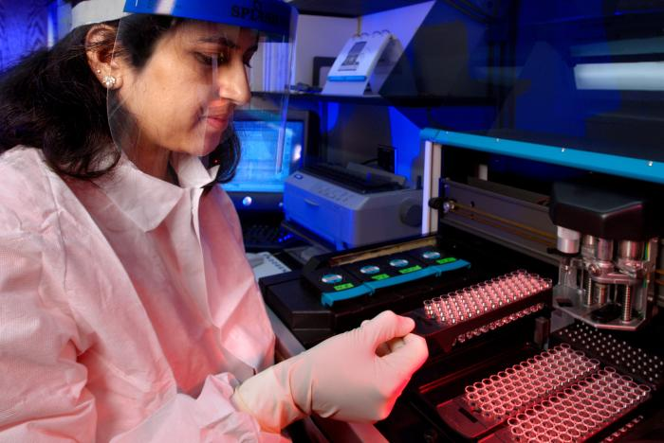
Quantitative Examinations
Measure the quantity of a particular substance in a sample
Measurements should be both accurate and precise

Slide 7
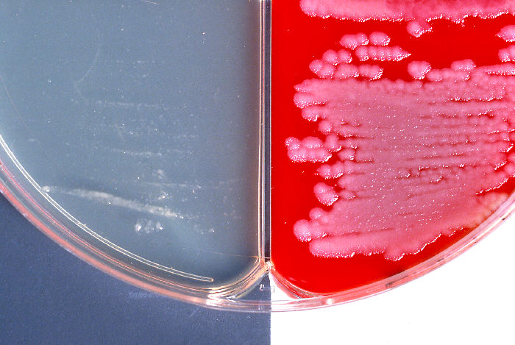
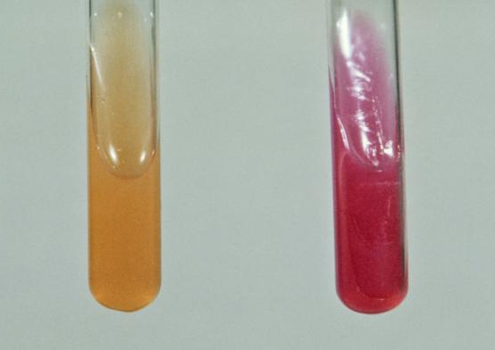
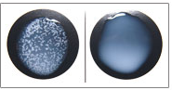
Qualitative Examination Methods
Examinations that do not have numerical results:
  growth or no growth
  positive or negative
  reactive or non-reactive
  color change

Slide 8
Semi-quantitative Examination Methods
Results are expressed as an estimate of the measured substance:
“trace amount”, “moderate amount,” or “1+, 2+, or 3+”
number of cells per microscopic field
titers and dilutions in serologic tests
Notes:
8

Slide 9
include corrective actions
QC Program Steps

Slide 10
QC Summary
important part of quality management system
goal is to identify errors and eliminate them before reporting patient results
different methods applied for quantitative, qualitative, and semi-quantitative results

