Slide 1
POLYMER PROCESSING MANAGEMENT
UNIT-5
QUALITY MANAGEMENT SYSTEMS

Slide 3
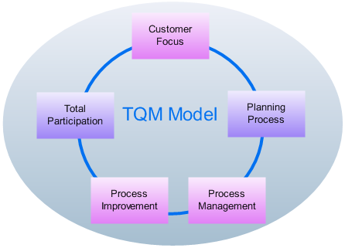

Slide 5
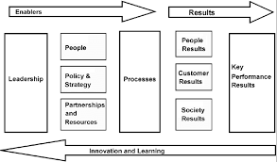
EFQM EXCELLENCE MODEL

Slide 6
ISO 9000 family - Quality management
The ISO 9000 family addresses various aspects of quality management and contains some of ISO’s best known standards. The standards provide guidance and tools for companies and organizations who want to ensure that their products and services consistently meet customer’s requirements, and that quality is consistently improved.

Slide 8
ISO 14000 is a family of standards related to environmental management that exists to help organizations
minimize how their operations (processes, etc.) negatively affect the environment (i.e. cause adverse changes to air, water, or land);
comply with applicable laws, regulations, and other environmentally oriented requirements; and
(c) continually improve in the above.

Slide 9
ISO/TS 16949 is an ISO technical specification aimed at the development of a quality management system that provides for continual improvement, emphasizing defect prevention and the reduction of variation and waste in the automotive industry supply chain.

Slide 11
THANKS

