Slide 1
Pricing methods:
Full cost pricing, Marginal cost pricing, Pricing of new products, Penetration pricing, Skimming pricing.

Slide 2
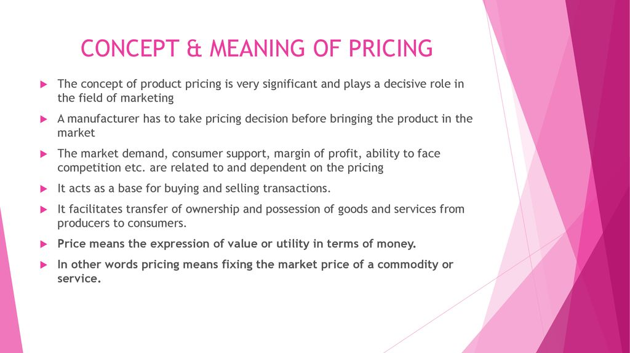
Concept and meaning of pricing

Slide 3
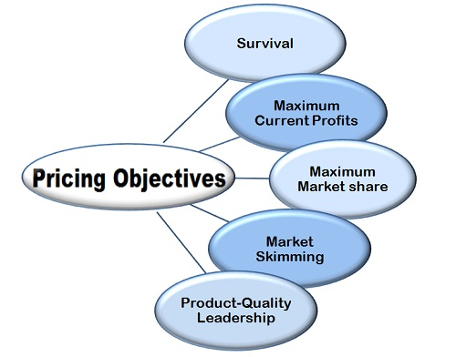
Objectives of Pricing :

Slide 4
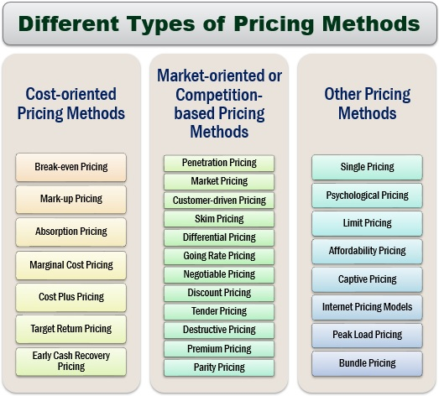

Slide 5
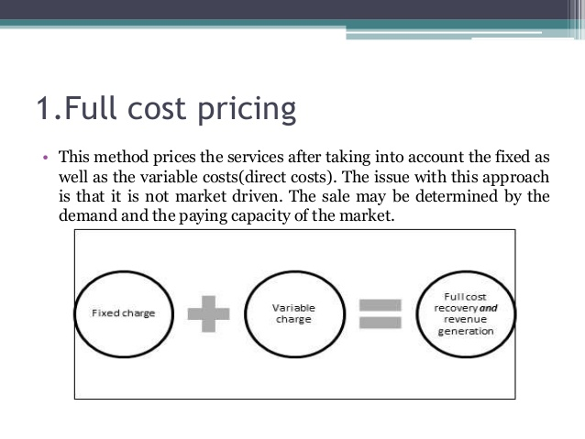

Slide 6
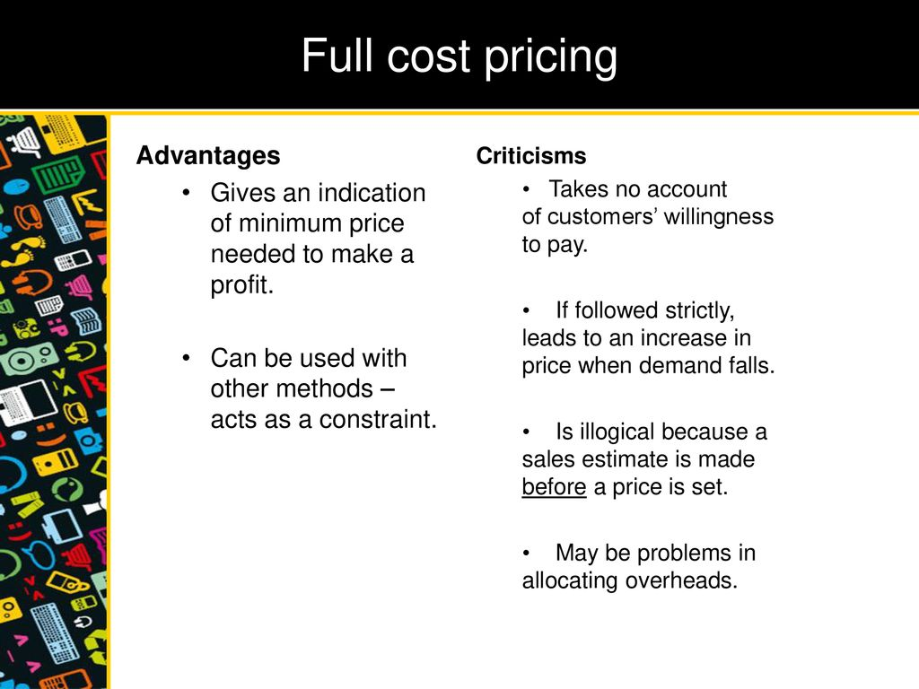

Slide 7
Marginal cost pricing
Marginal-cost pricing, is the practice of setting the price of a product to equal the extra cost of producing an extra unit of output. By this policy, a producer charges, for each product unit sold, only the addition to total cost resulting from materials and direct labour. Businesses often set prices close to marginal cost during periods of poor sales. If, for example, an item has a marginal cost of $1.00 and a normal selling price is $2.00, the firm selling the item might wish to lower the price to $1.10 if demand has waned. The business would choose this approach because the incremental profit of 10 cents from the transaction is better than no sale at all

Slide 8
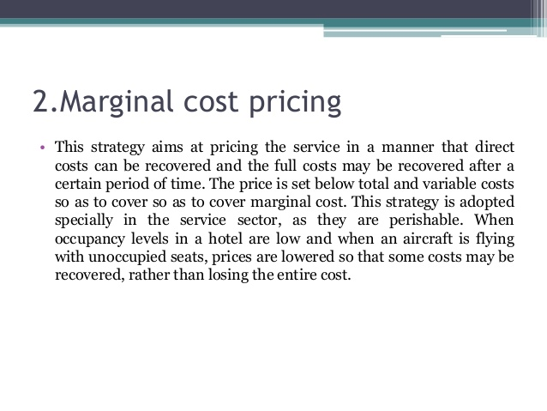

Slide 9
Advantages and disadvantages of marginal cost pricing
Advantages
It is a relatively simple pricing method - quick to calculate and easy to implement
Can help to smooth fluctuations in demand.
It can be very useful where the firm has spare capacity and may not be able to put its resources to other, perhaps more profitable, uses.
Can be a useful way to attract other different market segments into the market e.g. low peak train travellers may be attracted by lower prices and only travel during the day because of low prices - they may not otherwise have travelled.
Can be a good way to remain in business and price-competitive in a time of difficult trading. Prices can then be raised later when the economic situation improves.

Slide 10
Disadvantages
Not sustainable as a long-term pricing strategy as the firm will need to recover the full costs of production.
Can result in lower price expectations and make it more difficult to raise prices again at a later stage.
If markets are not fully separated then there can be leakage between the markets with different prices. Customers who might have paid a higher price may take advantage of the lower marginal cost price.

Slide 11
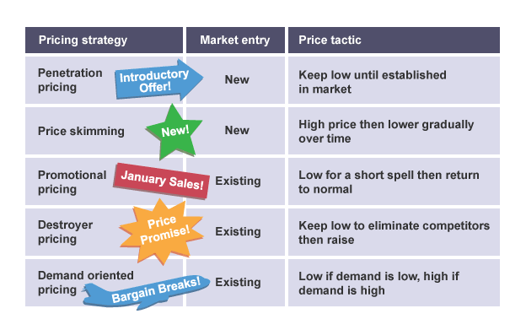
Pricing of new products

Slide 12
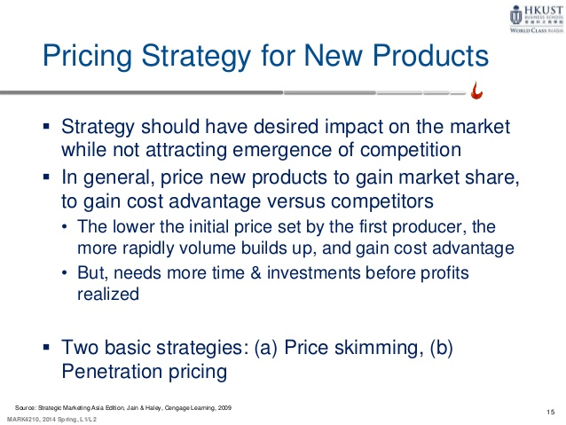

Slide 13
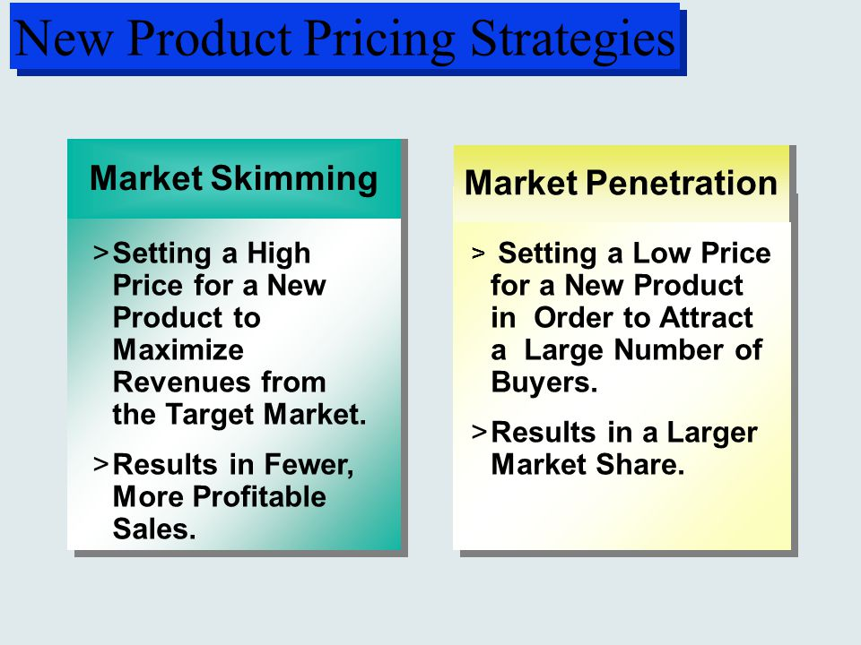

Slide 14
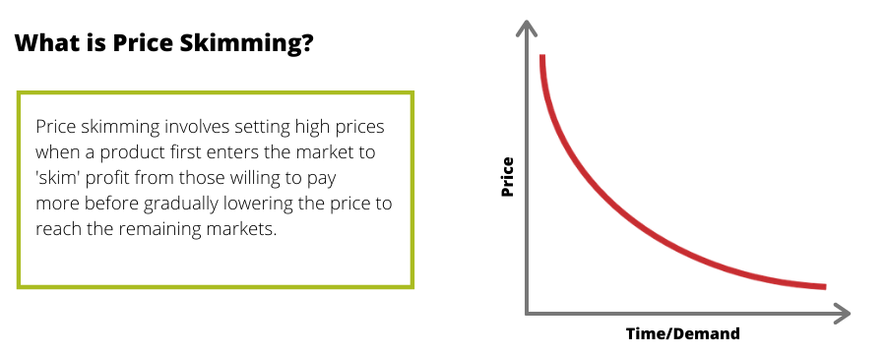

Slide 15
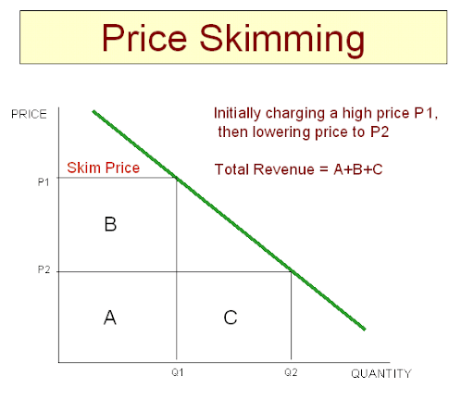
Diagrammatical representation :

Slide 16
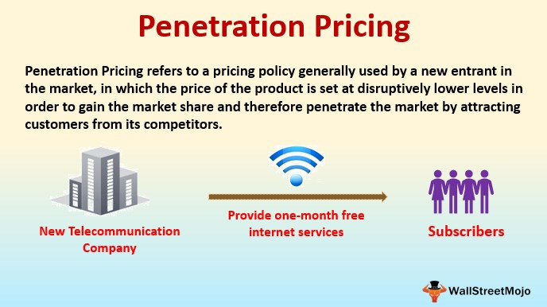
Penetration pricing :

Slide 17
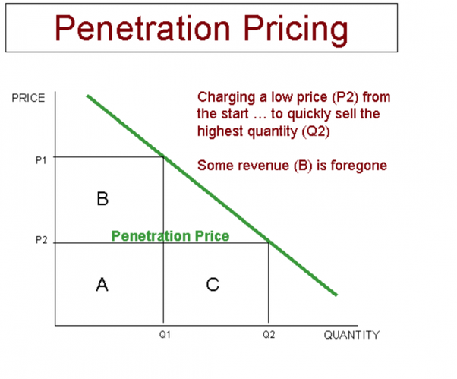
Diagrammatical representation :

Slide 18
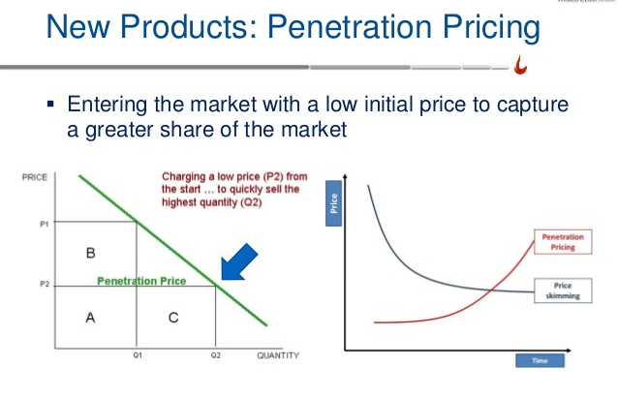

Slide 19


