Slide 1
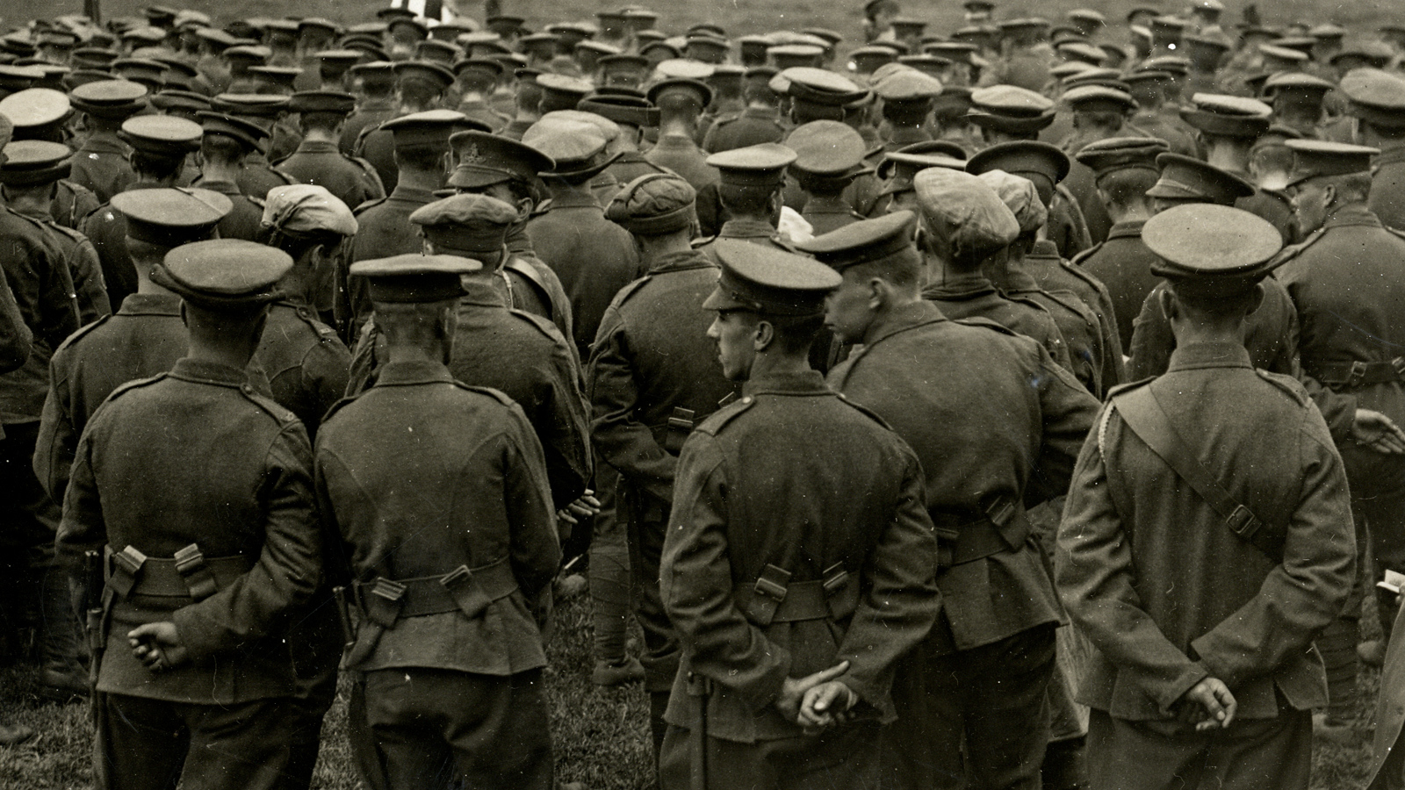
Soldier poets
The great war
1914-19
English Lit. 3rd Yr Hons P I MLSUniv.Udaipur
MINAKSHI JAIN
Soldier Poets:
Rupert Brooke, Wilfred Owen,
Siegfried Sassoon

Slide 2
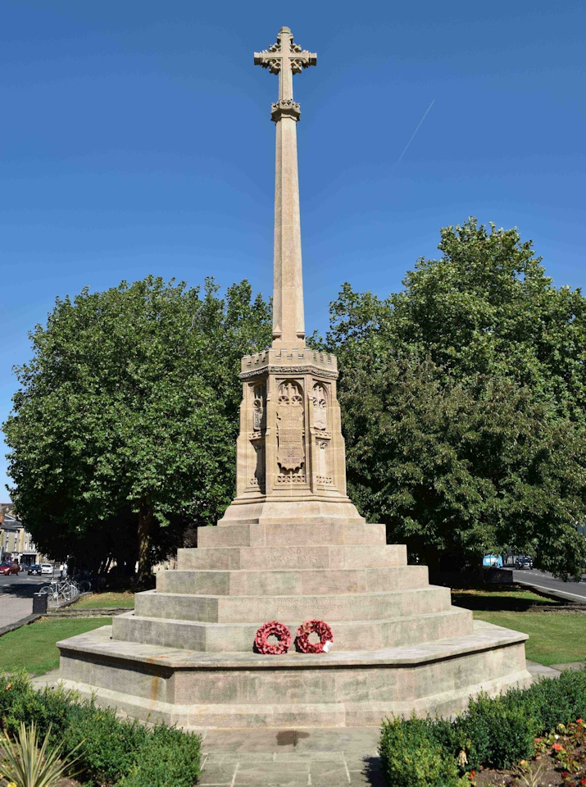
Your country needs you!
Soldiers-Poets
Glorious/Noble Sacrifice

Slide 3
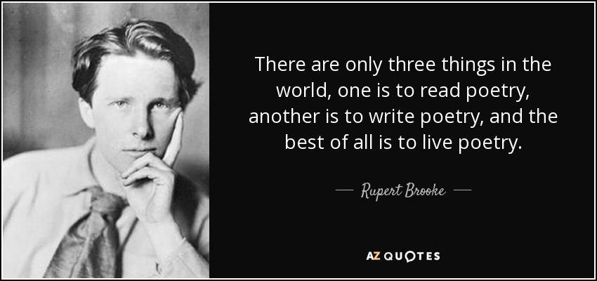

If I should die, think only this of me:
That there’s some corner of a foreign field
That is for ever England.
If I should die, think only this of me:
That there’s some corner of a foreign field
That is for ever England. (‘The Soldier’)
Blow out, you bugles, over the rich Dead!
There’s none of these so lonely and poor of old,
But, dying, has made us rarer gifts than gold.
These laid the world away; poured out the red
Sweet wine of youth; gave up the years to be
Of work and joy, and that unhoped serene,
That men call age; and those who would have been,
Their sons, they gave, their immortality. (‘The Dead’)

Slide 4
“These hearts were woven of human joys and cares,
Washed marvellously with sorrow, swift to mirth.
The years had given them kindness. Dawn was theirs,
And sunset, and the colours of the earth.
These had seen movement, and heard music; known
Slumber and waking; loved; gone proudly friended;
Felt the quick stir of wonder; sat alone;
Touched flowers and furs and cheeks. All this is ended. “
( The Dead )

Slide 5

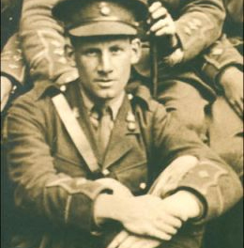
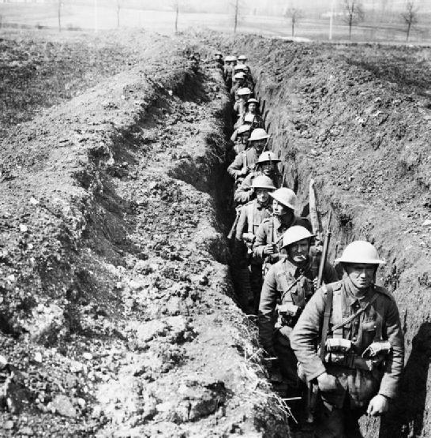
Anti-militarism
What passing-bells for these who die as cattle?
Anthem for Doomed Youth – Owen
To find the face of him that I have lost
The Last Meeting- Sassoon
Embankment, barbed wire fence, trench-feet
Trench War - Great War

Slide 6
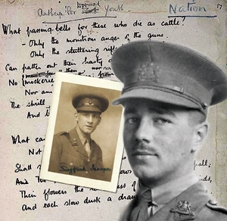
think only this of me:
That there’s some corner of a foreign field
That is for ever England.

Slide 7
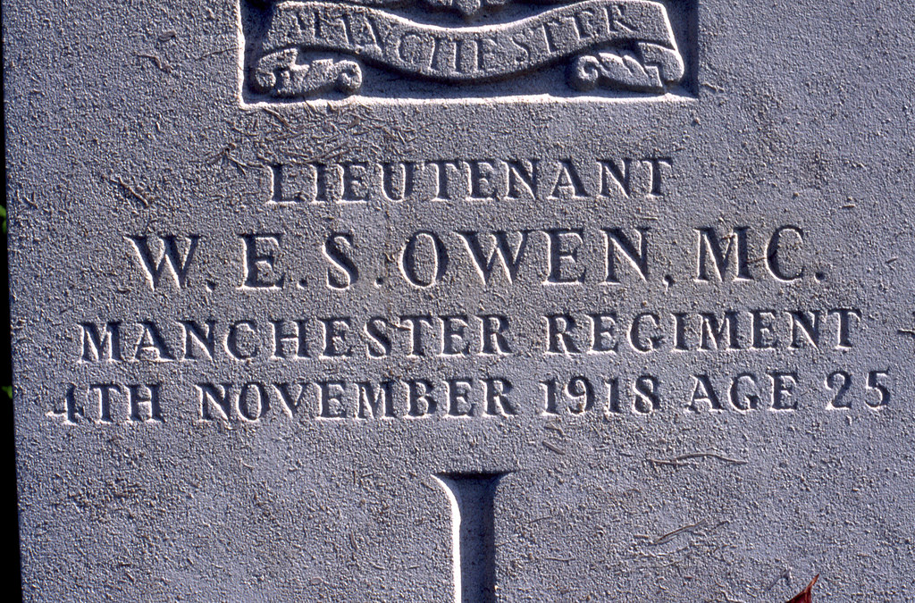
think only this of me:
That there’s some corner of a foreign field
That is for ever England.

Slide 8
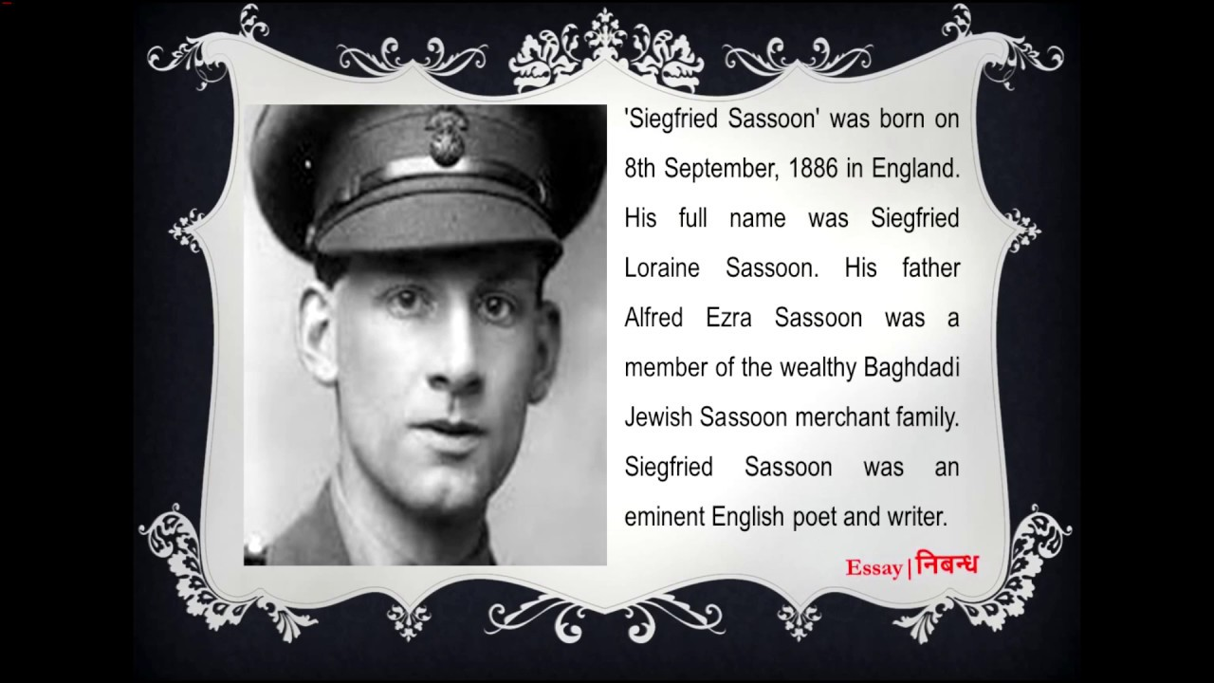

Slide 9
‘The last meeting’
Siegfried sassoon

Slide 10
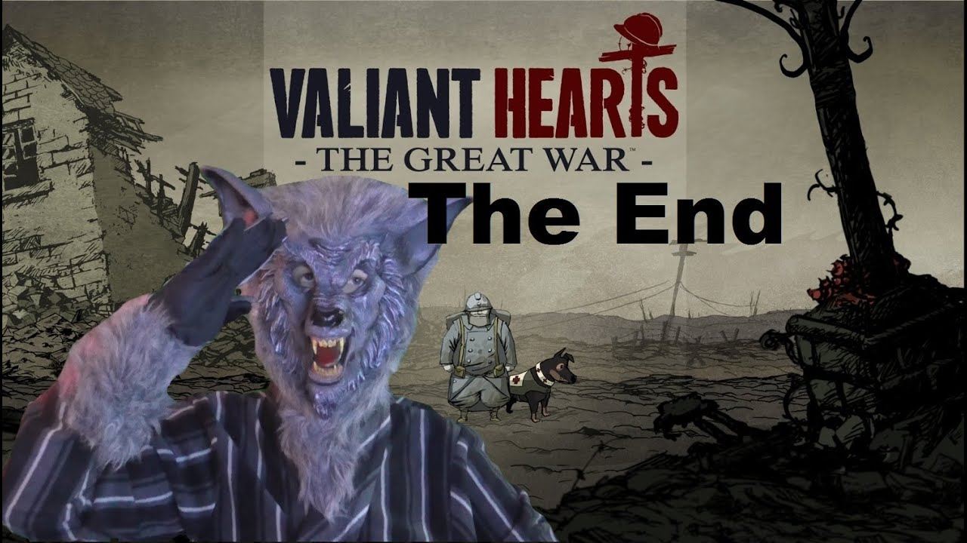
think only this of me:
That there’s some corner of a foreign field
That is for ever England.

