Slide 1
Temperature and reaction rate
A- Ability to meet (molecules that are well mixed will have a greater chance of colliding)
Concentration of reactants (more molecules means more collisions)
Temperature (faster moving molecules means more collisions per unit of time).

Slide 2
Temperature and reaction rate
By increasing the temperature, a small number of molecules reach Ea. The reaction is exothermic, further increasing temperature and causing more molecules to reach Ea, etc.
Shift due to higher temperature
Fraction of molecules
Ea
Kinetic energy ⎯→

Slide 3
Maxwell–Boltzmann Distributions
This fraction of molecules can be found through the expression
where R is the gas constant and T is the Kelvin temperature.
-E_{a}
RT
f = e

Slide 4
Endothermic Reactions

Slide 5
Exothermic Reactions

Slide 6
The Arrhenius Equation
k = rate constant at temperature T
A = frequency factor
E_{a} = activation energy
R = Gas constant, 8.31451 J/K·mol

Slide 7
The Arrhenius Equation, Rearranged
Simplifies solving for E_{a}
-E_{a} / R is the slope when ln(k) is plotted against (1/T)
ln(A) is the y-intercept
Linear regression analysis of a table of ln(k) vs. (1/T) can quickly yield a slope
E_{a} = -R(slope)

Slide 8
Arrhenius Equation
Taking the natural logarithm of both sides, the equation becomes
ln k = - ( ) + ln A
E_{a}
R
1
T
y = m x + b
Therefore, if k is determined experimentally at several temperatures, E_{a} can be calculated from the slope of a plot of ln k vs. .
1
T

Slide 9
Catalysis
Catalyst: A substance that speeds up a reaction without being consumed
Enzyme: A large molecule (usually a protein) that catalyzes biological reactions.
Homogeneous catalyst: Present in the same phase as the reacting molecules.
Heterogeneous catalyst: Present in a different phase than the reacting molecules.

Slide 10
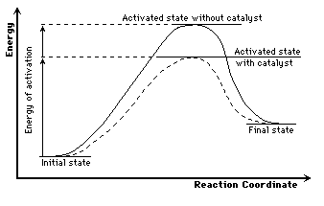
Lowering of Activation Energy by a Catalyst

Slide 11
Catalysts Increase the Number of Effective Collisions

