Slide 1
CHAPTER – 1
MOLECUALR WEIGHT OF
POLYMERS

Slide 3
The Molecular weight (M.W) of a polymer is the sum of the weights of all
the monomers which make up the entire polymer.
For example the general formula for Polyethylene is , and if value of n= 500 (here n= no. of monomers attached to the polymer) then the molecular weight of PE=14000 while if n=1000 then molecular weight will be 28000.
So the molecular weight of the single can be varied by changing the no of the monomeric units attached to it.
Molecular weight
definition

Slide 7
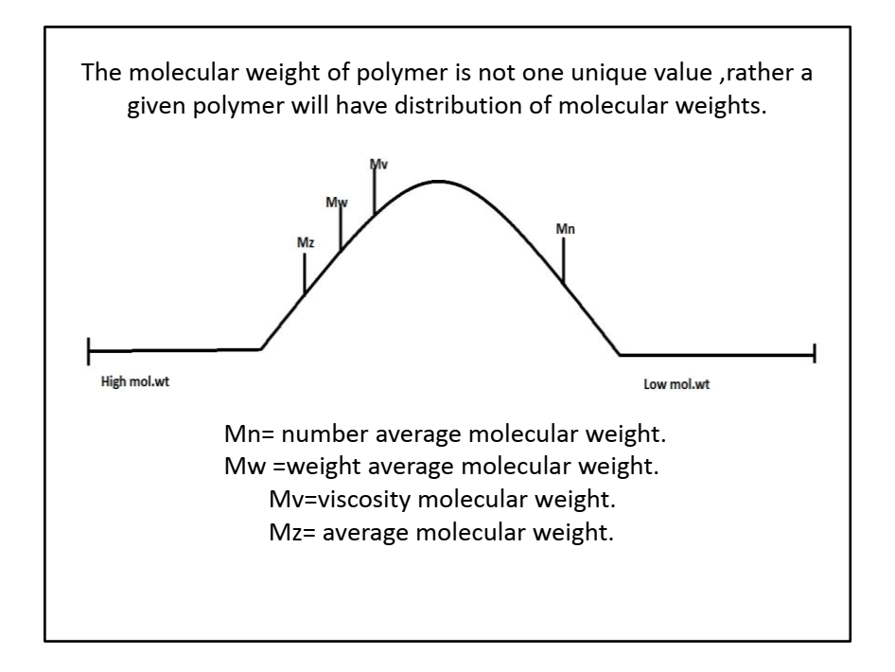
TYPES OF MOLECULAR
WEIGHT

Slide 10
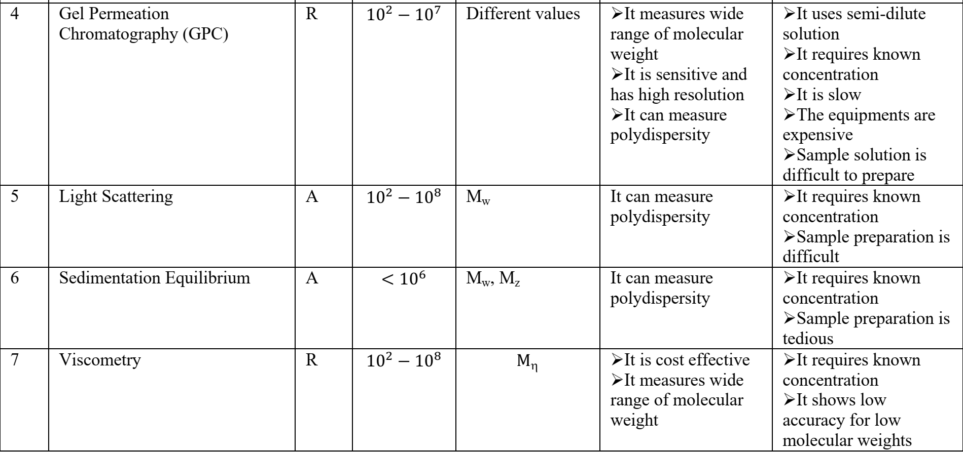

Slide 11
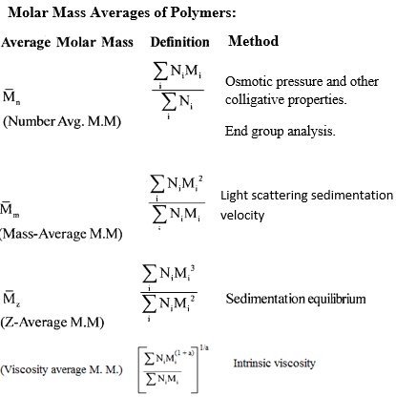

Slide 13
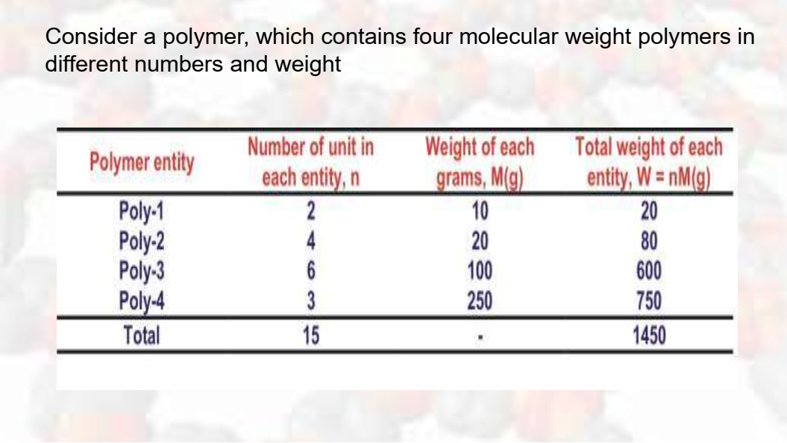
Similarly, Weight average molecular weight (M_{w}) of the polymer is calculated as :

