Slide 1
MAHABALIPURAM
BY- R PARTHSARTHY

Slide 2
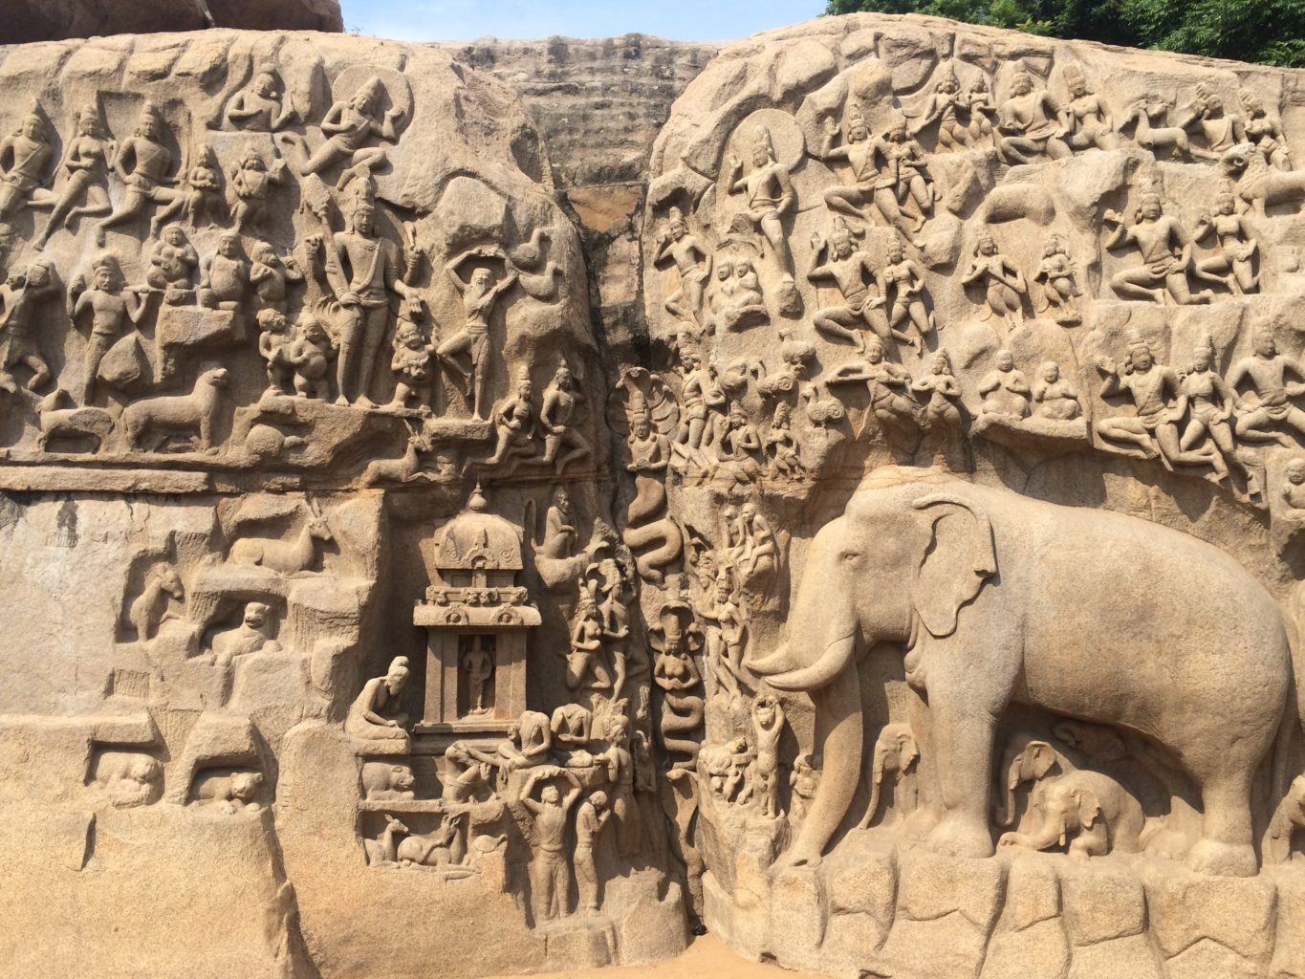
MAHABALIPURAM RELIEF

Slide 3
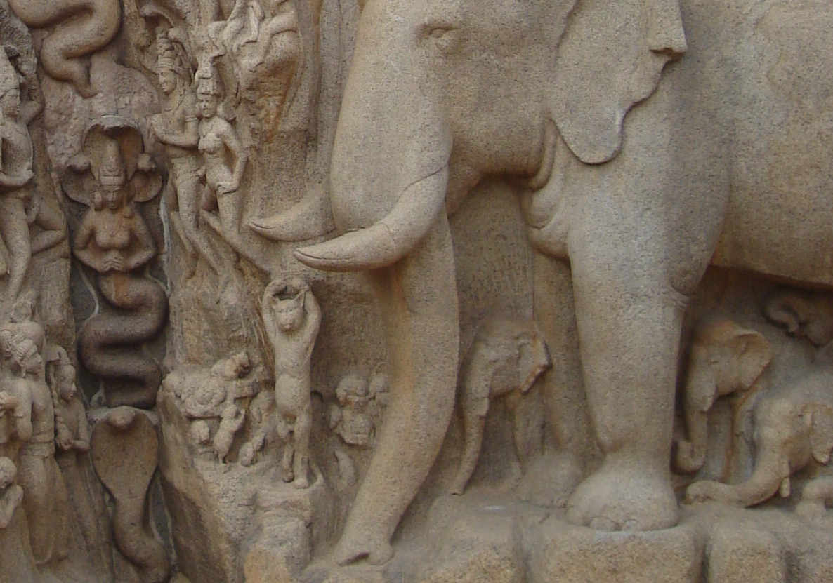

Slide 4
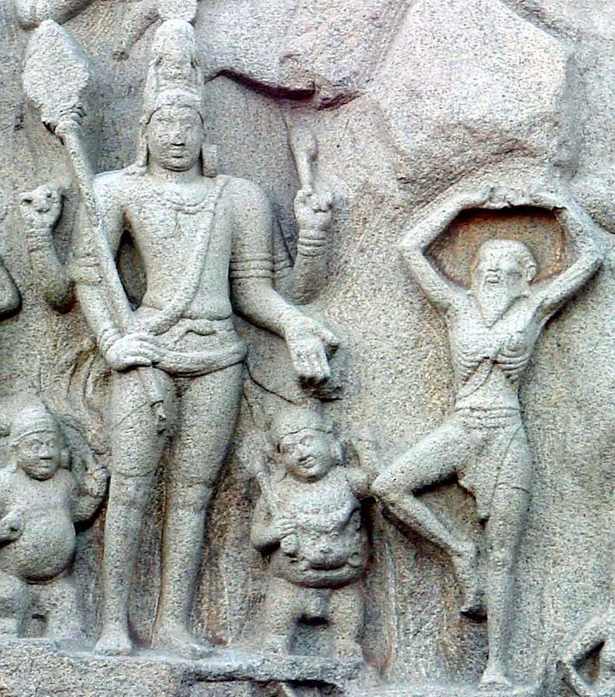

Slide 5
Hawks in ripples circumscribe the vision
Painstakingly a wind thumbs paragraphs
Of bright sea. In adoration bends the sky
To rocks, dreams in stone, of a thousand years.
Here a king and his people built: only
The casuarina endures and survives
The penance of Arjuna, the boon
Of four-armed Siva to Bhagiratha.
Beasts roam the forest. A cat meditates.
These are stones and to the finger sweat dust.
Dream of Time in stone, who shall tell
Us the dream, Hiuen Tsang or Manucci?

Slide 6
THANK YOU.

