Slide 1
regret
By- R. PARTHASARTHY

Slide 2
Evening, wet and depressing
Dripped over the housetops: over
The far-off hill, High spires for horns.
And the unsuspecting arm of the seashore
Held the lovers, loops of moonlight for eyes, who
Drowned with each whisper the wave’s roar-
And the city lay entangled in the rain’s net.
This is my regret now: O how
Readily I have forfeited the embarrassing gift innocence
In my scramble to be man
When Spring is no more
The young season.

Slide 3
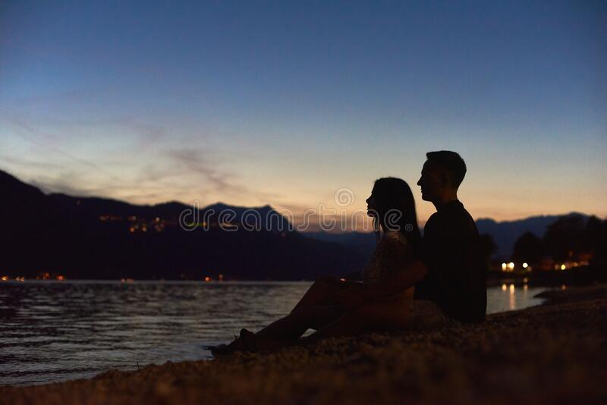

Slide 4
Thanks…

