Slide 1
Theatre and
William Shakespeare
(1564-1616)

Slide 2
Introduction
Context:
Invention of printing machine in 1485; William Caxton issued the first imaginative book to be published in England -Sir Thomas Malory’s retelling of the Arthurian legends as Le Morte D’Arthur

Slide 3
Exploration of the World
In 1492, Christopher Columbus’s voyage to the Americas opened European eyes to the existence of the New World.
Rise of Renaissance “ the rebirth of learning and culture”

Slide 4
Elizabethan Age(1558-1603)
Renaissance reached its peak during the reign of Queen Elizabeth I.
In 1588, the Spanish Armada, the fleet of the Catholic King Philip of Spain, was defeated.

Slide 5
Theatre in Elizabethan Age
First public theatre in 1576, the stage became the place for debate, spectacle, and entertainment.
Hence it led to the development of modern English as a national language.

Slide 6
University Wits
Christopher Marlowe, Robert Greene, George Peele, Thomas Nashe and Thomas Lodge

Slide 7
Theatre
Comedy
Tragedy
Terence
Plautus
Seneca

Slide 8
Mediaeval Plays
Mystery, Miracle, Morality plays and Court Interludes
First Comedy-Ralph Roister Doister (1552) by Nicholas Udall
First Tragedy-Gorboduc (1561) by Thomas Norton and Thomas Sackville

Slide 9
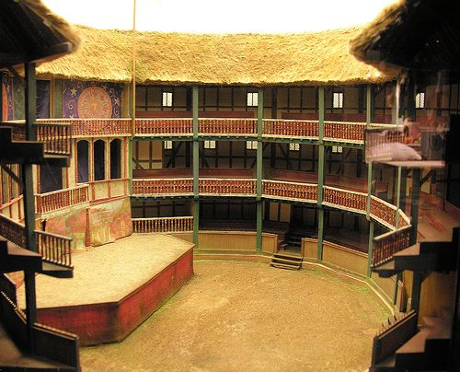
Shakespeare’s Globe Theatre
Thrust stage

Slide 10
Shakespeare’s Company
The Lord Chamberlain’s
The King’s Men
His works
37 plays
154 sonnets
2 long poems- Venus and Adonis (1593) The rape of Lucrece (1594)

Slide 11
Shakespeare’s Life (26 April 1564 – 23 April 1616)
An English playwright, poet, and actor, widely regarded as the greatest writer in the English language and the world's greatest dramatist.
He is often called England's national poet and the "Bard of Avon" (or simply "the Bard")
Shakespeare was born and raised in Stratford-upon-Avon, Warwickshire. At the age of 18, he married Anne Hathaway, with whom he had three children: Susanna and twins Hamnet and Judith. Sometime between 1585 and 1592, he began a successful career in London as an actor, writer, and part-owner of a playing company. At age 49 (around 1613), he appears to have retired to Stratford, where he died three years later.

Slide 12
First Publication of His Works
In 1623, two fellow actors and friends of Shakespeare's, John Heminges and Henry Condell, published a more definitive text known as the First Folio, a posthumous collected edition of Shakespeare's dramatic works that included all but two of his plays. The volume was prefaced with a poem by Ben Jonson, in which Jonson presciently hailed Shakespeare in a now-famous quote as "not of an age, but for all time".

Slide 13
As You Like It: A Pastoral Comedy
The direct and immediate source of As You Like It is Thomas Lodge's Rosalynde, Euphues Golden Legacie, written 1586–87 and first published in 1590. Lodge's story is based upon "The Tale of Gamelyn".
As You Like It was first printed in the collected edition of Shakespeare's plays, known as the First Folio, during 1623. By means of evidences, external and internal, the date of composition of the play has been approximately fixed at a period between the end of 1598 and the middle of 1599.

Slide 14
Macbeth
A tragedy placed near to Shakespeare's other greatest tragedies, Hemlet, Othello and King Lear
Publication
Macbeth cannot be dated precisely.Some scholars have placed the original writing of the play as early as 1599,but most believe that the play is unlikely to have been composed earlier than 1603, as the play is widely seen to celebrate King James' ancestors and the Stuart accession to the throne in 1603. Many people agree that Macbeth was written in the year 1606, citing multiple allusions to the Gunpowder Plot of 1605 and its ensuing trials. However, A. R. Braunmuller finds the 1605–06 arguments inconclusive, and argues only for an earliest date of 1603. Simon Forman saw Macbeth at the Globe in 1610 or 1611.Macbeth was first printed in the First Folio of 1623.

