Slide 1
TOXICOLOGY
B. Sc. THIRD YEAR
PAPER – I

Slide 2
Outline- Dose-response
Dose
Response
Lethal concentrations
Tolerance limits
Dose-response relationships
LD50 and LC50
Margin of safety
TOXICITY CURVES

Slide 3
FACTORS THAT INFLUENCE TOXICITY
ACUTE
EXPOSURE
SUB CHRONIC
CHRONIC
DOSE
RESPONSE

Slide 4
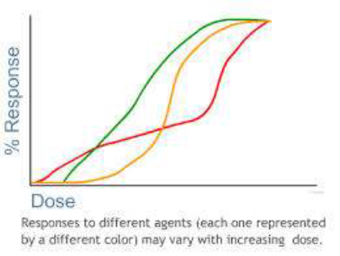
Dose
The amount of chemical entering the body
This is usually given as mg of chemical/kg of body weight = mg/kg
The dose is dependent upon
    The concentration
    The properties of the toxicant
    The timing and frequency of exposure
    The length of exposure
    The exposure pathway

Slide 5
What is a Response?
The degree of responses depend upon the dose and the organism
  Change from normal state could be on the molecular, cellular, organ, or organism level--the symptoms
Local vs. Systemic
Reversible vs. Irreversible
Immediate vs. Delayed
Monotonic – response increases with dose (cyanide and many traditional toxicants)
Nonmonotic – response does not increase with dose (hormones, endocrine disruptors, micronutrients and vitamins)

Slide 6
DOSE LIMITS- ACUTE TOXICITY
Acute toxicity: It involves lethal concentrations and short-term exposures .
The end point is usually death
ROUTE that carries toxic substances to blood stream and the LETHALITY are dependent on each other
Three routes are used to determine MEDIUM LETHAL DOSE (LD50)
    ORAL
    DERMAL
    INHALATION
LD50 is a dose of a toxic chemical that kills half of the population.
LD50 is obtained by plotting, for a given dose the proportion of the population that responded to that dose and all lower doses .

Slide 7
CHRONIC TOXICITY
Chronic toxicity: It involves Sub-lethal concentration and long-term exposure
Chronic toxicity test is used to derive Effective Dose
ED50: Is the dose by which half of the population has been affected
Effect could be anything but death
ED50 is obtained by plotting, for a given dose the proportion of the population that responded to that dose and all lower doses

Slide 9
Dose response
Definition:
The characteristics of exposure and the spectrum of effects come together in a correlative relationship customarily referred to as the dose-response relationship
Two types:
    Individual to varying doses of a chemical
    Population of individuals

Slide 10
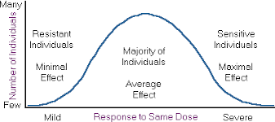

Slide 11
DOSE RESPONSE CURVE- basic principles
A CURVE describing the relationship between the dose (quantity) of the chemical administered and the percentage response of the test population
THRESHOLD CONCENTRATION - a concentration above which some effect or response will be produced and below which it will not
Every interaction of the toxicant is either reversible or irreversible and generate a proportional response od varied type
Variability in the response of the individual to dose may be expressed graphically by distribution curve

Slide 12
Dose Response Curves

Slide 13
Monotonic Dose Response
LD50
• Quantal responses can be treated
as gradient when data from a
population is used.
• The cumulative proportion of the
population responding to a certain
dose is plotted per dose (10-30
fold variation w/in a population)
• If Mortality is the response, the
dose that is lethal to 50% of the
population LD50 can be generated
from the curve
• Different toxicants can be
compared (lowest dose is most
potent)

Slide 14
TOXICITY CURVE
No Observable Adverse Effect Level (NOAEL) – the threshold where no effects are observed.
Lowest Observable Adverse Effect Level (LOAEL) – the concentration level where effects are observed.

Slide 15
Interaction of chemicals
Additive effect
The combine effects of two chemicals is equal to the sum of the effects of each agent given alone
1) Example: 2 + 3 = 5
2) Organophosphous pesticides ⇒ Cholinesterase inhibition
Synergistic effect
The combine effects of two chemicals are greater to the sum of the effects of each agent given alone
1) Example: 2 + 2 = 20
2) Carbon tetrachloride and ethanol induced hepatoxicity

Slide 16
Interaction of chemicals
3. Potentiation effect
One chemical dose not has a toxic effect on a certain organ but when
added another chemical
1) Example: 0 + 2 = 10
2) Isopropanol is not hepatoxic, but enhance carbon tetrachloride
induced hepatoxicity
4. Antagonistic effect
The combine effects of two chemicals interfere with each other’s
action
1) Example: 4 + 0 = 1
2) Dimercaprol (BAL) chelates with metal ions, As, Pb….
3) Atropine and PAM are OP antidotes
4) Metal-binding protein, Metallothionein binding with Cd

Slide 17
Potency – concentration to produce an effect.

Slide 18
Comparison of dose response:
Therapeutic index (TI) - TI is defined as the ratio of the dose required to produce a toxic effect and the dose needed to elicit their desired therapeutic response.
    For drugs use in risk assessment
    TI = LD50/ED50
    The higher TI is relative safety
Marginal of safety (MOS):
  For nondrug chemicals use in risk assessment
  Estimated exposed dose to a human population and the highest nontoxic dose determined in experimental animals
  MOS = LD1/ED99

Slide 19
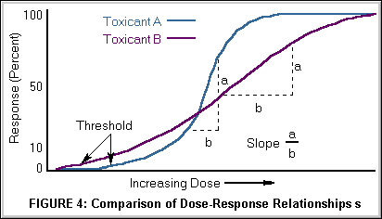

Slide 20
The dose-effect relationship is the relationship between dose and effect on the individual level.
An increase in dose may increase the intensity of an effect, or a more severe effect may result.
A dose-effect curve may be obtained at the level of the whole organism, the cell or the target molecule. Some toxic effects, such as death or cancer, are not graded but are “all or none” effects.
It is essential to toxicology to establish dose-effect and dose-response relationships.
In medical (epidemiological) studies a criterion often used for accepting a causal relationship between an agent and a disease is that effect or response is proportional to dose.

Slide 21
Several dose-response curves can be drawn for a chemical—one for each type of effect.
The dose-response curve for most toxic effects (when studied in large populations) has a sigmoid shape. T
here is usually a low-dose range where there is no response detected; as dose increases, the response follows an ascending curve that will usually reach a plateau at a 100% response.
The dose-response curve reflects the variations among individuals in a population. The slope of the curve varies from chemical to chemical and between different types of effects.
For some chemicals with specific effects (carcinogens, initiators, mutagens) the dose-response curve might be linear from dose zero within a certain dose range.
This means that no threshold exists and that even small doses represent a risk. Above that dose range, the risk may increase at greater than a linear rate.

Slide 22
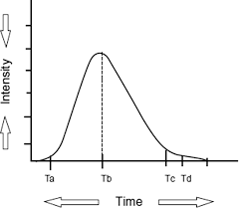

Slide 23
LD₅₀ (effective dose) is the dose causing 50% lethality in an animal population. The LD₅₀ is often given in older literature as a measure of acute toxicity of chemicals. The higher the LD₅₀, the lower is the acute toxicity. A highly toxic chemical (with a low LD₅₀) is said to be potent. There is no necessary correlation between acute and chronic toxicity.
ED₅₀ (effective dose) is the dose causing a specific effect other than lethality in 50% of the animals.
NOEL (NOAEL) means the no observed (adverse) effect level, or the highest dose that does not cause a toxic effect. To establish a NOEL requires multiple doses, a large population and additional information to make sure that absence of a response is not merely a statistical phenomenon.
LOEL is the lowest observed effective dose on a dose-response curve, or the lowest dose that causes an effect.

Slide 24
A safety factor is a formal, arbitrary number with which one divides the NOEL or LOEL derived from animal experiments to obtain a tentative permissible dose for humans.
This is often used in the area of food toxicology, but may be used also in occupational toxicology.
A safety factor may also be used for extrapolation of data from small populations to larger populations.
safety factors range from 10⁰ to 10³.
A safety factor of two may typically be sufficient to protect from a less serious effect (such as irritation) and a factor as large as 1,000 may be used for very serious effects (such as cancer).
The term safety factor could be better replaced by the term protection factor or, even, uncertainty factor. The use of the latter term reflects scientific uncertainties, such as whether exact dose-response data can be translated from animals to humans for the particular chemical, toxic effect or exposure situation.

