Slide 1
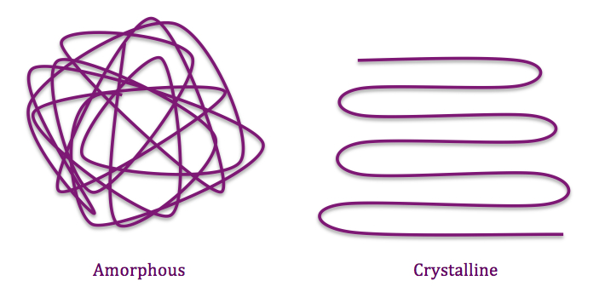
CRYSTALLINITY
IN
POLYMERS

Slide 2
CRYSTALLINITY

Slide 8
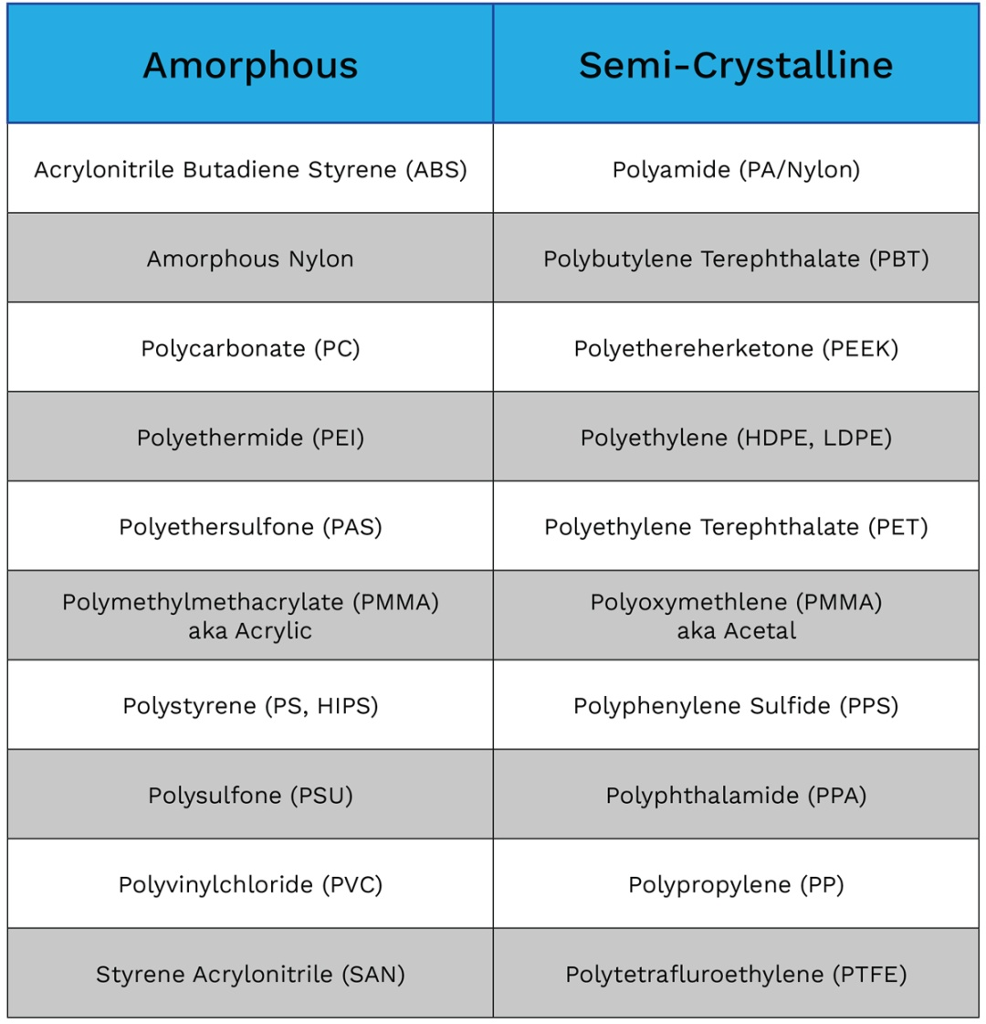
CRYSTALLINE POLYMERS
POLYETHYLENE (HDPE, LDPE)
ISO-TACTIC POLYPROPYLENE (PP)
POLYETHYLENE TERPHTHALATE (PET)
KEVLAR
CELLULOSE
NATURAL RUBBER (NR)
POLYPHENYLENE

Slide 13
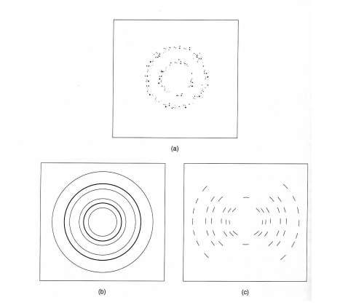
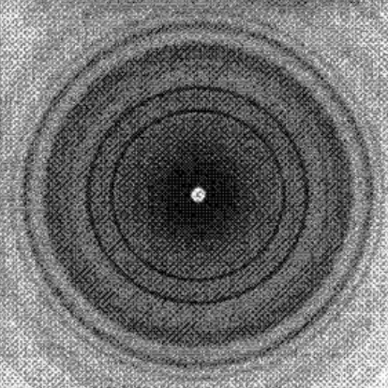
Semi – Crystalline Poly(3-hydroxybutyrate) polymer
Amorphous Polymer
Crystalline Polymers
Semi – Crystalline Polymers

Slide 18
FACTORS AFFECTING DEGREE
OF CRYSTALLINITY

