Slide 1
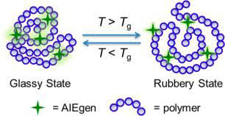
GLASS TRANSITION
TEMEPERATURE (Tg)

Slide 3
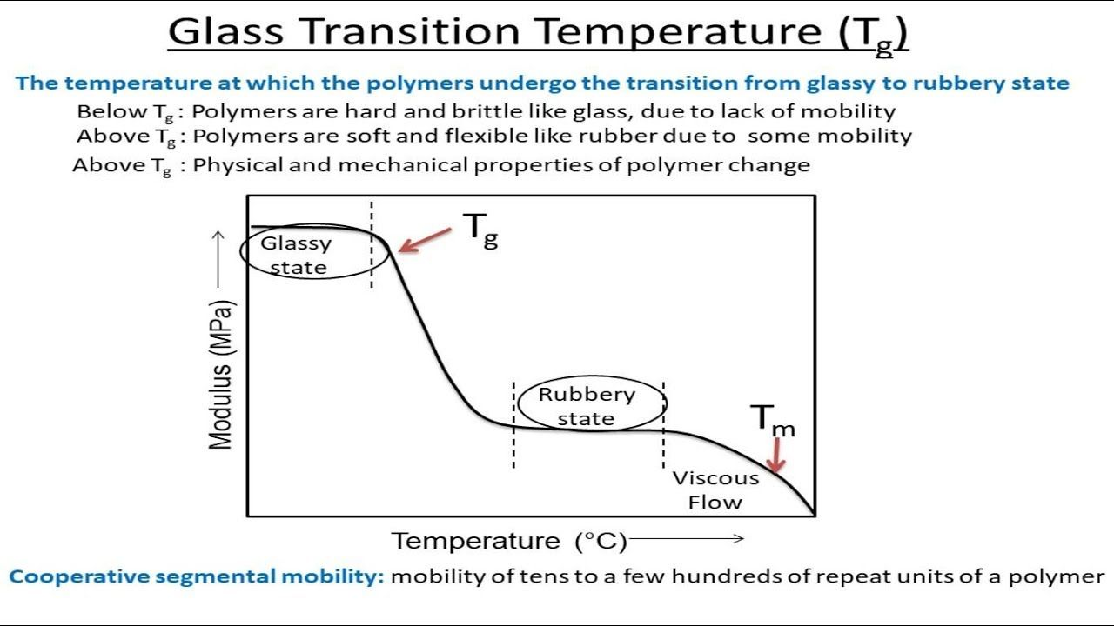

Slide 5
FACTORS AFFECTING Tg
Effect of Molecular Weight on Tg
Effect of Cross linking and Crystallinity
Effect of Intermolecular Forces
Effect of Steric Effects and Bulky Groups
Effect of aromatic ring or rigid ring structure
Effect of Chain Flexibility & Rigidity
Effect of Plasticizers on Glass Transition Temperature

Slide 6
1. Molecular Weight
The molecular weight of a polymer affects on glass transition temperature (Tg), but up to a limited value, i.e., 20,000.

Slide 7
2. CROSSLINKING & CRYSTALLINITY

Slide 8
3. INTERMOLECULAR FORCES

Slide 9
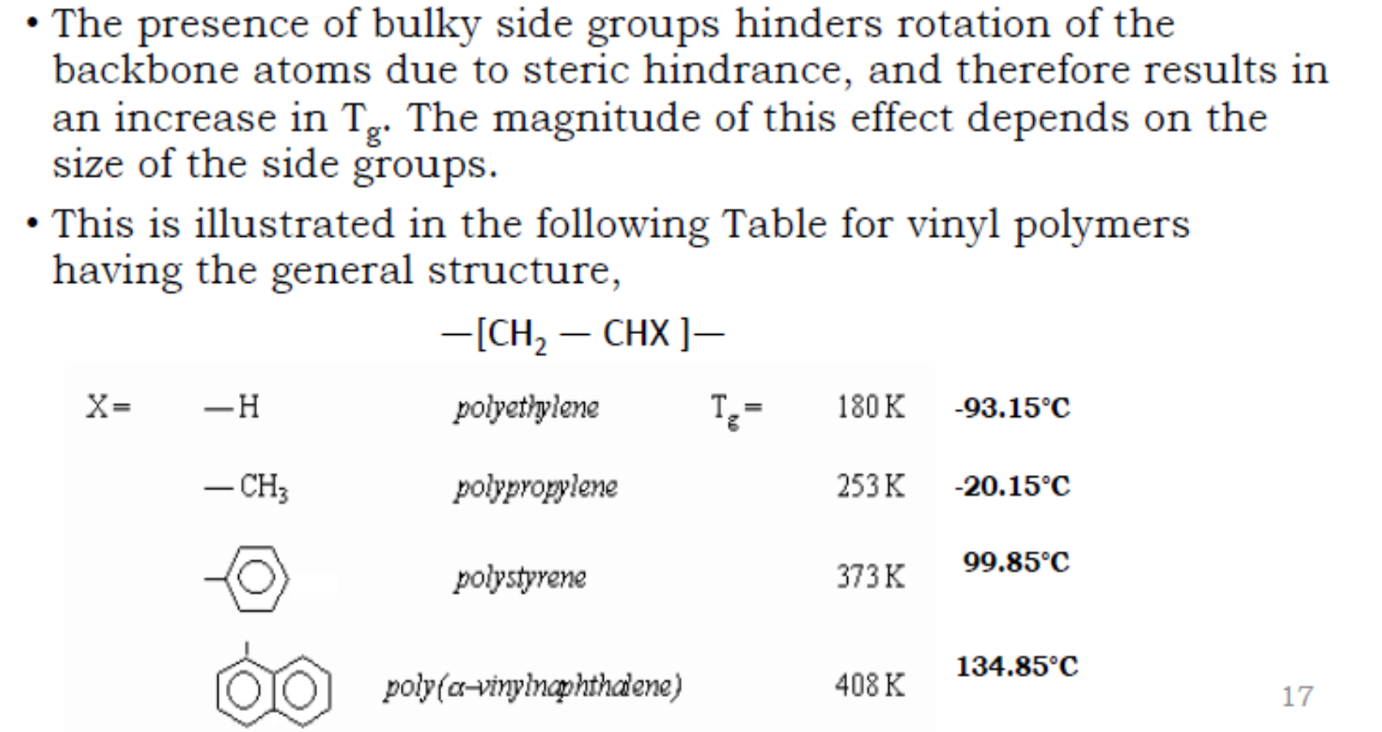
4. Steric Effect & Bulky Group

Slide 10
In case of polyvinyl-carbazole, the Tg value is 150oC, which is very high as it consists of bulky side groups:
polyvinyl-carbazole
A comparison of Tg among various chemicals gives an idea about the Tg effect on chemical structure is given below:-

Slide 11
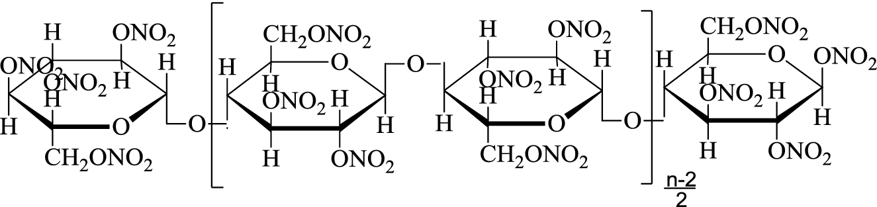
5. PRESENCE OF AROMATIC GROUPS
If the aromatic rings are present in chain of polymer, it decreases the flexibility of the chain; therefore, the glass transition value is high.
For example:-
1. Glass transition temperature of Polyethylene terephthalate is 67 °C to 81°C.
2. Glass transition temperature of Nitrocellulose is in the range of 192 °C to 209°C.

Slide 12
6. Chain Flexibility & Rigidity

Slide 13
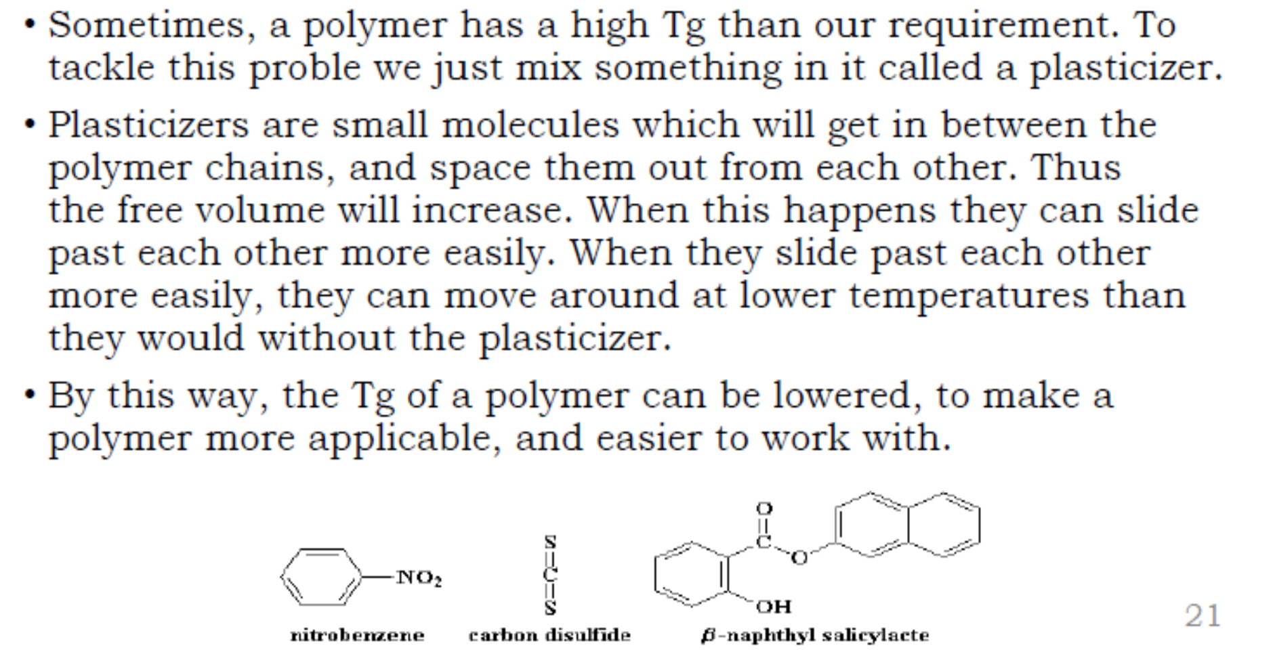
7. ADDITION OF PLASTICIZERS

Slide 14
Tg OF COPOLYMERS

Slide 15
METHODS TO MEASURE Tg
Differential Scanning Calorimetry (DSC) Method
Thermo Mechanical Analysis (TMA) Method
Dilatometric Method

Slide 16
IMPORTANCE OF Tg

Slide 17


