Slide 1
LIGHT
SCATTERING
METHOD

Slide 4
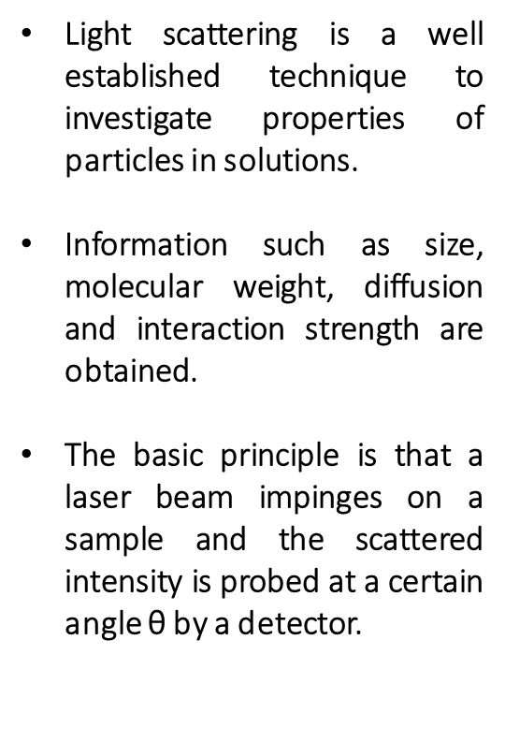

Slide 5
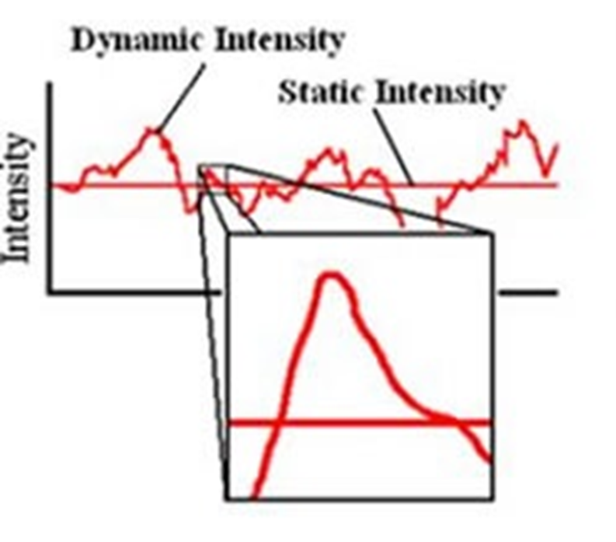
Basic Principle
From the intensity fluctuations in time (from below figure), information on the dynamics within the solution are obtained.
The evaluation of the fluctuations is commonly named as dynamic light scattering (DLS) while the analysis of the absolute mean intensity is known as static light scattering (SLS).
The intensity is very sensitive to variations in size of the solutes, so that it is advantageous to investigate aggregation in solution.
The scattering vector Q is defined as difference between outgoing and incoming wave vector and its magnitude is scattering vector.

Slide 7
The main quantities influencing the static light scattering intensity, are the molecular weight M, concentration and size of the particles in solution.
Due to the long wavelength, particles of size of nanometers (typical for proteins) can be interpreted as (independent) scattering centers whose intensity interferes constructively.
If the particles are big enough (>λ/20), an angle dependent change in intensity can be observed.
The Rayleigh ratio R ∝ I_{s} is introduced as quantity independent of the experimental setup.
To have a direct estimation of the results, the scattering intensity is normalized by the solute concentration c and reduces for small concentration to
Where A₂ is called second virial coefficient describing the interactions between the particles, R_{g} is the radius of gyration and K is an optical constant.

Slide 8
INSTRUMENTATION

Slide 9
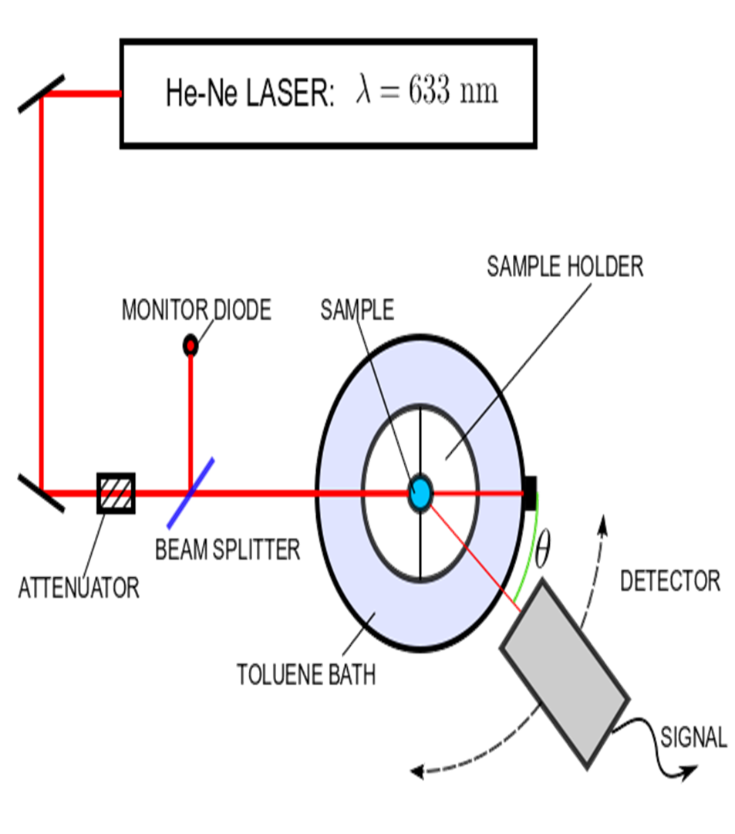
The laser beam passes through a beam splitter in order to detect a reference intensity at the monitor diode.
In transmission it impinges on a glass cuvette immerged in a toluene bath.
This bath avoids reflexes and its temperature can be controlled accurately.
The beam scattered by the sample is detected at an angle θ by an avalanche photo diode (APD) transferring the signal to a PC.
The purpose of the attenuator is to protect the APD from a too high photon flux.

Slide 10
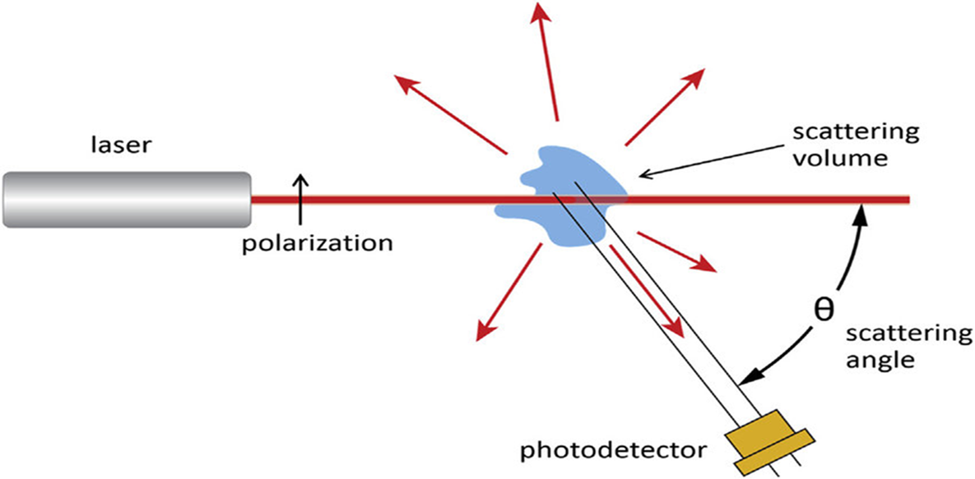
Technical specifications :
Instrument : ALV-CGS-3
Angular Range : [17° - 150°]
Correlator : Multiple Tau 7004 /Fast Autocorrelator
Sampling Time Range : [100 ns - 3435.9 s]
Wavelength : λ= 632.8 nm

Slide 11
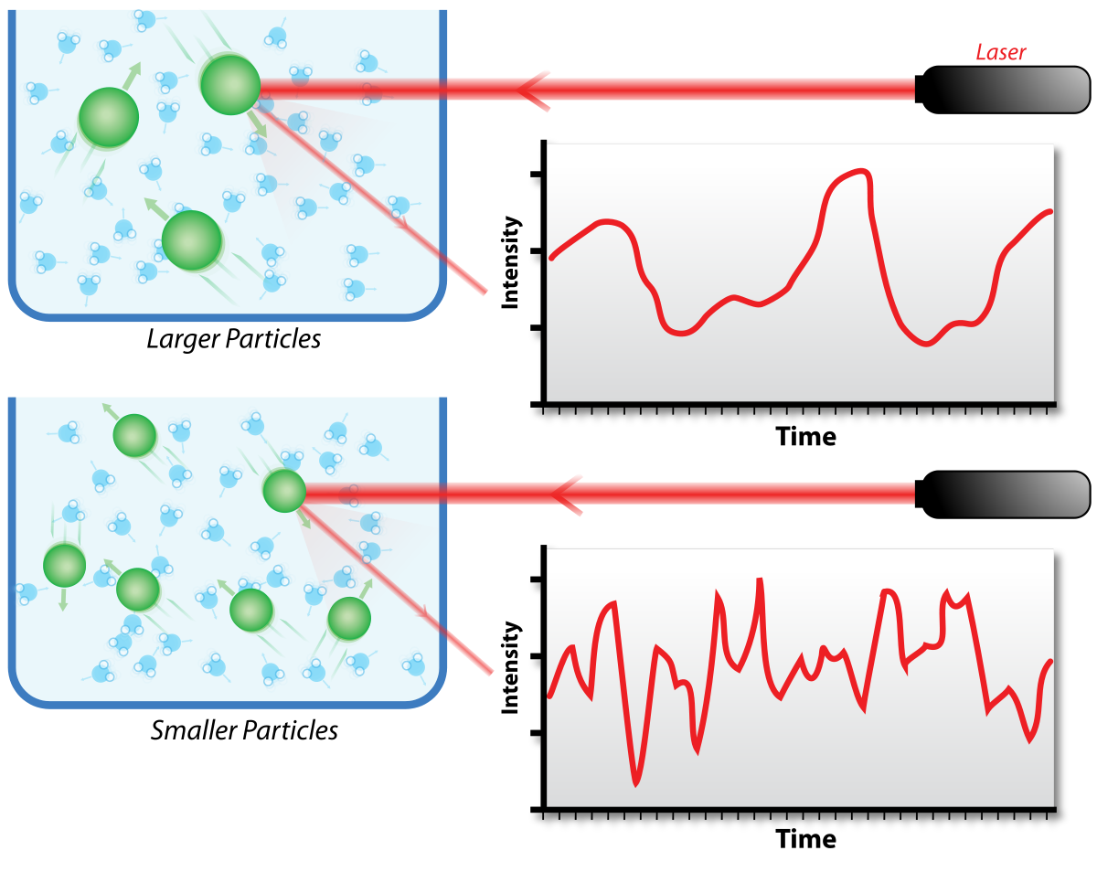
Note : This method is useful for the determination of high molecular weight (M_{Z})polymers only & it is time consuming and expensive.

Slide 12
APPLICATIONS
Molecular weight Determination
Particle Size Distribution
Air Pollution Analysis
Characterization of Polymers for DNA (different proteins )

