Slide 1
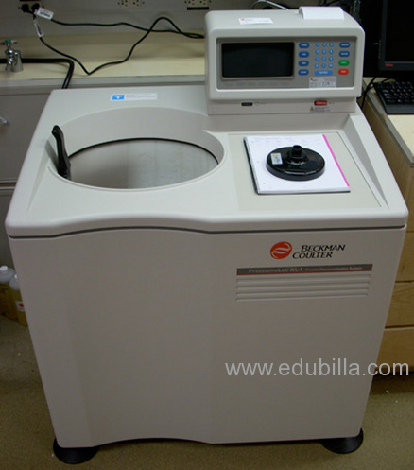
ULTRACENTRIFUGATION
OR
SEDIMENTATION METHOD

