Slide 1
POLYMER
REACTIONS

Slide 2
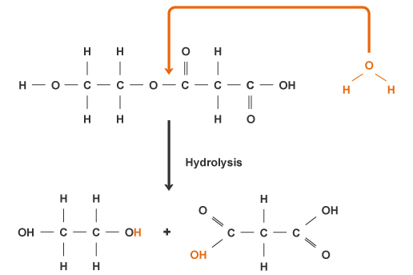
1. hydrolysis
Polymers with amide, ester and acetal linkages can be easily hydrolysed in the presence of acids and alkalies.
Case 1 - when such groups are present in the chain backbone, the hydrolysis leads to chain scission or degradation.

Slide 3
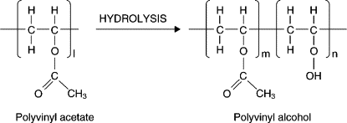
Case 2 – When hydrolysis takes place in the side groups of the polymer chain then it leads to change in functional group instead of any chain scission.
Note : Reactions of this type, which lead only to changes in functional groups and not to any chain degradation, are called the Polymer Analogue Reactions.
In such reactions the chemical composition of the polymer repeat unit is changed, but the degree of polymerization remains unchanged.

Slide 4
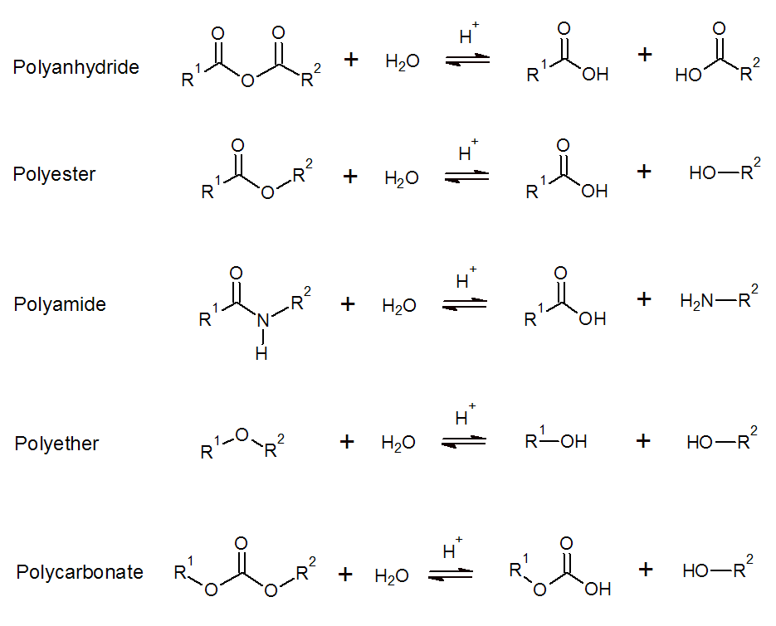
Some other examples of back bone hydrolysis of polymers are as follows:

Slide 5
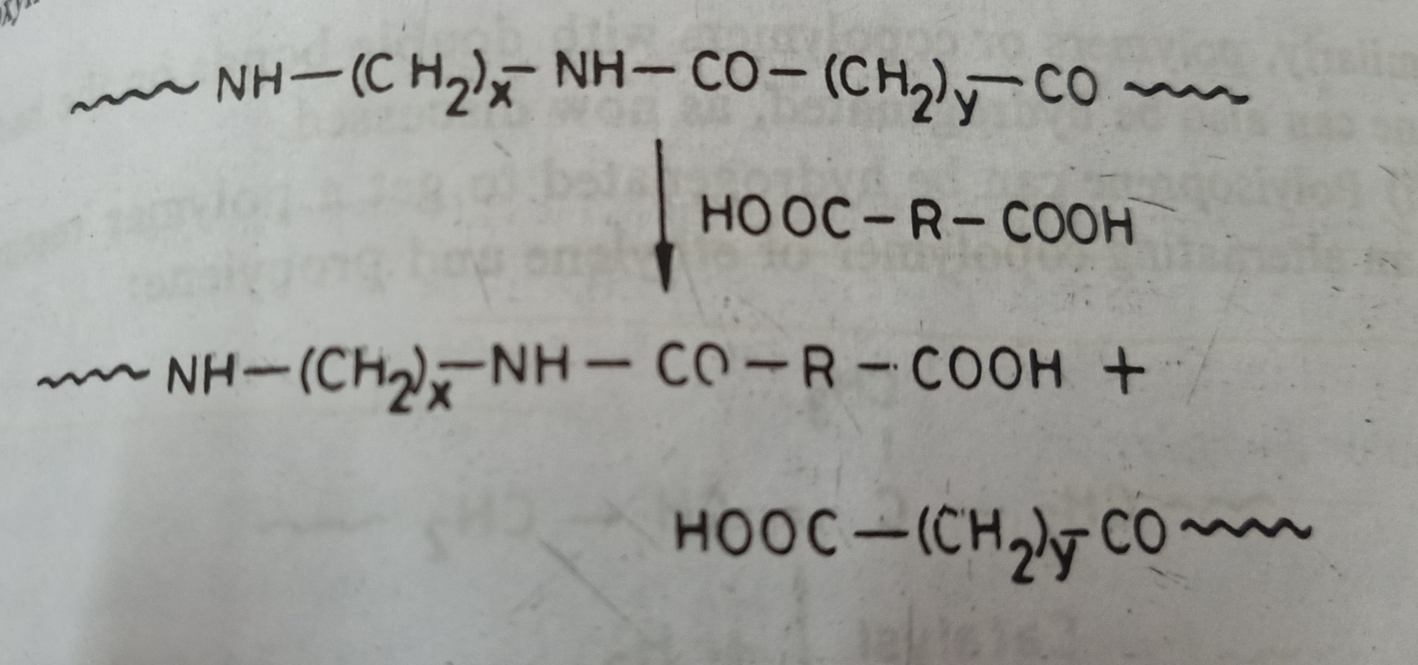
2. acidolysis
It involves the splitting of the polymer molecule using carboxylic acids:
In the above example, high molecular weight polyamide is degraded into a low molecular weight polymer with terminal carboxyl groups.

Slide 6
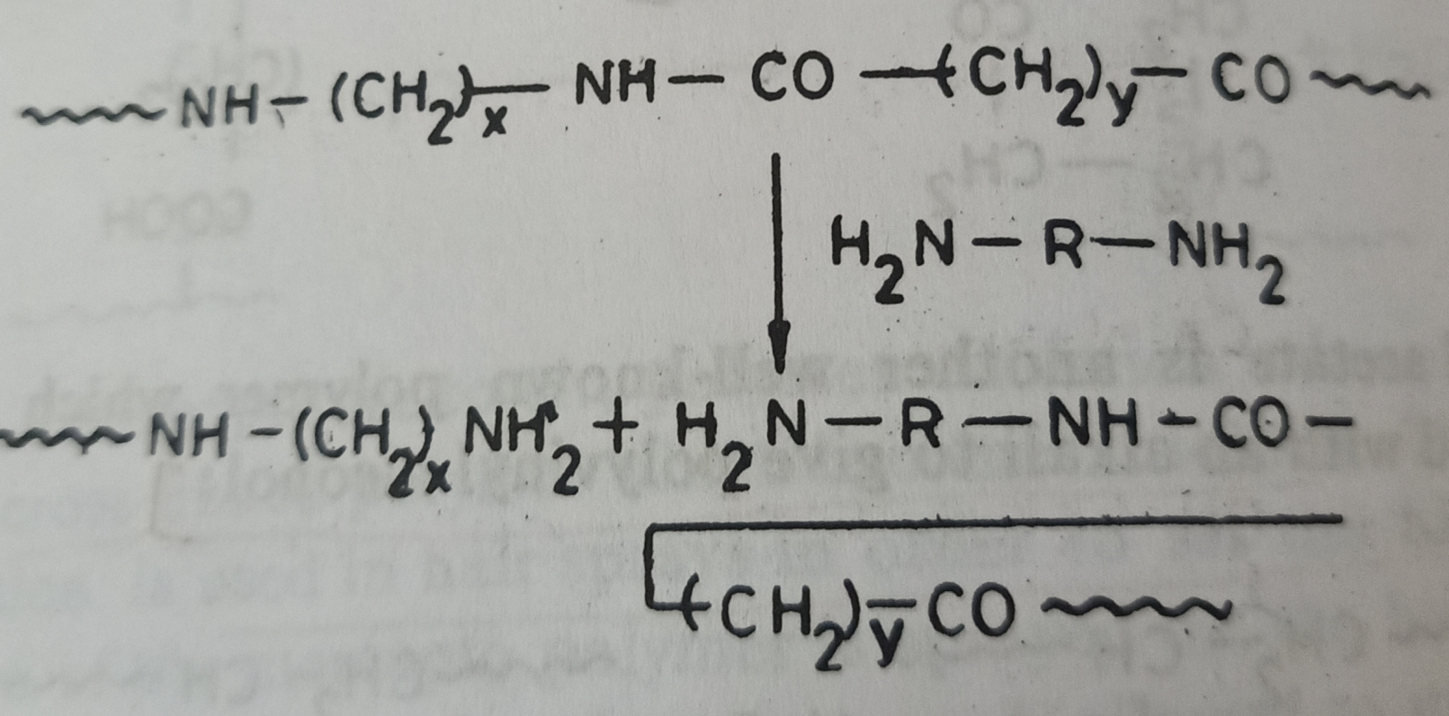
3. aminolysis
It involves the splitting of the polymer molecule with an amine and this also proceeds in a manner similar to acidolysis.
In this case, we get a low molecular weight polymer with amine terminal groups.

Slide 7
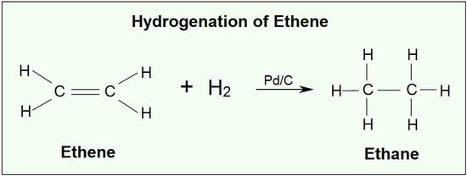
4. hydrogenation
Hydrogenation is the process where hydrogen atom binds to the double bond of a compound/polymer, facilitating its conversion to a single bond, in the presence of a catalyst.
The same technique can be used to obtain many new polymers from the existing ones:

Slide 8
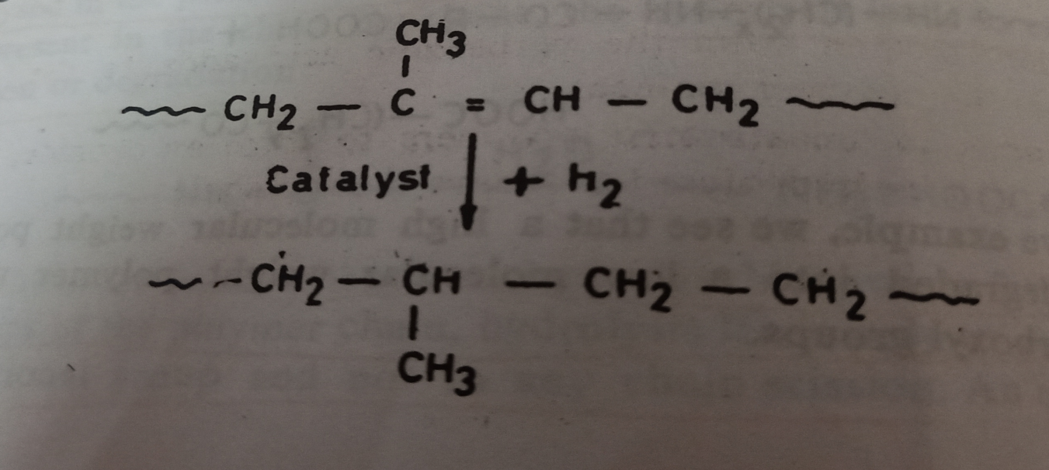
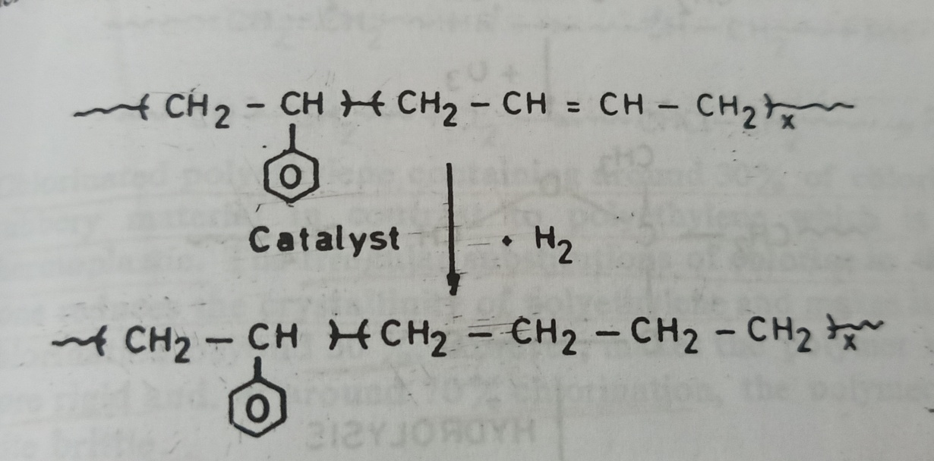
e.g. 1) Polyisoprene can be hydrogenated to get a polymer resembling an alternating copolymer of ethylene and propylene:
e.g. 2) Styrene-butadiene rubber can be hydrogenated to a copolymer of styrene and ethylene:

Slide 9
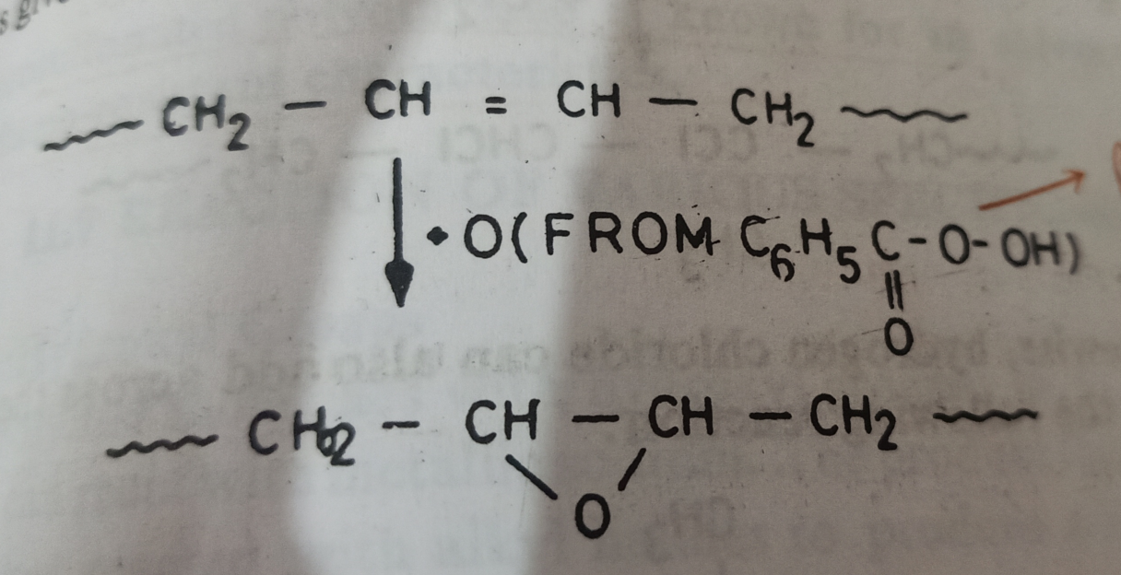
5. Addition and substitution reactions
Addition of oxygen, chlorine, bromine, ozone or hydrogen chloride to unsaturated polymers is common. Thus, Polybutadiene can be epoxidised with perbenzoic acid, peracetic acid, etc.,
In this reaction, oxygen from the perbenzoic acid adds to the double bond in the polymer molecule.

Slide 10
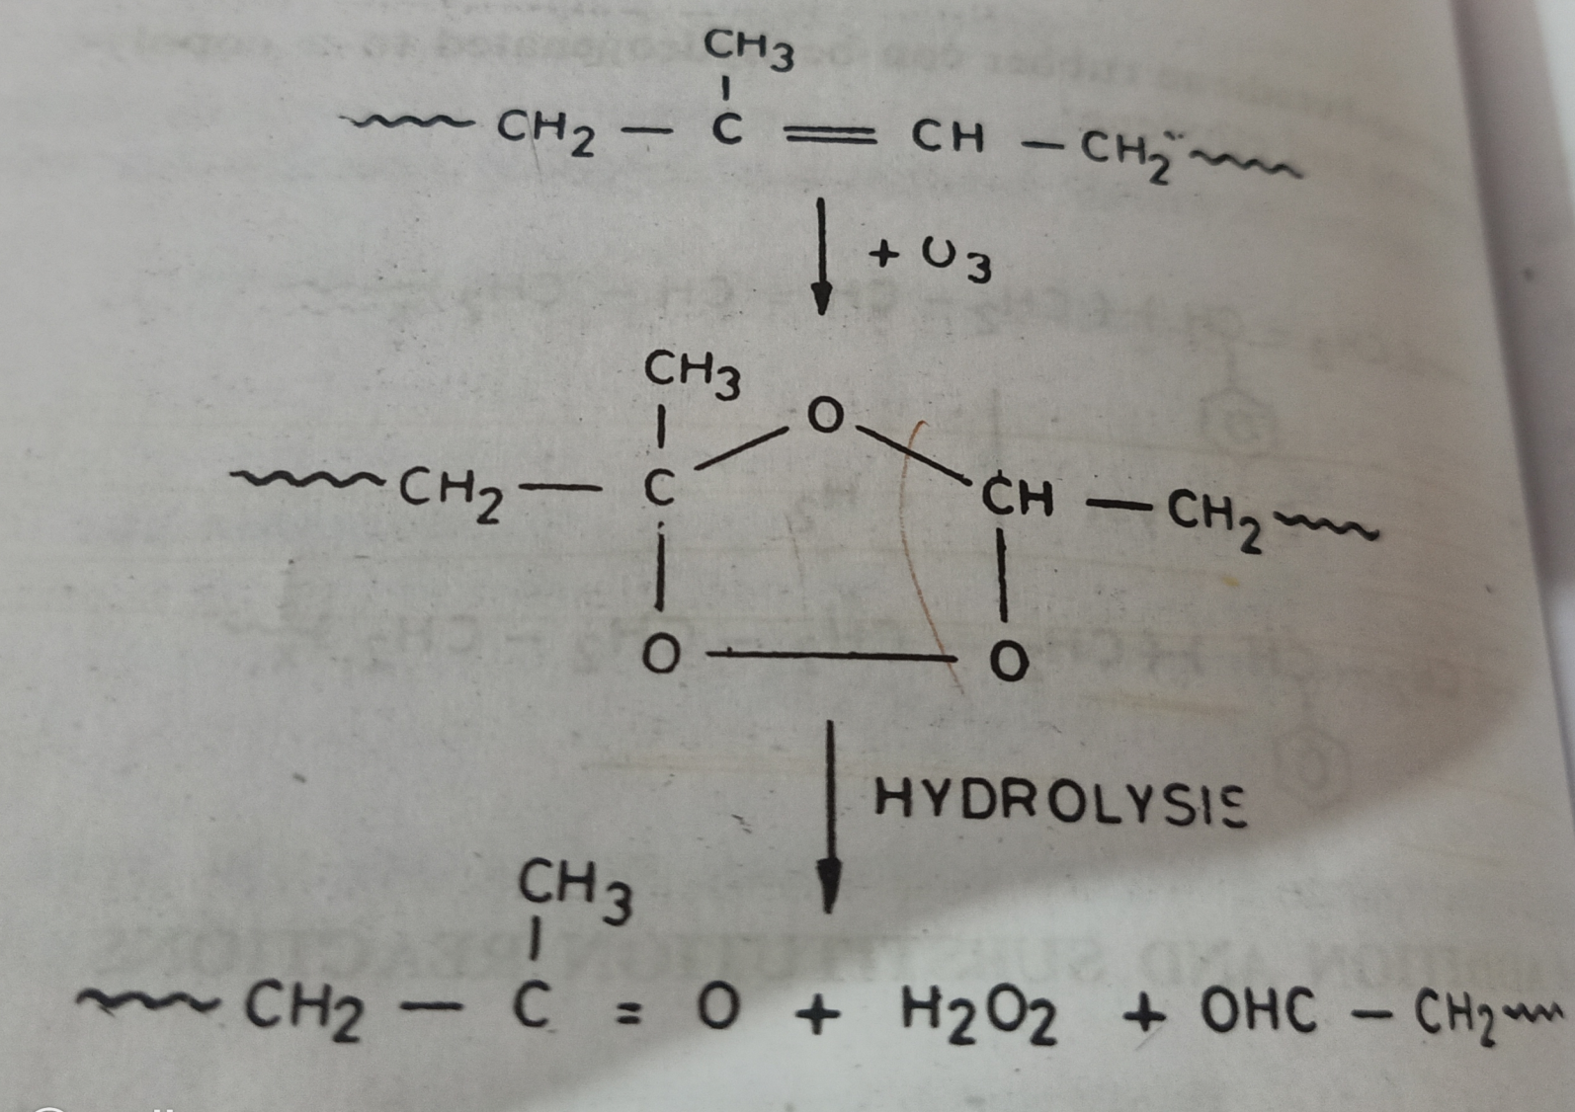
2. Ozone adds to a unsaturated polymers to form an ozonide, which, in turn, can be hydrolyzed to cleave the molecule:

Slide 11
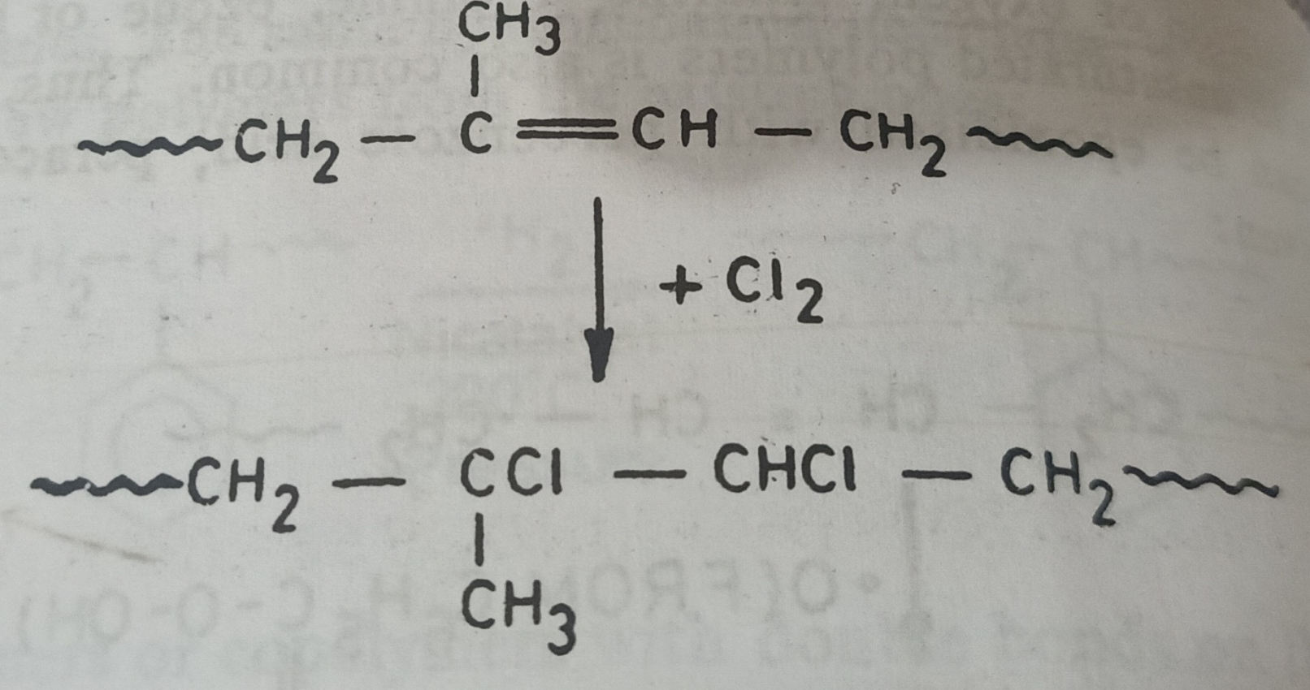
3. Chlorine adds to natural rubber to form chlorinated rubber as follows:

Slide 12
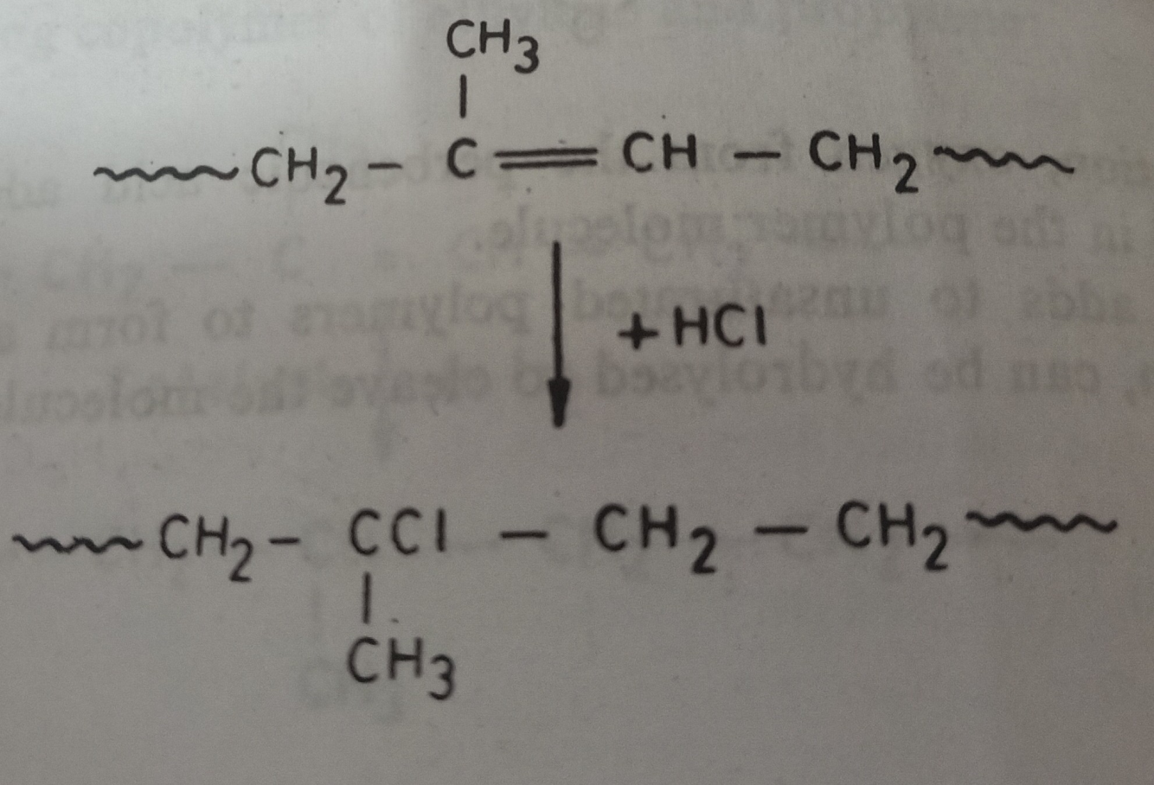
4. Likewise, hydrogen chloride can also add across the double bond, as in the following reaction:

Slide 13
5. With saturated polymers such as polyethylene, chlorination can be carried out by a substitution reaction through a radical chain process;
Chlorinated polyethylene having 30% of chlorine is rubbery in nature in contrast to PE which is tough thermoplastic.
The irregular substitutions of chlorine in the backbone reduces the crystallinity of PE and makes it rubbery.
Chlorination beyond 50% makes polymer more and more rigid and at around 70% Chlorination, it becomes quite brittle.

Slide 14
6. PE can also be chlorosulfonated through a substitution process:
Chlorosulfonated PE is known for its solvent, chemical and flame- resistant characteristics.

