Slide 1
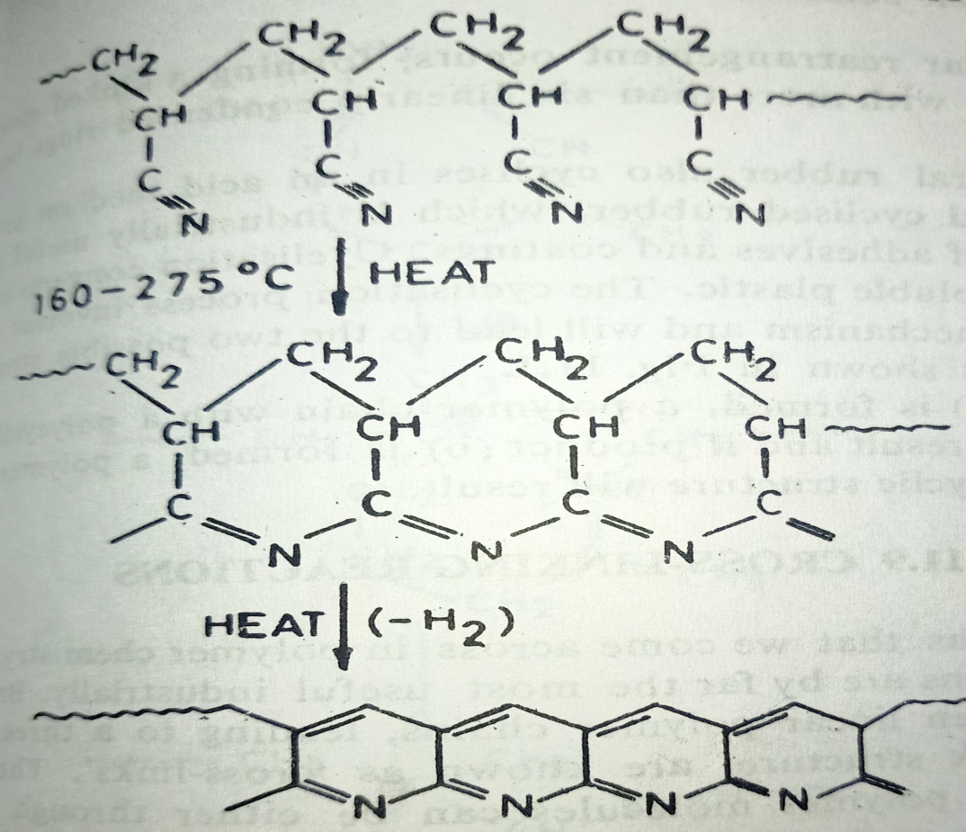
Cyclization reactions
1. Polyacrylonitrile, upon heating, cyclises to form a ladder polymer, which is highly flame – resistant in nature:

Slide 2
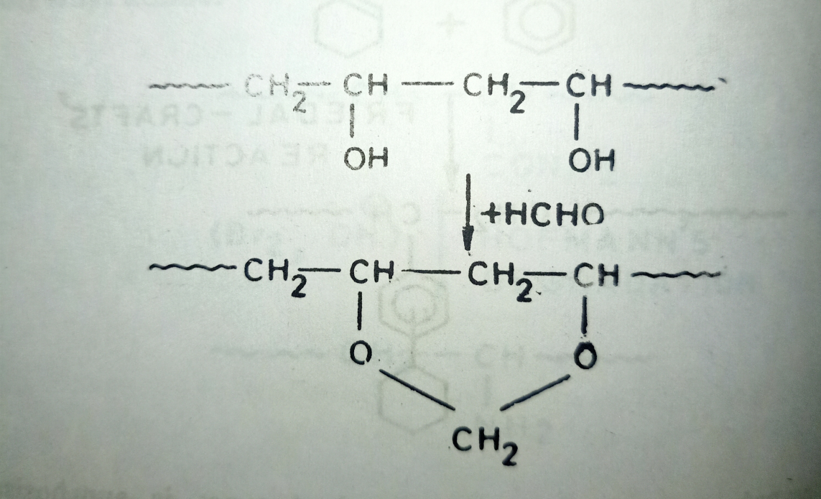
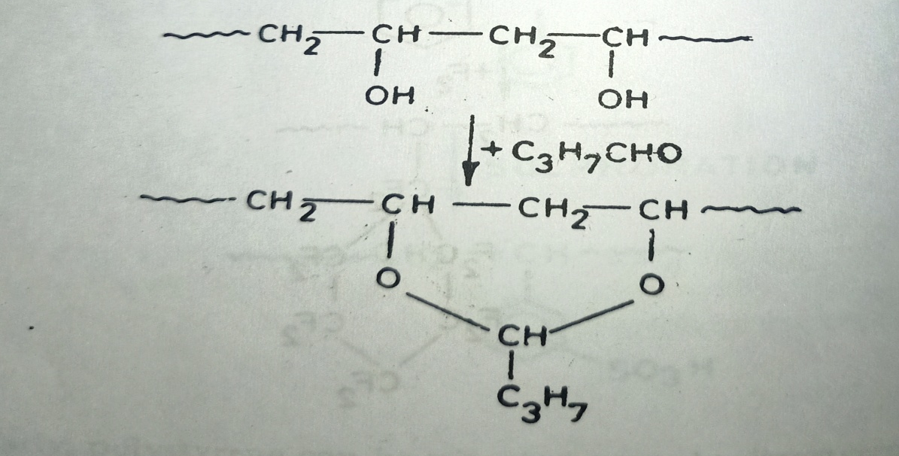
2. Polyvinyl alcohol when reacted with formaldehyde gives polyvinyl formal:
3. When butyraldehyde is reacted with polyvinyl alcohol, polyvinyl butyral is formed:

Slide 3
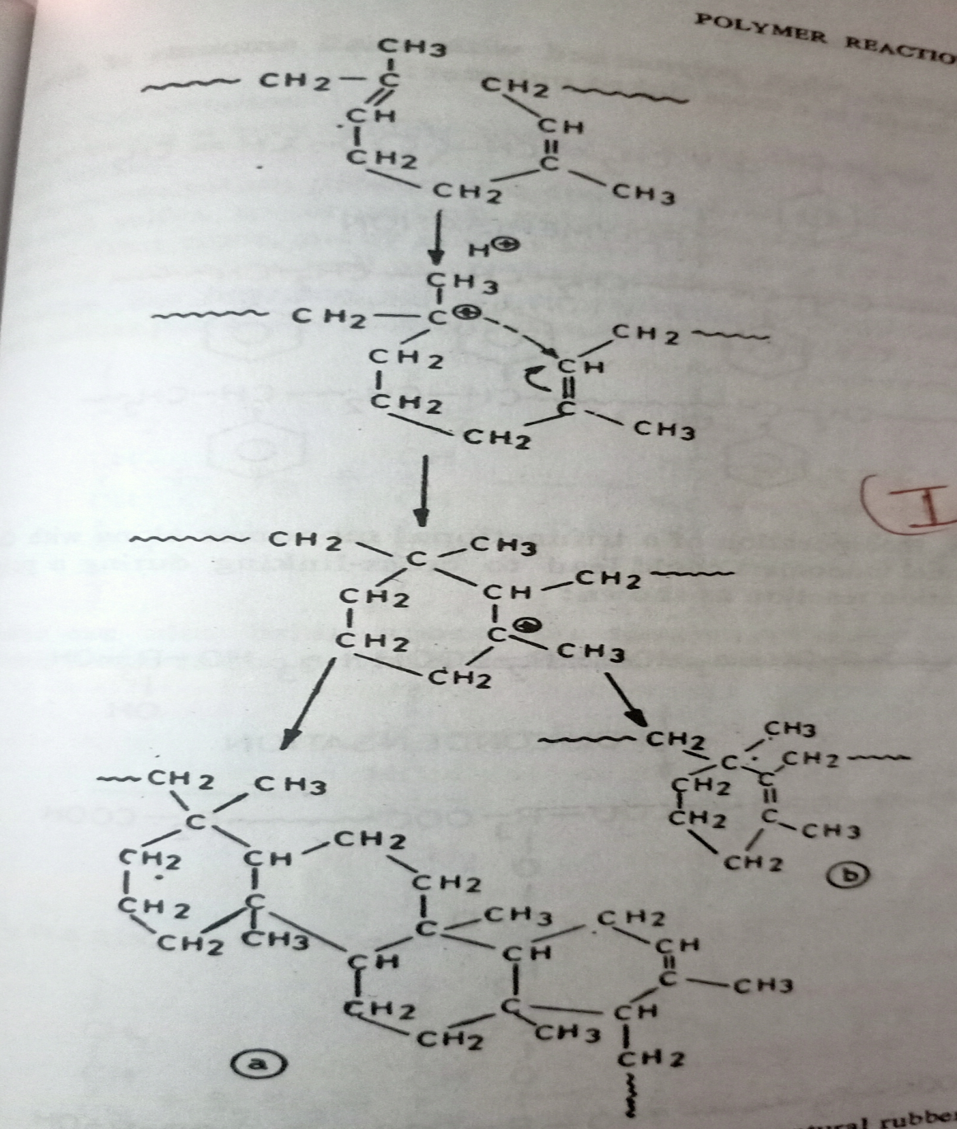
4. Natural rubber also cyclises in an acid medium to form cyclised rubber, which is industrially useful in the preparation of adhesives and coatings.

Slide 4
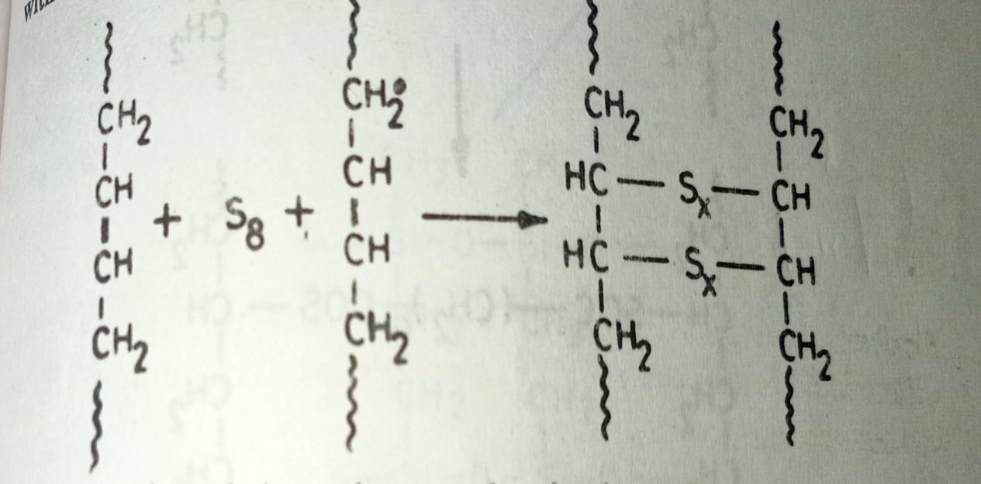
Cross-linking reactions
Cross-linking reactions in rubber are known as Vulcanization reactions.
Vulcanization is used in rubber technology to effect cross-linking.
Vulcanization process was discovered by Goodyear in 1839.
Vulcanization using Sulphur and Sulphur related compounds:
a) When S₈ form of sulphur is used for vulcanization process of Natural Rubber .

Slide 5
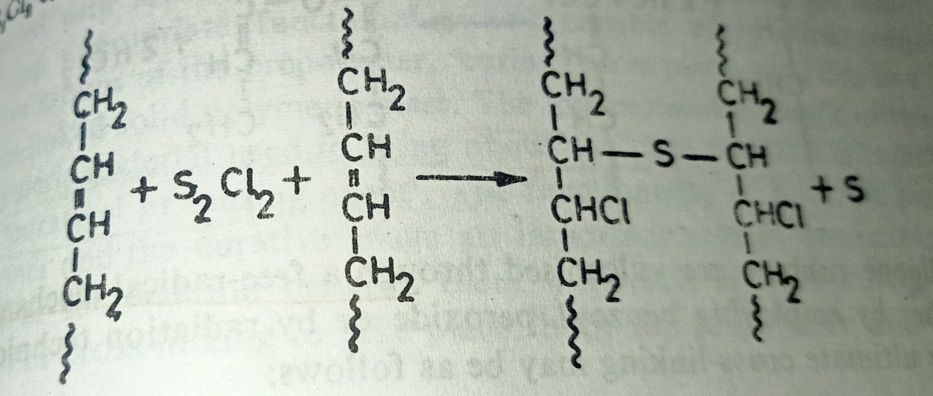
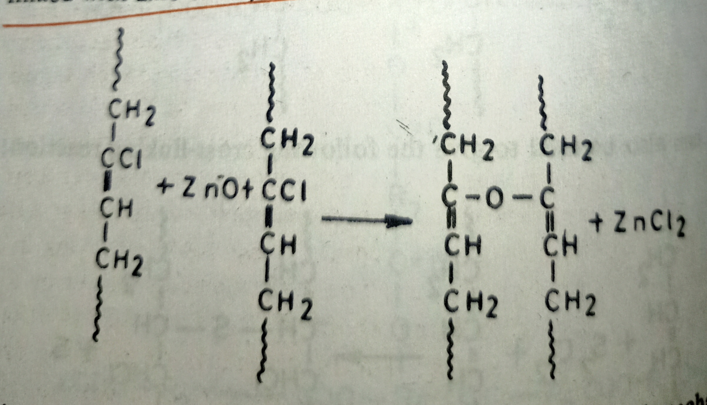
b) When S₂Cl₂ form of sulphur is used for vulcanization reaction:
2. Polychloroprene can be cross-linked with zinc oxide, as follows:

Slide 6
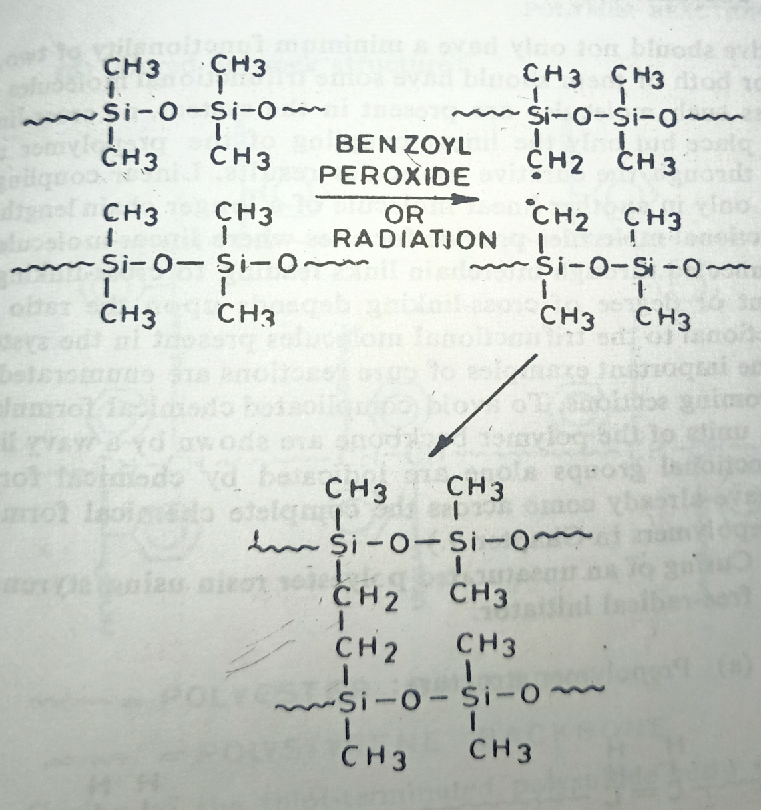
3. Silicone rubbers can be vulcanized through a free radical mechanisms, with the help of benzoyl peroxide as follows:

