Slide 1
Unit-II
Aldehyde and Ketone
By
Dr. Neetu Kumari
Assistant Professor
Department of Chemistry
UCOS, MLSU

Slide 8
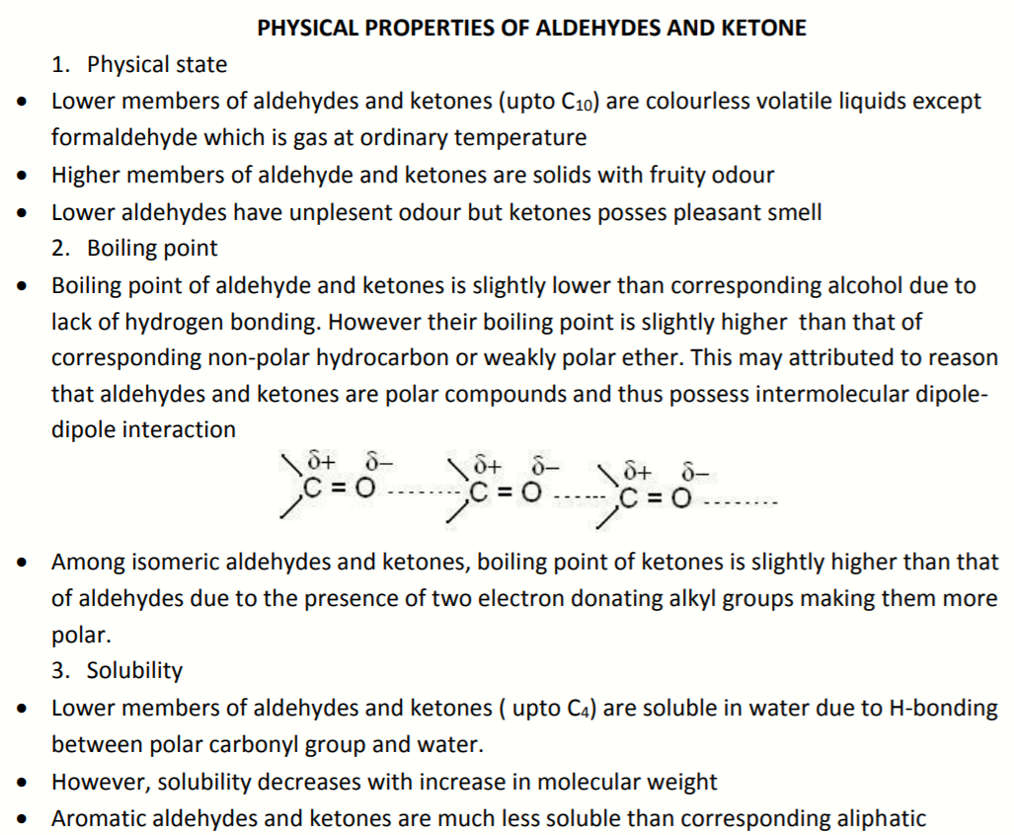

Slide 9
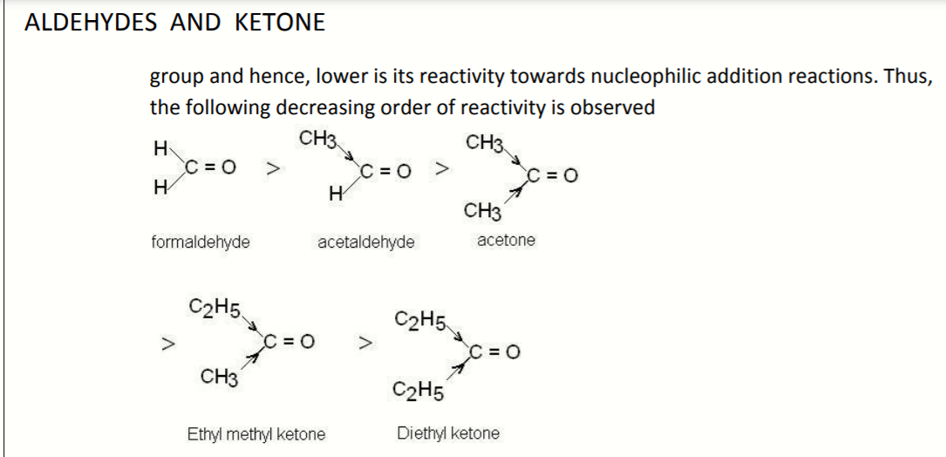

Slide 10
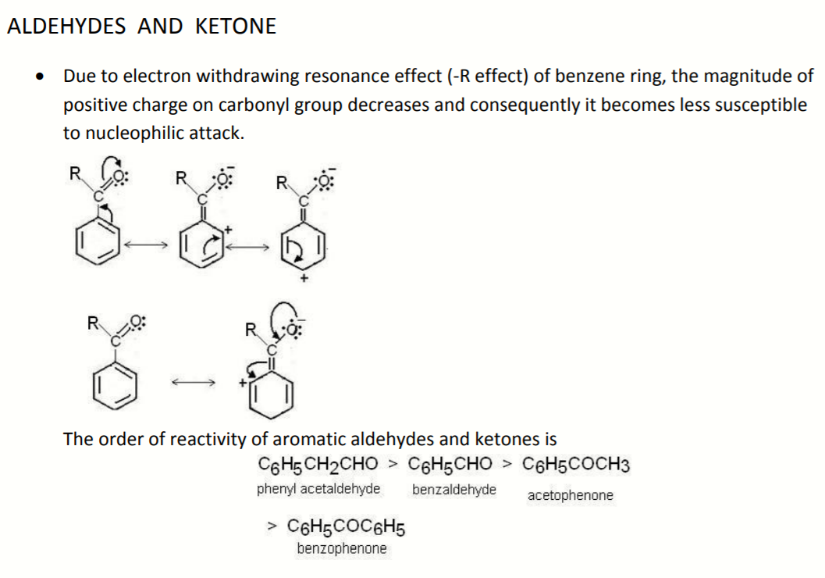

Slide 11
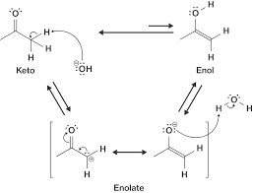
Keto-Enol Tautomerism

Slide 12
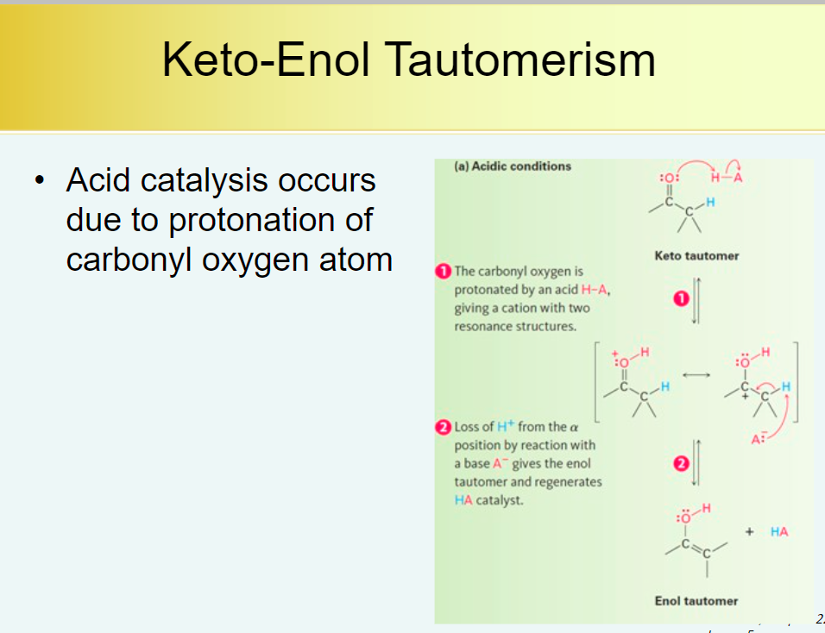

Slide 13
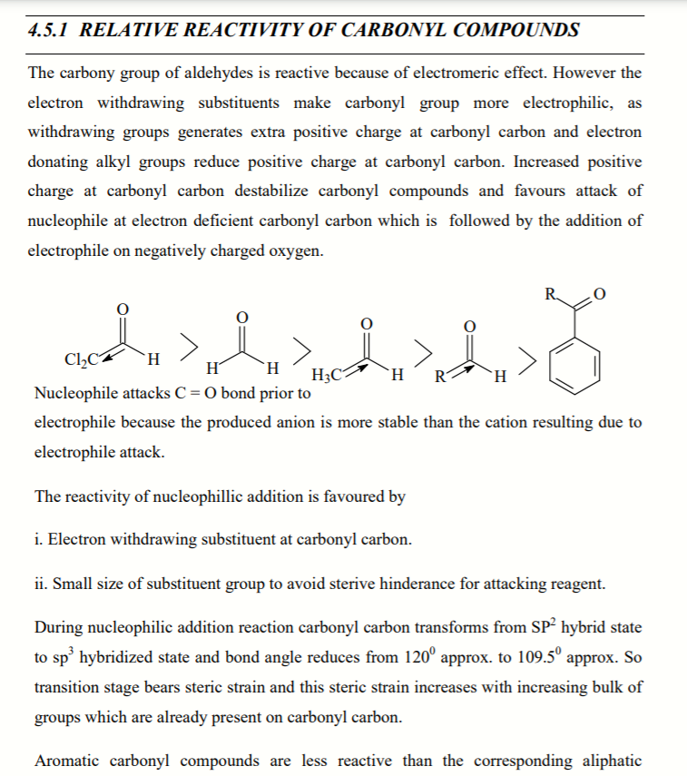

Slide 14
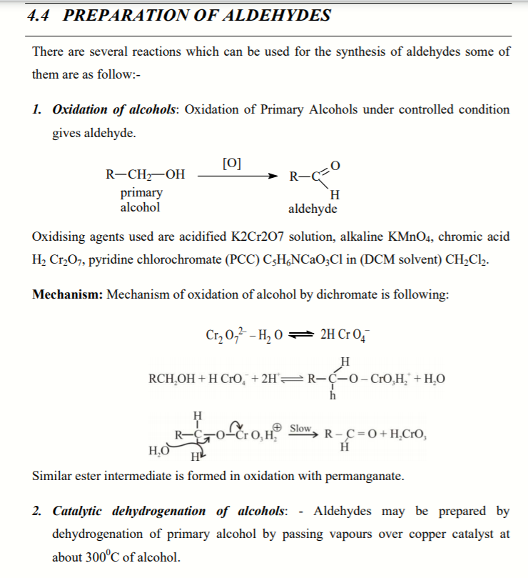

Slide 15
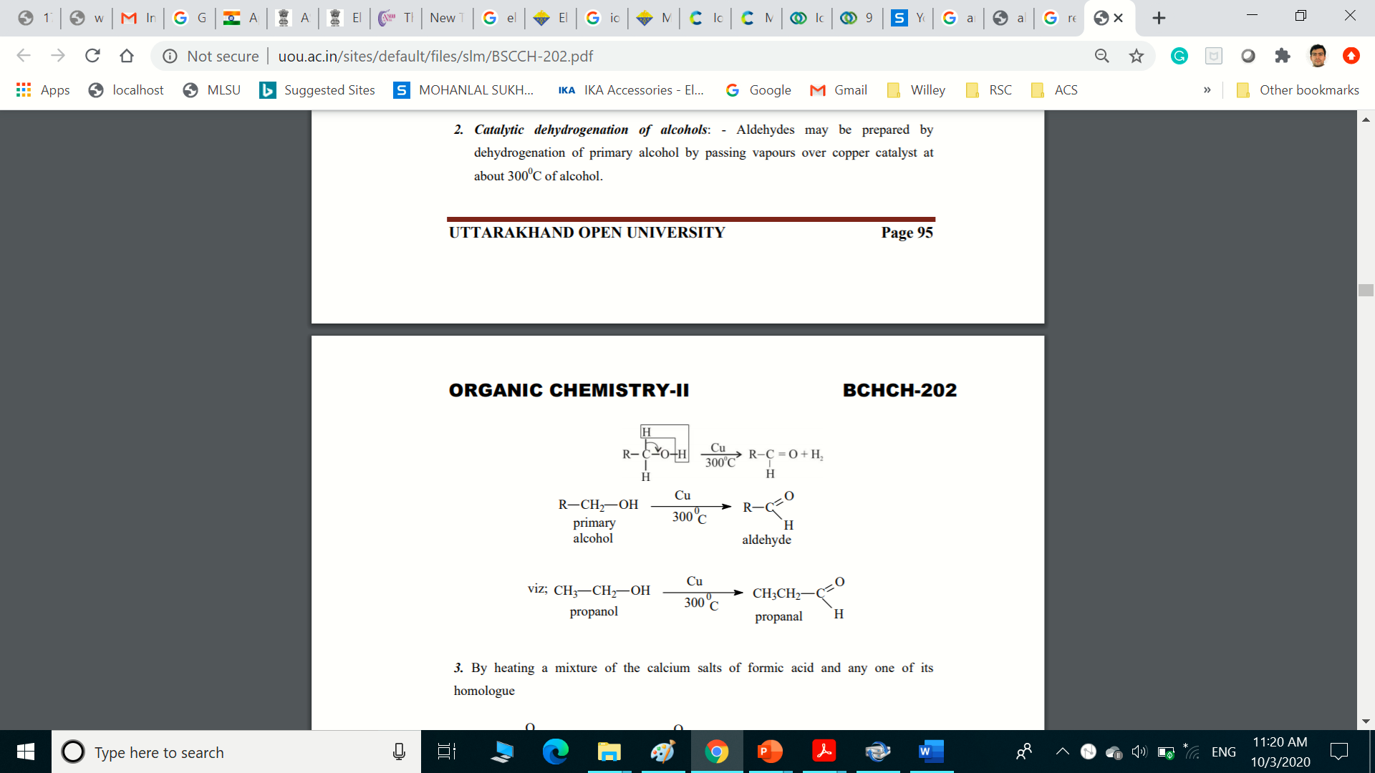

Slide 16
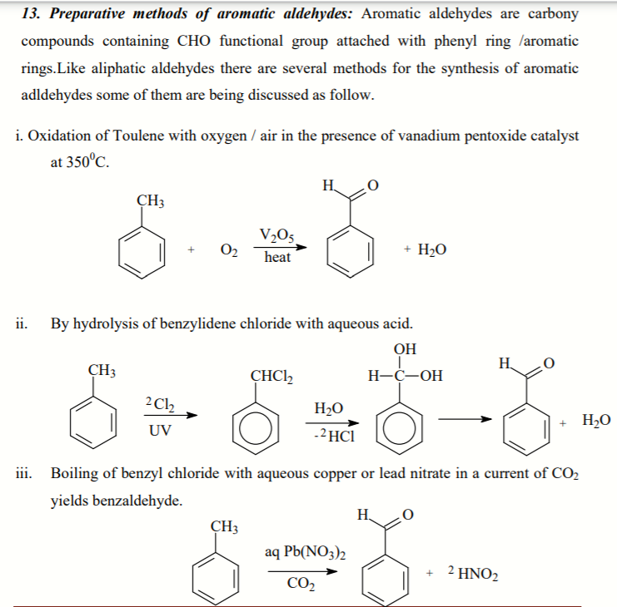

Slide 17
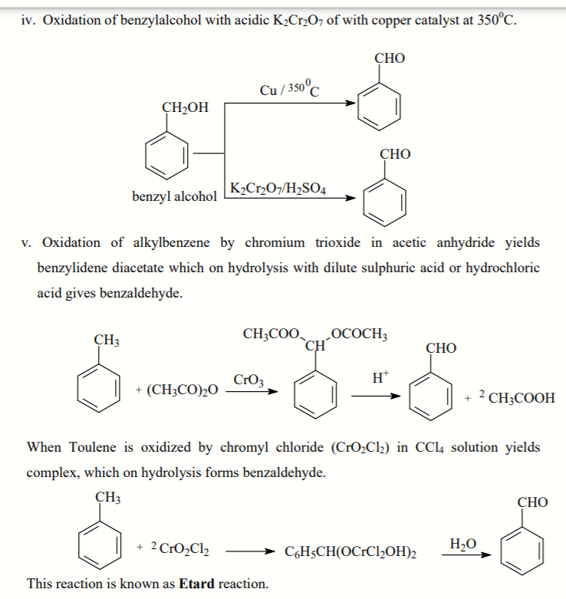

Slide 18
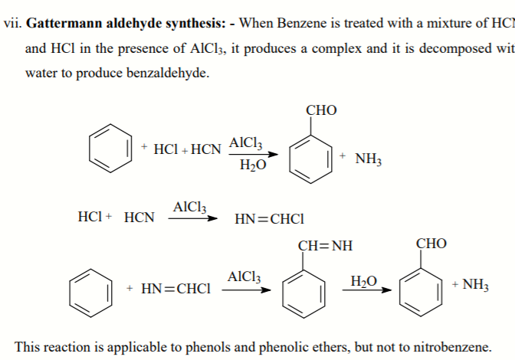

Slide 20
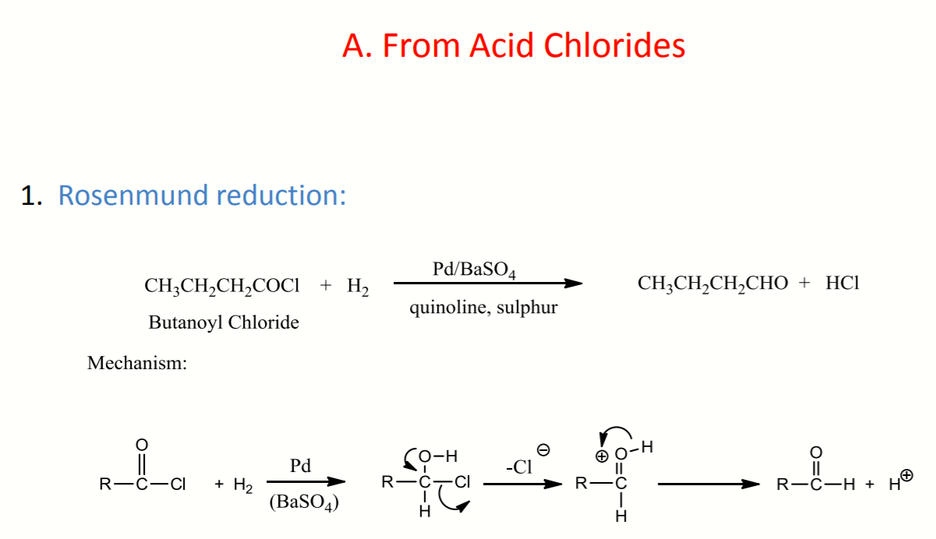

Slide 21
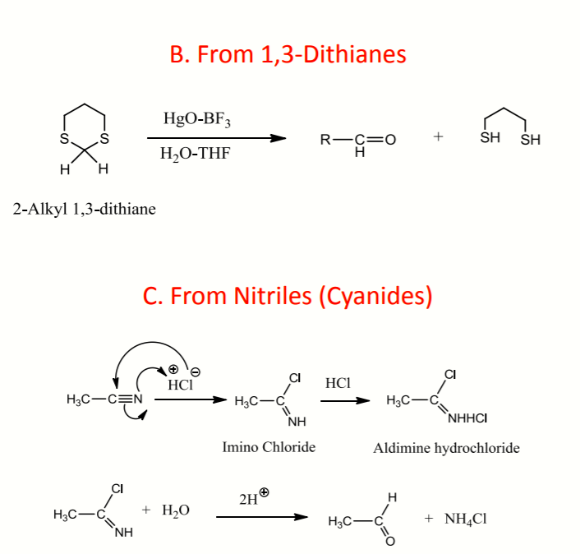

Slide 23
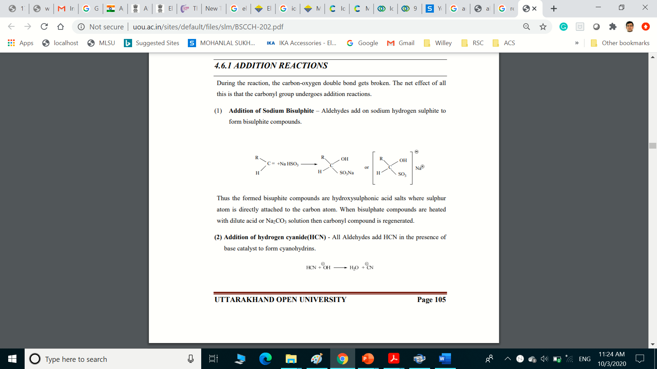
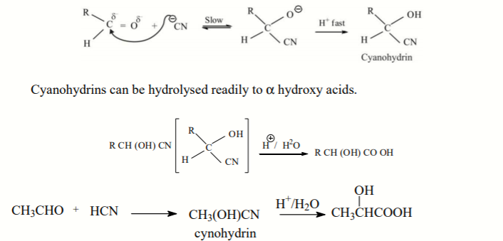
CHEMICAL PROPERTIES

Slide 24
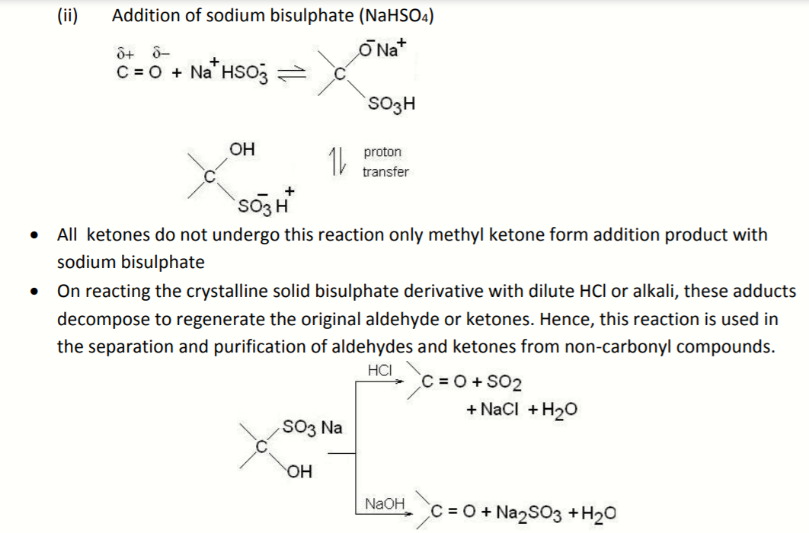

Slide 25
Acetal as protecting group

Slide 27
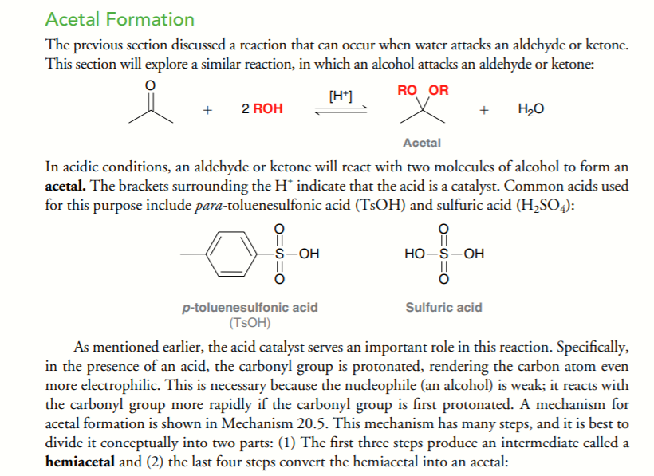

Slide 28
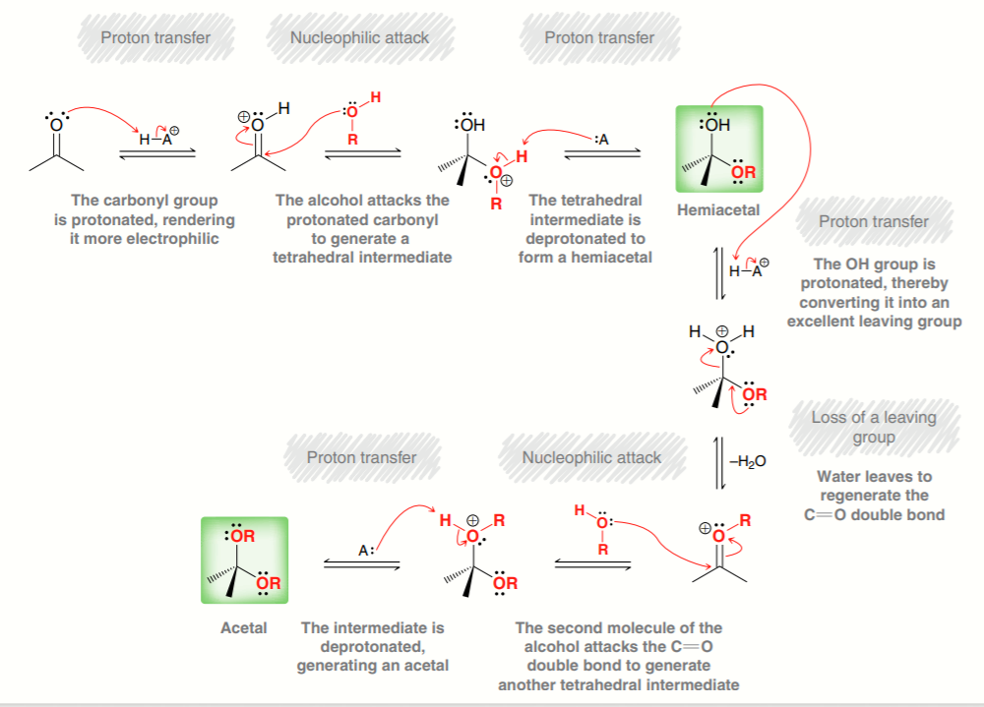

Slide 33
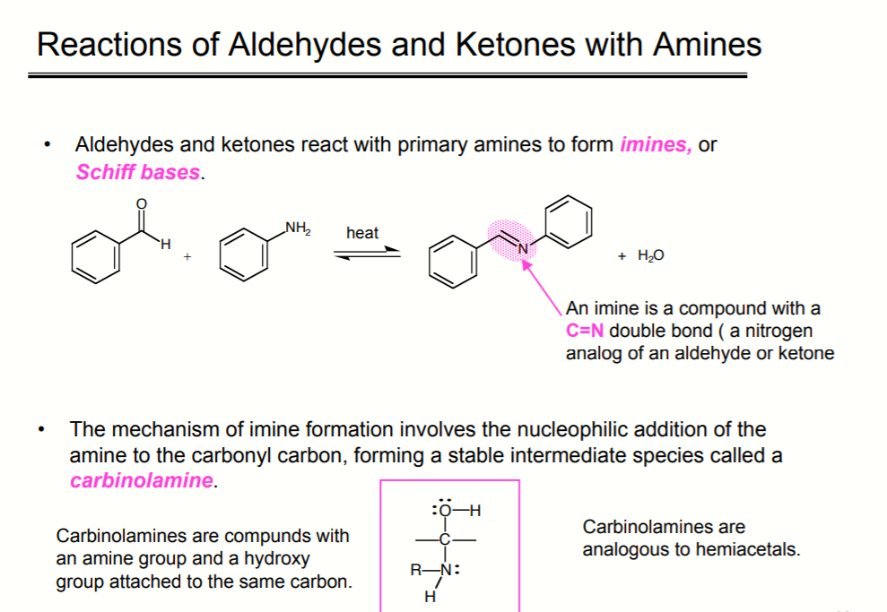

Slide 34
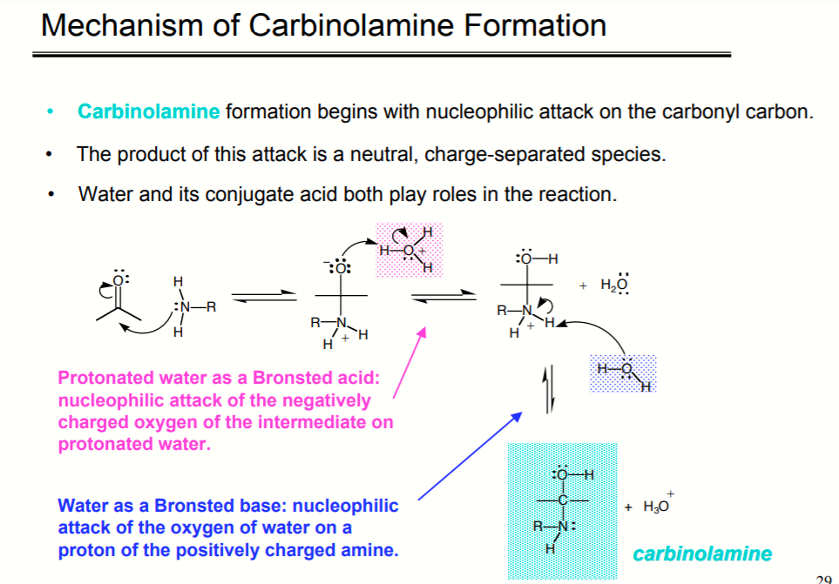

Slide 36
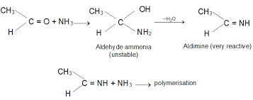
Condensation reaction of with ammonia

Slide 37
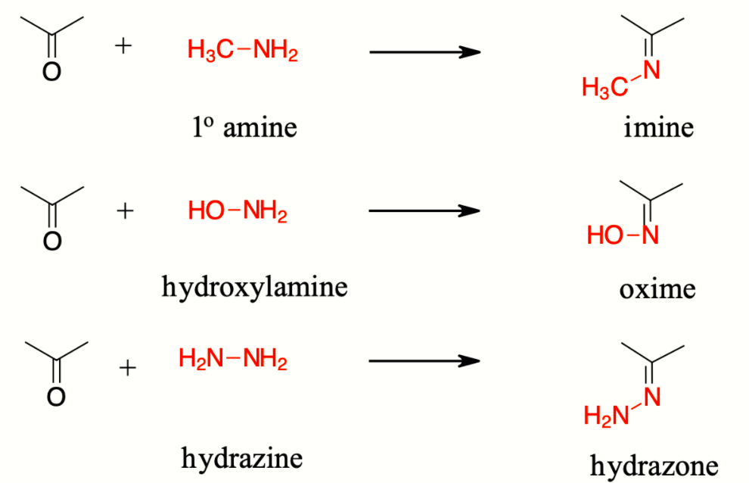
Condensation reaction of with ammonia and its derivatives

Slide 38
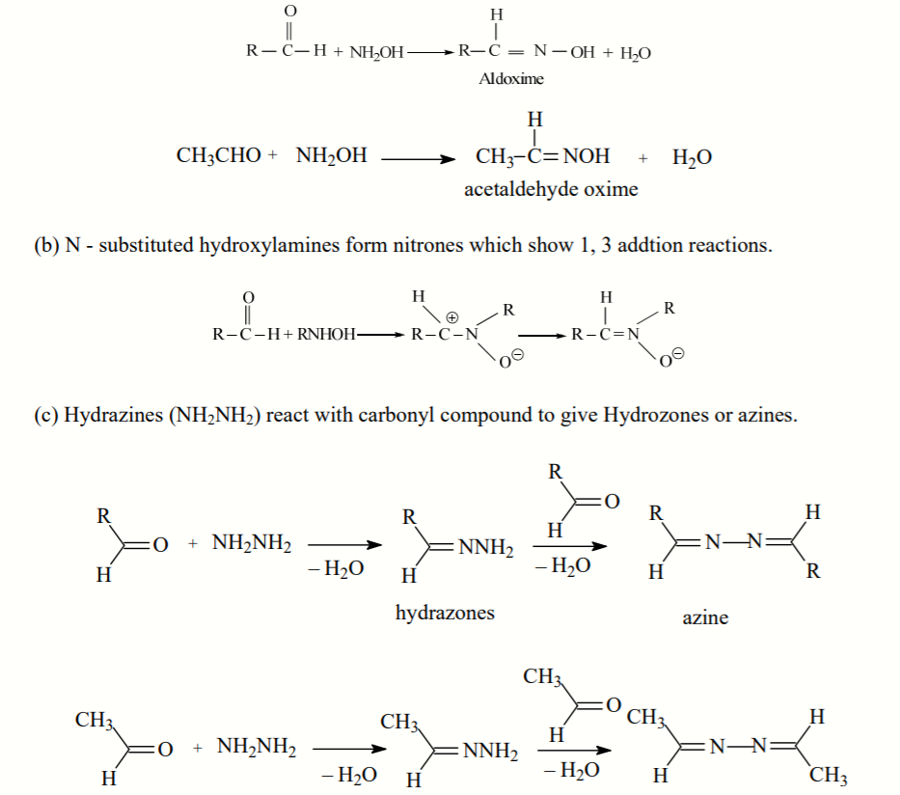

Slide 39
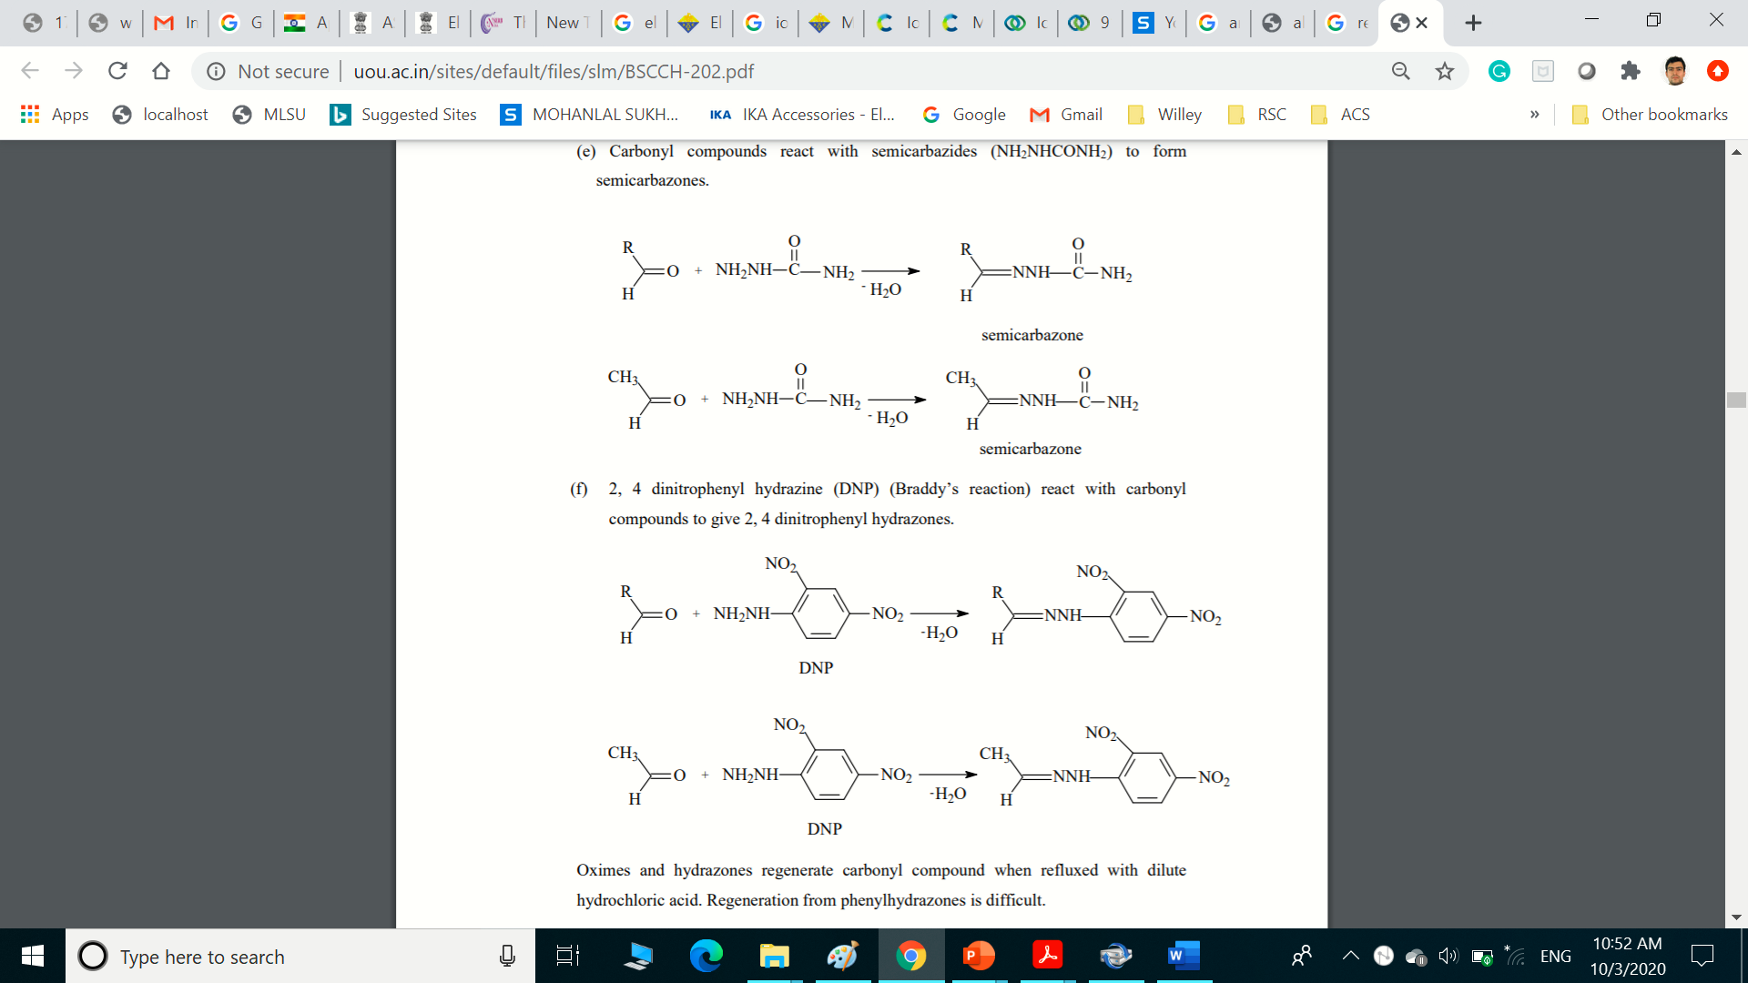

Slide 40

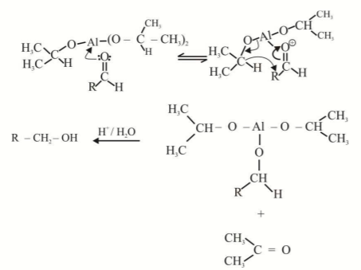
Meerwein-Ponndorf-verely (MPV) reduction

Slide 41
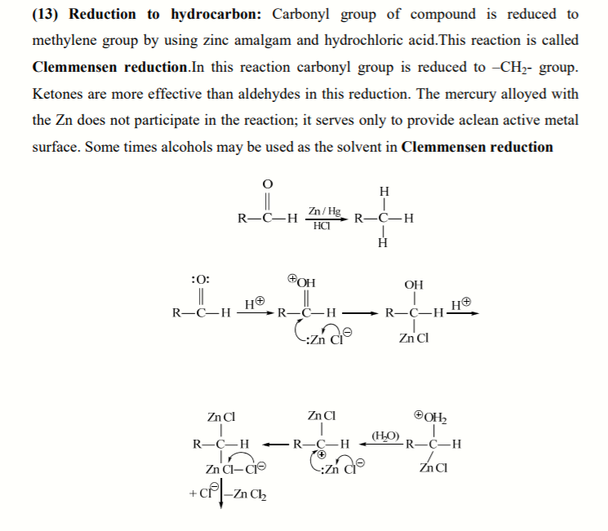
Clemmensen reduction

Slide 42
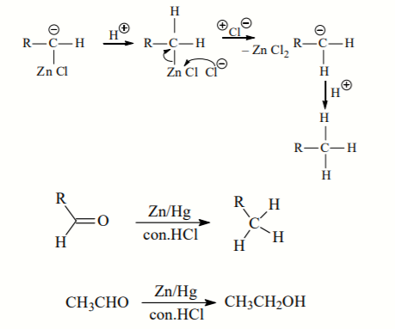

Slide 45
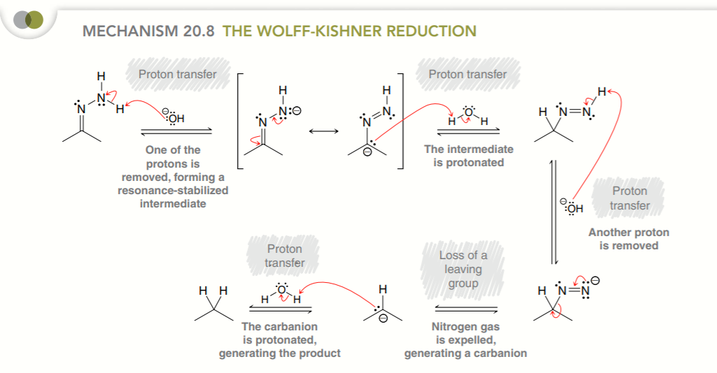

Slide 46
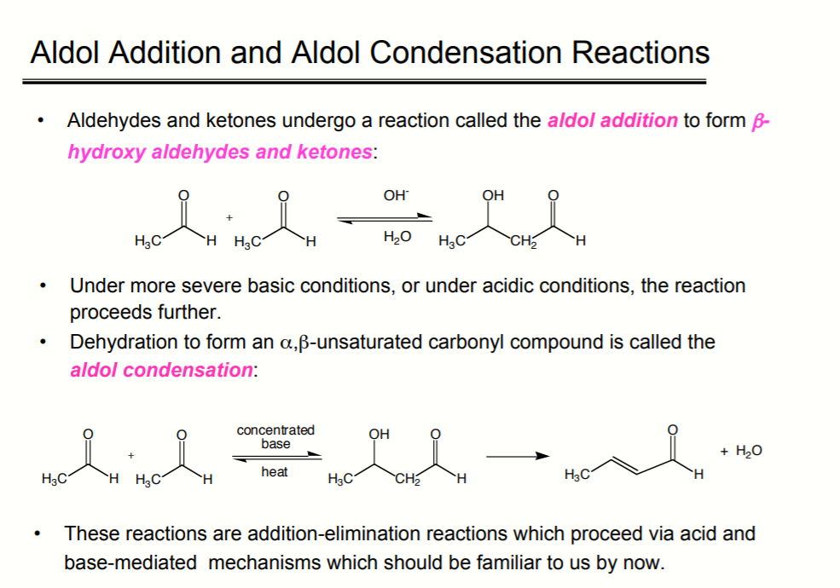

Slide 47
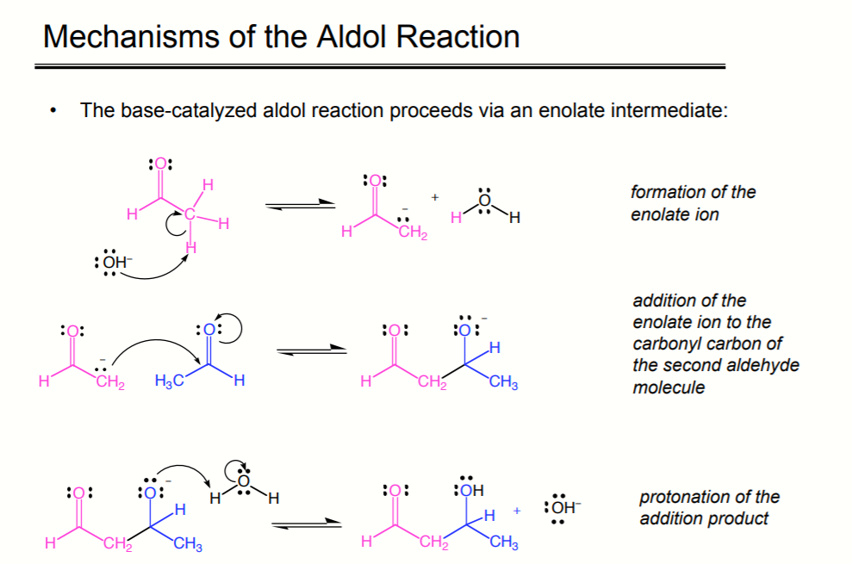

Slide 48
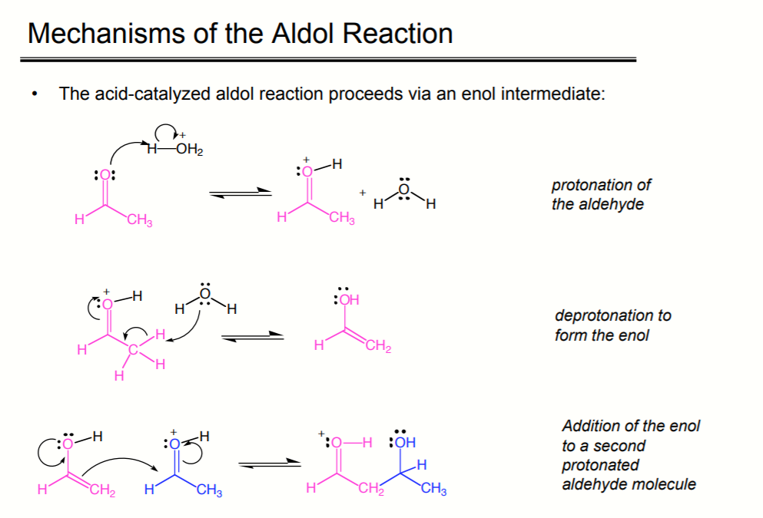

Slide 49
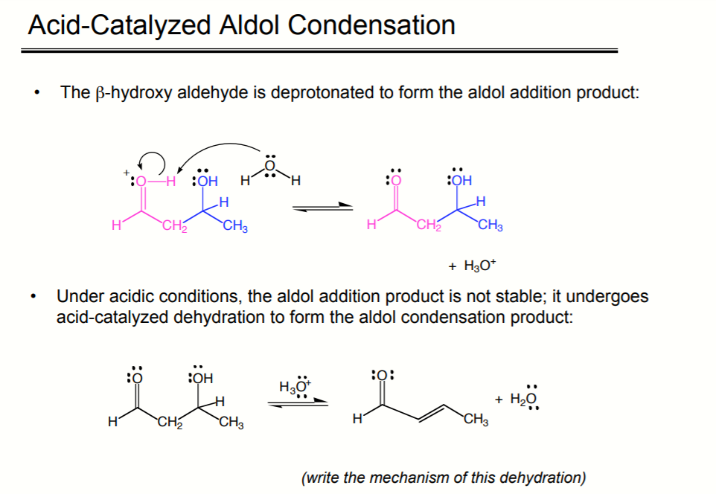

Slide 50
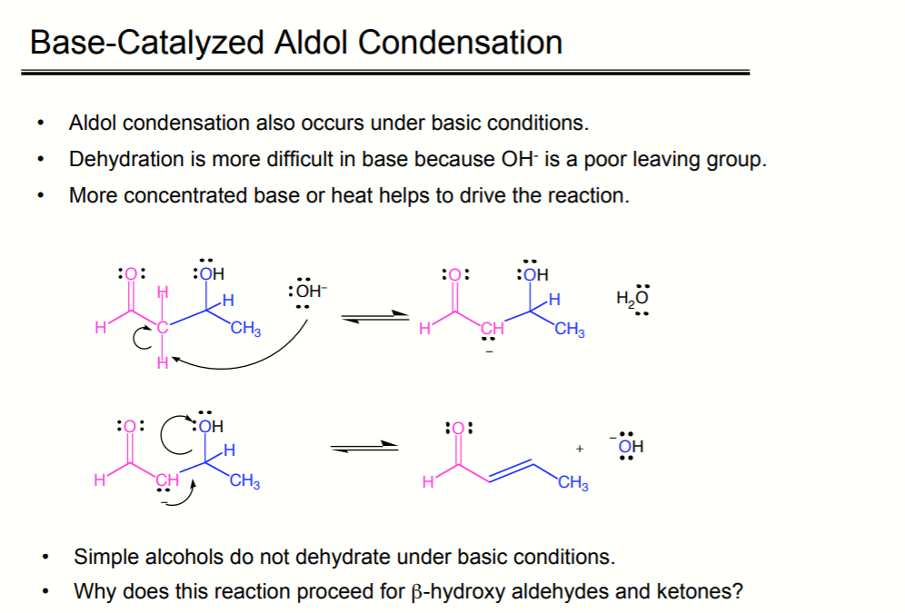

Slide 51
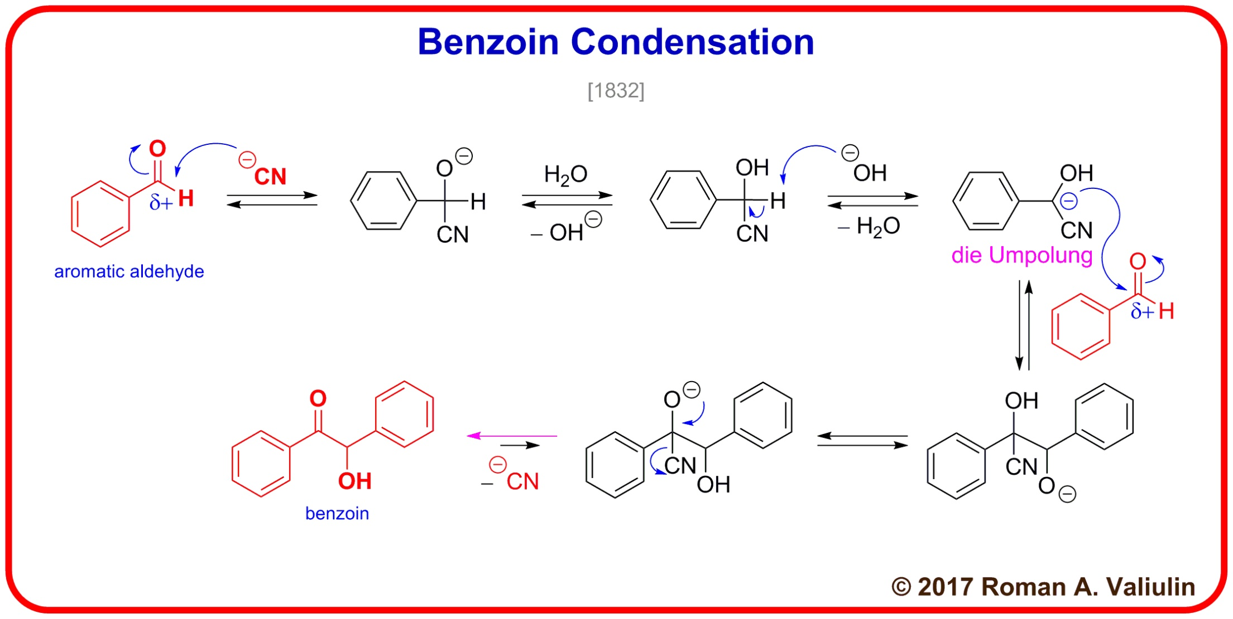
The benzoin addition is an addition reaction involving two aldehydes. The reaction generally occurs between aromatic aldehydes or glyoxals.^{[1][2]} The reaction produces an acyloin. In the classic application benzaldehyde is converted to benzoin.

Slide 52
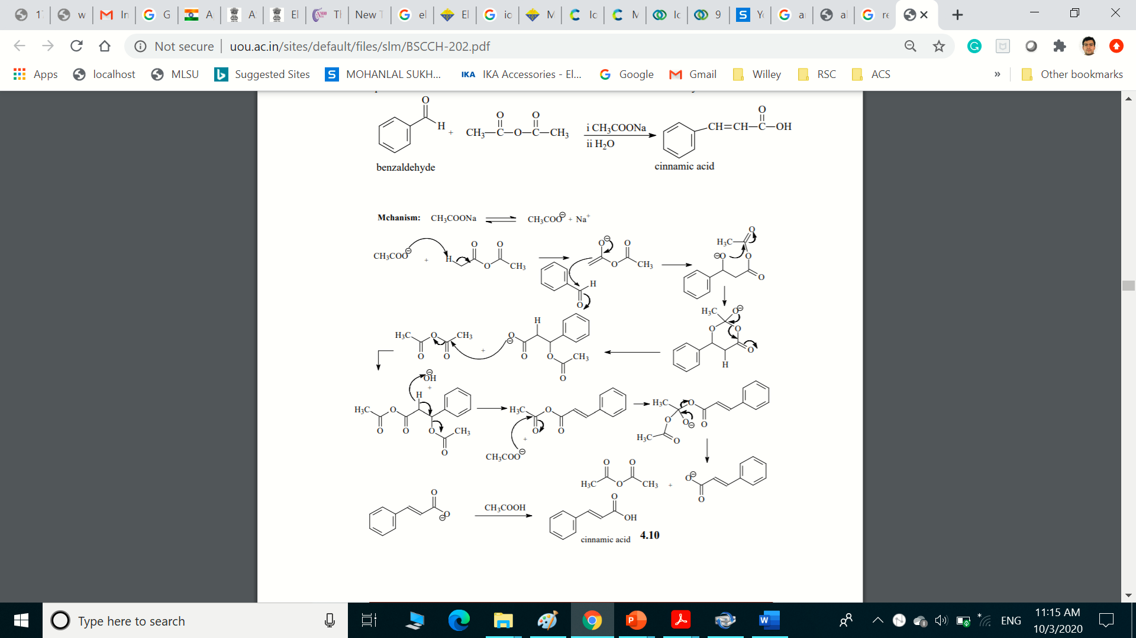
Perkin reaction
It gives an α,β-unsaturated aromatic acid by the aldol condensation of an aromatic aldehyde and an acid anhydride, in the presence of an alkali salt of the acid.^{[1][2]} The alkali salt acts as a base catalyst, and other bases can be used instead.^{[3]}

Slide 53
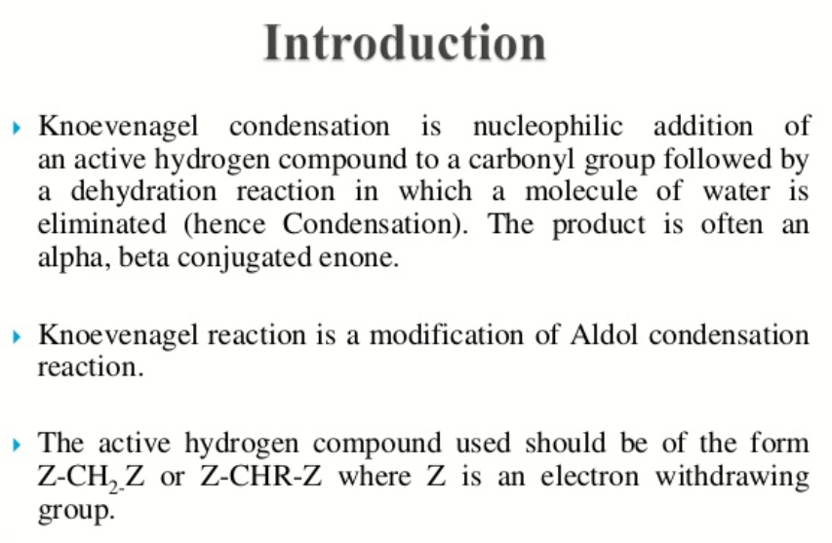
Knoevenagel Condensation

Slide 54
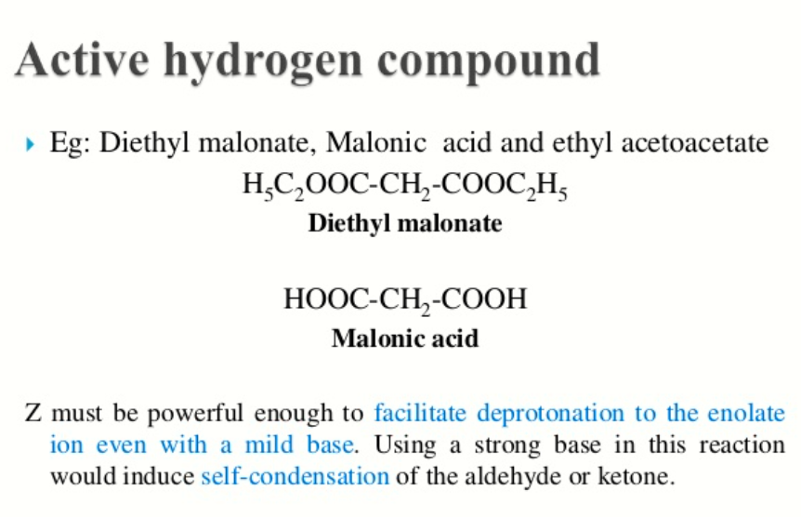

Slide 55
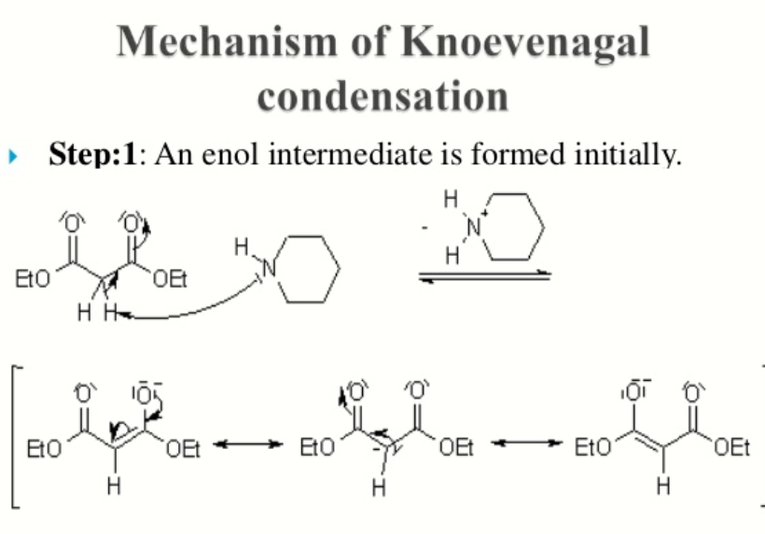

Slide 56
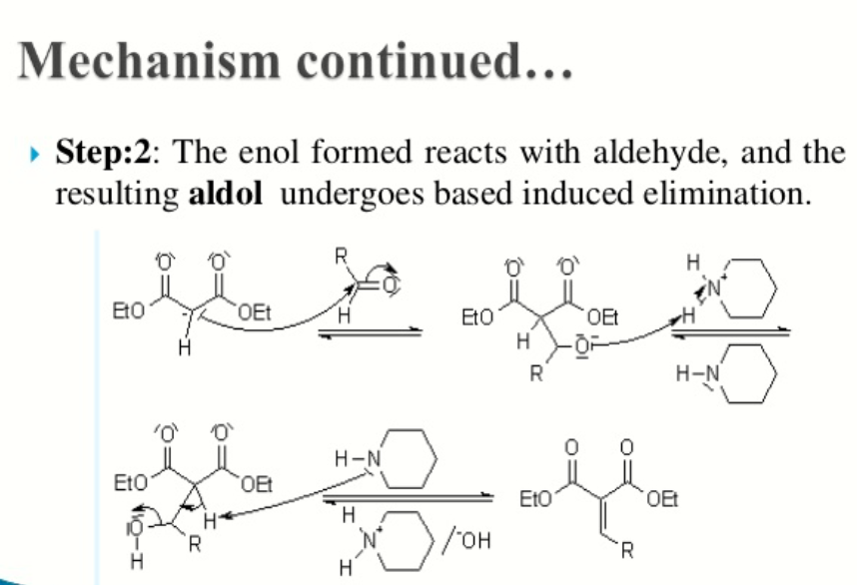

Slide 57
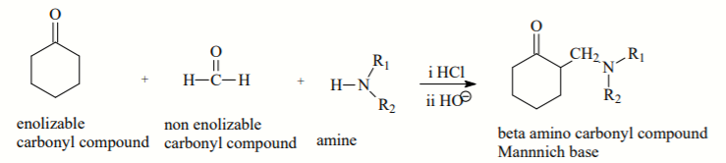
Mannich reaction
The Mannich reaction is an organic reaction which consists of an amino alkylation of an acidic proton placed next to a carbonyl functional group by formaldehyde and a primary or secondary amine or ammonia. The final product is a β-amino-carbonyl compound also known as a Mannich base.

Slide 58
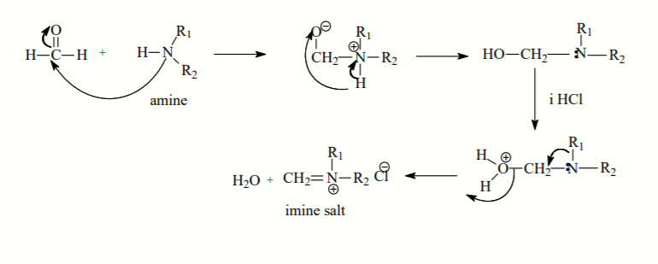
Mechanism:

Slide 59
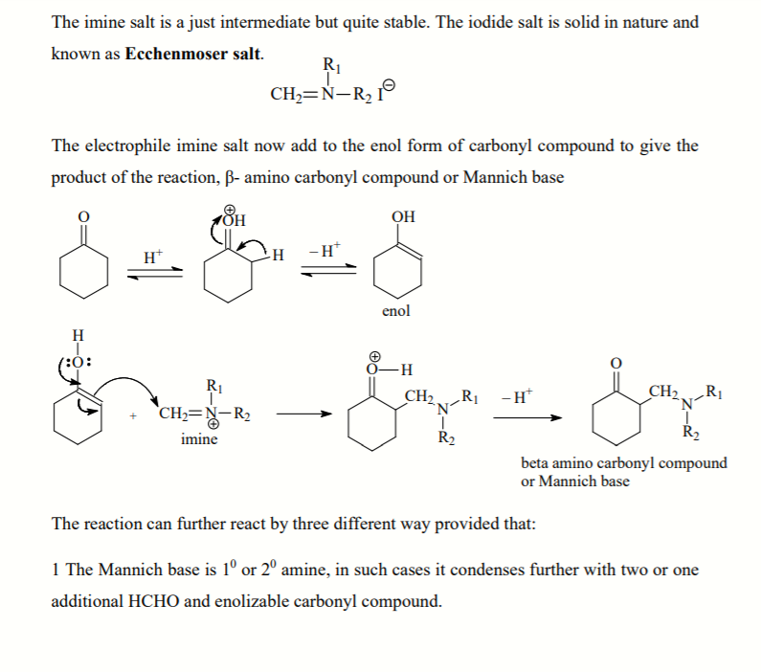
Mannich Reaction Mechanism

Slide 60
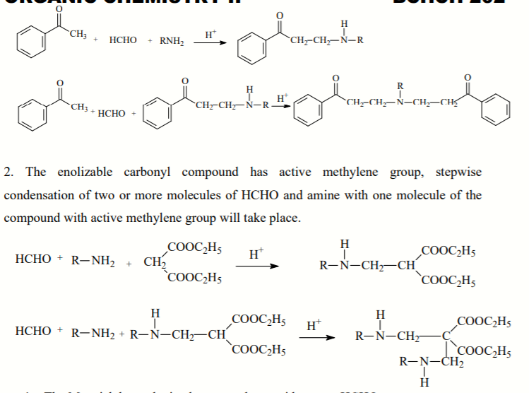
Mannich Reaction

Slide 61
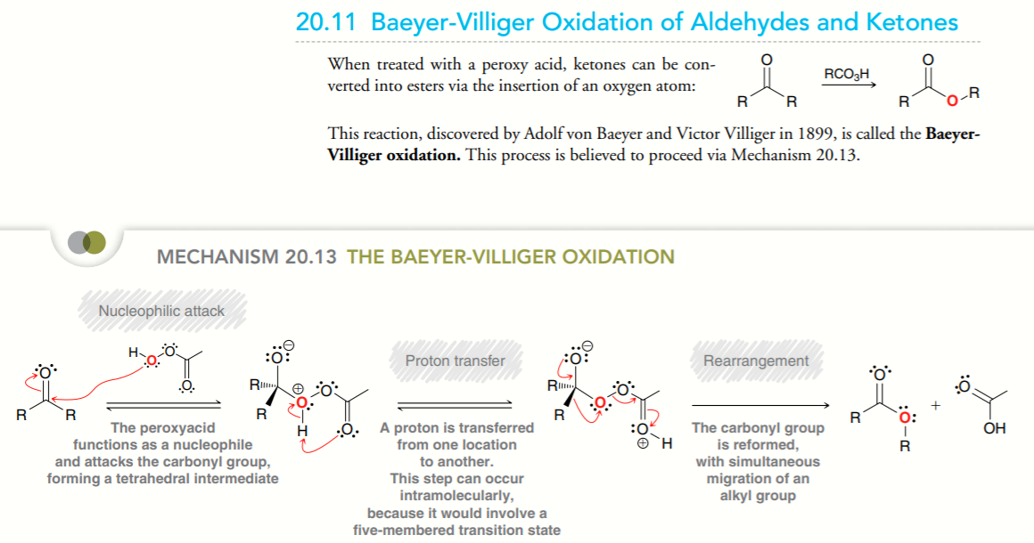

Slide 68
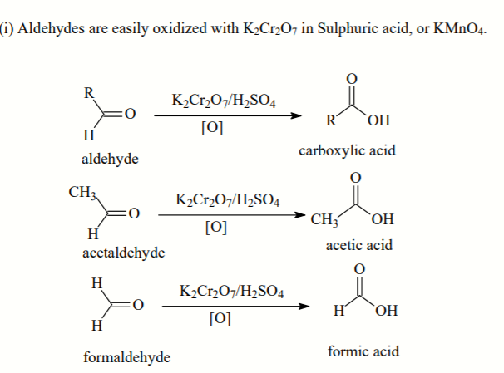
OXIDATION REACTIONS OF ALDEHYDES

Slide 70
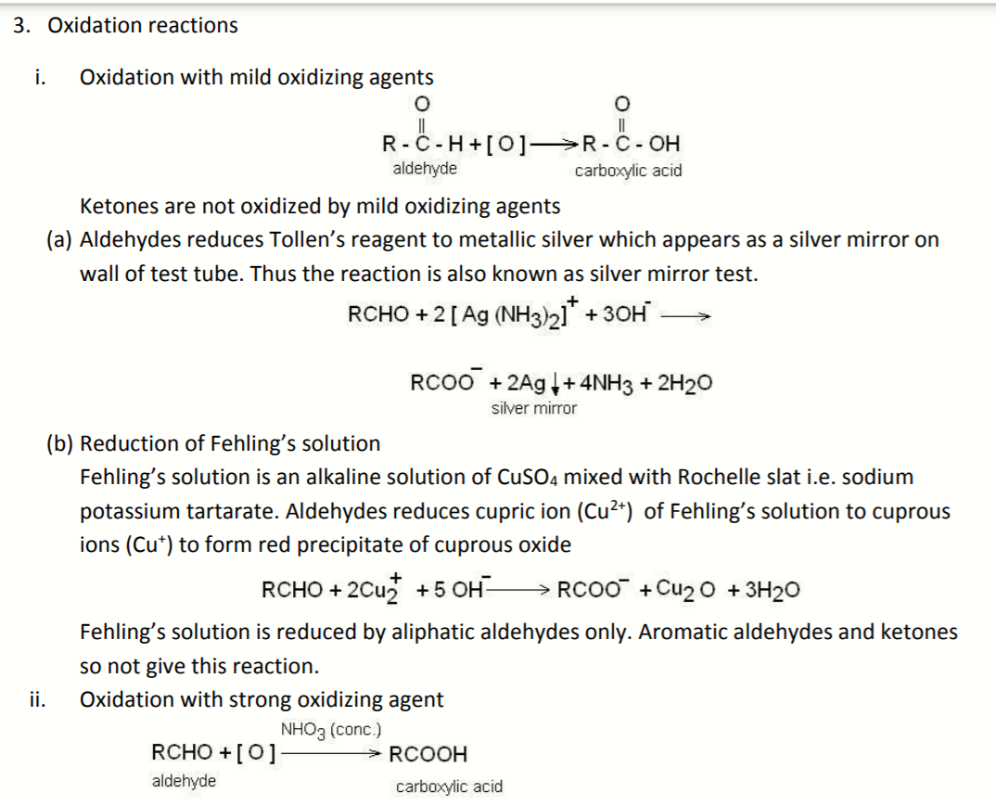

Slide 72
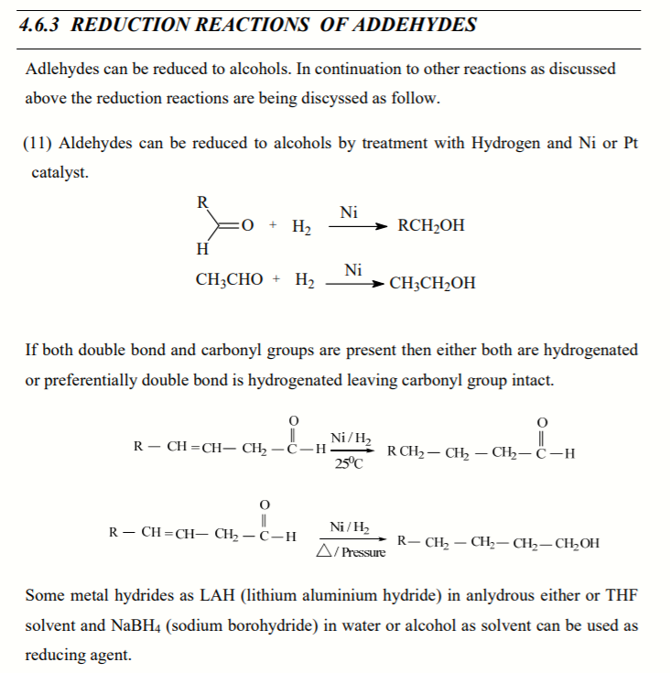

Slide 73
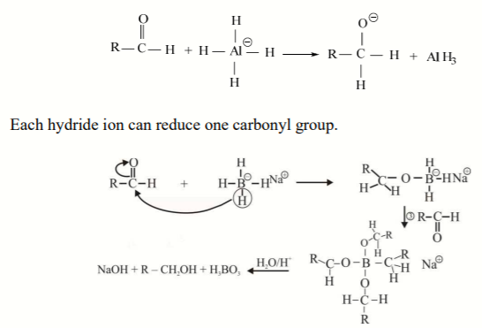

Slide 74
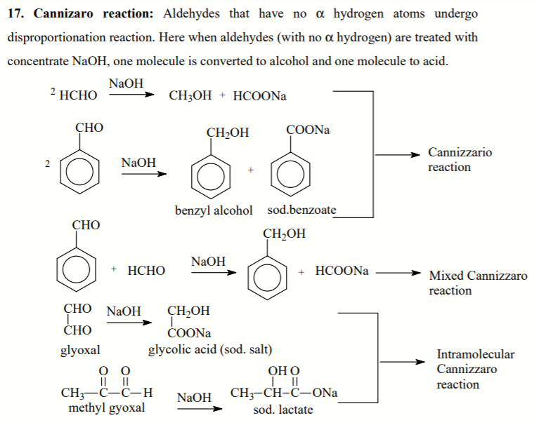

Slide 75
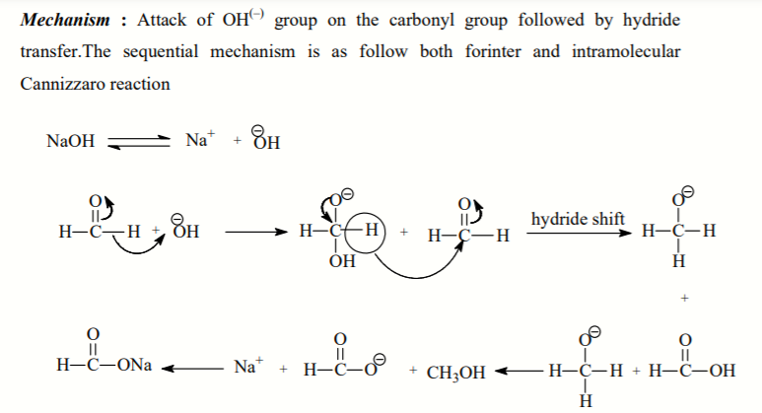

Slide 76

Ketone halogenation
In organic chemistry ketone halogenation is a special type of halogenation. The reaction may be carried out under either acidic or basic conditions in an aqueous medium with the corresponding elemental halogen. In this way, chloride, bromide, and iodide (but notably not fluoride) functionality can be installed selectively in the alpha position of a ketone.

Slide 77

Base Catalyzed Ketone halogenation

