Slide 1
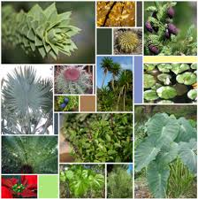
MORPHOLOGY OF FLOWERING PLANTS (LEAF)
Dr. SUNITA PANCHWAT
Assistant Professor
Department of Pharmaceutical Sciences
MLSU, Udaipur

Slide 2
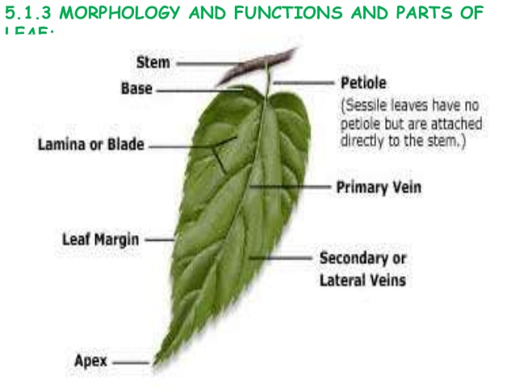

Slide 4
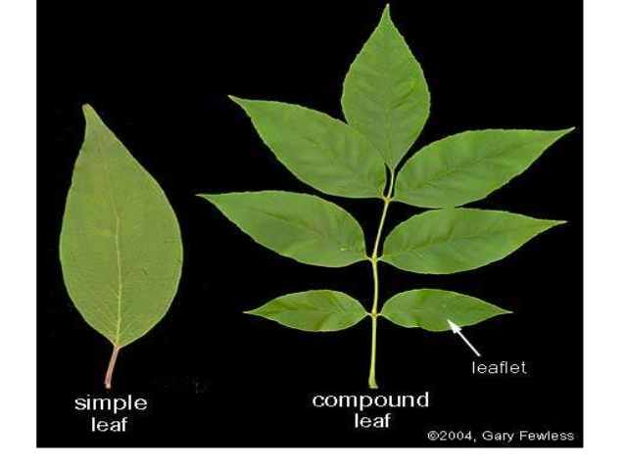

Slide 5
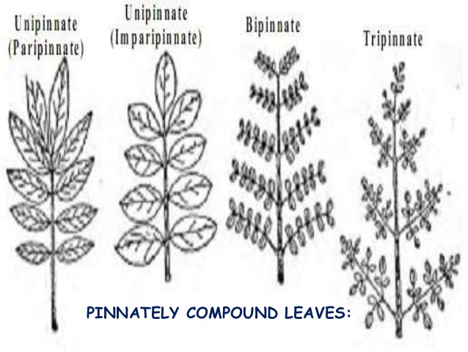

Slide 7
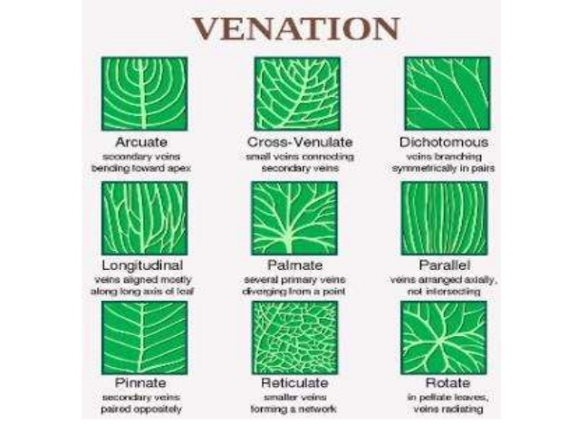

Slide 10
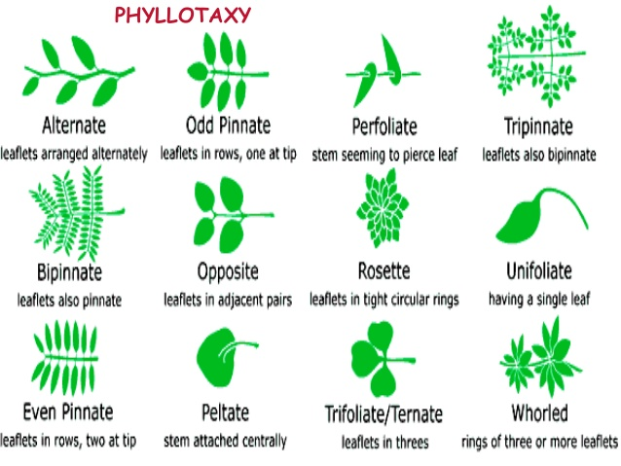

Slide 11
Morphology of Flower

Slide 12
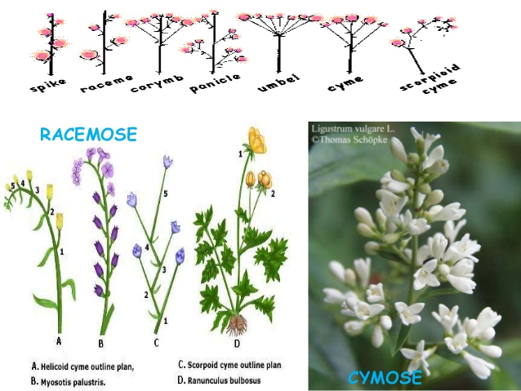

Slide 13
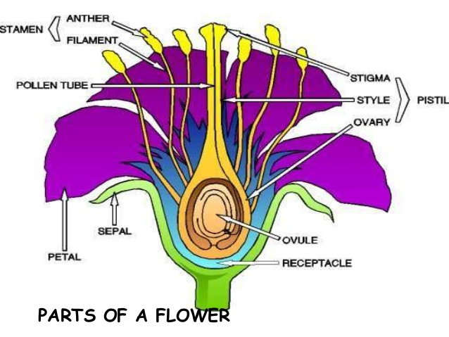

Slide 14
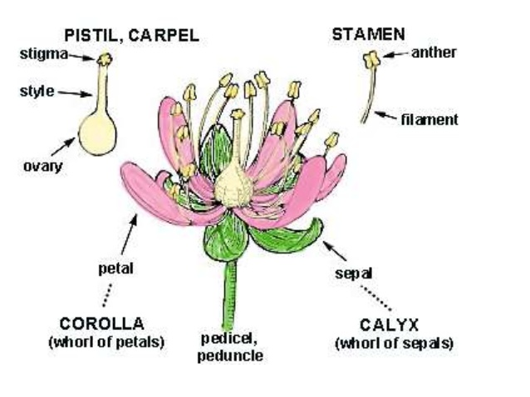

Slide 15
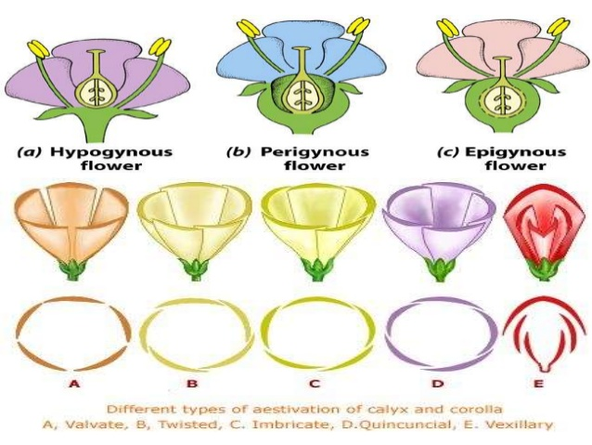

Slide 17
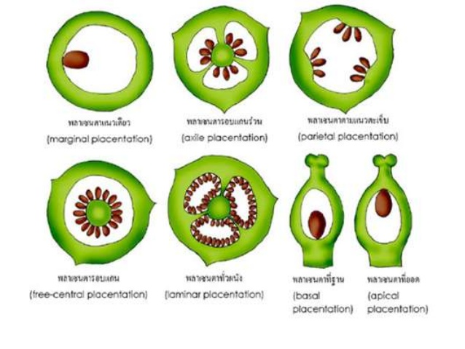

Slide 18
