Slide 1
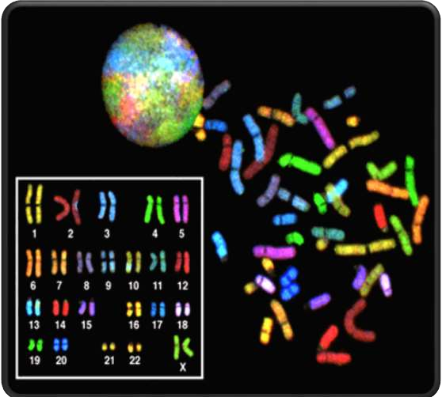

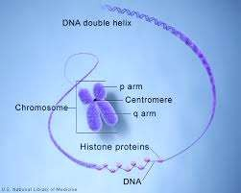
Karyotype

Slide 2
“Karyotype”
Definition:
A karyotype is the number and appearance of chromosome in the nucleus of a eukaryotic cell The term is also used for the complete set of chromosomes in a species or in an individual organism and for a test that detects this complement or measures the number

Slide 3
Karyology & Idiogram
Definitions :
The study of whole sets of chromosomes is sometimes known as karyology.
The chromosomes are depicted in a standard format known as a
karyogram or idiogram

Slide 4
Chromosome
DNA packaging into thread-like structure Is called “chromosomes”.
Each chromosome is made up of DNA tightly coiled many times around proteins that support its structure.
Only visible during cell division.
It has specific number in each species e.g.
Humans have 46 chromosomes while dog has 78 & fruit fly has 8 chromosomes.

Slide 5
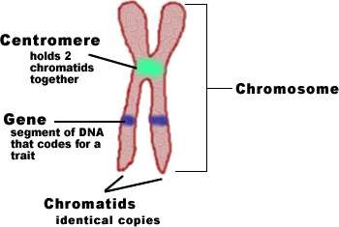

Slide 6
Division of chromosome according to centromere location
Metacentric
  A chromosome that has a centrally placed centromere.. having centromere in the center such that both sections are of equal length.
Sub metacentric
  A chromosome whose centromere is placed closer to one end than the other having centromere slightly offset from the center leading to asymmetry.
Acrocentric
A chromosome whose centromere is placed very close to, but not at, one end having centromere severely offset from center leading one very long and one very short section
Telocentric :- having centromere at very end of chromosome.
Humans don’t have this type of chromosomes but found in other species like mice.

Slide 7
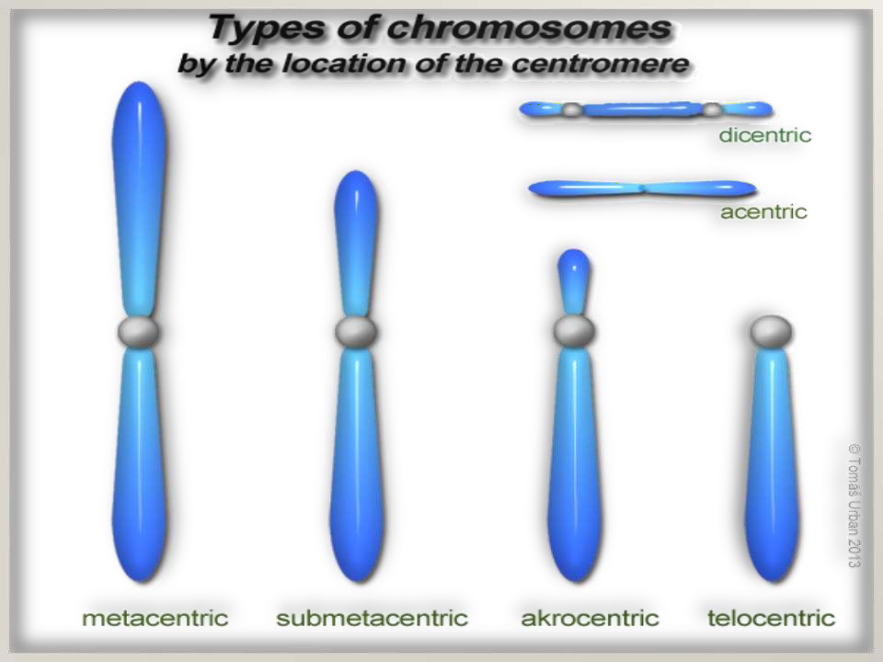

Slide 8
Group A (1-3) – large metacentric chromosomes (but chr. 2 – submetacentric)
Group B (4-5) – large submetacentric
Group C (6-12, X) – medium-sized submetacentric
Group D (13-15) – medium-sized acrocentric
Group E (16-18) – short submetacentric
Group F (19-20) – short metacentric
Group G (21-22, Y) – short acrocentric (but chr. Y – submetacentric)

Slide 9
Advantages of karyotype
Detection of chromosomal abnormalities
Genetic disorders
Gender identification
Identify loss and addition of chromosome
Pre-birth diagnosis of genetic diseases
Identification of chromosomal numbers in different organism
Identification of proper position of genes in chromosomes

Slide 10


