Slide 1
Cost Records and rules (2014)
Rule 1- Rule 6

Slide 2
COMPANIES
SERVICE
PRODUCTION

Slide 3
◻ TABLE-A (REGULATED SECTORS)
Sl. No. | NAME OF THE INDUSTRY/SECTOR/PRODUCT/SERVICE | CETA HEADING
1. | Telecommunication Services (other than broadcasting) | NA
2 | Generation, Transmission, Distribution and Supply of electricity (Other than for captive generation)
3 | Petroleum Products | 2709 to 2715
4 | Drugs and Pharmaceuticals | 2901 to 2942 ; 3001 to 3006
5 | Fertilisers | 3102 to 3105
6 | Sugar and Industrial alcohol | 1701, 1703, 2207

Slide 4
(NON REGULATED SECTORS)
MORE THAN 30 SECTORS ARE KEPT AS NON- REGULATED SECTOR STEEL, IRON, CEMENT

Slide 5
Non specified sector
Some sectors are kept as non specified sector like education

Slide 6
1. Short title and commencement [Rule 1
(1) These rules may be called the Companies (Cost Records and Audit) Rules, 2014.
(2) They shall come into force on the date of publication in the Official Gazette.

Slide 7
Rule 2 Definitions
a) Act;
(aa) Central Excise Tariff Act Heading;
(b) Cost Accountant
in practice;
(c) cost auditor
(d) cost audit report;
(e) cost records;
(f)form;
(g) institute;
(h) all other words and expressions used in these
rules

Slide 8
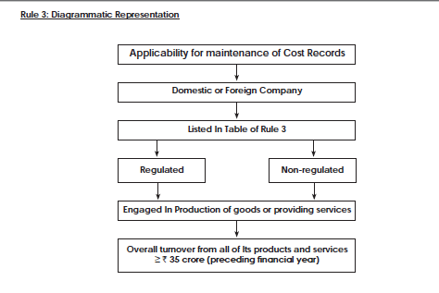

Slide 9
Rule 4
Overall Turnover during immediately preceding f/y Rs. 50 Cr. or More and
Aggregate turnover from individual product(s)/service(s) Rs. 25 Cr.
TABLE A
Overall Turnover during immediately preceding f/y Rs. 100 Cr. or more and
Aggregate turnover from individual product(s)/service(s) Rs. 35 Cr.
TABLE B AND C

Slide 10
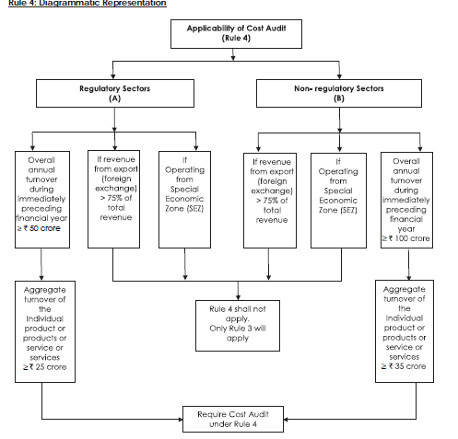

Slide 11
Micro or Small Enterprises including as per Turnover criteria under sub section (9) of section 7 of the Micro, Small and Medium Enterprises Development Act, 2006.
Companies whose revenue from exports, in foreign exchange, exceeds 75% of total revenue
Companies operating from Special Economic Zones

