Slide 1

Cost Records and rules (2014)
Rule 1- Rule 6
PART -II

Slide 2
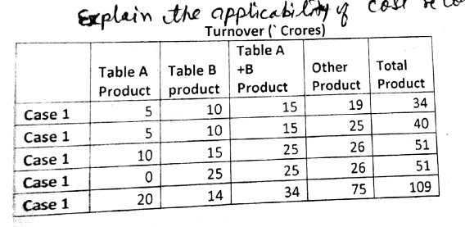
Question

Slide 3
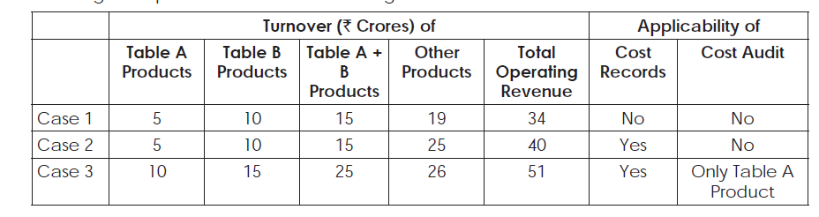
Solution

Slide 5
Rule 5
It is related to maintaining cost records in form CRA 1.

Slide 6
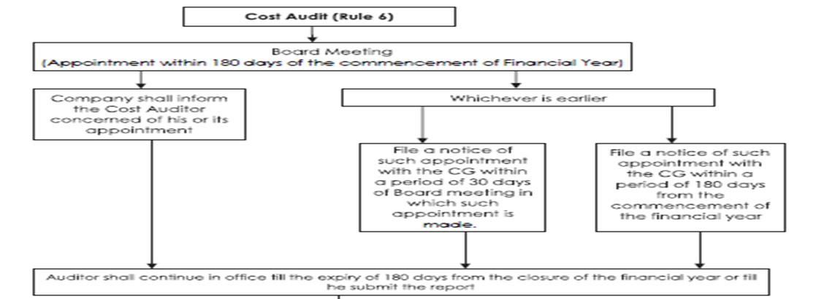

Slide 7
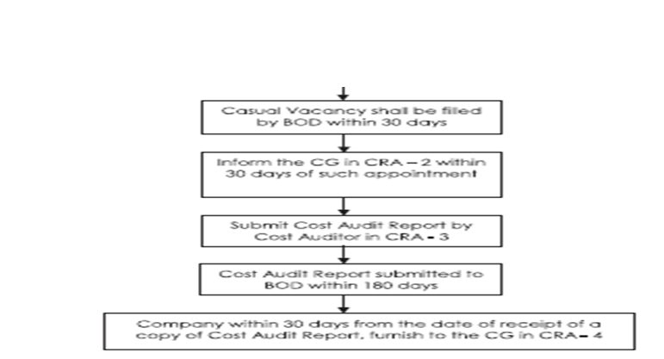

Slide 8









APPOINTMENT
WITHIN 180 DAYS OF THE COMMENCEMENT OF EVERY F/Y
APPOINTMENT IS TO BE MADE IN BOARD MEETING
MEETING
FORM FORM
SUBMISSION
FORM CRA-2 TO BE FILED
WITHING 30 DAYS OF APPOINTMENT IN BOARD MEETING OR
WITHIN 180 DAYS OF THE COMMENCEMENT OF EVERY F/Y WHICHEVER IS EARLIER

