Slide 1
COST ACCOUNTING STANDARD-4
CAPTIVE CONSUMPTION

Slide 2
Introduction
The Cost Accounting principle for determination of cost of production is well established. Similarly, rules for levy of excise duty on goods used for captive consumption are also well defined.

Slide 3
Captive Consumption
: Captive Consumption means the consumption of goods manufactured by one division or unit and consumed by another division or unit of the same organization or related undertaking for manufacturing another product(s).

Slide 4
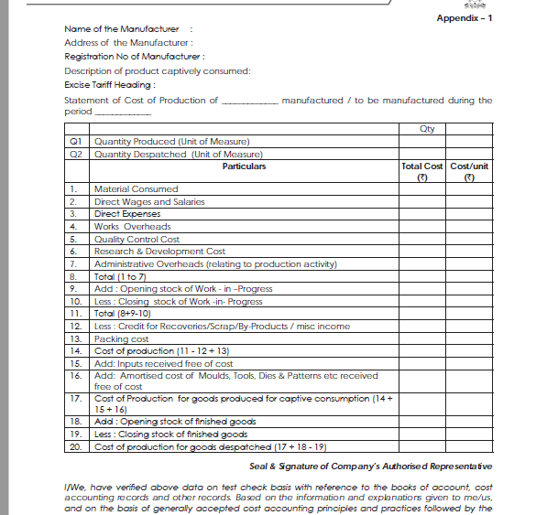

Slide 6
