Slide 1
CAS-5 COST ACCOUNTING STANDARD
DETERMINATION OF AVERAGE (EQUALIZED) COST OF TRANSPORTATION

Slide 2
Transportation cost is an important element of cost for procurement of materials for production and for distribution of product for sale.
Therefore, Cost Accounting Records should present transportation cost separately from the other cost of inward materials or cost of sales of finished goods.

Slide 3
objectives
To bring uniformity in the application of principles and methods used in the determination of averaged/equalized transportation cost.
To prescribe the system to be followed for maintenance of records for collection of cost of transportation, its allocation/apportionment to cost centres, locations or products.

Slide 4
Cost of Transportation comprises of the cost of freight, cartage, transit insurance and cost of operating and other incidental charges whether incurred internally or paid to an outside agency for transportation of goods but does not include detention and demurrage charges.

Slide 5
Treatment of cost:
Inward transportation costs shall form the part of the cost of procurement of materials which are to be identified for proper allocation/ apportionment to the materials / products.
Outward transportation cost shall form the part of the cost of sale and shall be allocated /apportioned to the materials and goods on a suitable basis.

Slide 6
The following basis may be used, in order of priority, for apportionment of outward transportation cost depending upon the nature of products, unit of measurement followed and type of transport used :
i) Weight
ii) Volume of goods
iii) Tonne-Km
iv) Unit / Equivalent unit
v) Value of goods
vi) Percentage of usage of space

Slide 7
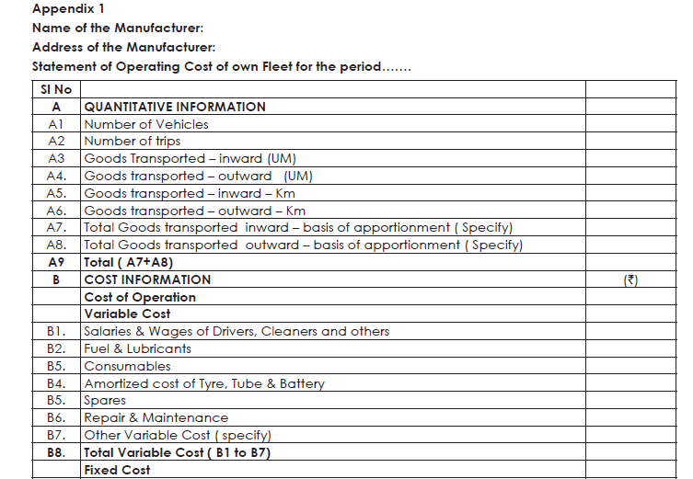

Slide 9
Qusetion

Slide 11
Calculation of passenger KM
Total seating capacity= (10*50)+(15*40)= 1100
Capacity utilized= 1100*75/100*20/25=660
Average distance run in the month=8*10*30=2400
Effective passenger kms.= 660*2400=1584000

