Slide 1

COST ACCOUNTING STANDARD 6
Material Cost

Slide 2
The standard CAS 6 prescribes principles and methods of determining the Material Cost.

Slide 3
Material for the purpose of this standard includes raw materials, process materials, additives, manufactured / bought out components, sub – assemblies, accessories, semi finished goods, consumable stores, spares and other indirect materials.

Slide 4
The Standard deals with the following issues.
Principles of Valuation of receipt and
issue of materials.

Slide 5
Principles of Valuation of receipt and
In case of buy the product
In case Self manufactured components

Slide 6
Valuation of receipt
The material receipt should be valued at purchase price including duties and taxes, freight inwards, insurance, and other expenditure directly attributable to procurement (net of trade discounts, rebates, taxes and duties refundable or to be credited by the taxing authorities) that can be quantified with reasonable accuracy at the time of acquisition.

Slide 7
The FOREX component of imported material cost shall be converted at the rate on the date of the transaction. Any subsequent change in the exchange rate till payment or otherwise shall not form part of the material cost.
Any demurrage or detention charges, or penalty levied by transport or other authorities shall not form part of the cost of materials.

Slide 8
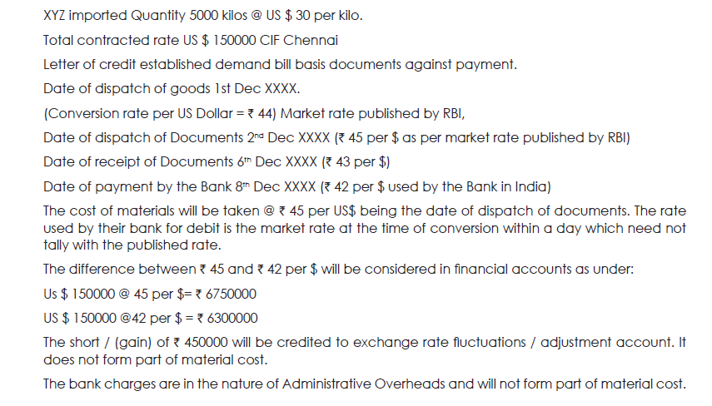

Slide 9
Material cost may include imputed costs not considered in financial accounts.

Slide 10
Subsidy/Grant/Incentive and any such payment received/receivable with respect to any material shall be reduced from cost for ascertainment of the cost of the cost object to which such amounts are related.

Slide 11
Self manufactured components
Self manufactured components and sub-assemblies shall be valued including direct material cost, direct employee cost, direct expenses, factory overheads, share of administrative overheads relating to production but excluding share of other administrative overheads, finance cost and marketing overheads. In case of captive consumption, the valuation shall be in accordance with Cost Accounting Standard 4.

Slide 12
Issue of Material
The CAS-6 provides for adopting any of the following three methods for valuation of issues of material:
a) First in First out (FIFO)
b) Last in First out (LIFO)
c) Weighted Average Rate

Slide 13
Assignment of material cost to cost objects.

Slide 14
This standard targets to bring uniformity and consistency in the principles and methods of determining the material cost with a reasonable degree of accuracy.
This standard should be applied to cost statements which require classification, measurement, assignment, presentation and disclosure of material costs including those requiring attestation.

Slide 15
Quantity and rates of major items (which forms at least 5% of the total cost of materials) shall be disclosed.
Disclosures may be made in the body of the Cost statement or as a foot note or as a separate schedule to the main statement.

Slide 16

Question

Slide 17
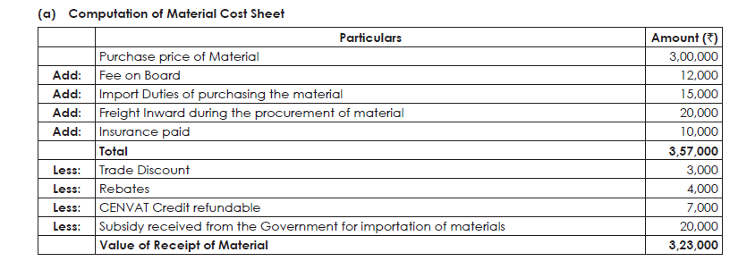
Solution

