Slide 1
Taxonomy and Binomial Nomenclature
Dr. DEEPAK RAWAL
Assistant Professor
Department of Zoology
MLSU Udaipur

Slide 2
Aristotle: Historia Animalium
>95% organisms are invertebrates
Out of them, 80% are arthropods
Species is unit of classification
Taxis: arrangement
Nomia:distribution
Term taxonomy coined by A. P. de Condolle

Slide 3
Def: Branch of science deals with identification, nomenclature and classification of organisms.
Systematics: determination of evolutionary relationships.
Old taxonomy: based on homology/morphology
New taxonomy/neosystematics/biosystematics: based on Phylogeny/DNA barcoding/Molecular taxonomy

Slide 4
Father of Taxonomy: Carolus Linnaeus
Taxon: singular; Taxa: plural
Why we need taxonomy?
Different languages in different regions.
Misleading common names such as starfish, sea horse, jelly fish etc.
Analogy/homoplasies such as bats and birds
Universal and unique in research.

Slide 5
*Taxonomic categories/ranks/hierarchies:
1. Domain (Karl Woese): Archaea, Bacteria and Eukarya.
2. Kingdom (Whittaker): Monera, Protista, Fungi, Plantae and Animalia.
3. Phylum: Arthropoda
4. Class: Insecta/Hexapoda
5. Order: Diptera
6. Family: Muscidae
7. Genus: Musca
8. Species: domestica
*1.7-1.8 million species described already.
*Viruses are not included.

Slide 6
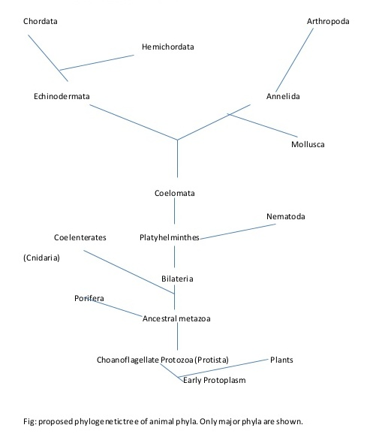

Slide 7
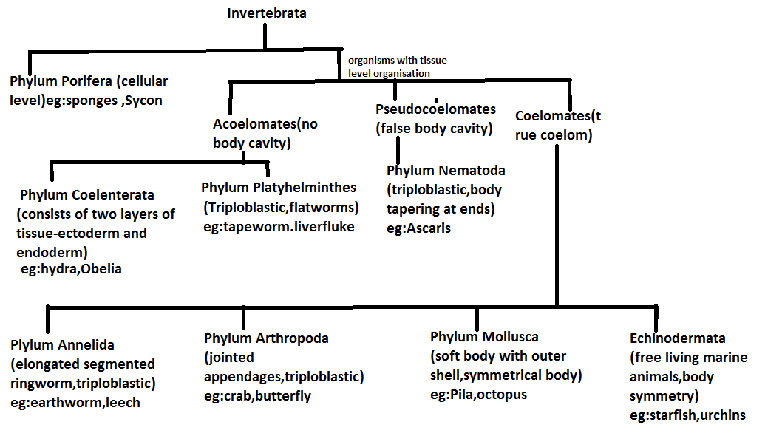

Slide 8
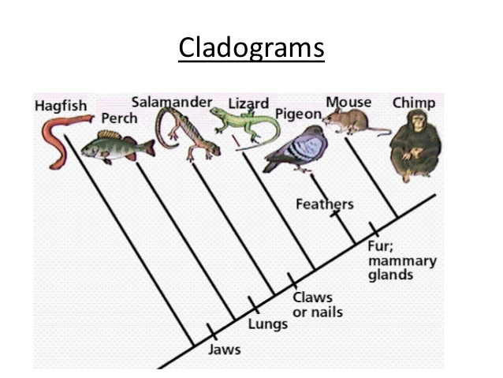
Cladogram/evolutionary tree/phylogenetic tree

Slide 9
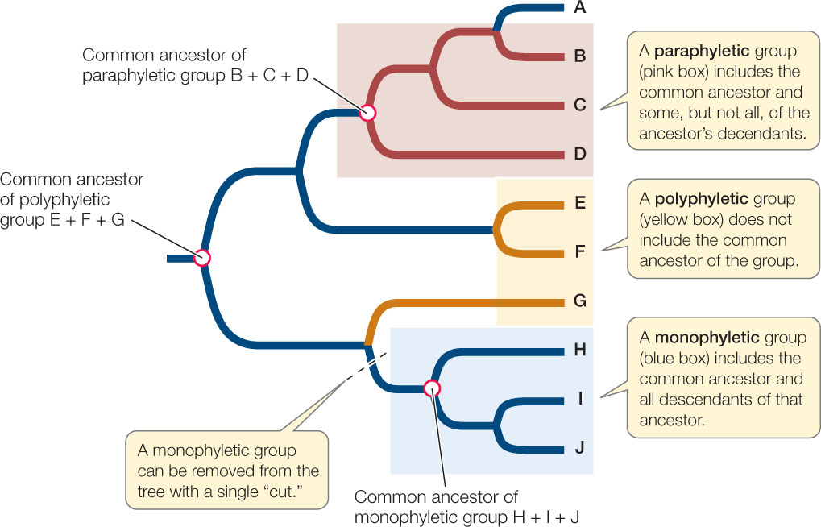
Monophyletic/Paraphyletic/Polyphyletic groups

Slide 10
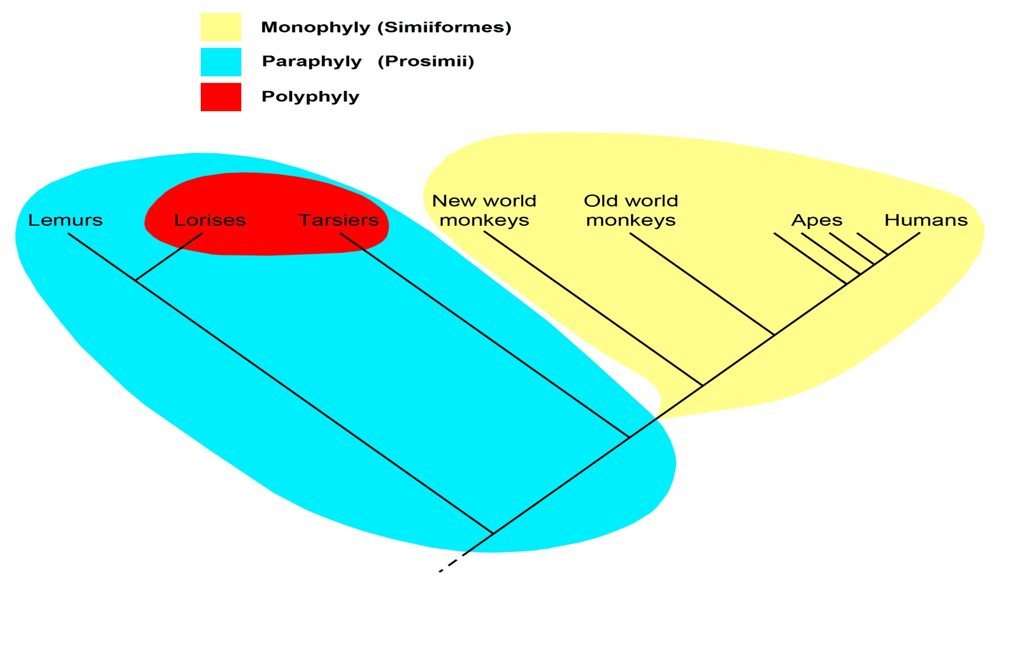
Monophyletic/Paraphyletic/Polyphyletic groups

Slide 11
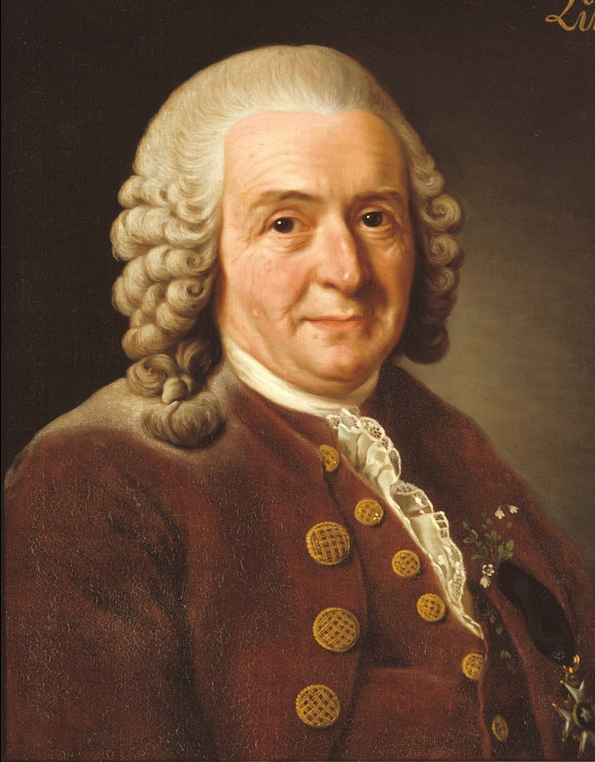
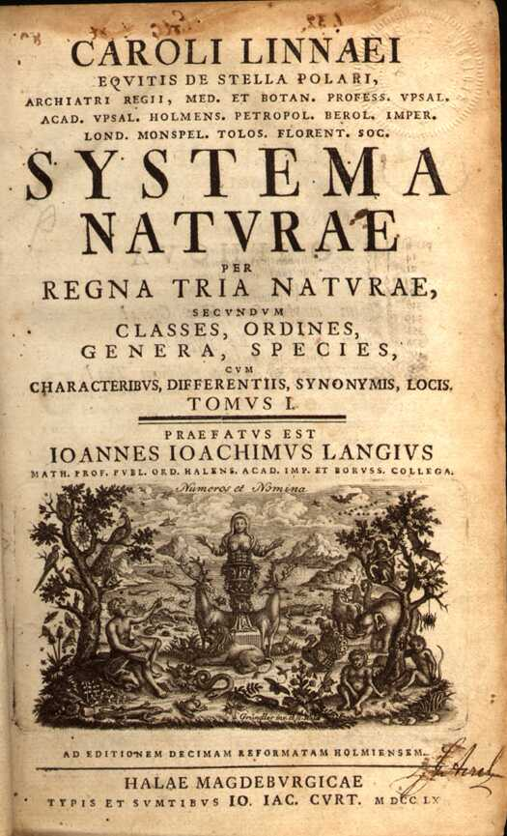
BINOMIAL NOMENCLATURE
Before: all taxa were used
In future: may be numbering system
CAROLUS LINNAEUS- SYSTEMA NATURAE (1758)

Slide 12
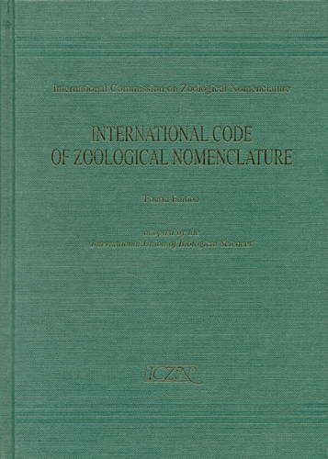
BINOMIAL NOMENCLATURE
ICZN-INTERNATIONAL CODE OF ZOOLOGICAL NOMENCLATURE
ICNafp-INTERNATIONAL CODE OF NOMENCLATURE FOR ALGAE, FUNGI AND PLANTS
ICTN-INTERNATIONAL CODE FOR TAXONOMY OF VIRUSES

Slide 13
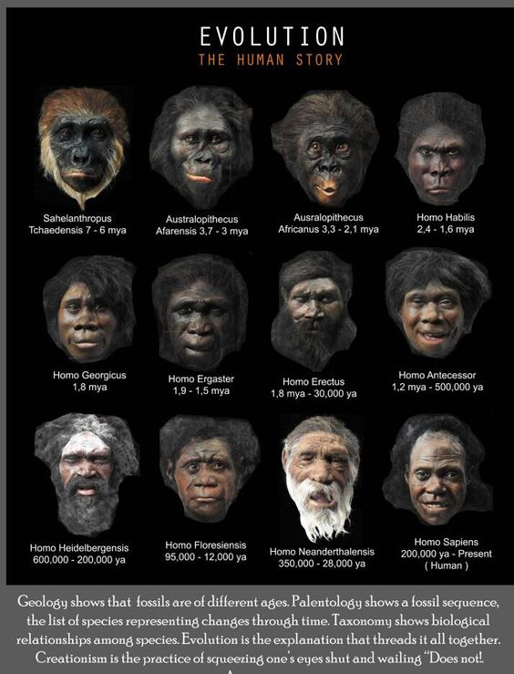
BINOMIAL NOMENCLATURE
FIRST WORD- GENUS
SECOND WORD- SPECIES EPITHET
eg- Homo sapiens

Slide 14
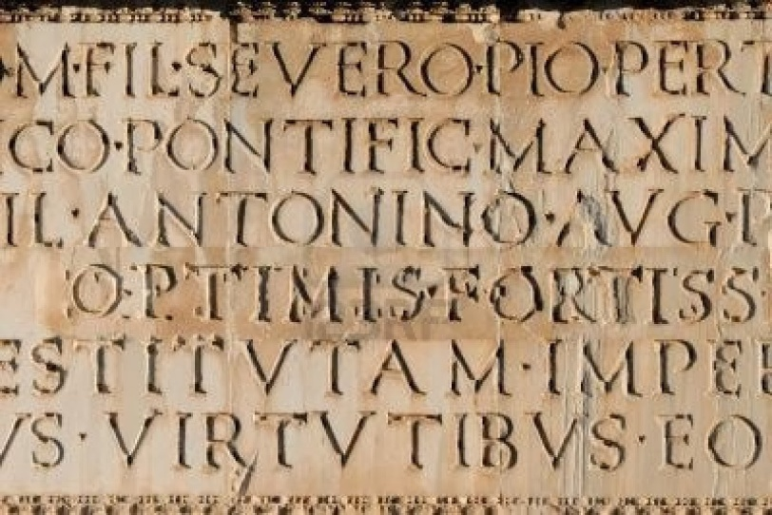
BINOMIAL NOMENCLATURE
NAME MUST BE LATINIZED AND PRITNTED IN ITALLIC FONT STYLE
eg- Einfeldia pritiensis Singh and Rawal, 2016

Slide 15
BINOMIAL NOMENCLATURE
AUTHOR’ S NAME AND YEAR OF PUBLICATION MAY USED AFTER NAME
eg- Homo sapiens Linn., 1758

Slide 16
BINOMIAL NOMENCLATURE
NAME MUST BE UNIQUE AND UNAMBIGUOUS

Slide 17
BINOMIAL NOMENCLATURE
NOT TOO SHORT NOT TOO LONG

Slide 18
BINOMIAL NOMENCLATURE
LAW OF PRIORITY
1970-Y
1950-X

Slide 19
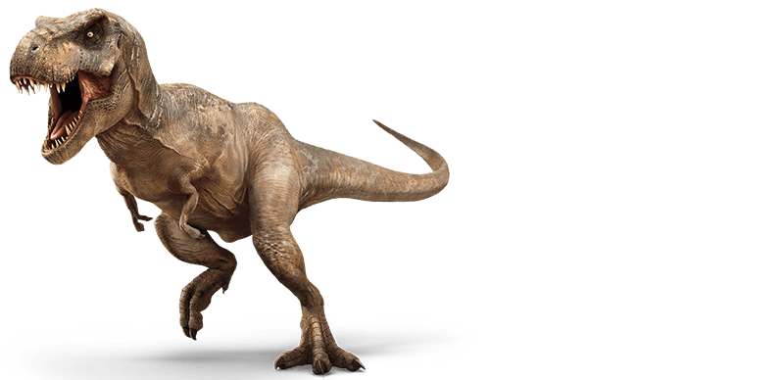
BINOMIAL NOMENCLATURE
MORPHEME ‘†’ MAY USED FOR EXTINCT SPECIES
eg.-Tyrannosaurus rex † or † Tyrannosaurus rex
1970-Y
1950-X

Slide 20
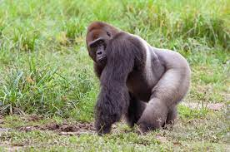
BINOMIAL NOMENCLATURE
Tautonyms: Gorilla gorilla
1970-Y
1950-X

Slide 21
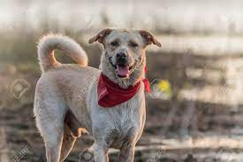
BINOMIAL NOMENCLATURE
Trinomial Nomenclature: for subspecies
eg- Canis lupus familiaris
1970-Y
1950-X

Slide 22
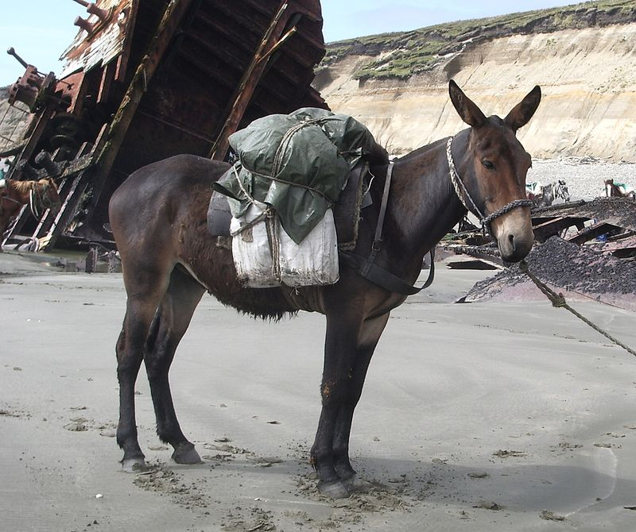
BINOMIAL NOMENCLATURE
Hybrids: Not species
Mule= Equus asinus (male donkey)*Equus caballus (female horse)
1970-Y
1950-X

Slide 23
THANK YOU
1970-Y
1950-X

